Slide 1
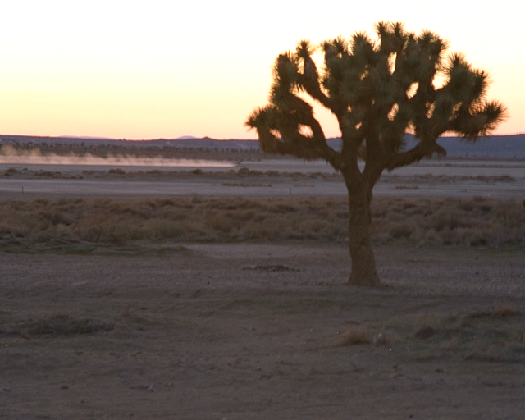

Rapid Ecoregional Assessment
Step 1 of the BLM’s Landscape Approach
For the Management of Public Lands
Mojave Basin and Range Ecoregion
Notes:
BLM land use policies, allocations, and authorizations historically have been driven by local and by national considerations. The ecological consequences of decisions made at these spatial-scale endpoints have accumulated at intermediate “landscape” scales—sometimes with adverse consequences. along with, and often contributing to, extensive changes caused by invasive species, altered wild land fire cycles, climate change, urban and industrial development, and other agents.
The BLM now has the opportunity and the tools to systematically identify our remaining landscape-scale values and risks, and to work strategically to achieve ecologically-based conservation and restoration objectives.

Slide 2
Roadmap
BLM’s Landscape Approach
Rapid Ecoregional Assessment

Slide 3

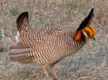
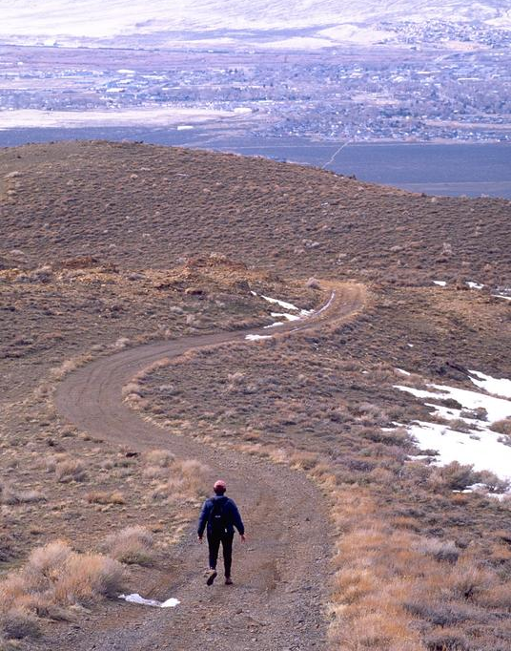
Why a Landscape Approach?
Environmental challenges transcend management jurisdictions
  Climate change
  Fire
  Invasive species
  T&E species
  Energy development
  Population growth
How can we best address these challenges and sustain public land values?
Notes:
As Tom Armstrong has just shown, the impacts of climate change are sobering and profound. The BLM, and land managers throughout the nation, face unprecedented environmental challenges that transcend land ownership and administrative jurisdictions.
Together, we are managing a landscape where, for example, arctic permafrost is thawing…
…where wildfires have become larger, more frequent, and more damaging;
…where invasive species are crowding out native plants and wildlife;
…and where the survival of sage-grouse and other native species is at increasing risk.
As BLM managers, we also carry the considerable responsibility to develop critical energy supplies for the nation, to help reduce our reliance on foreign oil, and to foster a transition to renewable energy resources.
We must find the best ways to address these challenges and sustain the health, productivity, and beauty of the public lands – for ourselves and for future generations.
I think that’s the essence of what this workshop is about, and why we’re here today.

Slide 4
BLM’s Landscape Approach
Five Interrelated Components:
  Rapid Ecoregional Assessment
  Ecoregional Direction
  Field Implementation
  Monitoring
  Science Research
Notes:
So, all these reasons – our past experiences, our present situation, and the Secretary’s direction – reinforce the need to develop a better integrated, landscape-scale approach for managing public lands.
The Washington Office, the NOC, and many field managers and specialists, have been working intensively for months to frame and initiate this effort.
Here’s the basic concept.
It has 5 interrelated components that, together, can provide a long-term, science-based, adaptive management process.
These five components are:
Rapid Ecoregional Assessments;
Ecoregional Direction;
Field Implementation;
Monitoring; and
Science Research
This is presented as a list, but in reality it’s not linear.

Slide 5
BLM’s Landscape Approach
Rapid Ecoregional
Assessments
Science
Research
Ecoregional
Direction
Monitoring
Field
Implementation
Notes:
Think of it basically as a circle with several feedback loops.
Let’s discuss the key questions that we’re trying to answer at each phase.
Rapid Ecoregional Assessments ask – what do we know? What are the resource conditions and trends in this ecoregion, and where are the best management opportunities for both resource conservation and development?
Ecoregional Direction asks – how can we use this information to manage more effectively across BLM jurisdictions and programs? What priorities and guidance are constructive and value-added at the landscape scale?
Field Implementation asks - how can achieve these landscape-scale goals though our planning, use authorization, and budgeting processes? How can we coordinate and focus our limited resources most efficiently?
Monitoring asks – what should we monitor consistently over time, and how do we standardize data collection & retrieval.
And the key question for Science Research is – can we better link science research and technology development with management needs?

Slide 6
Rapid Ecoregional Assessment
Gather available information
Assess resource conditions and trends
Provide baseline for adaptive management
Identify management opportunities
Not decision making!
Rapid: approximately 1.5 years
Notes:
Now let’s briefly discuss each link in this chain, starting with rapid ecoregional assessments.
REAs are part census, part forecast
They assess conditions, and forecast trends, and provide a reference baseline for adaptive management.
REAs also identify the key management opportunities within an ecoregion for conservation and development.
At the very least, REAs should help us prepare better land use plans. They’ll clearly enhance our discussion of the affected environment. The REAs could also strengthen our cumulative effects analysis, which has been a perennial NEPA weakness and vulnerability.
But the REAs could do more than that…

Slide 7
Ecoregional Direction
Establish regional priorities for conservation and development
Identify mitigation opportunities
Address science, sub-assessments, and monitoring needs
Notes:
The REAs could be used to help establish consistent management direction for the ecoregion.
This ecoregional direction could, for example:
Establish regional priorities for conservation and development, including priority areas for conserving core habitats and migration corridors, and for focusing energy development and transmission corridors.
It could also identify opportunities for implementing habitat mitigation
…and it could prioritize science, sub-assessment and monitoring needs for an ecoregion.
Ecoregional direction could take the form of joint-state director guidance, and/or national guidance. The national sage-grouse guidance, now under development, may provide a good example of how that could work.

Slide 8
Field Implementation
Making the Landscape Approach
real through:
Planning
Use authorization/BMPs
Sub-assessments and monitoring
Budget process
  How to focus and share resources
Notes:
The next, and probably most important step, is to integrate the REAs and ecoregional direction into on-the-ground management…
… through land use planning and activity planning,
… through use authorizations and Best Management Practices
… by conducting sub-assessments and monitoring
… and by using the budget process to focus and share resources.

Slide 9
Monitoring
Key to adaptive management
Standardize & integrate data collection, retrieval, & assessment process
AIM Strategy being finalized
Notes:
Now let’s touch on the monitoring component.
Clearly, effective and consistent monitoring is essential for adaptive management. We need the ability to collect, synthesize, and share geospatial information in order to develop conservation and development strategies, and evaluate their effectiveness.
This is both a fundamental requirement and a difficult challenge.
I think we’re making significant progress. The AIM Strategy is being finalized and it will underpin, and evolve with, this landscape management approach.

Slide 10
Linkages
DOI Climate Change Science Framework
CSCs - Provide climate change science
LCCs - Public-private partnerships to connect science with management
  BLM forming Great Basin LCC
  Key roles in BLM landscape approach
  Much TBD regarding process and function
Notes:
It’s important to keep in mind that the BLM’s landscape approach is evolving within the DOI’s climate change framework.
Earlier, Tom Armstrong discussed the formation of the Climate Change Science Centers, which will coordinate and provide climate change science on a regional basis.
DOI is also forming 22 Landscape Conservation Cooperatives, which are intended to help foster place-based partnerships and integrate science with management needs.
The BLM has taken the lead in forming the Great Basin LCC and we’re active participants in many others.
It’s fair to say that the role and structure of the LCCs remains a work in progress. But it’s also fair to expect that the LCCs could have an important role in the landscape-scale management approach we’re discussing this week.
LCCs could, for example, help shape the REAs and enhance their value for other land managers within an ecoregion. They could also help in establishing research priorities and consistent data and monitoring standards.
Building effective partnerships is central to successful land management, and it’s one of the BLM’s defining strengths. We have an opportunity now to help shape and guide the LCCs, and to build the relationships and linkages needed to respond effectively to landscape-scale changes.

Slide 11
Rapid
Ecoregional
Assessment
Mojave Basin and Range Ecoregion, Arizona

Slide 12
Timeline to Date
REA
Contractors
Selected
FedBizOps
Sources
Sought
BLM
National
Planning
Conference
REA
National
Strategy
Meeting
REA
Planning
Meeting
Proposals
Due
BLM
CC & HL
Workshop
Contracts
Awarded
FedBizOps
Solicitation
Mar
Apr
May
Jun
Jul
Aug
Sep
Oct
Nov
Dec
Jan
Feb
Mar
Apr
May
Jun
Jul
2009
2010
Mojave
Partner
Meetings
Mojave &
Central
RFPs Sent
Pre-Work
Workshop
Mojave
Kickoff
Meeting
Mojave &
Central
Draft Memo
I-1-a
Central
Kickoff
Meeting
Central
Partner
Meeting

Slide 13
REA Fundamentals 1
Funded by ARRA and 2010 Climate
Managed by (and funds to) states
BLM NOC provides operational support
REAs to be contracted
  Develop IDIQ contracts
  Develop Statements of Work (SOW)

Slide 14
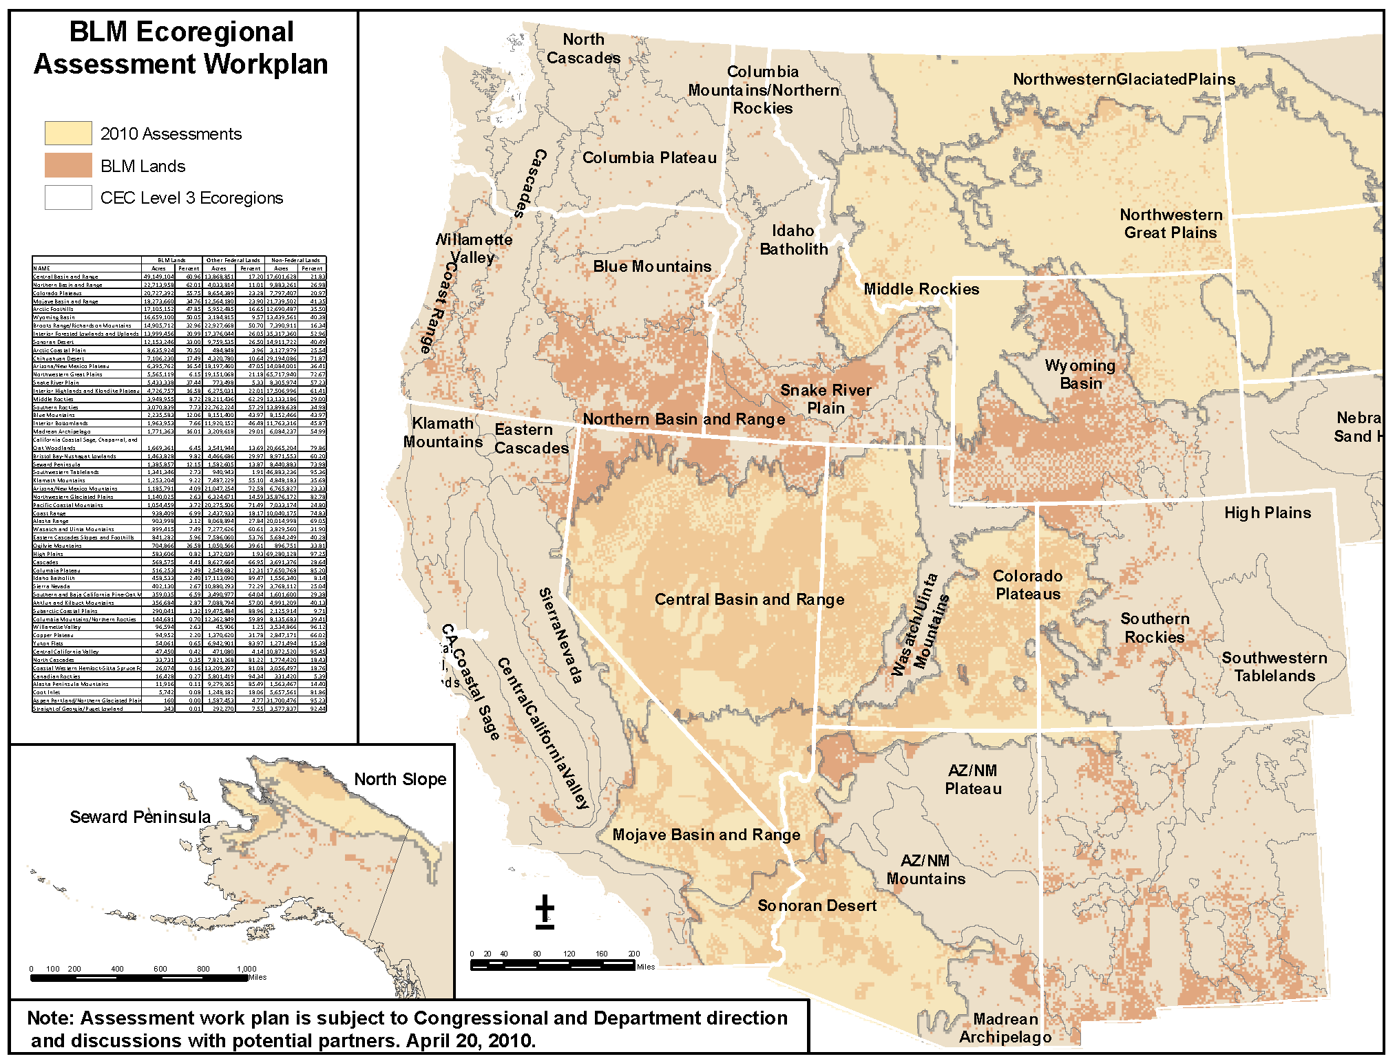
Ecoregions Map
Notes:
This map show the Level III ecoregions in the West. The assessment we’re initiating this year are shown in light yellow.

Slide 15
REA Fundamentals 2
Management questions
Science-based: guided by conceptual models
Conservation elements (CEs)
  Classes
    Species
    Ecosystems & landscapes
    Others
  Types
    Core
    Desired
Change agents (CAs)
  Wildland fire
  Development
  Invasive species
  Climate change

Slide 16
REA Fundamentals 3
Extent: CEC Level III ecoregions
Grain size:
  5th field, 10-digit hydrologic unit
  30-meter grid
Scenarios, not alternatives

Slide 17
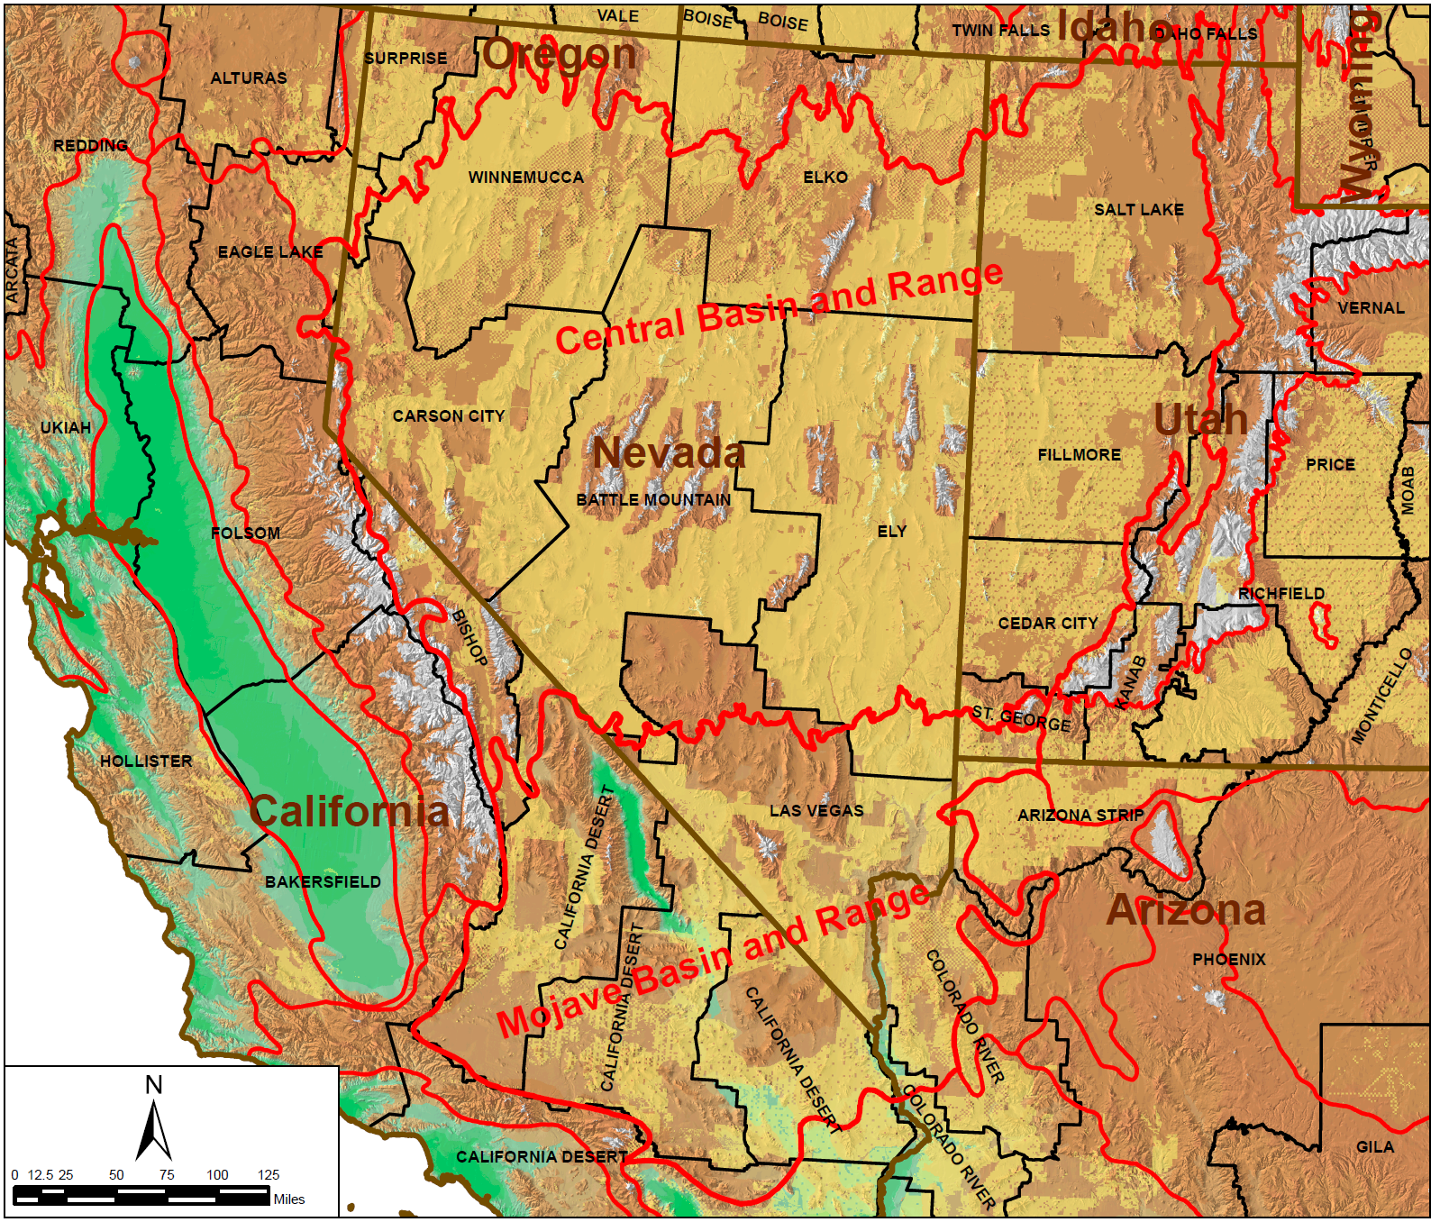
Thinking Outside the Box

Slide 18
Not Just BLM Lands

Slide 19
Not Just BLM Lands

Slide 20
REA Organization
Ecoregion
Assessment Policy Team
Ecoregion
Partners
Ecoregion
Technical Resources
Team
Ecoregion
Stakeholders
Ecoregion Assessment Management Team
Data Management
Team
National Policy & Technical Teams
NOC
REA Coordination Team
Contracting
Officer
REA
Point of Contact
Contracting
Office Representative
Ecoregion/State/Field
National Operations Center
National/Washington Office
REA Contractor
Contractor
Others

Slide 21
REA Workflow
Phase I
Phase II
Task 1
Develop base ecoregional model
Refine management questions
Select conservation elements (CEs)
Select change agents (CAs)
Task 1
Compile and Generate “Source” Datasets
Initiate REA
Task 2
Conduct Analyses
Generate Findings
Task 2
Identify, Evaluate, and Recommend Potential Datasets
Task 3
Prepare REA Documents
Task 3
Identify, Evaluate, and Recommend Methods, Models, and Tools
Task 4
Prepare Rapid Ecoregional Assessment Work Plan (REAWP)

Slide 22
Phase II

Slide 23
REA Task Workflow Process
Datasets and Other Information
Inputs
Contractor
Performs Task Components
AMT Workshop
AMT Guidance
Contractor
Finalize Work Products
Prior Task
Next Task
Draft Memorandum
AMT Workshop Summary
Final Memorandum
AMT/Tech Team/Partner
Review information and provide input to AMT

Slide 24
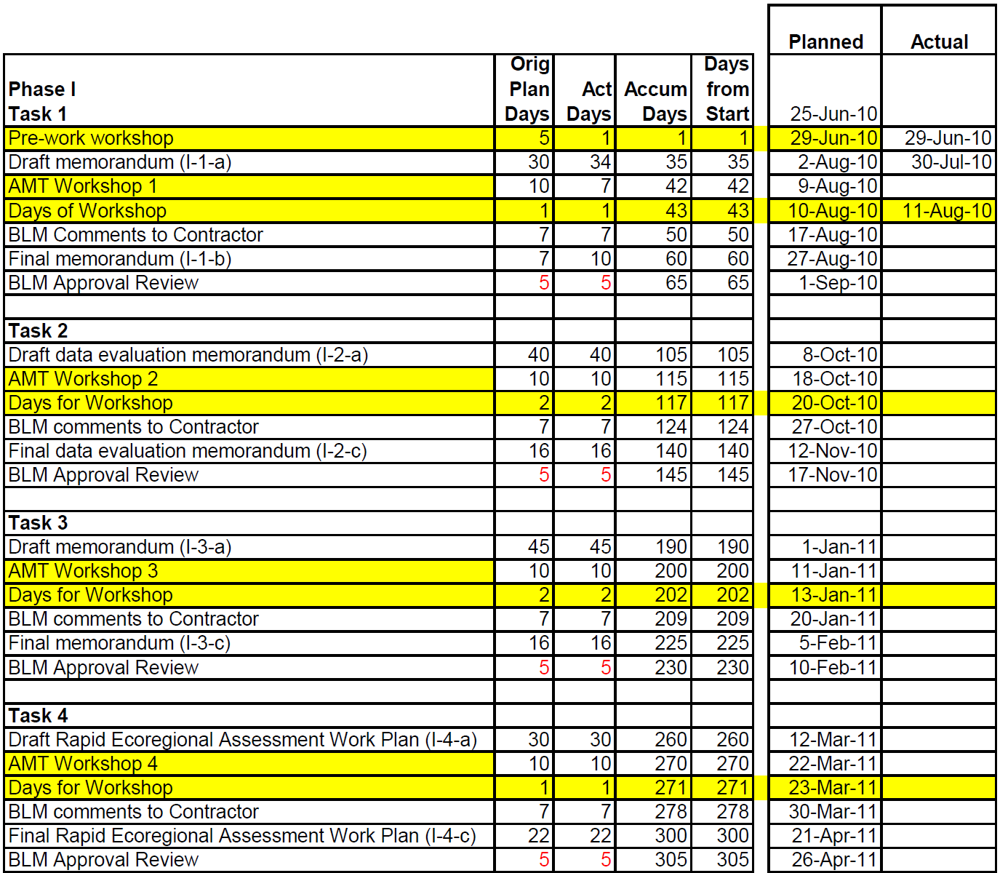
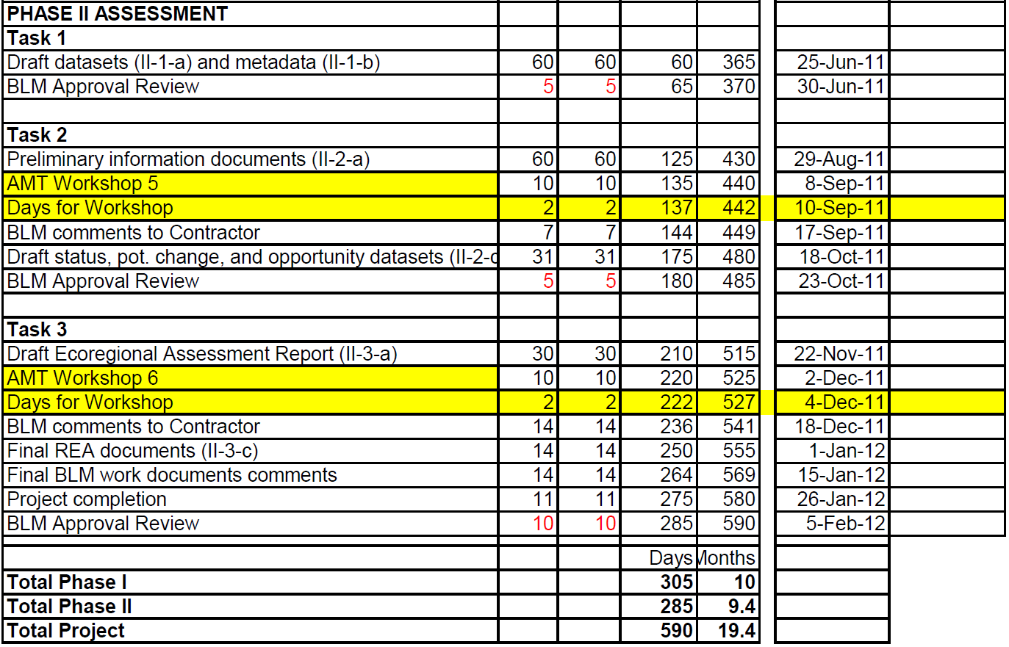
Schedule

Slide 25
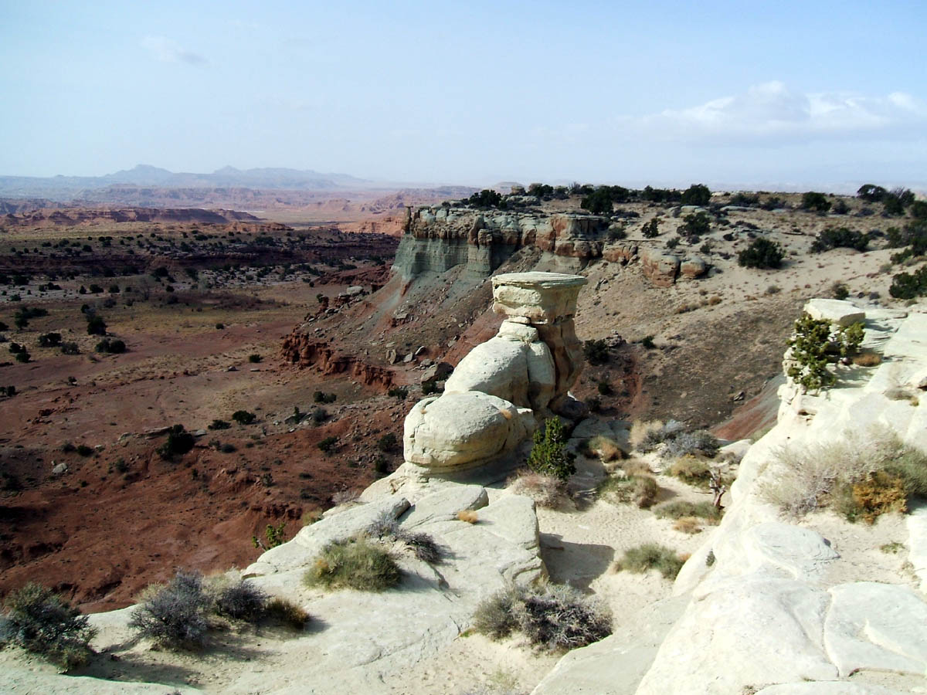
Questions?
Colorado Plateaus Ecoregion, Utah

Slide 26
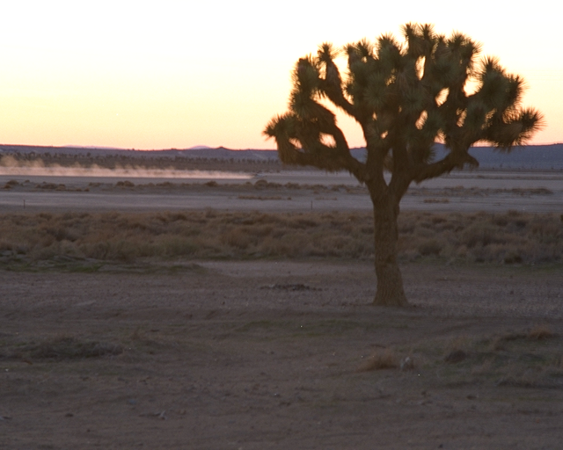

Rapid
Ecoregional
Assessment
Mojave Basin and Range Ecoregion
Mojave Basin and Range Ecoregion

Slide 27
AMT Workshop I: Outline
AM
Overview of Task 1
Ecoregion Conceptual Model
Overarching Management Questions
Candidate Conservation Elements
PM
Specific Management Questions
Candidate Change Agents
Decisions and Next Technical Steps

Slide 28
The NatureServe Team
BLM AMT
NatureServe
Pat Comer
C0-Project Oversight
CE Science Coordination
NatureServe
Patrick Crist
POC, Primary Project Oversight, Assessment & Products Coordination
NatureServe
Marion Reid
Routine Project Management
Ecosystem Science
Ecosystem models, Conservation element models & science, Spatial models & Climate effects
NatureServe
Sound Science LLC
California Academy of Sciences
Natural Heritage Programs
GIS & Data Management
Data acquisition, evaluation, generation & management, quantitative GIS assessment
NatureServe
Sound Science LLC
Natural Heritage Programs
Assessment
Management Questions, Change agents, Conservation Lands, Urban growth, Energy Analyses, Carbon Sequestration
NatureServe
Sound Science LLC
NCCSP
Natural Heritage Programs
Products & Communication
Workshops, reports, documentation
NatureServe
Sound Science LLC

Slide 29
Overview of Task 1 Objectives
Construct a conceptual ecoregion model
Review and refine Management Questions (MQs)
Review and suggest Conservation Elements (CEs)
Review and suggest Change Agents (CAs)

Slide 30
Overview of Task 1 Deliverables
Draft Memorandum (submitted)
AMT review workshop
Draft workshop summary
Final workshop summary
Final memorandum

Slide 31
Task 1 in Context
Sets the stage by reviewing and forwarding candidates for MQs, CEs, and CAs
First step, not final decisions on these
Candidates pass through feasibility filters:
  Adequate data to represent them?
  Feasible model approach to assess them?

Slide 32
Objectives for Workshop 1
Vet candidates for MQs, CEs, and CAs to promote to task 2 assessment
ID issues needing further AMT process/discussion to resolve
ID items to revise to finalize memo 1a
Generally get on same page moving forward

Slide 33
Bounding the Ecoregion
Efficient Spatial Frame for Assessment of Conservation Elements and Change Agents
Both Terrestrial and Aquatic ecological considerations
Potential utility for subregionalization to subset analysis and for reporting
Notes:
Our Purpose:

Slide 34
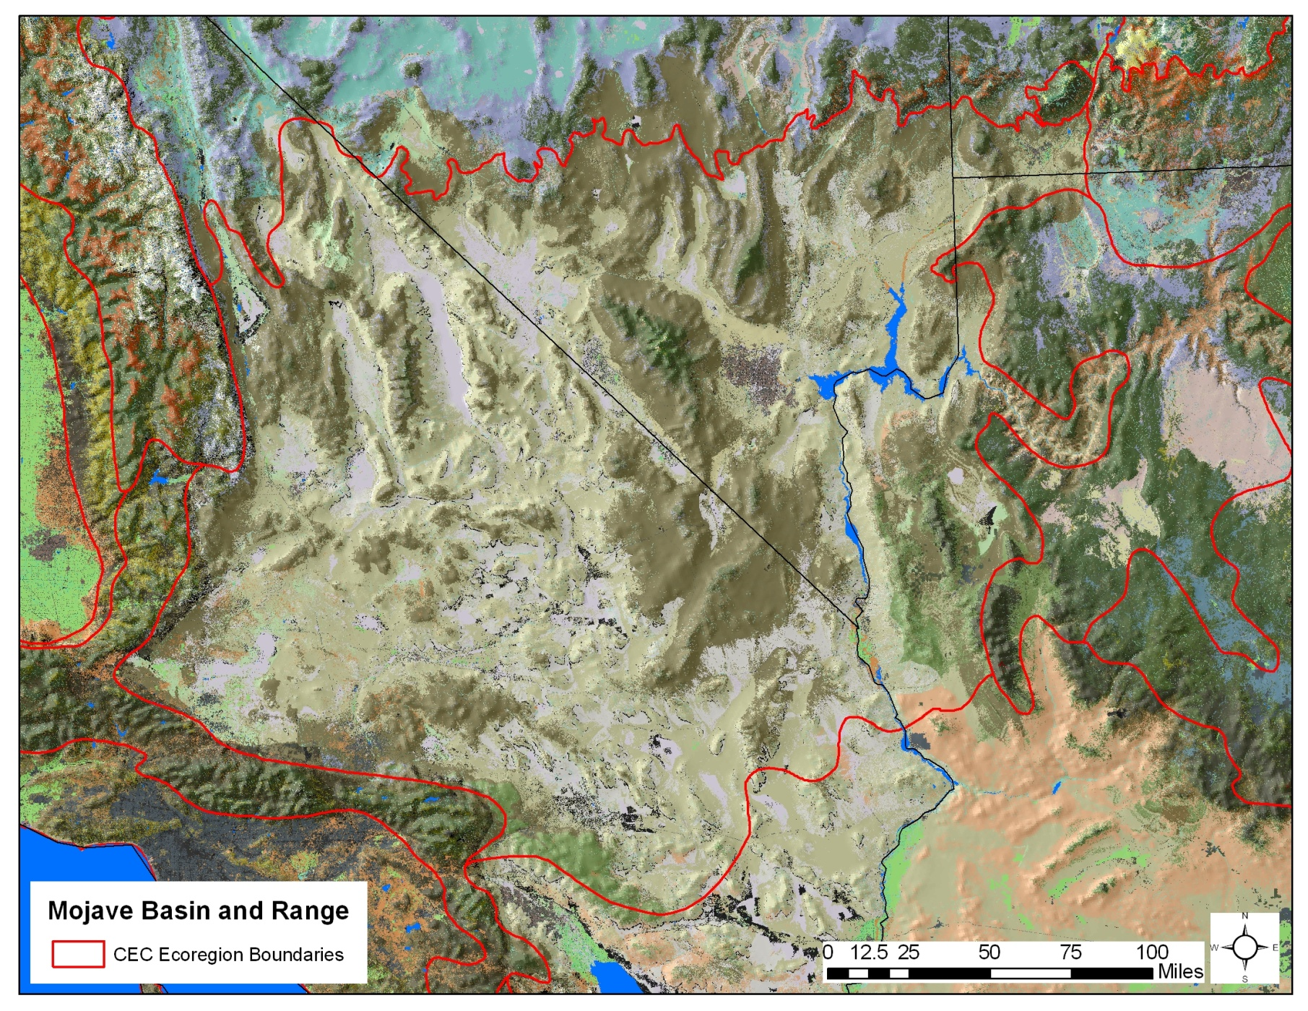
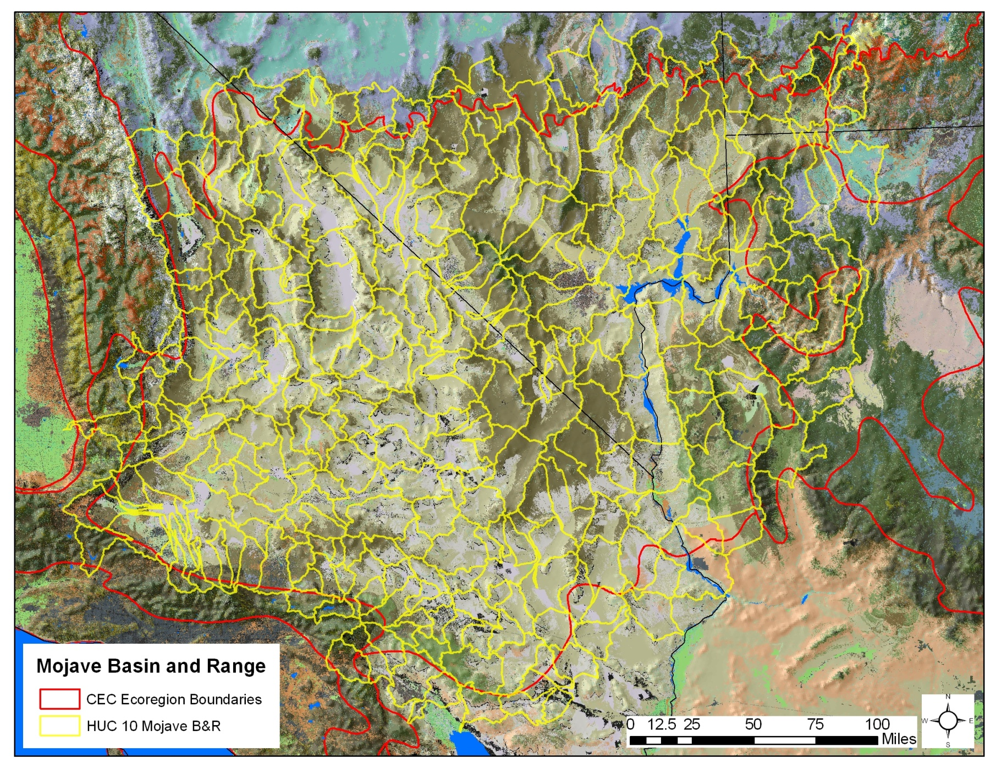
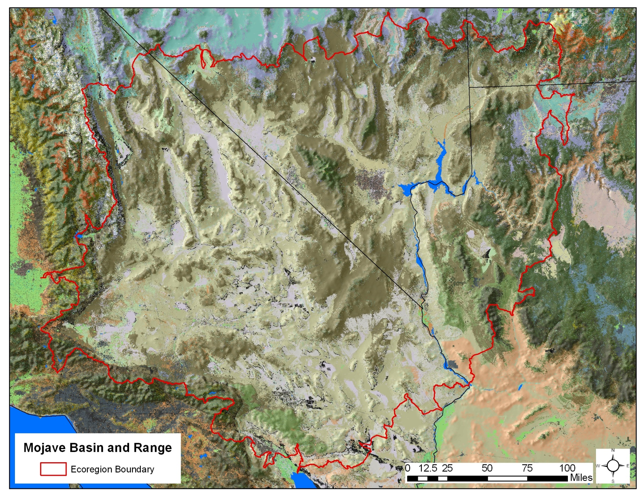
Bounding the Ecoregion

Slide 35
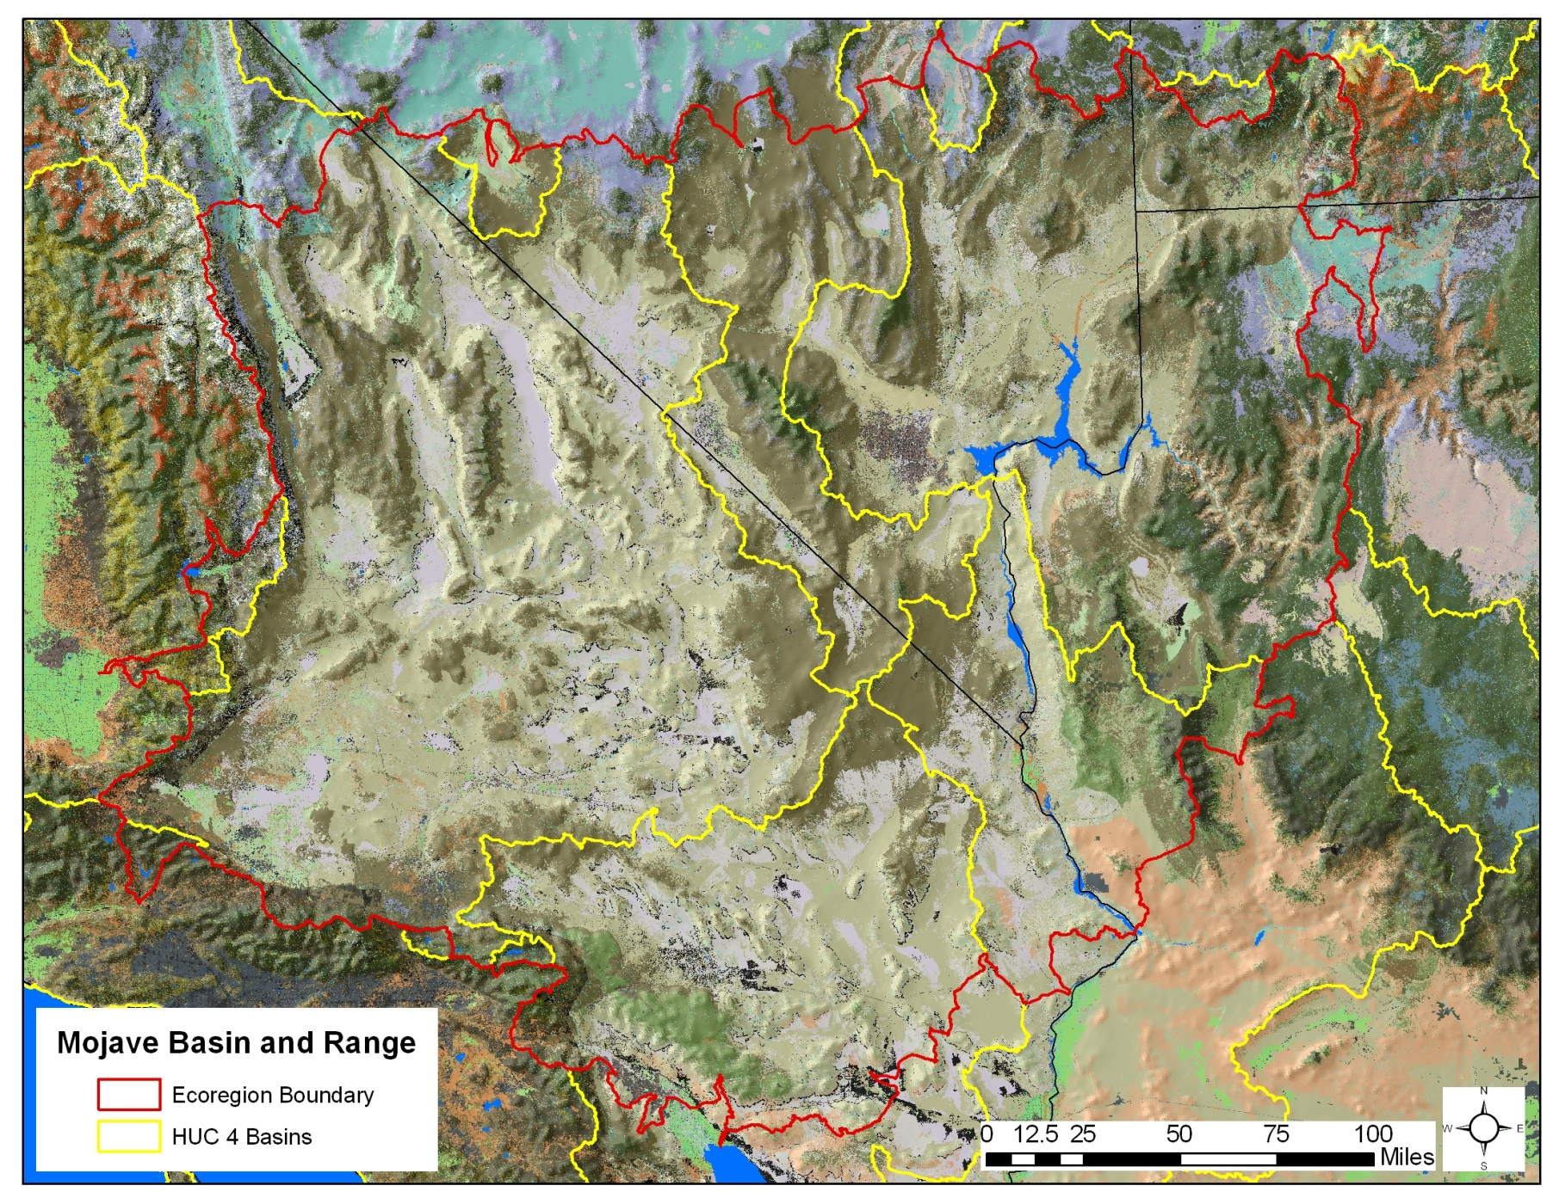
Subregions?

Slide 36
Ecoregion Conceptual Model
Purpose of the model
Spatial and Temporal Boundaries
Multi-level Structure
Notes:
The purpose of this model is to articulate key assumptions about regional landscape pattern and process that will inform our selection and analysis of conservation elements and change agents. This overarching description and model will provide a framework for series of component models for the ecoregion.
To define the spatial and temporal bounds of our model, the extent of the Rapid Ecoregional Assessment includes the area within the boundary of ecoregion number 13, as originally defined by Omernik (1987) and EPA (2002) plus the area within a buffer surrounding the ecoregion. The buffer includes that area outside the ecoregion boundary comprised of those 5th-level, 10-digit hydrologic units that overlap the ecoregion boundary.
The temporal bounds of this conceptual model would include the past two centuries, but center on the 20th century and decade of 2001-2011. This time period reflects the climatic regimes, ecological patterns and processes, and change agents that are most applicable to this assessment. Our assessment will look to future time periods for evaluation of climate-induced stress and land use scenarios, but for conceptual modeling, our initial set of assumptions lead up to today.

Slide 37
Biophysical Controls
Climate and Physiographic System
Temperature Regimes (lat/long, altitudinal)
Precipitation Regimes (lat/long, altitudinal, rain shadow)
Wind Regimes
Wet and Dry deposition
Air quality/visibility
References
Chung-MacCoubrey, A. L., R. E. Truitt, C. C. Caudill, T. J. Rodhouse, K. M. Irvine, J. R. Siderius, and V. K. Chang. 2008. Mojave Desert Network vital signs monitoring plan. NPS/MOJN/NRR—2008/057. National Park Service, Fort Collins, Colorado.
Miller, M.E., 2005, The Structure and Functioning of Dryland Ecosystems—Conceptual Models to Inform Long-Term Ecological Monitoring: U.S. Geological Survey Scientific Investigations Report 2005-5197, 73 pp.
Moore, J., C. Rumsey, T. Knight, J. Nachlinger, P. Comer, D. Dorfman, and J. Humke. 2001. Ecoregion-based Conservation in the Mojave Desert. The Nature Conservancy, Las Vegas, NV. 150 pp. + appendices.

Slide 38
Climatic and Physiographic System
Seasonal weather pattern, drought, wind, fire, water runoff-infiltration, evaporation, soil erosion/disturbance, soil development, soil chemistry, freeze/thaw, nutrient cycling
snowpack formation/melt, water runoff-detention-recharge, surface flow, aquifer storage, surface-subsurface water exchange, evaporation, sediment erosion-deposition, connectivity, water chemistry, freeze/thaw
Montane Dry Land System
Basin Dry
Land System
Montane
Wet System
Basin
Wet System
grazing, recreation, logging, fire alteration, land conversion, contamination, invasive species, air pollution, hunting, wildlife/human conflict, trampling, collecting
water withdrawal/diversion, grazing, invasive species, water pollution, wetland drainage, fishing, trampling, recreation
Human Systems
(Change Agents and Drivers of Change): demography, socioeconomics, policy, resource development pressure
Natural Driver
Human Driver

Slide 39
Montane Dry Land System
‘Slow’ Physical Drivers: landscape exposure (slope/aspect), organic soil development, soil chemistry, freeze/thaw, nutrient cycling, soil erosion/disturbance
‘Fast’ Physical Drivers: drought, wind, fire
Biotic Drivers: herbivory, pollination, plant pest infestation, dispersal, predator/prey
Subalpine/Montane Forests & Woodlands
Montane
Shrublands
Montane Canyons
Alpine Uplands
grazing, logging, fire alteration, land conversion, invasive and managed species, air pollution (including wet/dry deposition), recreation wildlife/human conflict, trampling
Human Systems
(Change Agents and Drivers of Change): demography, socioeconomics, policy, resource development pressure
Natural Driver
Human Driver

Slide 40
Basin Dry Land System
‘Slow’ Physical Drivers: water infiltration, organic soil development, soil chemistry, nutrient cycling
‘Fast’ Physical Drivers: drought, wind, soil erosion/disturbance
Biotic Drivers: Biological soil crust dynamics, herbivory, pollination, dispersal, predator/prey
Semi-desert Shrub and Steppe
Cliff and Outcrop
Desert Scrub
Dunes
grazing, fire introduction, land conversion, recreation, invasive species, air pollution, trampling, nature experience, military training, waste disposal
Human Systems
(Change Agents and Drivers of Change): demography, socioeconomics, policy, resource development pressure
Natural Driver
Human Driver

Slide 41
Montane
Wet System
‘Slow’ Physical Drivers: drainage network connectivity, water chemistry, subsurface recharge and discharge
‘Fast’ Physical Drivers: snowpack formation & melt, rainfall, freeze/thaw, surface flow, water erosion/sediment deposition, nutrient input, stream-wetland-riparian connectivity,
Biotic Drivers: food web dynamics, predator/prey
Montane Lakes and Wetlands
Montane Streams and Riparian
water withdrawal/diversion, dams, altered watershed function, grazing, invasive and managed species, wet/dry deposition, water pollution, fishing, trampling
Human Systems
(Change Agents and Drivers of Change): demography, socioeconomics, policy, resource development pressure
Natural Driver
Human Driver

Slide 42
Basin
Wet System
‘Slow’ Physical Drivers: drainage network connectivity, water chemistry, subsurface recharge and discharge
‘Fast’ Physical Drivers: watershed snowpack formation & melt, rainfall, watershed runoff & surface flow, evapotranspiration, water erosion/sediment deposition, stream-wetland-riparian connectivity,
Biotic Drivers: food web dynamics, predator/prey
Basin Lake/Reservoir
Basin River and Riparian
Playa, Greasewood Flats, Washes
Desert Springs, Seeps
surface water and aquifer withdrawal/diversion, dams, altered watershed function and erosion, channel aggradation and incision, grazing, invasive and managed species, water pollution, wetland drainage, fishing, trampling
Human Systems
(Change Agents and Drivers of Change): demography, socioeconomics, policy, resource development pressure
Natural Driver
Human Driver

Slide 43
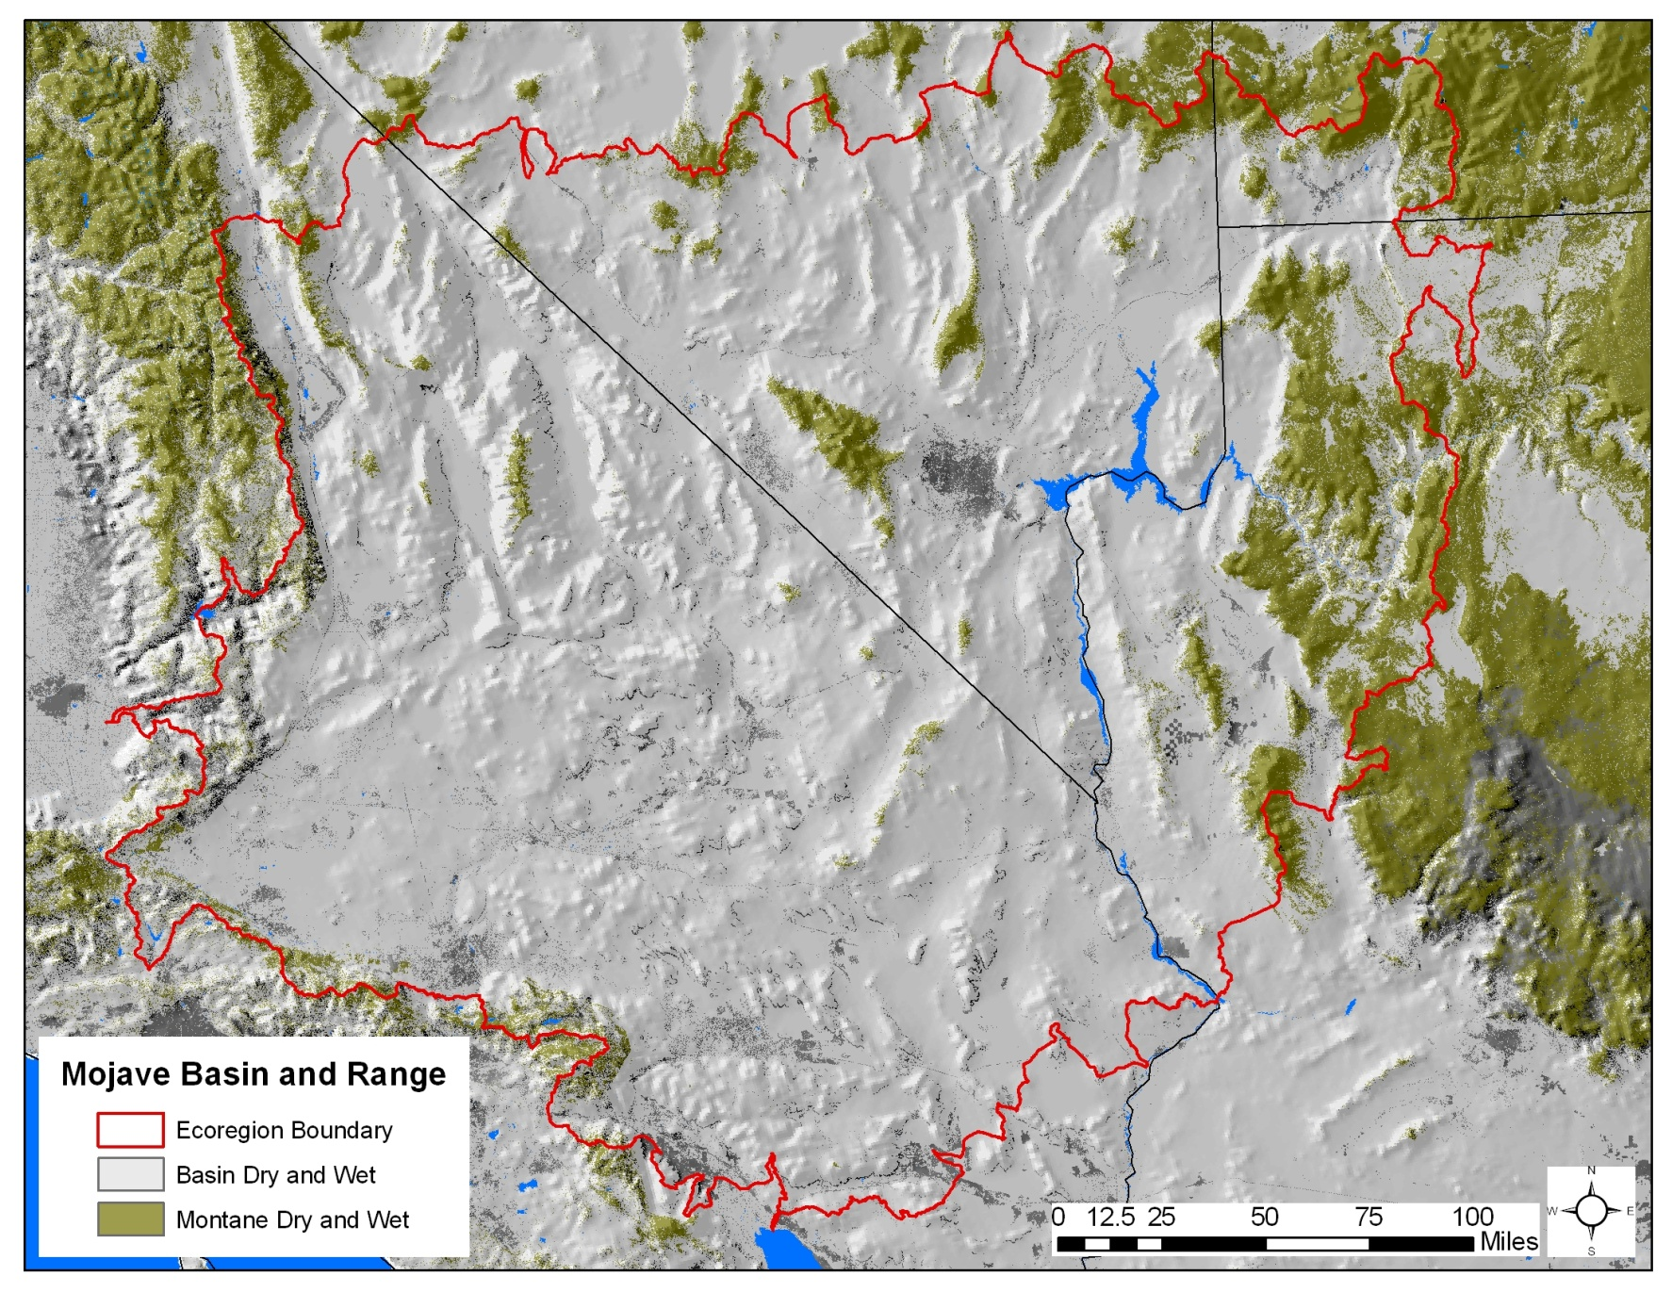
Relative Proportion of Model Components

Slide 44
Overarching Management Questions
Mojave Basin and Range

Slide 45
Management Questions
Overview
• Individual Management Questions address specific needs for information.
• Collectively, the Management Questions “roll up” to create understanding about status and trends, and also identify threats, resilience, and opportunities for constructive management.
• Individual Management Questions are driven by (A) understanding of the systems (i.e., the Model), (B) Elements of concern, and (C) Change Agents.
• The 70+ Management Questions can be grouped into logical groups or overarching questions.
Notes:
There are 70 management questions originally proposed by BLM. Here we discuss how they naturally group together, and ways we can usefully think of how they “roll up” to concerns that span the eco-region and the process of the REA.

Slide 46
Criteria for evaluating
Management Questions
(1) Is each Question stated in a clear and focused way that can be commonly understood by all participants?
(2) Is each Question matched to and answerable with available data and planned analyses?
(3) Are there important issues or questions missing from the list or questions?
(4) Are there questions that are extraneous, duplicative, or determined to be of lesser importance?
(5) Do any Questions suggest Conservation Elements or Change Agents that are missing from the target lists under development for the project?
(6) Are all Elements and Change Agents addressed in at least one management question?
(7) Are each of the questions clearly incorporated somewhere into the ecological models under development for the project?

Slide 47
Original Preliminary Management Questions by Group
Box 1. Groups of preliminary Management Questions for the Mojave Ecoregion, provided by BLM (the number of preliminary Questions in each group). Many questions have multiple outputs corresponding to the Elements and Change Agents.
• Species (9)
• Wild Horses and Burros (5)
• Native Plant Communities (2)
• Terrestrial Sites of High Biodiversity (2)
• Soils (2)
• Surface and Subsurface Water Availability (6)
• Aquatic Sites of High Biodiversity (2)
• Aquatic Ecological Function and Structure (2)
• Specially Designated Areas (1)
• Fire History (3)
• Fire Potential (1)
• Invasive Species (4)
• Urban and Roads Development (4)
• Oil, Gas, and Mining Development (6)
• Renewable Energy Development (4)
• Groundwater Extraction and Transportation (5)
• Climate Change: Terrestrial Resource Issues (5)
• Climate Change: Aquatic Resource Issues (5)
• Military Constrained Areas (2)

Slide 48
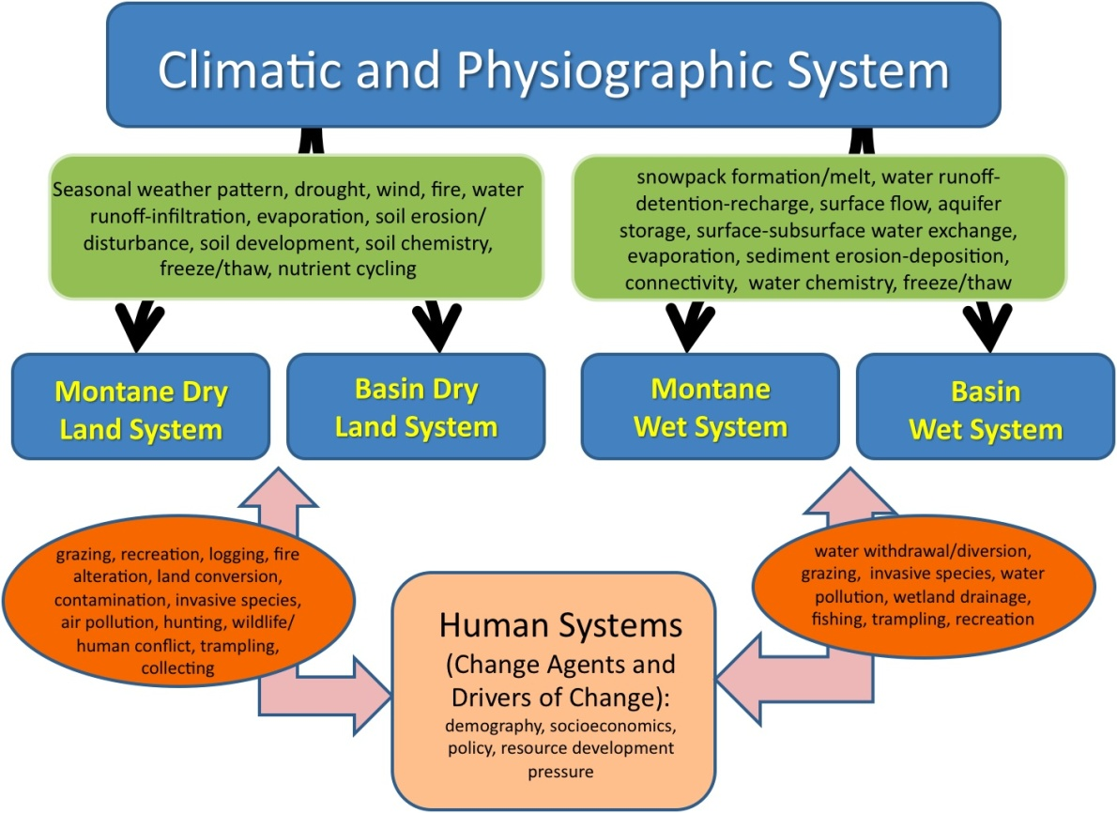
Elements
Change Agents
Mgt
Questions
Climate
Change
Aquatic
Climate
Change
Terrestrial
Model
Species
Questions
Sites of High
Biodiversity
Soils
Natural
Communities
Aquatic
Communities
Elements
Surface
Water
Aquatic
Ecological
Function
Horses
Burros
Ground
Water
Extraction
Military
Sites
Grazing
Invasive
Species
Fire
Change
Agents
Development
Oil, Gas & Mining

Slide 49
Species, Habitats, Sites, Change Agents
Where are Elements, features, and processes of importance (species, native communities, biodiversity sites, refugia, aquatic communities)?
Where are critical habitats or landscape features (connectivity, restoration areas, protected areas)?
Where are locations of significant action by Change Agents?
Where might climate change have the greatest ecological impact on species or habitats?
Studying the overlap among these classes of questions identifies
(A) areas that may experience the most significant ecological change, and
(B) opportunities for high impact management action.
Notes:
There are many details within these Overarching MA’s (OMA’s) – many underlying questions. But these summarize the core ideas. This page is about species, habitats, CA’s, and how climate change may affect them. Overlaying these layers creates pictures of the locations of threats and opportunities.

Slide 50
Water, Development, Climate Change
Where are aquatic systems, areas with persistent water, critical aquifers and recharge zones?
Where are locations with significant fire history? Where might future risks be?
Where are locations significantly threatened by invasive species? Where might future risks be?
Where is development and human use? Where is development planned?
What locations will experience the greatest changes in climate attributes?
Where might climate change have the greatest impact on ecological processes?
Notes:
Water, processes, human uses, and climate change.

Slide 51
Emergent Management Questions
Roll Up: Integrity, Management
What qualities of the ecoregion contribute (positively or negatively) to the ability of the ecoregion’s ecological systems to resist or respond to disturbance & change?
How are these qualities distributed across the ecoregion, and how might their distribution be affected by climate change, development, and other change agents?
Where are opportunities for effective ecological management?
The Management Questions are meant to create a picture of the overall health and integrity of the ecoregion, and point to locations of potentially effective and sustaining high-impact management actions.
Notes:
Roll up all the answers to the MQ’s to create a geo-spatial picture of health, integrity, resilience, threat, and opportunities for management. We’ll talk about the details of MQ’s later, but these OMA’s are the holy grail we’re striving for.

Slide 52
Conservation Elements - Approach and Criteria
Mojave Basin and Range

Slide 53
Selection Criteria - Categories
Core Conservation Elements
  Supporting regional biodiversity and ecosystem services
  Emphasizes assessment of ecosystem integrity
Desired Conservation Elements
  Resource values of interest to stakeholders
  Feasible treatment in rapid process

Slide 54
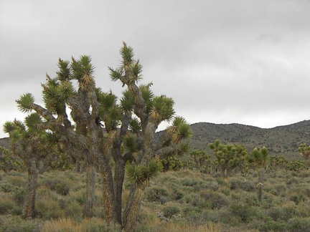
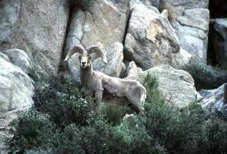
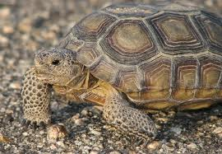
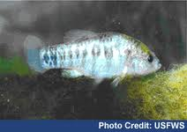

Approaches to Natural Resource Assessment
Species Diversity “hotspots”
“Vertebrate Gap Analysis”
“Focal Species”
“Landscape Representation”
How do we effectively represent biodiversity in resource management and conservation?
Notes:
Underlying our work is the effective representation of biodiversity for conservation

Slide 55
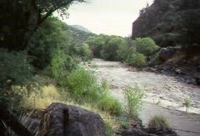
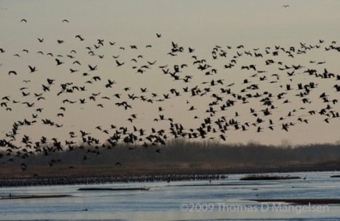
“Coarse Filter/Fine Filter” Approach
Ecological Systems
  recurring groups of communities
Focal Habitats
  Vulnerable assemblages
  Movement corridors
  Migratory stopovers
Focal Species
  imperiled, declining, endemic, vulnerable, “umbrella”
  (habitats and/or extant subpopulations)
Notes:
Elements of concern are hierarchical in nature and are grouped into species, communities, and ecological systems categories.
This encompasses what is commonly called the “coarse-filter/fine-filter approach.” Using this approach, spearheaded by The Nature Conservancy and NatureServe back in the 1970s, all characteristic ecological systems, then a subset of rare and vulnerable communities and species are used to represent the environmental variation and ecological processes that support all biological diversity.
The “coarse-filter” is provided by representing characteristic ecological system types (e.g., different forest, shrubland, grassland, wetland, and riverine systems). The “fine-filter” encompasses rare communities and species at risk that require special consideration to ensure that the ecological processes supporting them are considered in planning.
Our focus is on standard ecological classification and its application to conservation.

Slide 56
“Coarse Filter” Elements
Coarse Filter Conservation Element | Number of Elements
Basin Dryland Ecosystems | 10
Basin Wet Ecosystems | 7
Montane Dryland Ecosystems | 3
Montane Wet Ecosystems | 1

Slide 57
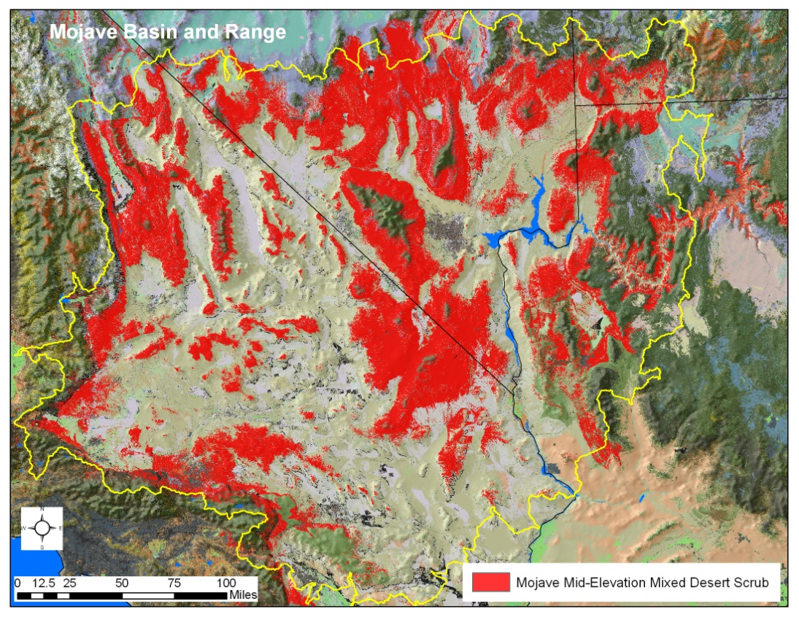
Mojave Mid-Elevation Desert Scrub
32.5% of ecoregion extent
© Southwest ReGAP

Slide 58
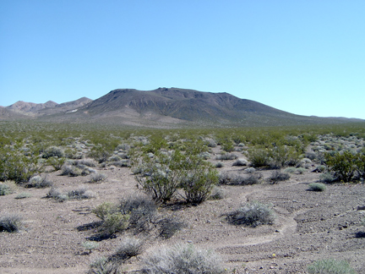
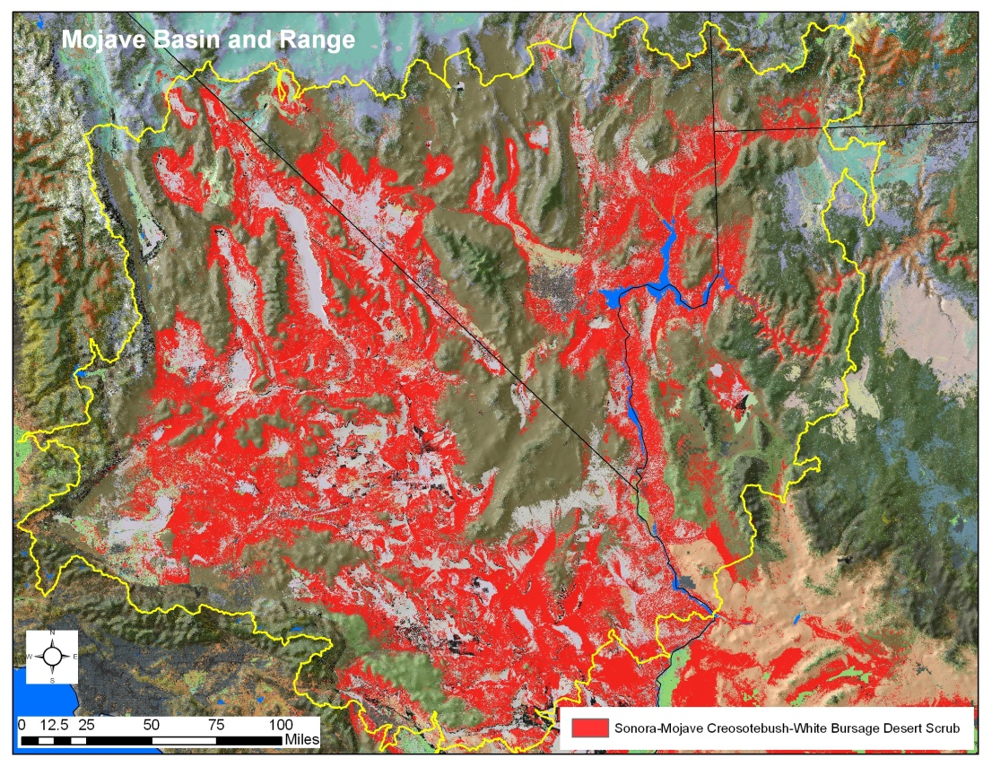
Sonora-Mojave Creosote-White Bursage Desert Scrub
33.8% of ecoregion extent
© Southwest ReGAP

Slide 59
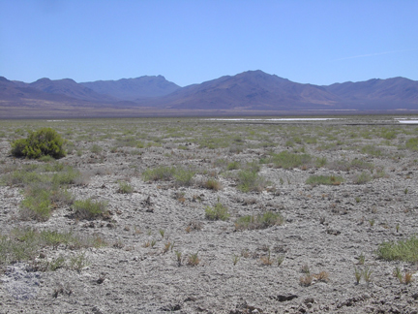
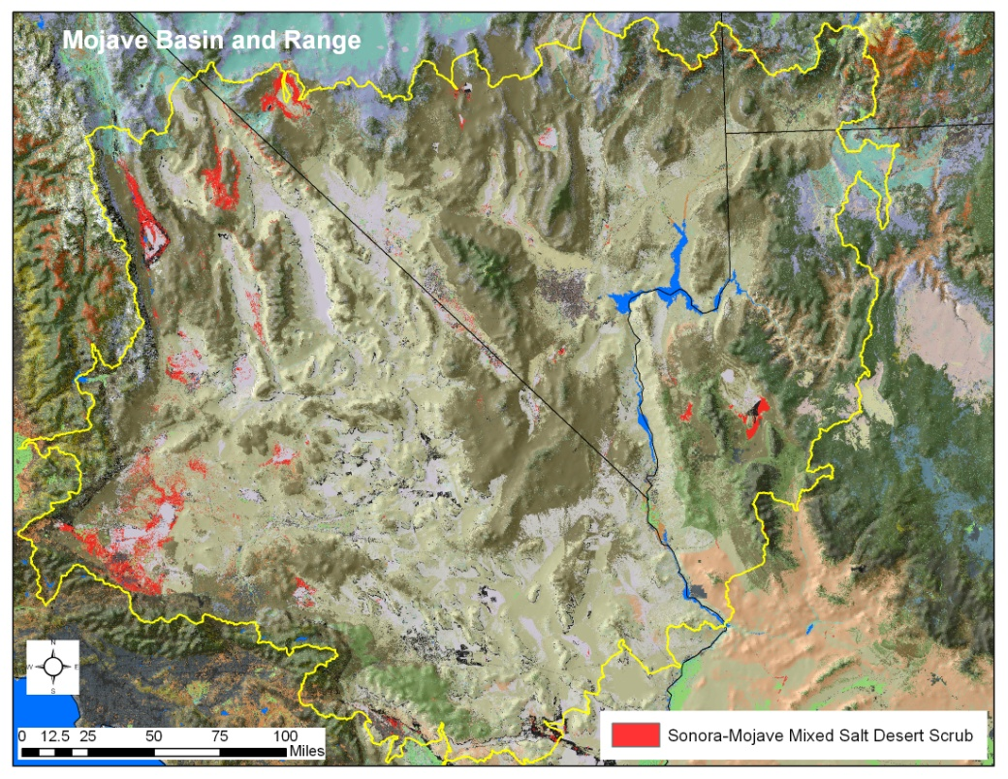
Sonora-Mojave Mixed Salt Desert Scrub
1.7% of ecoregion extent
© Southwest ReGAP

Slide 60
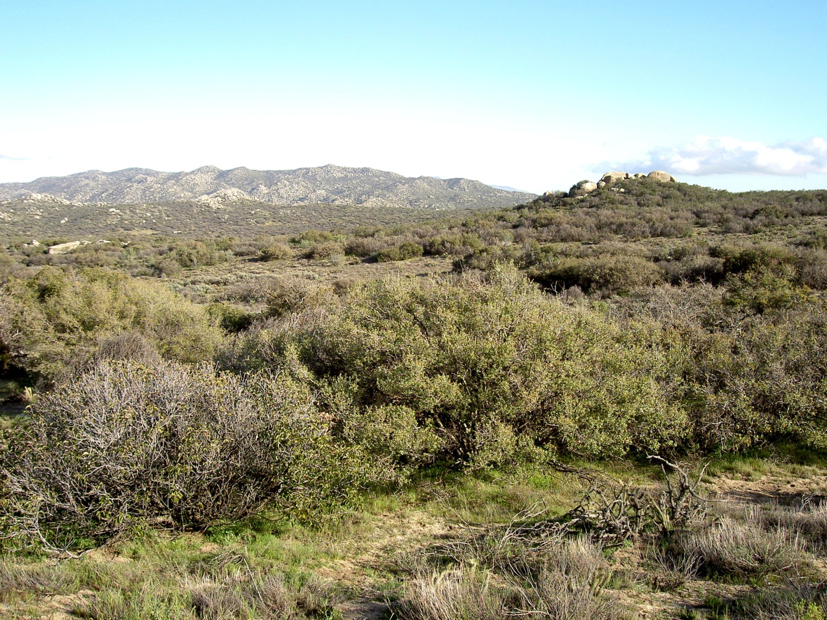
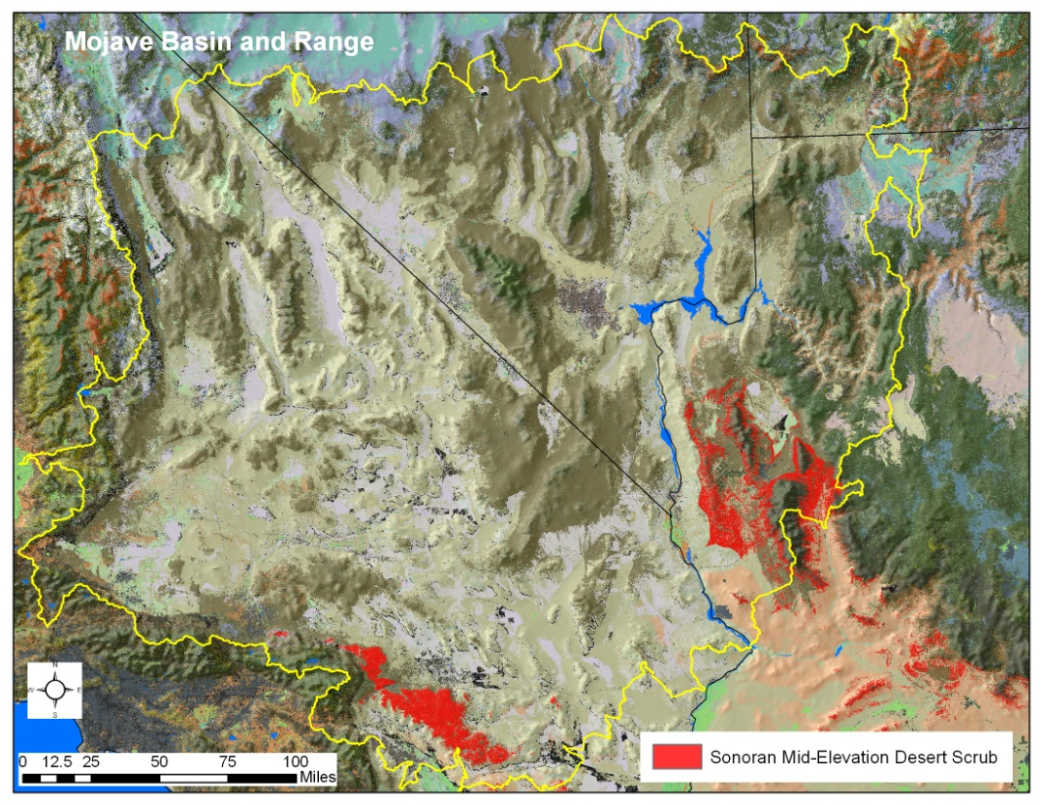
Sonoran Mid-Elevation Desert Scrub
2.2% of ecoregion extent
© Patrick Comer

Slide 61
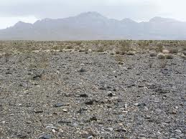
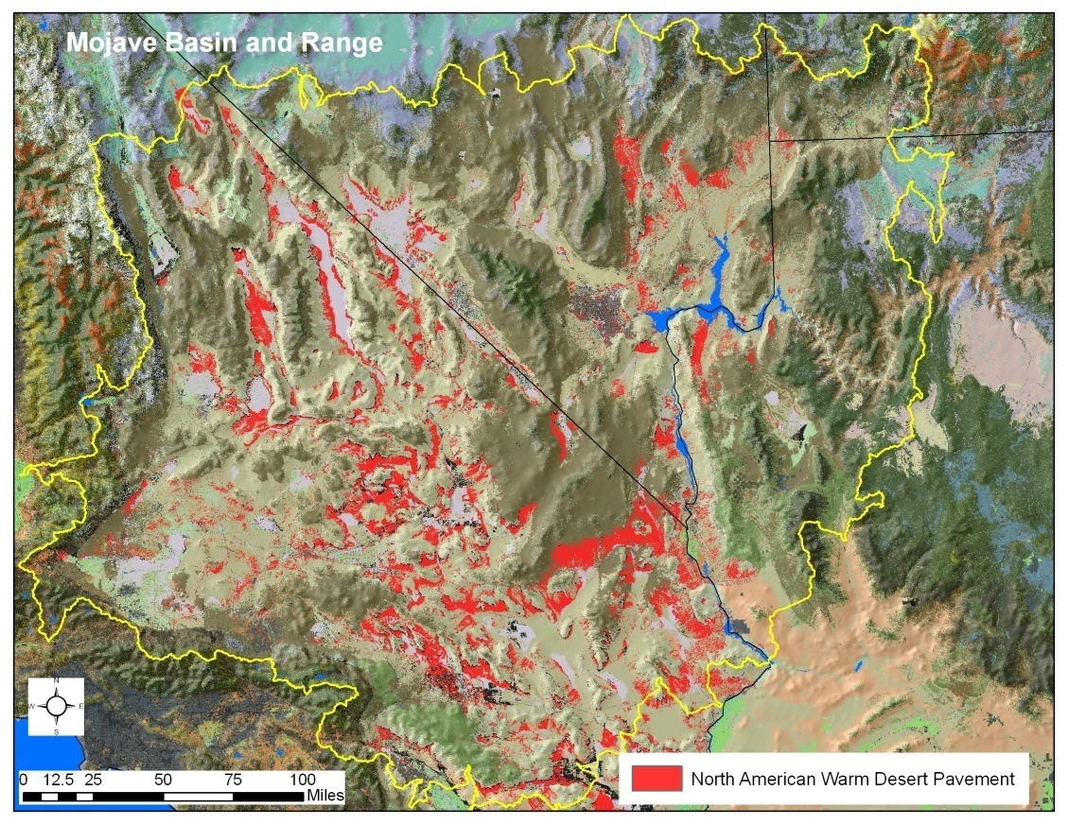
North American Warm Desert Pavement
8.8% of ecoregion extent
© Walter Feller – digital desert.com

Slide 62
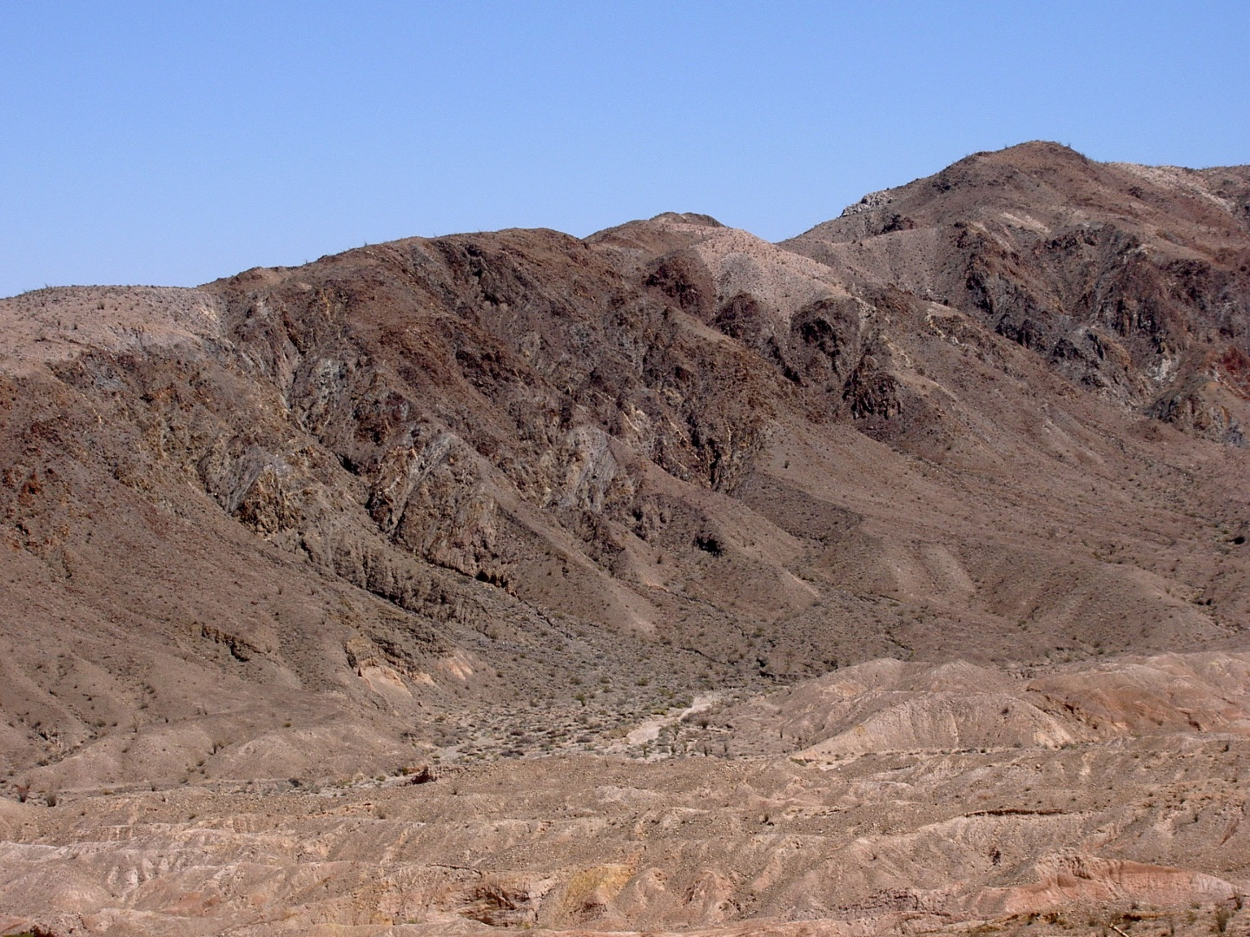
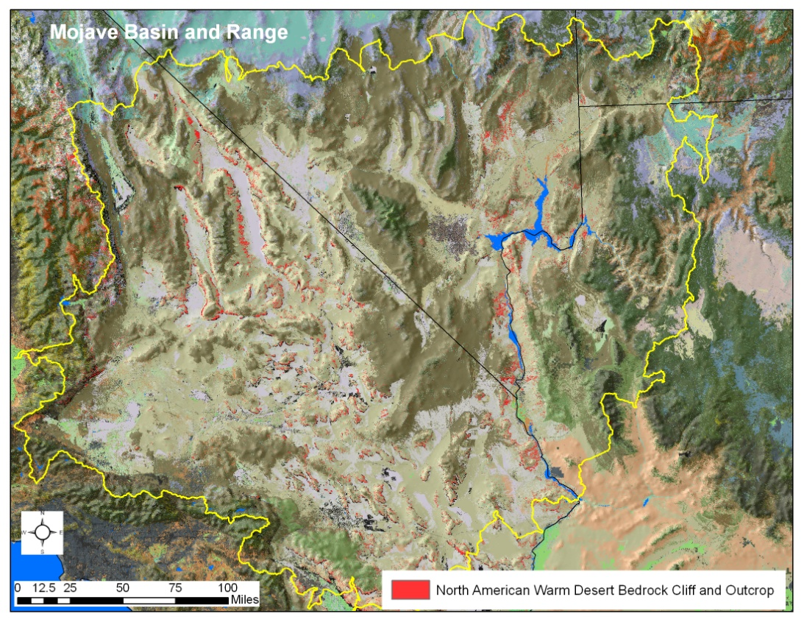
North American Warm Desert
Bedrock Cliff and Outcrop
2.4% of ecoregion extent
© Patrick Comer

Slide 63
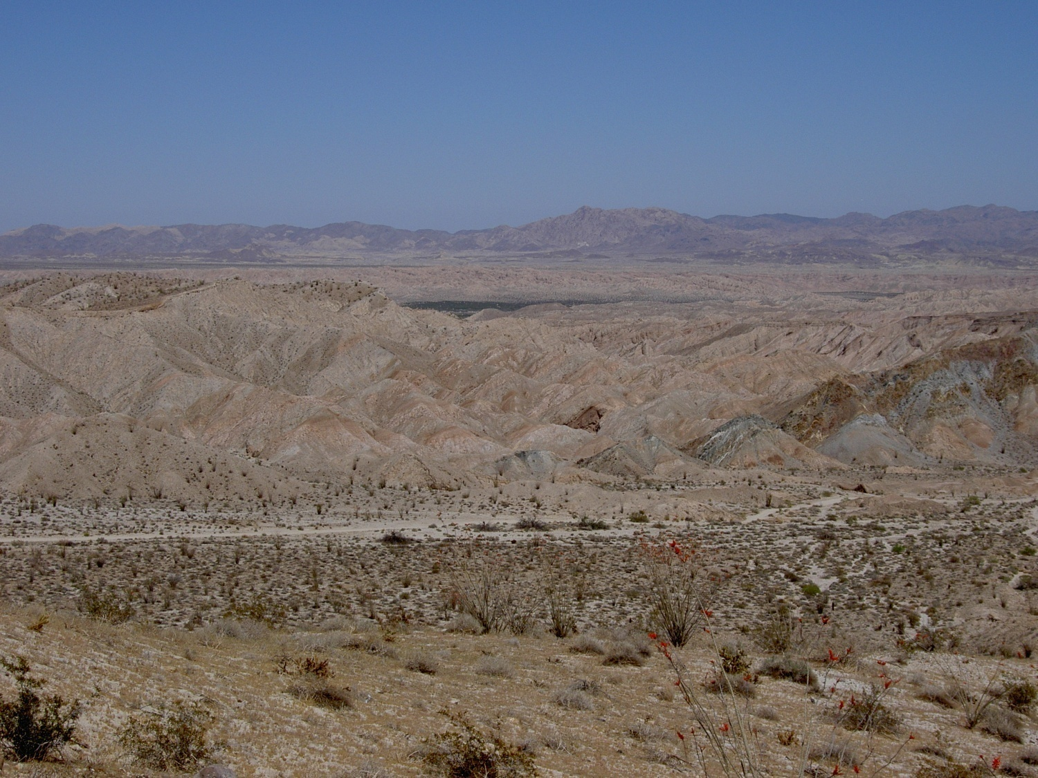
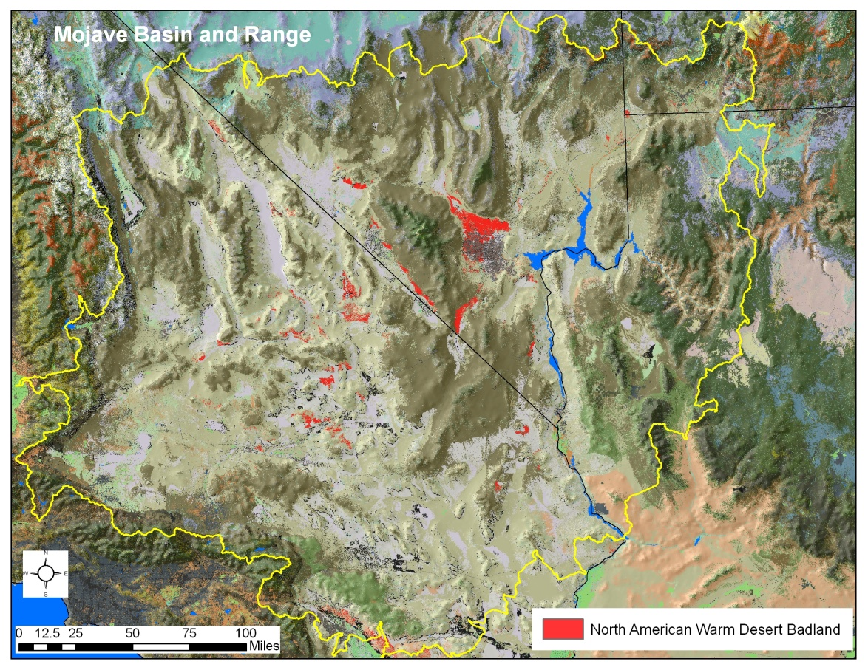
North American Warm Desert Badland
1.0% of ecoregion extent
© Patrick Comer

Slide 64
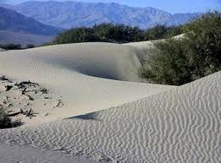
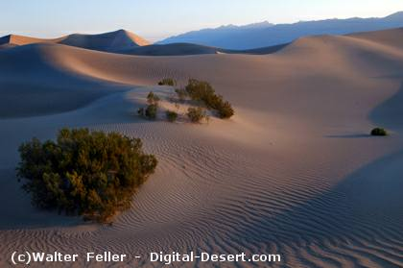
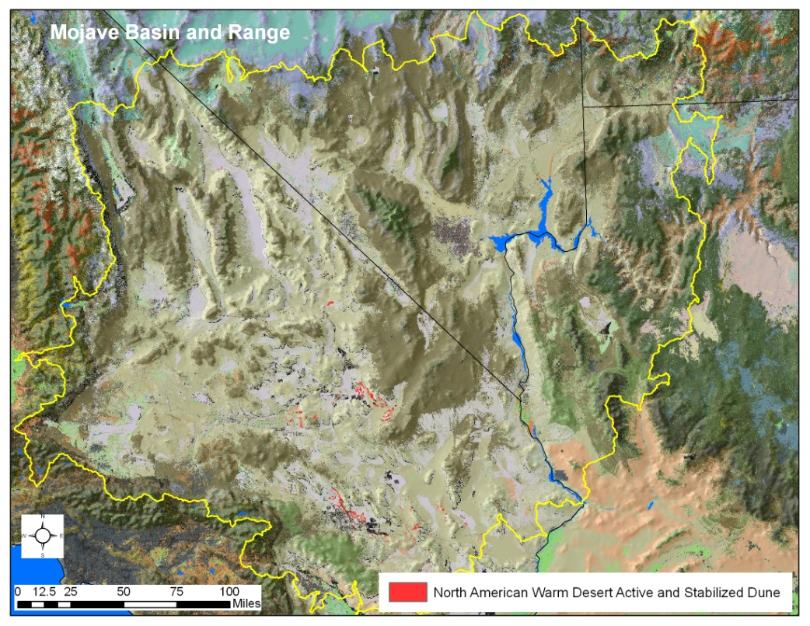
North American Warm Desert
Active and Stabilized Dunes
0.2% of ecoregion extent
© NPS Death Valley NP

Slide 65
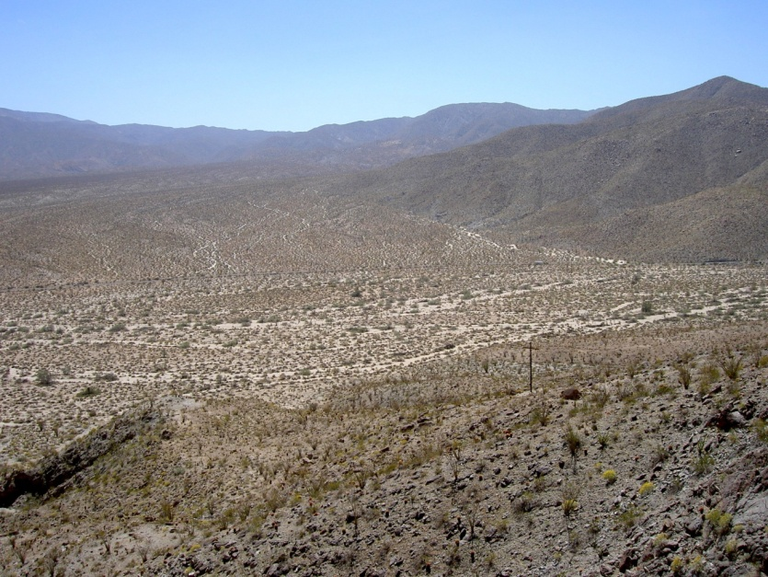
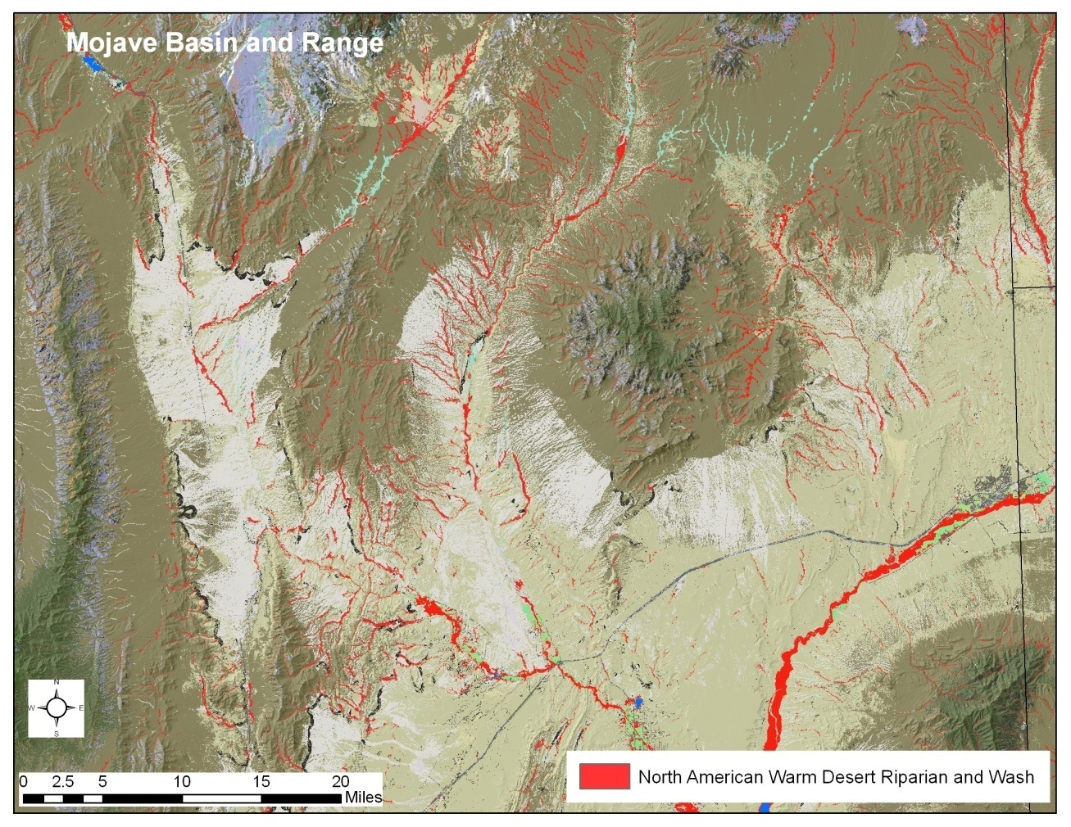
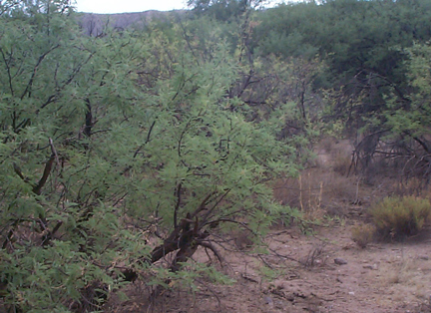
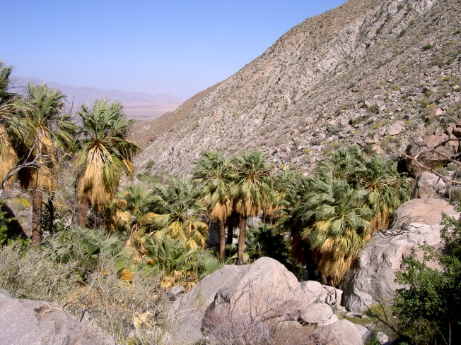
North American Warm Desert Riparian and Stream systems
0.5% of ecoregion extent
© Southwest ReGAP
© Patrick Comer
© Southwest ReGAP
© Patrick Comer

Slide 66
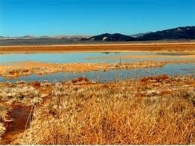
North American Arid West Emergent Marsh/Pond
0.1% of ecoregion extent
© NPS Death Valley NP
© BLM.gov

Slide 67
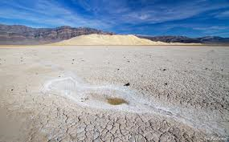
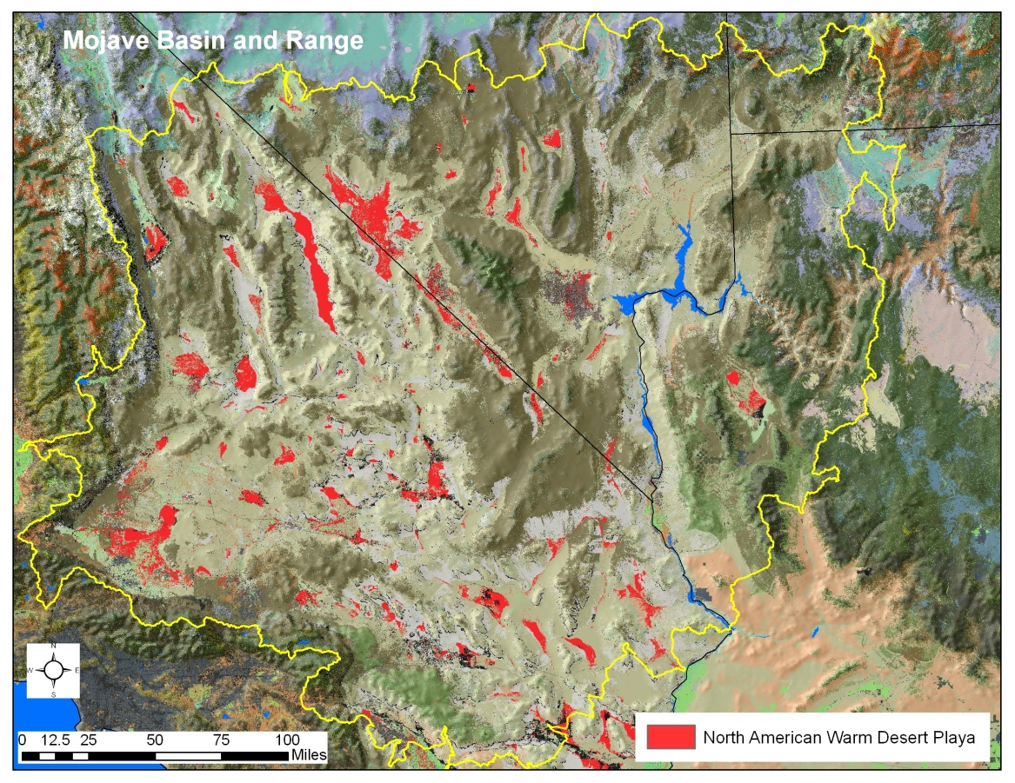
North American Warm Desert
Playa
4.5% of ecoregion extent
© NPS Death Valley NP

Slide 68
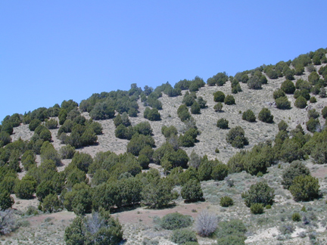
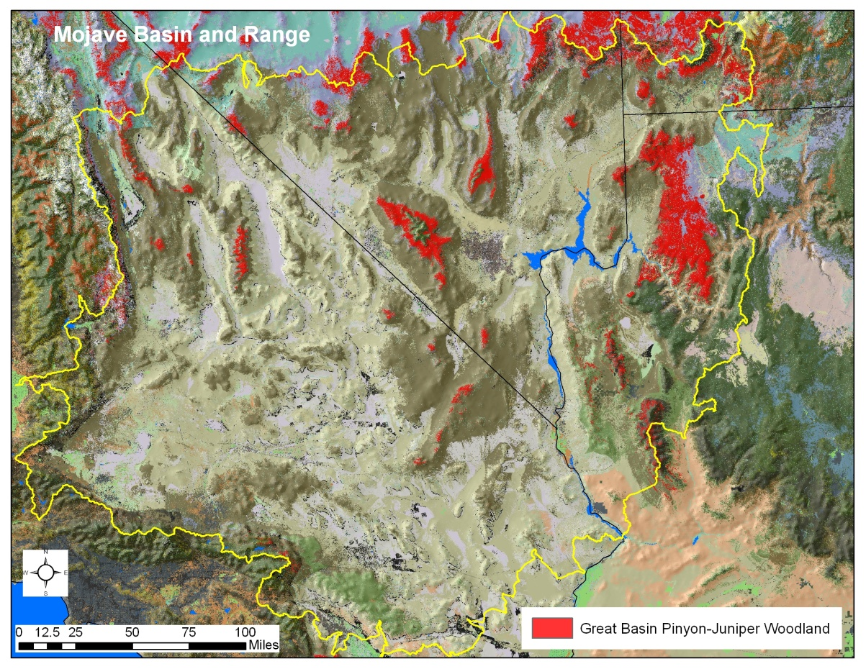
Great Basin Pinyon-Juniper Woodland
1.9% of ecoregion extent
© Southwest ReGAP

Slide 69
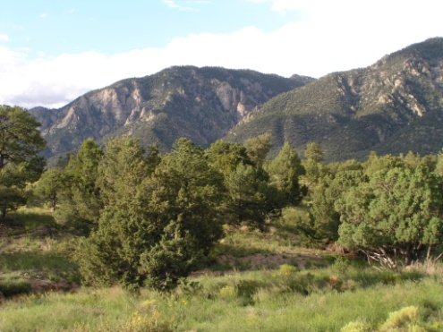
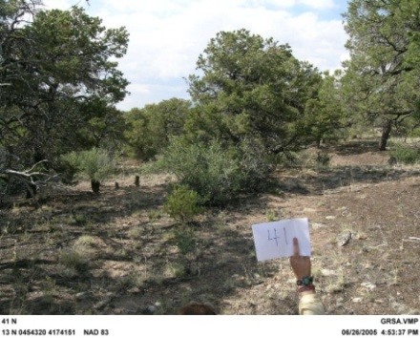
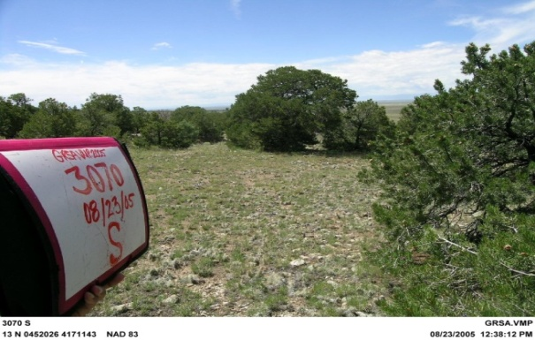
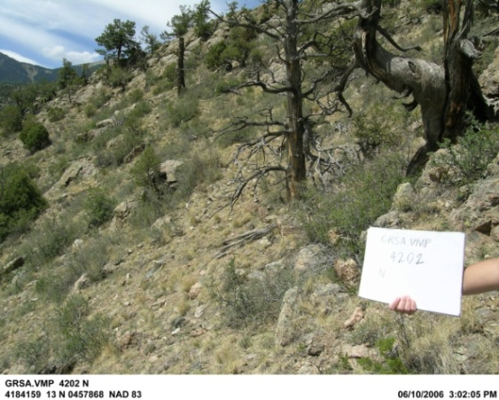

State and Transition Model Pinyon Juniper Woodland
Ecological System and component
Vegetative States
Class B (Mid Closed)
Class C (Mid Open)
Class A (herb/shrub/treed)
Class D (Late Open)
Succession
Disturbance
Class E (Late Closed)
Notes:
The CoNHP rating specifications for this system include:
Size: “B” 10,000 – 30,000 Acres
Condition:
A SPECS
Tree density is <30 per ha on favorable sites, and up to 200 trees per ha on rocky, less favorable sites (Young and Evans 1981). Herbaceous cover between trees is heavy enough to carry regular fires. This is less important on steep, rocky sites. Non-native annual grasses are absent or incidental. Native perennial increaser species may be present <5% of the area. Microbiotic crusts are intact. Natural microrelief is undisturbed. Soil erosion is not accelerated by anthropogenic activities. No surficial disturbance is evident, the stand has never been “chained” and re-seeded. Some disturbance may be evident in small, isolated areas (e.g. mines or ranch activities and buildings; minor off-road vehicle use--<1%). There are few or no roads found within the occurrence. Fire has occurred within the stand within the last 10 years for deep soil sites. Accelerated soil erosion had not occurred, or if in the past, the herbaceous cover has increased sufficiently to check this problem.
B SPECS
Tree density is <40 ha on favorable sites, but not more than 600 trees per ha on rocky, less favorable sites. Vegetation is dominated by native species. Herbaceous undergrowth is present but may be declining, and native perennial increasers may be present and even dominant in spots, but not throughout the occurrence. Non-natives annuals may be present in disturbed areas only, and are not found throughout the occurrences (e.g. Bromus tectorum). Microbiotic crusts are intact in at least 80% of the occurrence. No surficial disturbance is evident, the stand has never been “chained” and re-seeded. If some disturbance is evident it is limited to less than 20% of the occurrence area (e.g. mines or ranch activities and buildings; off-road vehicle use--<5%). There are no to only a few roads found within the occurrence. Fire has occurred within the stand within the last 20-50 years for deep soil sites. Soil erosion may be accelerated in small patches, or lightly so throughout the occurrence. Soil erosion can be easily reversed by relatively simple, straightforward, and inexpensive changes in management.
However, these definitions are scale dependent, and an area of >10,000 acres is likely to have a diversity of types. Indeed, it is desirable to have such diversity within the landscape. Thus, one important component of system condition is the distribution and abundance of seral states or patches within the landscape mosaic. This is often more important than some measure of “average” condition across the entire area.
This slide provides a graphic representation of a VDDT (Vegetation Dynamics Development Tool) model – which is a quantitative state and transition model – of the Pinyon-juniper woodlands as they occur on GSD.
These models enable us to accomplish several goals for assessing terrestrial ecosystems:
We can look at the diversity of system drivers to ascertain the key ecological drivers for this system
We can use expert knowledge and data from the literature to determine the disturbance frequency necessary to maintain the system in a desired state
We can use knowledge about climatic change, and associate changes in disturbance/recovery rates to predict the potential trajectory of this ecological system over the next 50 – 500 years.
We can identify the required extent of management needed to maintain these systems in a desired state. For example, what if the frequency and extent of prescribed fire needed to prevent the system for succeeding into an undesirable closed state?

Slide 70
Ecological Integrity Assessment
Condition
  biotic – assessment of reproduction/ health, maturity, composition and structure, ecological processes
  abiotic - physical/chemical processes, regimes, constraints, etc.
+ Landscape Context - assessment of spatial patterns of occurrence (fragmentation / connectivity) and supporting landscape
+ Size - quantitative assessment of patch size, reach length, area of occupancy, abundance, density, etc.

Slide 71
“Coarse Filter/Fine Filter” Approach
Ecological Systems
  recurring groups of communities
Focal Habitats
  Vulnerable assemblages
  Movement corridors
  Migratory stopovers
Focal Species
  imperiled, declining, endemic, vulnerable, “umbrella”
  (habitats and/or extant subpopulations)
Notes:
Elements of concern are hierarchical in nature and are grouped into species, communities, and ecological systems categories.
This encompasses what is commonly called the “coarse-filter/fine-filter approach.” Using this approach, spearheaded by The Nature Conservancy and NatureServe back in the 1970s, all characteristic ecological systems, then a subset of rare and vulnerable communities and species are used to represent the environmental variation and ecological processes that support all biological diversity.
The “coarse-filter” is provided by representing characteristic ecological system types (e.g., different forest, shrubland, grassland, wetland, and riverine systems). The “fine-filter” encompasses rare communities and species at risk that require special consideration to ensure that the ecological processes supporting them are considered in planning.
Our focus is on standard ecological classification and its application to conservation.

Slide 72
“Fine Filter” Elements – Stated Criteria
Selected species of clear conservation interest
Species listed under legislation
Natural Heritage S1-S3 proportionally concentrated within the ecoregion

Slide 73



NatureServe
Factors and Categories of Conservation Status
Number of Occurrences/Area
Number of Occurrences/Area
w/Good Quality
Range Extent
Area of Occupancy
Long-term Trend
Short-term Trend
Threats (Severity, Scope, and Immediacy)
Apply to portion of range; e.g., N = Nation S=Subnation
N/S1 Critically Imperiled
N/S2 Imperiled
N/S3 Vulnerable
N/S4 Apparently Secure
N/S5 Demonstrably Secure
G1 Critically Imperiled
G2 Imperiled
G3 Vulnerable
G4 Apparently Secure
G5 Demonstrably Secure
Notes:
NatureServe has done rule based assessments for both species and ecological ‘elements’ of biodiversity to arrive at a ‘conservation status’ rank; with criteria applicable not only to global perspectives, but also for any subset of the range.

Slide 74
(39,000 species assessed)
Notes:
This chart shows the percent of species across 18 plant and animal groups that are at risk of extinction, with the different colors indicating different levels of risk. An examination of this chart reveals that invertebrates inhabiting freshwaters are particularly at risk, with up to 70% of the species in one group, freshwater mussels, either already recently extinct or at risk of extinction. I haven’t listed cave obligates here as they are an ecological rather than a taxonomic group, but if listed here they would top the charts with 90-95% of taxa at risk of extinction. On the other hand, groups that are the subject of much popular public and media attention, such as birds and mammals, are proportionately and numerically much less at risk.

Slide 75


Slide 76
Given Stated Criteria
(3)Selected species of clear conservation interest (Desert Tortoise, Desert Bighorn, Mohave Ground Squirrel)
(75)Species listed under Fed/State legislation
(120) addt’l Natural Heritage S1-S3 proportionally concentrated within the ecoregion

Slide 77
“Fine Filter” Elements
Species that are likely to be adequately represented through major ecological systems of the ecoregion (e.g., species strictly tied to desert springs);
Species that might be addressed as ecologically-based assemblages (e.g., bat roosts, migratory bird stopover sites, etc.);
Species best addressed as individuals; but in subsequent planning process
Species best addressed as individuals in the REA.

Slide 78
Proposed Criteria
Full species or Subspecies listed under Federal or State protective legislation
Full species with NatureServe Global Conservation Status rank of G1-G3
Full species listed by State Wildlife Action Plans with habitat included within the ecoregion
Full species scoring as Vulnerable within the ecoregion according to the NatureServe Climate Change Vulnerability Index.

Slide 79

Direct Climate Exposure
Indirect Climate Exposure
∆ Temp
Sea Level Rise
Subscore
Topo Barriers
Subscore
Climate Stress
Anthro Barriers
Subscore
Mitigation Impacts
Subscore
∆ Precip
Sensitivity
Dispersal
Subscore
Temp Regime
Subscore
Hydro Regime
Subscore
Disturb Regime
Subscore
Ice/Snow
Subscore
Habitat Specificity
Subscore
Interspecific Inter.
a, b, c, d, e
Subscores
Migrations
Subscore
Genetic Factors - a, b
Subscores
Phenology
Subscore
Σ = Overall Score

Slide 80
Index Scores “…by 2050”
 | Extremely Vulnerable
 | Highly Vulnerable
 | Moderately Vulnerable
≈ | Not Vulnerable/Presumed Stable
 | Not Vulnerable/Increase Likely
? | Insufficient Evidence

Slide 81
Proposed Criteria
Full species or Subspecies listed under Federal or State protective legislation
Full species with NatureServe Global Conservation Status rank of G1-G3
Full species listed by State Wildlife Action Plans with habitat included within the ecoregion
Full species scoring as Vulnerable within the ecoregion according to the NatureServe Climate Change Vulnerability Index.

Slide 82
“Fine Filter” Elements
Species that are likely to be adequately represented through major ecological systems of the ecoregion (e.g., species strictly tied to desert springs);
Species that might be addressed as ecologically-based assemblages (e.g., bat roosts, migratory bird stopover sites, etc.);
Species best addressed as individuals; but in subsequent planning process
Species best addressed as individuals in the REA.

Slide 83


Desired Conservation Elements
  Additional resource values of interest to stakeholders
  Feasible treatment in rapid process

Slide 84
Management Questions
Mojave Basin and Range

Slide 85
Management Questions by Group
Box 1. Groups of preliminary Management Questions provided by BLM (the number of preliminary Questions in each group).
Species (9)
Wild Horses and Burros (5)
Native Plant Communities (2)
Terrestrial Sites of High Biodiversity (2)
Soils (2)
Surface and Subsurface Water Availability (6)
Aquatic Sites of High Biodiversity (2)
Aquatic Ecological Function and Structure (2)
Specially Designated Areas (1)
Fire History (3)
Fire Potential (1)
Invasive Species (4)
Urban and Roads Development (4)
Oil, Gas, and Mining Development (6)
Renewable Energy Development (4)
Groundwater Extraction and Transportation (5)
Climate Change: Terrestrial Resource Issues (5)
Climate Change: Aquatic Resource Issues (5)
Military Constrained Areas (2)
Box 2. Groups of Management Questions resulting from the recommended amendments, followed by the number of questions (1st parenthesis), and the change in number from preliminary list (2nd parenthesis). * denotes a suggested change to the group name.
Species (10) (+1)
Wild Horses and Burros (0)(-5)
Native Plant Communities (3)(+1)
*Terrestrial Sites of High Biodiversity Value* (3)(+1)
Soils (3)(+1)
Surface and Subsurface Water Availability (6)(-)
*Aquatic Sites of High Biodiversity Value * (2)(-)
Aquatic Ecological Function and Structure (3)(+1)
Specially Designated Areas (1)(-)
Fire History (2)(-)
Fire Potential (1)(-)
Invasive Species (4)(-)
Urban and Roads Development (4)(-)
Oil, Gas, and Mining Development (6)(-)
Renewable Energy Development (4)(-)
Groundwater Extraction and Transportation (5)(-)
Surface Water Consumption and Diversion (5)(+5)
Climate Change: Terrestrial Resource Issues (5)(-)
Climate Change: Aquatic Resource Issues (4)(-1)
Military Constrained Areas (2)(-)
Change Agents with no Questions (0)(-)

Slide 86
Common issues in MQs
Working definitions of “significant effect”
“sustainable”
“restoration”
Time frame of such effects

Slide 87
Common phrasings of MQs
Where are current species populations (in the element list) potentially affected by change agents?
What areas are significantly ecologically affected by invasive species?
Which current MHA will experience significant effects of Change Agents?

Slide 88
Common phrasings of MQs
Where are current species populations (in the element list) potentially affected by change agents?
What areas are significantly ecologically affected by invasive species?
Which current MHA will experience significant effects of Change Agents?
• What qualifies as “significant” in an effect by a CA? Will depend on the Element and specific CA.
• Thresholds would be nice, but don’t exist in most Mgt contexts (but should), and aren’t generally compatible with the relatively coarse level of some of the analysis.
• Time scales of projecting future effects.

Slide 89
Candidate Change Agents
Review of results & discussion

Slide 90
Change Agent Introduction
Activities, features, phenomena that affect the viability of CEs (condition, size, distribution, landscape context)

Slide 91
Change Agent Review Process
Review will be ongoing as is highly iterative with MQs and CEs—CA’s irrelevant unless tightly coupled to them
Created table with review characteristics
Consulted a large variety of existing studies inside and outside the ecoregion
Held discussions with a few select experts in the region (heritage and TNC scientists)

Slide 92
CA Recommendation Process
Identified any potential additional CAs
Evaluated whether CAs are currently affecting the ecoregion, expected to in the future or both (this step needs further filtering in Task 2 data evaluation)
Characterized the general ecological effects of each CA
Identified potential CEs that would be affected
Characterize some potential CE impacts

Slide 93

Examples from CA Classes

Slide 94

Class I Wildland Fire
Increased fire frequency
  Invasion by exotic annual grass species such as Bromus spp. and Schismus spp. results in increased fuel load and continuity may result in native species mortality due to increased fire duration and intensity.
  Secondary effects include compromised small mammal and lizard habitat and food sources.
Decrease fire frequency
  Invasion of Pinyon and Juniper
  Loss of grass cover

Slide 95

Class II Development
Broad set of agents from a variety of human use sectors
Urbanization (habitat destruction and fragmentation, non-native species invasion)
  Urban commercial/industrial
  Urban residential (>1 per 2 acres)
  Exurban residential (1 per 2 to 40 acres)
Las Vegas, 1973 - 2000

Slide 96



Transportation and rights-of-way (removal of vegetation, habitat destruction of habitat, animal mortality, spread of invasive species, increased predation)
  Roads
  Transmission corridors (energy, water, gas)

Slide 97



Agriculture
  Grazing by domestic and feral herbivores (removal and trampling of native vegetation, soil erosion, spread of invasive plants)

Slide 98

Resource extraction (removal of vegetation, habitat destruction, fragmentation, source of erosion, dust & contaminated runoff)
  Mining, sand & gravel quarrying

Slide 99



Renewable energy (removal of vegetation, habitat destruction, fragmentation)
  Wind (avian mortality*)
  Solar (avian mortality*)
  Geothermal
  * Debated in the literature- siting and technology used are important factors

Slide 100


Water: Hydrologic Alterations
Groundwater withdrawals
Reduce extent of perennial stream flows (gaining stream reaches),
Increase extent of dry streambeds (losing stream reaches),
Lower water levels and alter hydrologic regime of springs and seeps;
Alter alluvial soil moisture regimes in riparian zones
Altered surface flow
Water diversions and flow manipulation cause diverse ecological consequences to key components of the flow regime:
  Magnitude,
  Frequency,
  Flood and drawdown timing,
  Flow duration
Surface flow connectivity
Barriers to movement of aquatic fauna & plant propagules reduce recolonization following disturbance
prevent aquatic animals from completing life-cycle changes

Slide 101

Military Constrained areas
  Military use areas- training activities cause soil erosion and compaction, disturb vegetation
  Conflict-of-use areas- military use is present off-base: aircraft noise and military “casual use” can cause conflicts on BLM lands
  Areas of moratoria on land-use planning- DOD has objected to wind turbines near bases, citing interference with radar, flight patterns

Slide 102
Military Constrained areas
  Potential military expansion areas- base expansion at Ft. Irwin has impacted T&E species, expansion at 29 Palms is planned
  Military use & DOE constrained areas- information and LU decisions are constrained which frustrates regional conservation planning
  Main base activity/mission activity- base activity has similar impacts to urban development; sources of dangerous contaminants

Slide 103
Air quality
  Fugitive dust – dust impacts physiology of Mojave desert shrubs, contributes to larger air quality problems
  Air pollution – pollution from Central Valley and LA Basin degrades air quality in Mojave, loss of visibility, negative effects on plant life

Slide 104

Recreation
  OHV – Habitat loss, displacement of species, Increase soil erosion, loss of roadless wilderness, noise pollution
  “Quiet ” (Hiking, Horseback riding, Bird watching)
  Displacement of carnivores and other species

Slide 105

Refuse management
  degradation of ground water, production of methane and VOCs toxic to plants and animals, increased road traffic, and dust and windblown litter

Slide 106






Class III Invasive Species
Terrestrial Invasives: competition with and displacement of native plants; alterations in soil ecology; alterations in species composition & richness; increased fuel continuity, fire frequency, and fire intensity

Slide 107



Class III Invasive Species
Aquatic Invasives: Competition with natives species, disrupts primary and secondary production, alters food webs and water chemistry, indirect effects, trophic cascades

Slide 108

Class IV Climate Change mid-century: Temperature
Ann ave. 4-5 degrees F increase
Summer ave 4.2-5.8 degrees F increase
Winter ave 3.3-4.2 degrees F increase
Ecological effects:
range shifts among plants, animals, and other living things
decline in number
local extirpations
range-wide extinctions.

Slide 109

Class IV Climate Change: Precipitation
Ann ave decrease -8% to 0%
Both summer & winter ave expected to increase
Largest change expected in the spring with 12.5% to 29.2% declines
Precipitation changes are highly variable but is expected to become drier due to increased evaporation and loss of snowpack
Ecological effects
Longer and more severe drought
Poss increase in seasonal flooding
Vegetation is in decline due to climate-related increases in fire and long-term drought (BLM 2007)
insect infestations in pine and mixed- conifer forests have led to broad scale vegetation conversions (BLM 2004)

Slide 110
Change Agents
Table Review
Discussion of key findings & issues

Slide 111
Change Agent Summary
Key changes/additions:
Candidate CAs provided by AMT highly relevant, recommend inclusion of all for further assessment for data availability and quality.
AMT evaluate and further define military constrained areas.
Add:
  Grazing
  Alterations to surface water hydrology
  grazing has important synergistic effects with other CAs and would (if feasible) inform the current status and condition of CEs.
  Atmospheric deposition to Air and Water Quality
The original invasive species list was edited to reflect those having the greatest impact to the Mojave Basin and Range.

Slide 112
Change Agent Summary
Key changes/additions:
The following species were added to the AMT provided list: For MB We documented these additional specific TES:
  Cheatgrass (Bromus tectorum)
  Filaree (Erodium cicutarium)
  Russian thistle (Salsola iberica)
  Split grass (Schismus spp.)
The following terrestrial species were recommended for removal:
  Mustards
  Palm trees
  Spotted knapweed
  Tall whitetop
  Pennisetum sp
And more specific Aquatic invasives:
  Didymosphenia gemenata (Didymo, rock snot)
  Apple snails (Pomacea sp.)
  European Ear Snail (Radix auricularia)
  Red-rim melania (Melanoides tuberculatus)
  New Zealand mudsnail (Potamopyrus antipodarum)
  Chinese mystery snail (Cipangopaludina chinensis malleata)
  African clawed frog (Xenopus laevis )
  Crayfish sp.
  Mollies and guppies (Poecilia sp.)
  Tilapia (Oreochromis sp)
  Gizzard shad
  Asian or European carp (Family Cyprinidae)

Slide 113
Wrap Up
Parking Lot Items
Next Steps
  NatureServe issues workshop summary
  AMT reviews/responds to summary
  Memorandum 1a finalized
  Begin Task 2 data evaluation
AMT Thoughts: what’s your take-away message for the Contractor
Schedule & Next AMT Workshop (dates, who needs to be at the next)

Slide 114

Mojave Basin and Range

