Slide 1

Integration of Source Features and EOs
(via Field Maps)
with the Observations Survey (in Survey123)
Whitney Weber

Slide 2

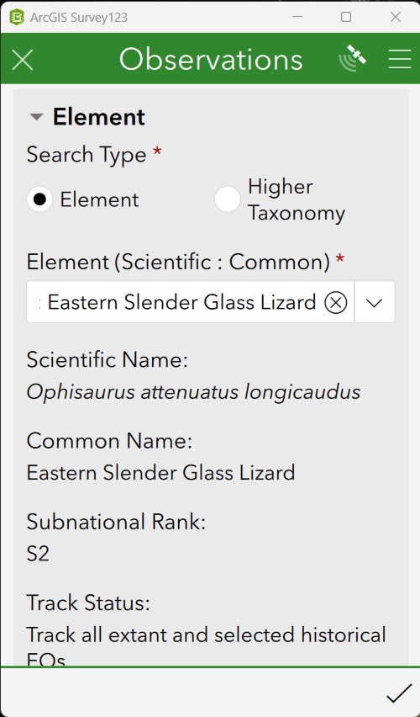

Scenario
Collecting Observations in the field via Survey123 and wondering if there are any existing Source Features & EOs (& Managed Areas & Conservation Sites) in the vicinity

Slide 3




Pros & Cons of Survey123 & Field Maps
Quest
See nearby Source Features and EOs when collecting Observations in the field via the Observations survey in Survey123
Challenge
Functionality | Survey123 | Field Maps
Complexity of data & logic
Interactive map
Submission by anonymous user
Solution
&

Slide 4
Including Source Features & EOs in a web map
Quest
See nearby Source Features and EOs when collecting Observations in the field via the Observations survey in Survey123
Challenge
Source Features & EOs are not available for offline viewing, which is needed in the field
Solution
Publish nightly Biotics backups as Feature Layer with offline viewing enabled, on a daily basis
How
Automate download of backups and publish/update as Feature Layer via daily scheduled task so that data does not become (too) stale

Slide 5
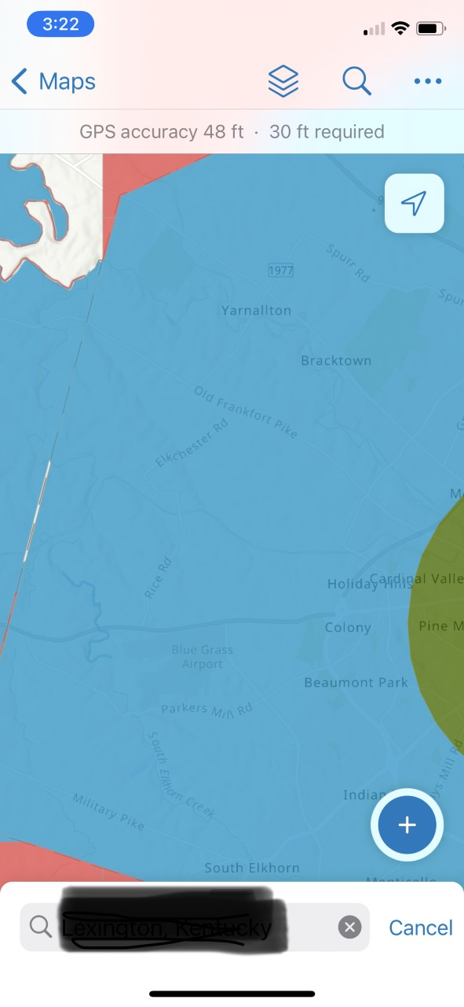
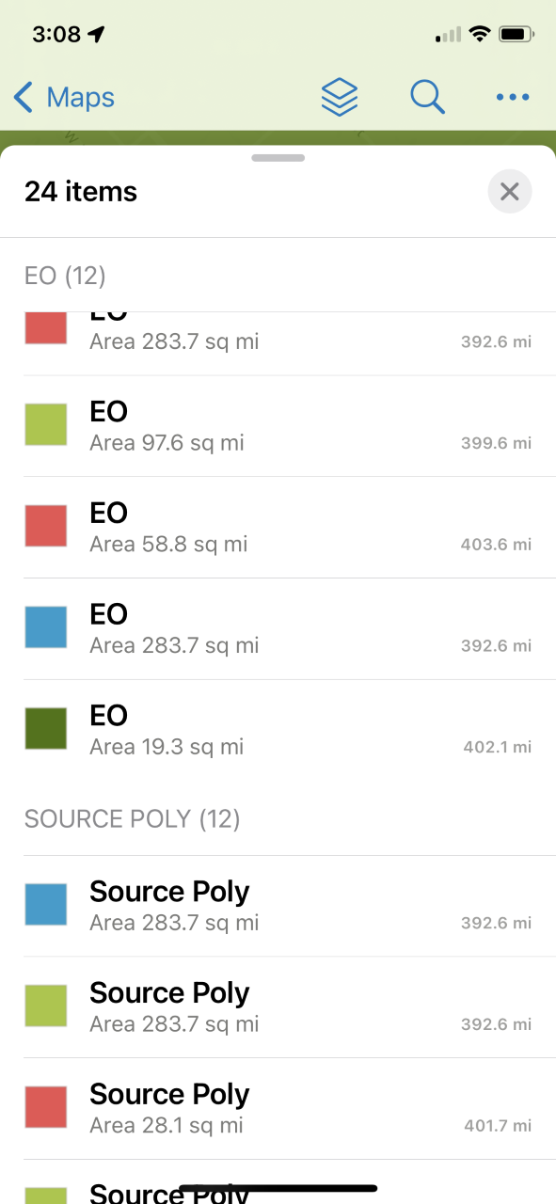
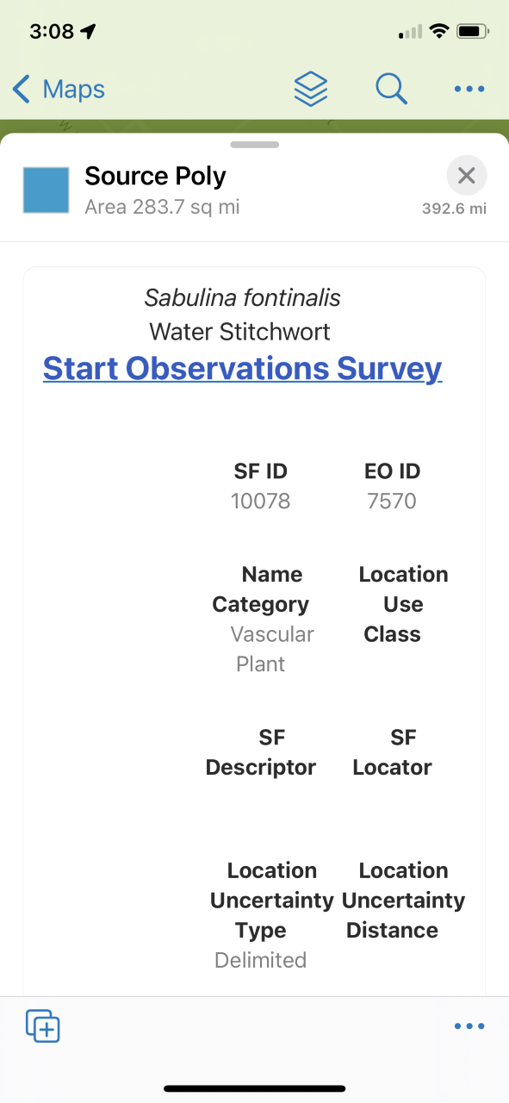
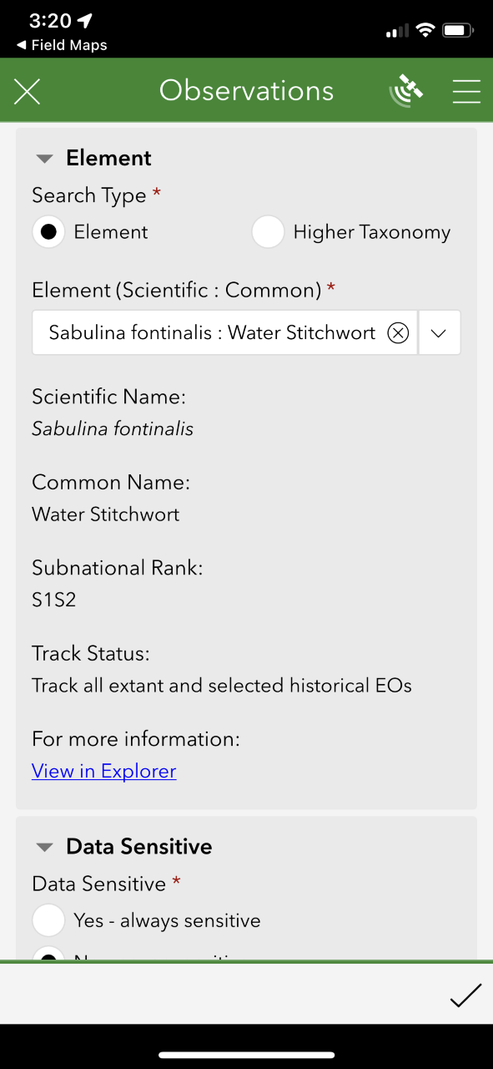
The Result
Click the link to create a new Observation in Survey123
Specific questions in the survey are auto-populated from Field Maps
In Field Maps, click the map to identify SFs & EOs
Select a SF or EO to view its details
Notes:
This webinar is going to be a demonstration of how to accomplish this and will be rather technical.
So for those of you just looking for the big picture, this is the end product.

Slide 6
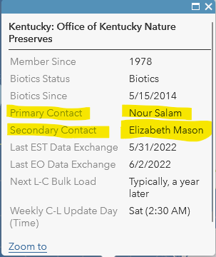



Requirements
Biotics 5 Status & Data Exchange Map
ArcGIS Pro
ArcGIS Online (AGOL) Organizational account with Creator “User type”
Access to nightly Biotics 5 backups (via Kiteworks)
Download attachment to solution

Slide 7
How are we going to do it?
Automate downloading of nightly Biotics backups
Publish/update as feature layer in ArcGIS Online (AGOL)
Create a scheduled task to automate process and run daily
Edit ConfigurePopUpAttributeExpressions.txt to reflect Observations survey ID
Create a web map displaying Biotics layers & Observations
Enable the Web Map for offline use
Use Field Maps to view Source Features, EOs, Observations and link to Observations survey in Survey123

Slide 8
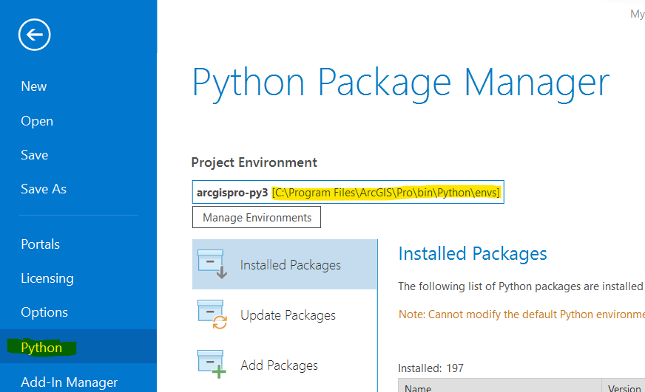
Get Started
Setup automation of downloads of nightly Biotics backups according to this solution.
In ArcGIS Pro, from the Project tab, select Python.
Copy the path to the arcgispro-py3.
Email biotics@natureserve.org requesting ability to automate nightly Biotics Backups; provide:
    path to Kiteworks folder from Step 1
    path to the arcgispro-py3 from Step 2

Slide 9
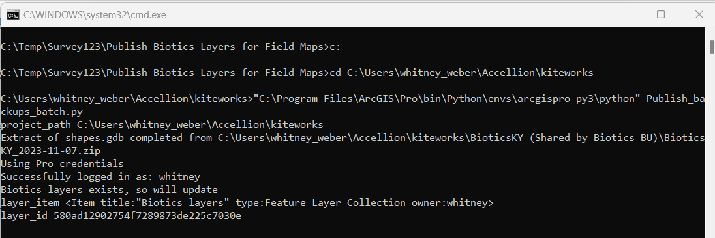
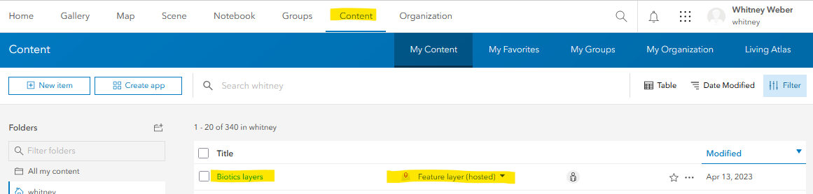
Publish the Biotics layers from Backup
Save the two files provided by NatureServe (Publish_backups_batch.py & Publish_Biotics_Backups.bat) to C:\Temp.
Test that the batch file works by double clicking Publish_Biotics_Backups.bat.
Log into ArcGIS Online and verify that the
Biotics layers hosted feature layer was created.

Slide 10
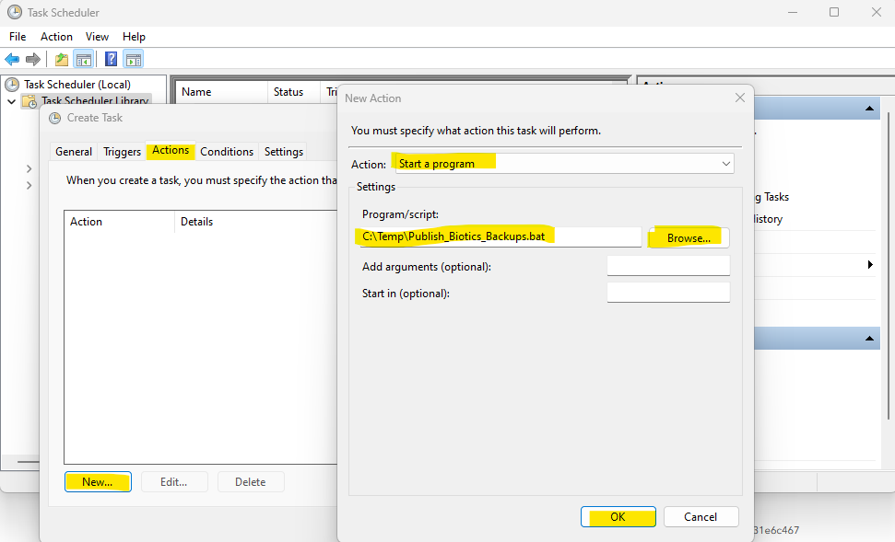
Create a Scheduled Task
Automatically, runs script, daily, to update the Biotics layers feature service within AGOL so that data is not stale
Within Task Scheduler, Create Task.
Within Create Task, on the General tab, name the task (ie. Download and Publish Biotics spatial layers).
From the Triggers tab, select New.
Within New Trigger, indicate to run the task Daily (or as often as preferred) and select the time the task should be run. NOTE: The computer has to be on to run the task, so make sure you indicate the time accordingly. Click OK.
From the Actions tab, click New.
Within New Action, Start a program and navigate to the Publish_Biotics_Backups.bat script. Click OK.
From the Conditions tab, indicate to Wake the computer to run this task.
Click OK to save the scheduled task.

Slide 11
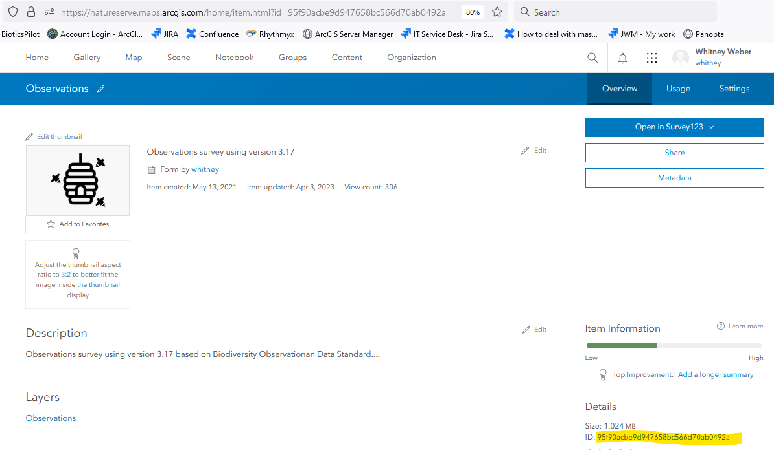
Edit ConfigurePopUpAttributeExpressions.txt to reflect Observations survey
In ArcGIS Online, navigate to the Survey-Observations folder.
Click on the Observations link, related to the Form
Copy the forms ID from the Details page.
Open the ConfigurePopUpAttributeExpressions.txt file and replace (CTRL-H) 95f90acbe9d947658bc566d70ab0492a with the ID of the Observations Form, copied in the previous step.

Slide 12
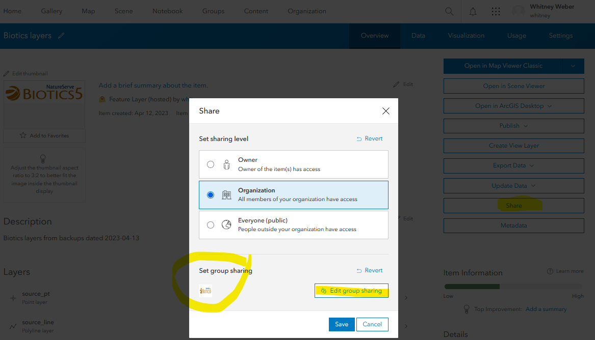
Configure the Biotics layers
In ArcGIS Online, go to My Content and click on Biotics layers.
Within the Biotics layers detail page, Share the Feature Layer to the appropriate users
Within Visualization, configure symbology, fields, etc.
Open in Map Viewer

Slide 13
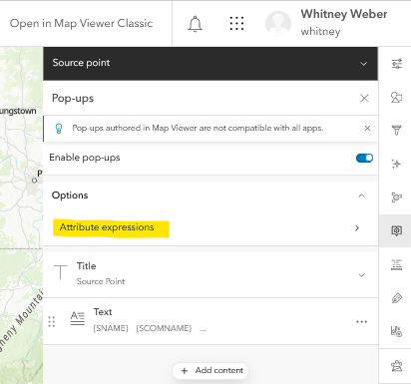
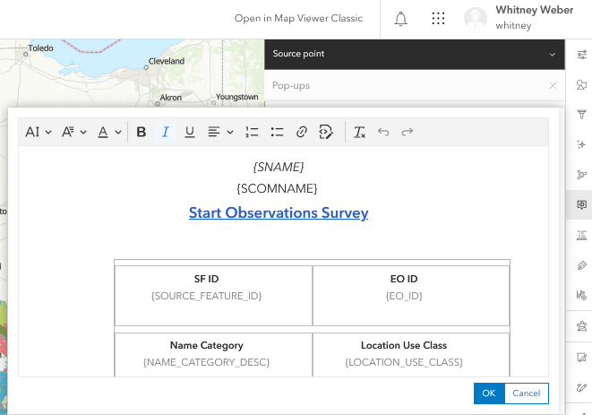
Configure the Web Map
Add the Observations feature layer.
Rename Source pt
Configure Pop-up for SFs
  Attribute expression: ConfigurePopUpAttributeExpressions.txt
  Add content: text
  ConfigurePopUpText_SFs.txt
Repeat for EOs:
ConfigurePopUpText_EOs.txt
Repeat for Observations:
ConfigurePopUpText_Observation.txt

Slide 14
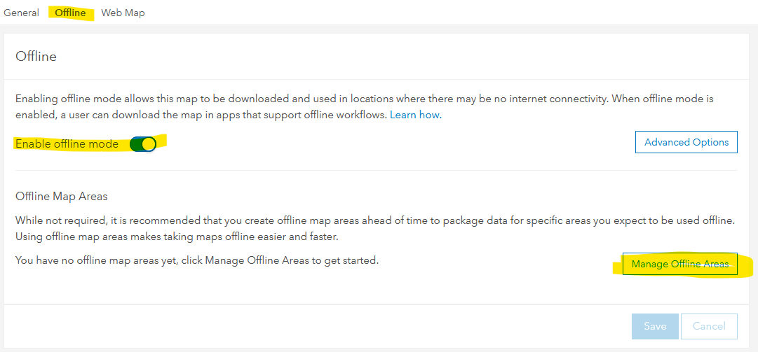
Enable the Web Map for Offline use
From the Map Properties icon, select Item Details
Within the Item Details, go to the Settings.
Within Settings, choose Offline and verify that Enable offline mode is indicated
Manage Offline Areas to create specific areas of the offline map to make download and use easier and quicker. (see image above)
Create up to 16 Map Areas, as needed.
Share the Web Map to the appropriate audience

Slide 15
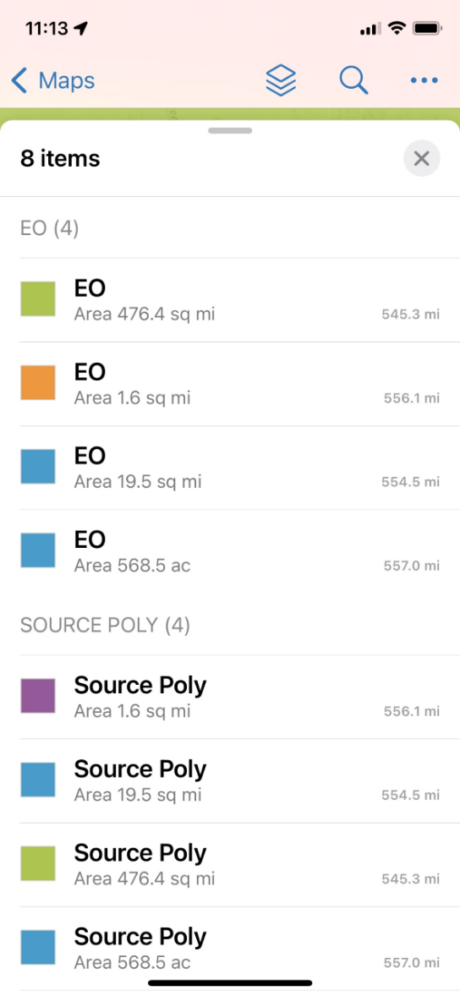
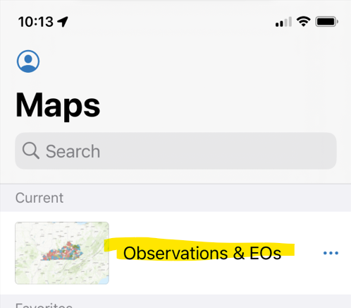
Use Field Maps to view SFs, EOs & Observations
Open
Open Field Maps.
Select
Select the Observations & EOs map
Identify
Click on the Map to Identify a feature
Select
Select the feature for more information
Link
Click the link within the Details dialog to start the Observations survey from the selected feature.
Notes:
The pertinent data will be auto-populated within the survey record, as listed below.

Slide 16
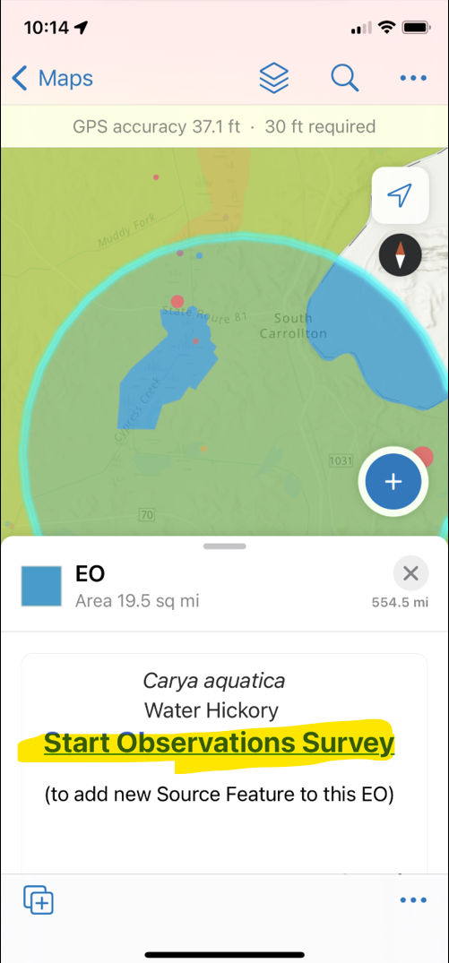
What will the links do?
Observation: links to the specific Observation record in the Observations survey for viewing
Source Feature: link creates a new Observation in the Observations survey, to be added as a Visit to that specific Source Feature record. Static data which is automatically populated within the survey includes:
  Element (element subnational id, scientific name, common name, track status, element type, S rank
  Source feature (source feature id, descriptor, location use class)
  EO ID
Element Occurrence: link creates a new Observation in the Observations survey, to be created as a new Source Feature record for that EO. Static data which is automatically populated within the survey includes:
  Element (element subnational id, scientific name, common name, track status, element type, S rank)
  EO ID

Slide 17
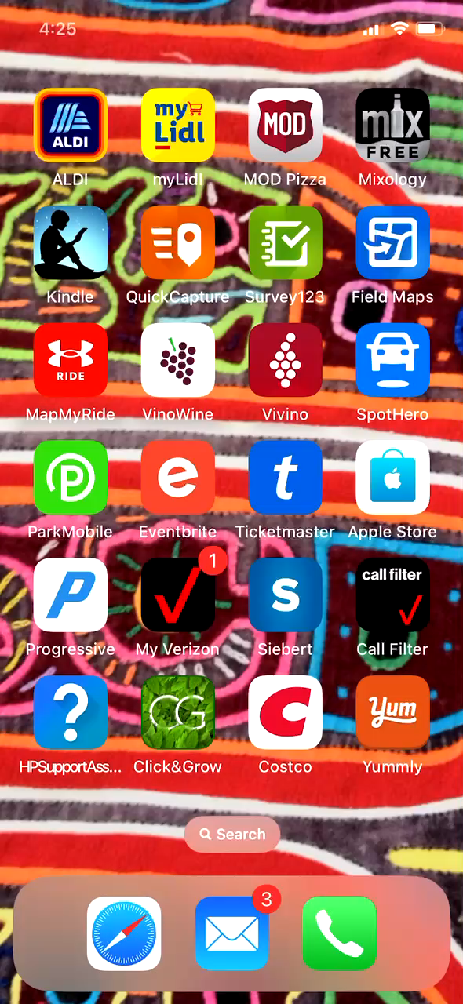

Slide 18



Acknowledgments
NatureServe IT Team for allowing and providing access and code for downloading nightly Biotics backups
Nour Salam, Office of Kentucky Nature Preserves, for providing example code and troubleshooting together!
Various Network members who have requested this functionality.

Slide 19
Resources
Integration of Source Features and EOs (via Field Maps) with the Observations Survey (in Survey123)
What's involved: NatureServe cloning data from NS AGOL to member AGOL
Create spatial View containing only Observations with QC Status = ‘Passed’
Offline Basemaps
  Create Offline Basemaps for use with Observations survey (Survey123)
  Use offline basemaps
Collect Data via Survey123
Using the Observations Dashboards
Toolboxes:
  Observations toolbox for use with Biotics (within zip file)
  Observations toolbox for Non-Biotics use for downloading survey data
The Observations Feature Layer, explained
Update the dropdown lists within the Observations survey
Survey Permissions - who can collect data, view data, and update the survey

Slide 20
Q & A

