Slide 1
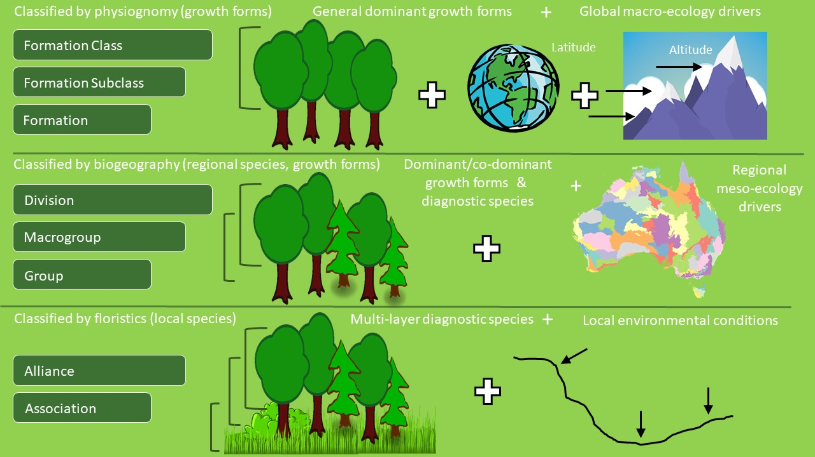
ECOLOGY - and the Network
EXISTING VEGETATION / NATURAL COMMUNITIES
International Vegetation Classification
  USNVC
  CNVC
  Latin America, Europe, Africa, Australia, IUCN: IVC partnerships
  KBAs (Key Biodiversity Areas) guidance
  Transitioning away from maintaining Ecological Systems classification
POTENTIAL VEGETATION
Ecological Systems
    Modeling potential distribution of existing vegetation
    climate change
    successional dynamics
  Ecological Site Groups / BLM, NRCS
  Biophysical Settings / LANDFIRE
Ecological Classifications
Network focus

Slide 2
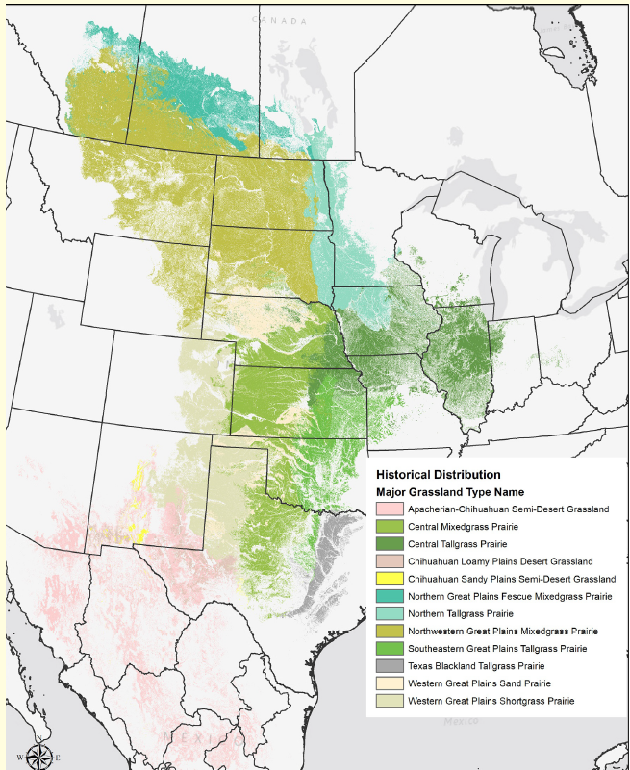
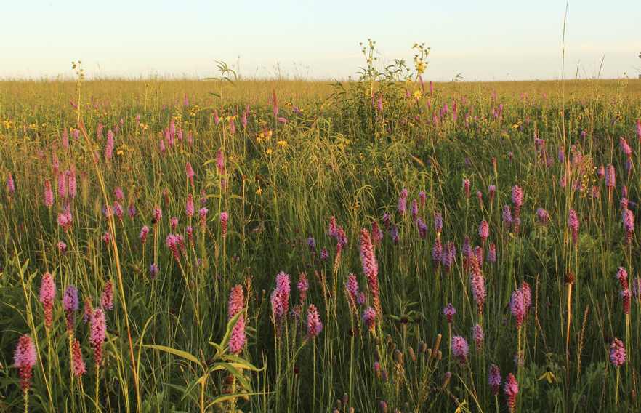
Hierarchy: Natural Vegetation
Hierarchy Levels | Example
Upper
Level 1 – Formation Class | Shrub & Herb Vegetation
Level 2 – Formation Subclass | Temperate & Boreal Shrubland & Grassland
Level 3 - Formation | Temperate Grassland & Shrubland
Mid
Level 4 – Division | Central North American Grassland & Shrubland
Level 5 – Macrogroup | Central Lowlands Tallgrass Prairie
Level 6 – Group | Central Tallgrass Prairie
Lower
Level 7 – Alliance | Big Bluestem – Indian grass Mesic Prairie
Level 8 – Association | Big Bluestem – Blazing Star Mesic Loam Prairie
Central Tallgrass Prairie
Increasing resolution
*Faber-Langendoen, D., T. Keeler-Wolf, D. Meidinger, D. Tart, C. Josse, G. Navarro, B. Hoagland, S. Ponomarenko, J-P. Saucier, A. Weakley, and P. Comer. 2014. Eco-Veg: a new approach to Vegetation Description and Classification. Ecological Monographs 84(4):533-561.
Notes:
Updated vegetation classification hierarchy (FGDC 2008, Faber-Langendoen et al. 2014)

Slide 3
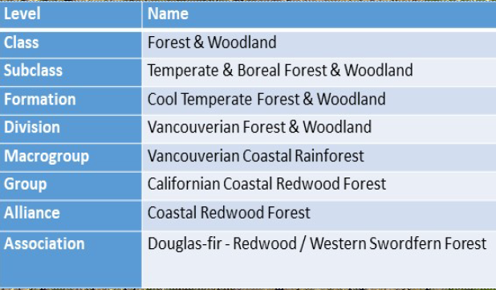
NatureServe’s
Ecosystem Elements
Major Ecosystems
Regional Ecosystems
Subregional Ecosystems
Local Ecosystems
Natural Communities

Slide 4
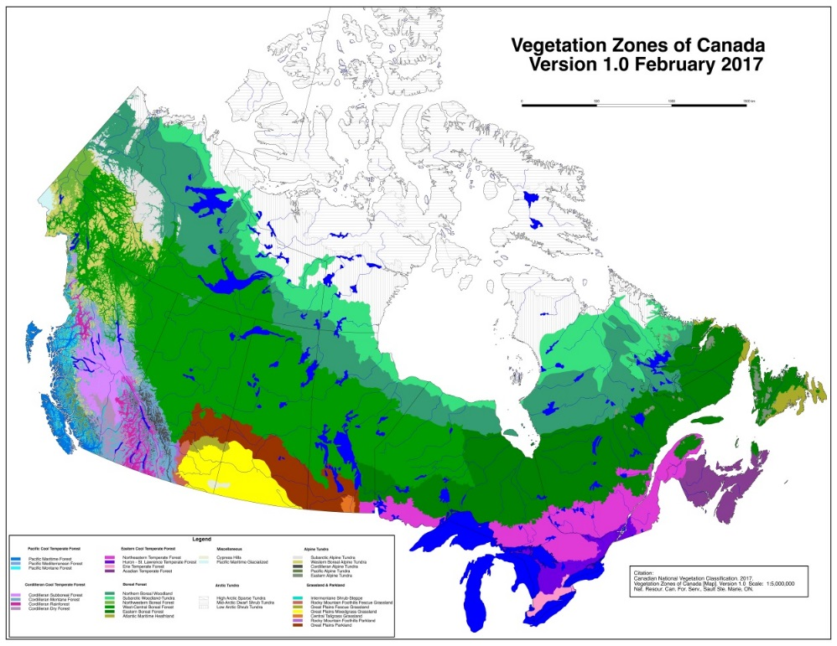
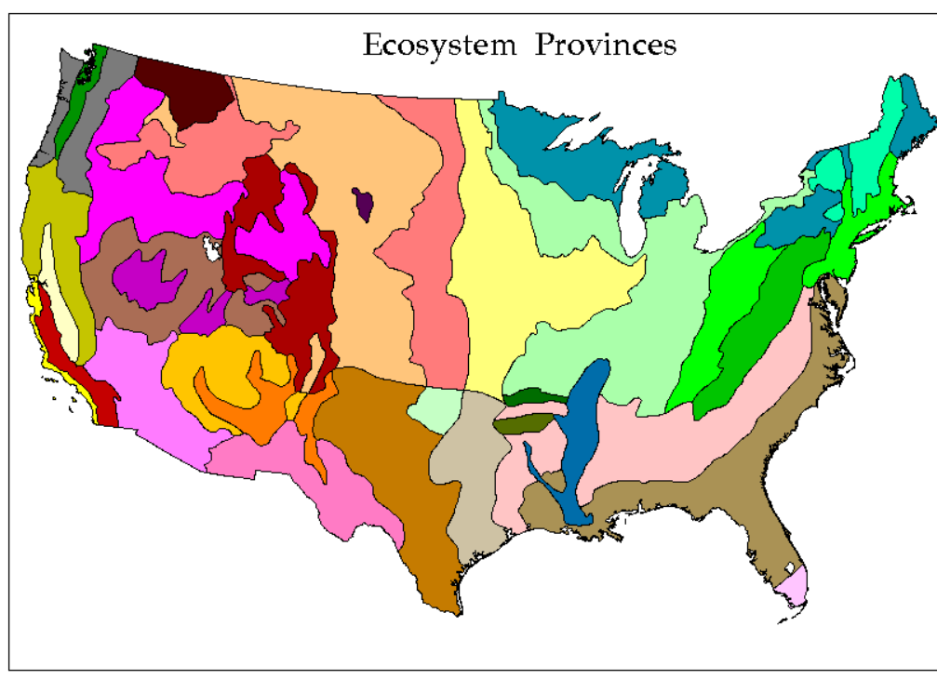
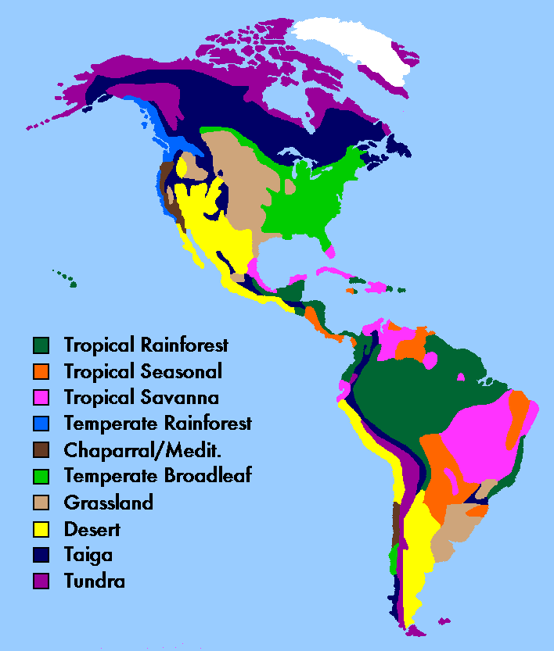


Inter/National Partnerships based on the EcoVeg Approach
CANADIAN / U.S. NATIONAL VEGETATION CLASSIFICATIONS
National classifications for all the natural and semi-natural vegetation in Canada and U.S.
INTERNATIONAL VEGETATION CLASSIFICATION
A classification of global vegetation. Best developed in the Americas
Notes:
The USNVC uses range-wide concepts for all types, nesting within a larger International Vegetation Classification, providing both a national and global perspectiveA great need to systematically inventory, classify, and map the incredible diversity of ecosystems on Earth in the face of ever intensifying land uses and changing landscapes. The implications for biodiversity, ecological processes, and ecosystem services are profound, as historic natural systems are degraded, or replaced by novel ecosystems.

Slide 5
Building the Next Generation of the USNVC
A. The 5-year alliance review plan (2019-2023)
B. State, federal, and academic partnerships
C. Peer review tools and the USNVC Review Board
E. Looking ahead: “The 2023 Edition of the USNVC”
D. The Plan 2023
Federal Geographic Data Committee
Federal agencies
Ecological Society of America
NatureServe and Network

Slide 6
A. The Five-year Alliance Review Plan: Why?
Placement of associations within alliances and groups needs additional QAQC.[ partly a legacy of moving from USNVC v1 to v2.]
Many US associations remain undescribed (~ 15%); placement uncertain;
Associations not fully developed (AK, much of Canada, Mexico)
Not all alliances are currently well-defined; or their concept is too strongly dominance based; i.e., not sufficiently floristic- ecological.
Build on and integrate ecological systems / natural communities
Better alliance (& refined group) concepts will help us build plot datasets; as they can guide plot compilations and analyses.

Slide 7
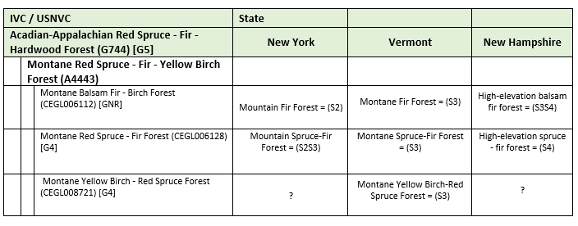
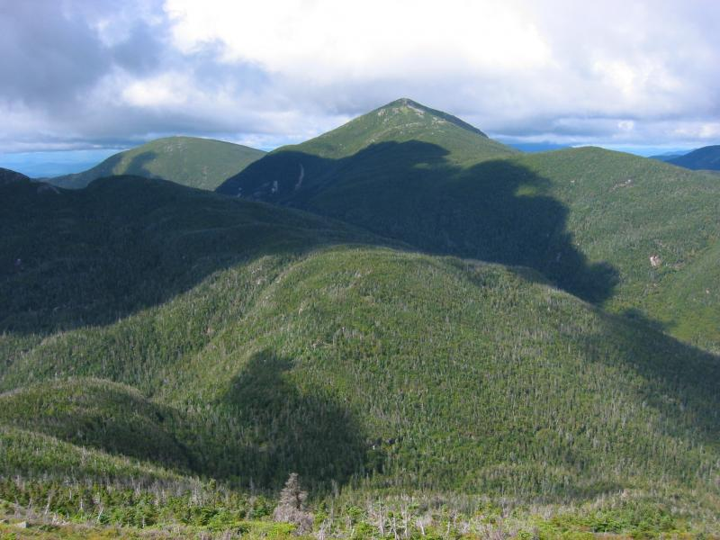
Alliance concept (Mueller-Dombois and Ellenberg (1974)
vegetation units that recur in similar form in many areas
structurally, physiognomically, ecologically distinct
well separated floristically; many characteristic spp.
A classification unit containing one or more associations, and defined by a characteristic range of species composition, habitat conditions, physiognomy, and diagnostic species, typically at least one of which is found in the uppermost or dominant stratum of the vegetation. (FGDC 2008, Jennings et al. 2009)
Habitat conditions: Alliances reflect regional to subregional climate, substrates, hydrology, moisture/nutrient factors, and disturbance regimes (Faber-Langendoen et al. 2014)
Group
Alliance
Association
Association
Association
Acadian-Appalachian Montane Spruce-Fir Forest (CES201.566) [G5]

Slide 8
A. Five-year Alliance Review Plan:
Goals:
To conduct a comprehensive expert review to ensure that alliances are as rigorous and conceptually consistent as possible with available information.
To enhance current types to ensure that they provide:
- ecologically and floristically meaningful units
- effective guides for resource management & conservation applications
Pursue this plan in parallel with compiling (and analyzing) plot data.
Enhance state use of USNVC – ongoing partnerships

Slide 9
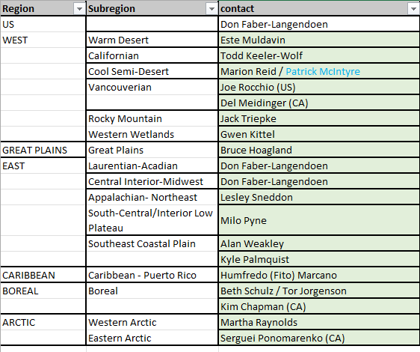
A. USNVC PEER REVIEW BOARD
Regional Editors
Associate Editors
USNVC Peer Reviewers

Slide 10

A. Five-year Alliance Review Plan:
Timeline - 2019-2023
Start Up
2016. First official version USNVC 2.0
“How do we do this peer review stuff anyways” phase/ NVC Review Board
2017-2018 Ramp up year(s): (Alaska)
Five-year Plan
First year: 2019
Second year: 2020
Third year: 2021
Fourth year: 2022
Fifth year: 2023

Slide 11
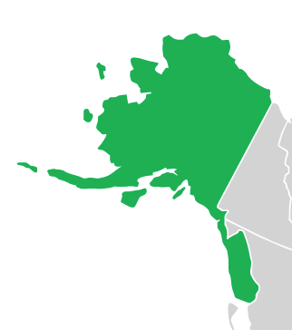
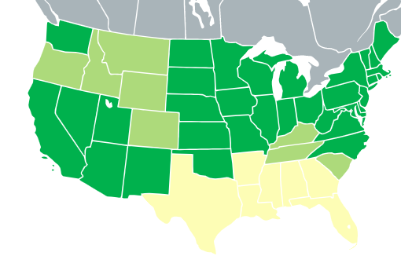
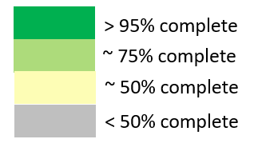
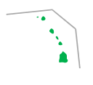
Five-year Alliance Review 2019-2023: January 2023
1
> 95% complete
~ 75% complete
~ 50% complete
3
2
< 50% complete
Review process
Improving USNVC alliance concepts
Improving state list of associations, alliances, and groups
Improving USNVC types with state information
4

Slide 12
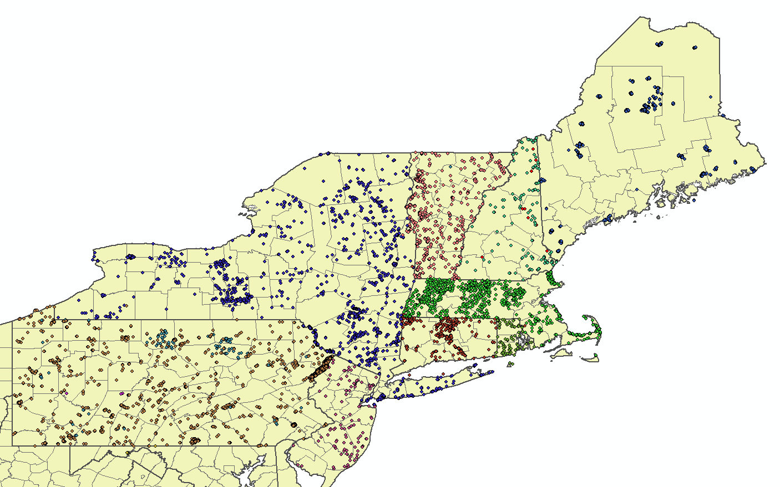
B. Northeast Vegetation Plots:
12,000+ plots (most are from state NHPs)
VegBank (vegbank.org)
An ecology plot observations database/archive

Slide 13
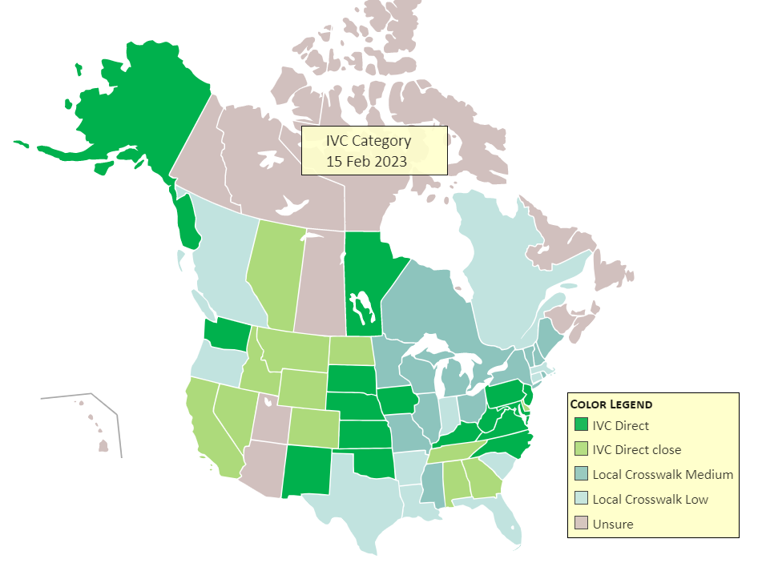
NatureServe Network and the IVC / USNVC-CNVC partnership with states provinces, and territories.
DRAFT MAP
Goal of collaboration is to identify exemplary and at-risk ecosystems across North America. To do that, the Network needs to achieve operational linkage between program classifications and IVC.

Slide 14
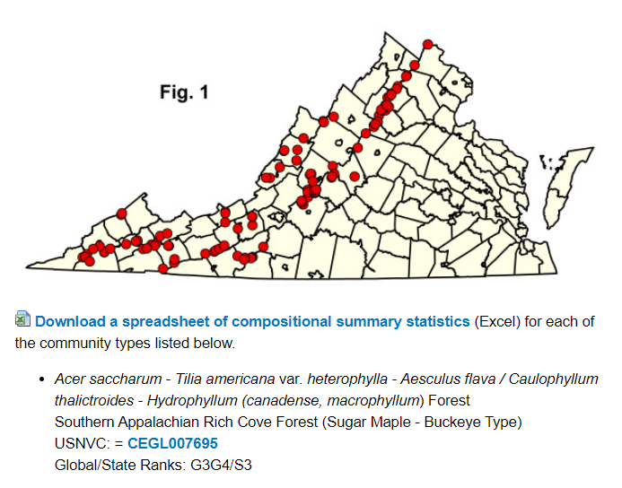
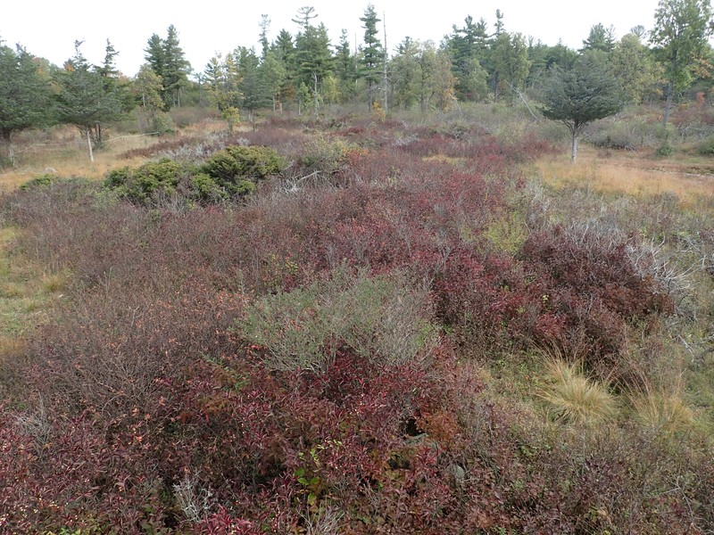
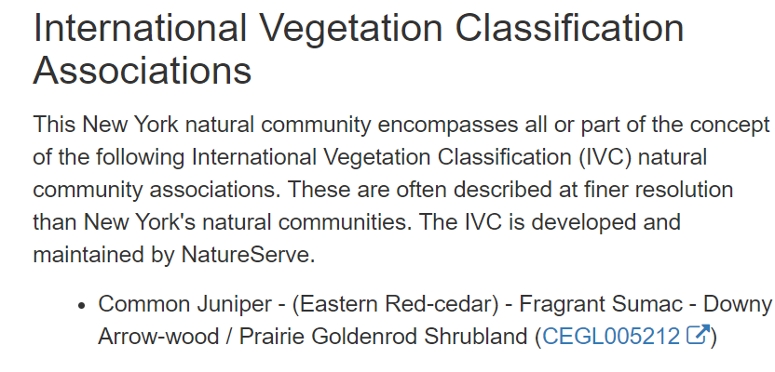
The IVC and the Network:
- direct use
- crosswalk
Virginia NHP: Southern Appalachian Rich Cove Forest (Sugar Maple-Buckeye Type)
New York NHP: Alvar Shrubland
Juniper Alvar Shrubland

Slide 15
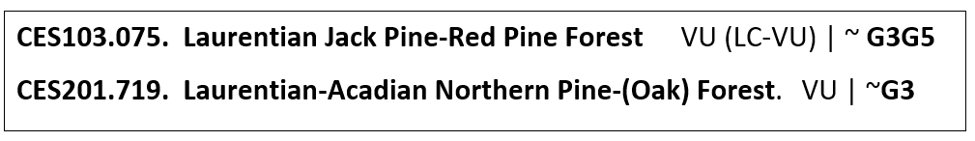
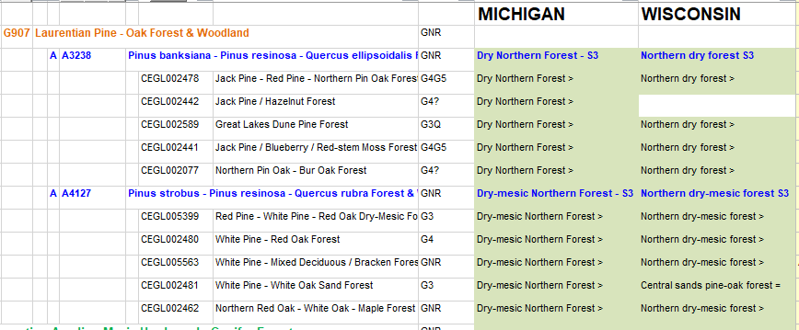
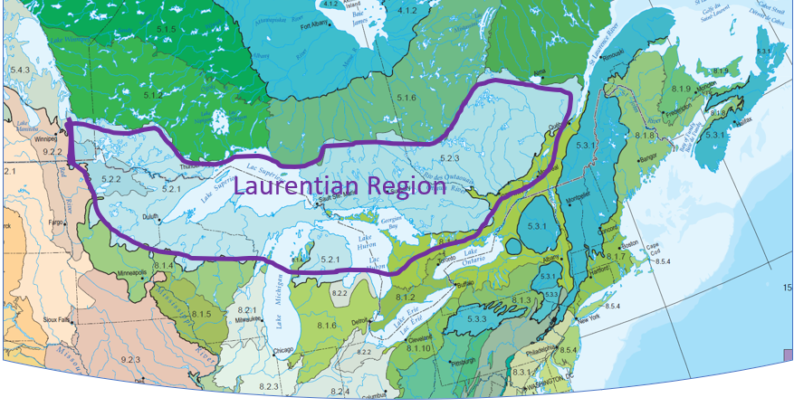
Groups, Alliances, and IVC Hierarchy
Increased connectivity with “non-standard” subnational clfs
15-20 programs across North America with “non-standard” classifications
  Associations: non-standard clfs > 50% equivalency
  Multi-level: non-standard clfs > 80% equivalency at some level of IVC
MN
G4G5
Laurentian Jack Pine - Red Pine - Oak Forest
Laurentian White Pine – Red Pine - Oak Forest

Slide 16
B. Alliance Review: State / Federal Partnerships
State(s) to USNVC partnership (direct or crosswalk) [natural communities or direct use, previous slide]
Ecological System to USNVC crosswalk: (NatureServe, federal partnership)
  Brings together the information on Existing Vegetation compiled for Systems with that of Groups.
  System to Group crosswalk largely complete.
    90% of Systems are = or finer than Groups, 10% complex.
  System to Alliance crosswalk underway.
USFS FIA Key to USNVC: Group (West); Macrogroup (East)

Slide 17
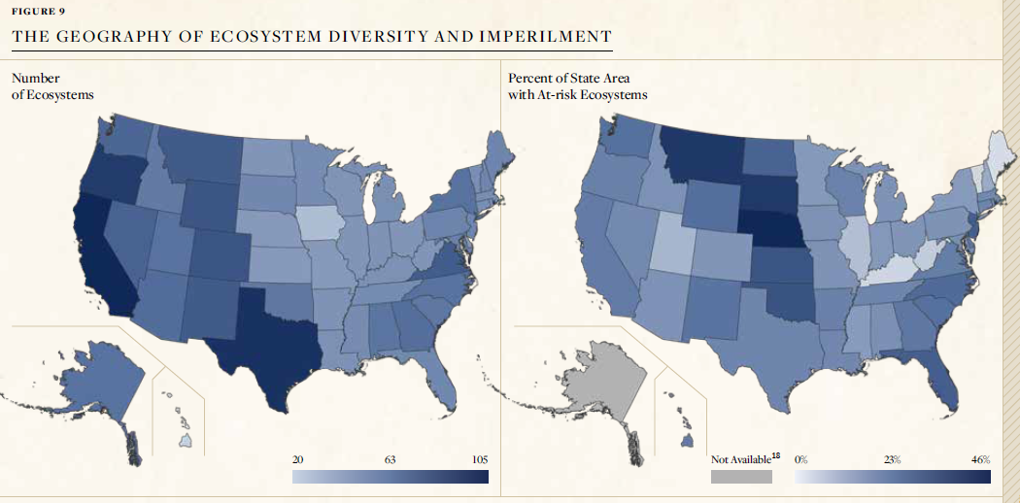
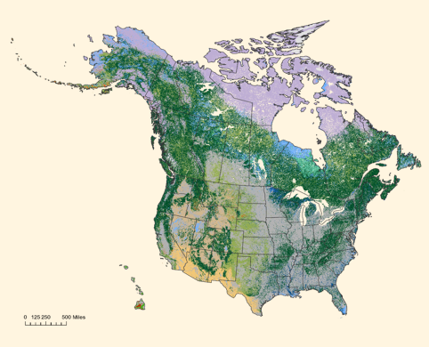
Building the Network capability to track Ecosystem Elements

Slide 18
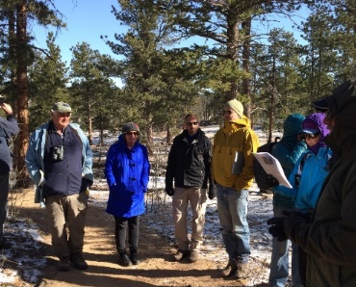

E. Looking ahead: Publish the 2023 USNVC Edition
Between Now and end of 2023
  Formations L1-L3, updates in 2023
  Macrogroups locked down (pretty much) since 2017;
  By middle of 2023, all group/alliance issues reviewed.
  Alliance QAQC April – November 2023.
Publications of a definitive USNVC edition in 2023
USNVC Edition, gives us room for a pause:
Continuing the process for compiling ongoing revisions
Emphasize plot-based assessments going forward
Test confidence of group/alliance concepts:
  diagnostic species.
  growth forms patterns.
  ecological relationships.
Subsequent editions, 2028….?

Slide 19
ECOLOGICAL CLASSIFICATIONS and the NatureServe Network
EXISTING VEGETATION:IVC / Natural Communities
National map of USNVC – Group (map review)
Global Ranks:
      Group G-ranks: now available (S-ranks)
      Alliance G-ranks (S-ranks)
      Association G-ranks: available, aging (S-ranks)
EORANKS/Ecological Integrity Assessments
  Network participation key to Rapid EIA (FQA, etc)
EOs and the Biological Locations Database
Observation Databases (plots, polygons, non EO-EOs :-)
FIA / USNVC – all FIA plots auto-assigned
ECOLOGICAL SYSTEMS
Ecological Sites / Biophysical Setting (model reviews)
Modeling, Climate Change (model reviews)
APPLICATIONS
(partial U.S. list)
(Network actions)

Slide 20
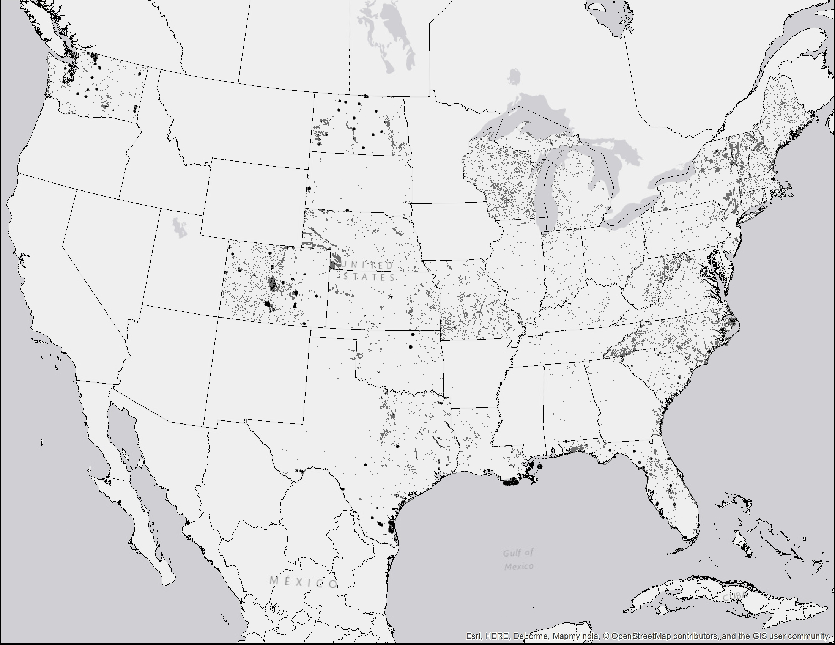
Natural Community EOs
OLD MAP! NEW ONE NEEDED
~67,000 Element Occurrence for Natural Communities derived from NHP field inventories

Slide 21
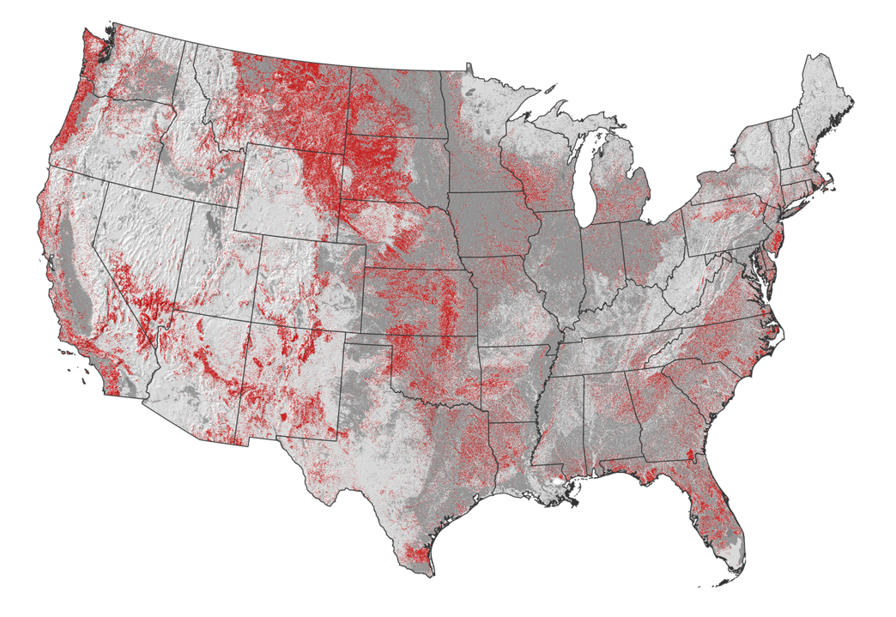
Location of At-risk (G1, G2, G3) ecosystems:
NVC Groups
DRAFT FALL 2021
Integrate Network documentation of Groups
Natural
At-Risk Ecosystem Groups
Secure Ecosystem Groups
Converted
Developed, agriculture, or ruderal vegetation
Notes:
The next question we asked was where is at-risk biodiversity located? Answering this question for ecosystems, the red on this map shows where NVC groups have been ranked as imperiled with ecological collapse. A huge area of the country has been completely transformed – the dark gray. The red is where we have the opportunity to intervene to restore ecosystems. Spectrum of management – light gray to red, to dark gray.

Slide 22
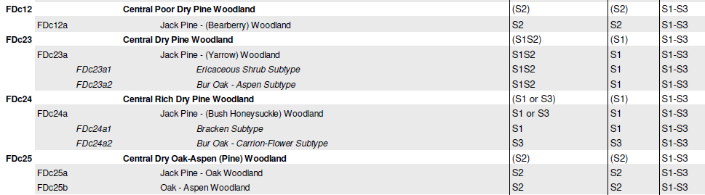
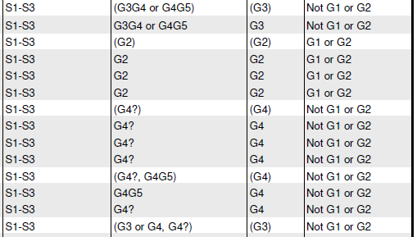
State multi-scale S-ranks (Minnesota)
G907: Laurentian Pine – Oak Forest & Woodland

