Slide 1
Pennsylvania Conservation Opportunity Area Tool
Development Release v0.2
July 17, 2018

Slide 2
Agenda
Review Functionality for v0.2
Demo v0.2
Review Next Release v0.3
Pending Items
Questions

Slide 3
Functionality v0.2
Project Type Workflow – AOI Select
Initial version of AOI Report

Slide 4
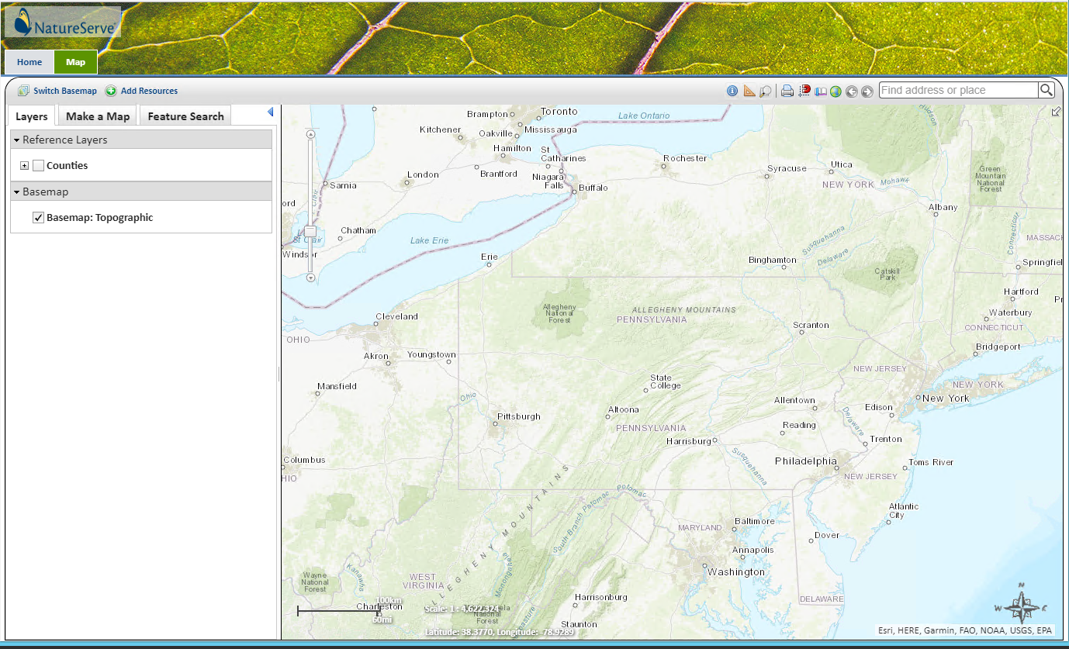
Demo Dev Site https://coapadev.natureserve.org

Slide 5
Development Release v0.3
Continue AOI report generation
Investigate Species Location Review
Site Theming

Slide 6
Pending Items / Questions
SSS Review
Sample Report
Multiple Species per Report?

Slide 7
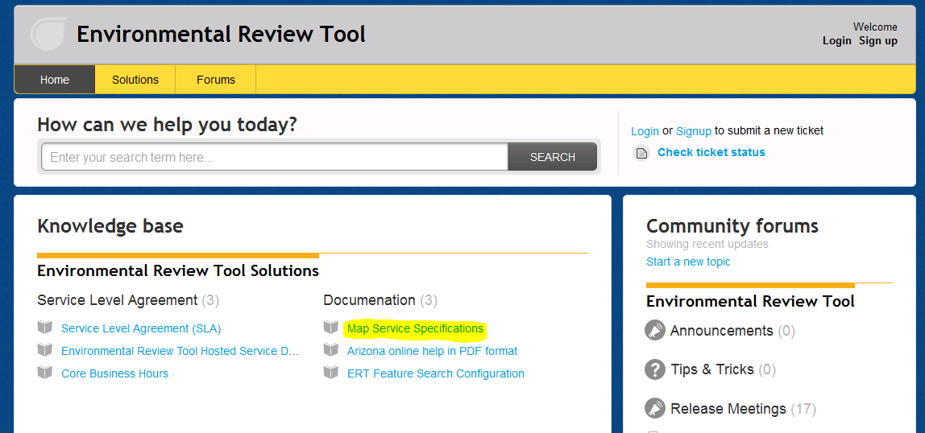
ERT Help Desk Support http://ertsupport.natureserve.org

