Slide 1
NE ERT Review MEETING v0.12 Wednesday, January 18, 2017 2:00 – 3:00 PM EST

Slide 2
Agenda
Latest Release Review
Demo
Development Release Plan
Discussion
Notes:
Biotics 4
Living with Aging system
Compatibility issues in new environments (Windows, Oracle)
Other common problems (DM comments)
Phasing out Biotics 4 – Support will continue through FY13 and be phased out in FY14 (discuss with Lori)
Four stages;
Market introduction / General Availability (2003- 2004)
Growth/Extended (2004 – 2010)
Maturity (2010 – 2013)
No new versions or patches
Standard support provided (helpdesk and email)
Continued expansion of online information and Knowledgebase
With release of Biotics 5 in 2013 we will enter the last 12 month of this stage
Limited support provided (helpdesk and email)
New environments not certified
Few updates to online information (i.e., Knowledgebase)
Saturation and decline/Retired (2014) – final phase of Biotics 4
Standard helpdesk and email support ends
Access to very limited support through Biotics 4 online help archives

Slide 3
Latest Release Review v0.11 – v0.12
0.11 –
Add new Project field “Prepared By”
Fix for Table 2 in customer report
0.12 –
Import Dynamic Analysis texts
Import Project Type and Activities texts
Import Matrix Rules
TBD: PT Activities rules – in process
Notes:
Biotics 4
Living with Aging system
Compatibility issues in new environments (Windows, Oracle)
Other common problems (DM comments)
Phasing out Biotics 4 – Support will continue through FY13 and be phased out in FY14 (discuss with Lori)
Four stages;
Market introduction / General Availability (2003- 2004)
Growth/Extended (2004 – 2010)
Maturity (2010 – 2013)
No new versions or patches
Standard support provided (helpdesk and email)
Continued expansion of online information and Knowledgebase
With release of Biotics 5 in 2013 we will enter the last 12 month of this stage
Limited support provided (helpdesk and email)
New environments not certified
Few updates to online information (i.e., Knowledgebase)
Saturation and decline/Retired (2014) – final phase of Biotics 4
Standard helpdesk and email support ends
Access to very limited support through Biotics 4 online help archives

Slide 4
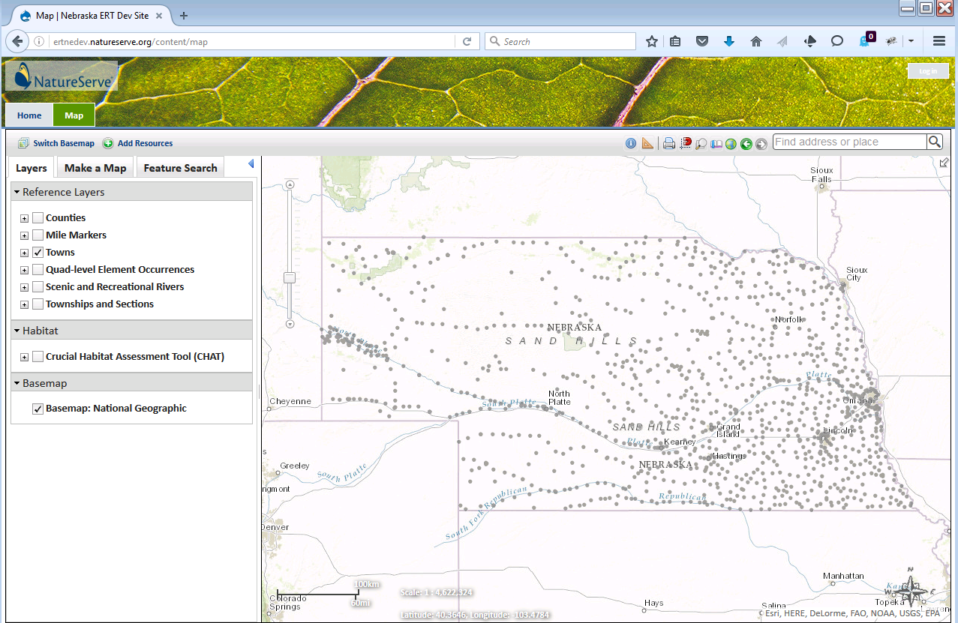
ERT Demo
https://ertnedev.natureserve.org/
Available 8:00 AM – 6:00 PM (Central)

Slide 5
Development Release Plan
v0.13 – v0.14
Import remaining texts/rules
Any related report generation details
Add Project Submission feature layer
Misc pending issues and/or bugs
Pending Items To Be Provided
Remaining matrix rules and report texts, as available
Notes:
Biotics 4
Living with Aging system
Compatibility issues in new environments (Windows, Oracle)
Other common problems (DM comments)
Phasing out Biotics 4 – Support will continue through FY13 and be phased out in FY14 (discuss with Lori)
Four stages;
Market introduction / General Availability (2003- 2004)
Growth/Extended (2004 – 2010)
Maturity (2010 – 2013)
No new versions or patches
Standard support provided (helpdesk and email)
Continued expansion of online information and Knowledgebase
With release of Biotics 5 in 2013 we will enter the last 12 month of this stage
Limited support provided (helpdesk and email)
New environments not certified
Few updates to online information (i.e., Knowledgebase)
Saturation and decline/Retired (2014) – final phase of Biotics 4
Standard helpdesk and email support ends
Access to very limited support through Biotics 4 online help archives

Slide 6
Discussion

