Slide 1
North carolina ERT 1.2 release thursday, june 16, 2016
11:00 – 12:00 aM EST

Slide 2
Agenda
New Functionality
ERT Core Highlights Review
Staging Demo
Discussion
Notes:
Biotics 4
Living with Aging system
Compatibility issues in new environments (Windows, Oracle)
Other common problems (DM comments)
Phasing out Biotics 4 – Support will continue through FY13 and be phased out in FY14 (discuss with Lori)
Four stages;
Market introduction / General Availability (2003- 2004)
Growth/Extended (2004 – 2010)
Maturity (2010 – 2013)
No new versions or patches
Standard support provided (helpdesk and email)
Continued expansion of online information and Knowledgebase
With release of Biotics 5 in 2013 we will enter the last 12 month of this stage
Limited support provided (helpdesk and email)
New environments not certified
Few updates to online information (i.e., Knowledgebase)
Saturation and decline/Retired (2014) – final phase of Biotics 4
Standard helpdesk and email support ends
Access to very limited support through Biotics 4 online help archives

Slide 3
New Functionality
    Demo
    April 2016 data updates (not tested)
    Replace EOStatus with EORank in report table
    Update project review letterhead
    Remove email address from review letter
    Notify for projects with CWMTF conflict (not tested)
    Enhance User, Subscription, and Project admin views
    Support phone extension in registration/user profile
    Discussion required
    Add North Arrow to report map images
    Site Admin create Subscription on user behalf
    Pending
    Update site theme
Notes:
Biotics 4
Living with Aging system
Compatibility issues in new environments (Windows, Oracle)
Other common problems (DM comments)
Phasing out Biotics 4 – Support will continue through FY13 and be phased out in FY14 (discuss with Lori)
Four stages;
Market introduction / General Availability (2003- 2004)
Growth/Extended (2004 – 2010)
Maturity (2010 – 2013)
No new versions or patches
Standard support provided (helpdesk and email)
Continued expansion of online information and Knowledgebase
With release of Biotics 5 in 2013 we will enter the last 12 month of this stage
Limited support provided (helpdesk and email)
New environments not certified
Few updates to online information (i.e., Knowledgebase)
Saturation and decline/Retired (2014) – final phase of Biotics 4
Standard helpdesk and email support ends
Access to very limited support through Biotics 4 online help archives

Slide 4
ERT Core Highlights Review
  Map Viewer
    Improved Draw Tools
    Save Spatial Bookmarks per User
    Enhanced Identify Tool
    Export Table Results to CSV
    View Description and Optional View Details
    Insecure Map Layers
  Miscellaneous
    View Project On Map
    Reset Login Failures
    Password Recovery Workflow
    Submit Button Spinner

Slide 5
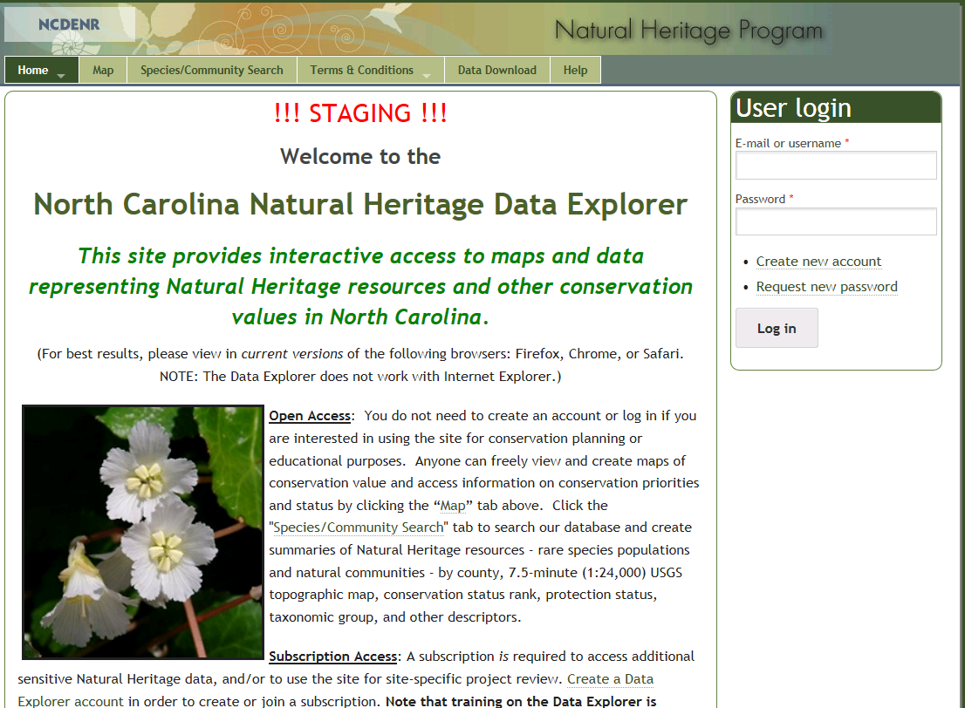
ERT Staging Demo v1.2a https://ncnhde-stg.natureserve.org

Slide 6
Remaining Items
Add North Arrow to report map image
Support Site Admin creating Subscription on user behalf
Site theming to reflect new department
Updated June GIS Data
Notes:
Biotics 4
Living with Aging system
Compatibility issues in new environments (Windows, Oracle)
Other common problems (DM comments)
Phasing out Biotics 4 – Support will continue through FY13 and be phased out in FY14 (discuss with Lori)
Four stages;
Market introduction / General Availability (2003- 2004)
Growth/Extended (2004 – 2010)
Maturity (2010 – 2013)
No new versions or patches
Standard support provided (helpdesk and email)
Continued expansion of online information and Knowledgebase
With release of Biotics 5 in 2013 we will enter the last 12 month of this stage
Limited support provided (helpdesk and email)
New environments not certified
Few updates to online information (i.e., Knowledgebase)
Saturation and decline/Retired (2014) – final phase of Biotics 4
Standard helpdesk and email support ends
Access to very limited support through Biotics 4 online help archives

Slide 7
Discussion/Questions

