Slide 1
Preparing for your Biotics 5 Conversion
Wednesday, march 26, 2014

Slide 2
Agenda
Providing Biotics 4 for conversion
Converting Biotics 4 spatial data
Spatial data
    Base layers vs. Reference layers
    Determine which layers in Navigator
    Determine which layers used for Spatial calculation
    Map organization
    Defining the layers
    Publish the map service(s)
Q & A
Notes:
Biotics 4
Living with Aging system
Compatibility issues in new environments (Windows, Oracle)
Other common problems (DM comments)
Phasing out Biotics 4 – Support will continue through FY13 and be phased out in FY14 (discuss with Lori)
Four stages;
Market introduction / General Availability (2003- 2004)
Growth/Extended (2004 – 2010)
Maturity (2010 – 2013)
No new versions or patches
Standard support provided (helpdesk and email)
Continued expansion of online information and Knowledgebase
With release of Biotics 5 in 2013 we will enter the last 12 month of this stage
Limited support provided (helpdesk and email)
New environments not certified
Few updates to online information (i.e., Knowledgebase)
Saturation and decline/Retired (2014) – final phase of Biotics 4
Standard helpdesk and email support ends
Access to very limited support through Biotics 4 online help archives

Slide 3
Conversion Guide
Download the Biotics 5 Conversion Guide from:
Biotics 5 transfer site
Biotics 5 Technical Support (i.e. Contact Support)
  Solutions: Conversion - Conversion Guide
Submit questions regarding the conversion process to the Biotics 4 Help Desk or Biotics 5 Help Desk, according to what the question pertains.

Slide 4
Providing Biotics 4 for Conversion
Who? | What?
Member Program | Update Biotics to the most recent version Clean up database (DBIC) Run QC procedures Provide database to NatureServe
NatureServe | Migrate Oracle database Update Oracle tables/views to accommodate database changes Run conversion scripts

Slide 5
Quality Control Procedures
Rectify ALL errors/problems/warnings in the Database Integrity Check
Clean up values in Reference usefulness fields (query provided)
Rectify invalid MAPPEDDATE values (query provided)

Slide 6
Providing Biotics 4 for Conversion
Db_upgrade_history.txt
Dbic.rpt
Tablespace_sizes.log
Biotics backup zip file
  BIOTICS folder
  Biotics_del.dmp & biotics_del.log
  Biotics_user.dmp & biotics_user.log

Slide 7
Conversion Biotics 4 Spatial Data
Who? | What?
Member Program | Provide managed layer shapefiles (EOs,MAs…) Prepare SpatialCalculations geodatabase including layers for use in spatial calculations Identify reference map layers needed Confirm source and format of hosted map services Provide Map Document (.mxd) and geodatabase containing reference layers, ONLY if to be hosted by NatureServe
NatureServe | Import managed layer shapefiles into Oracle database Publish reference map services, as needed

Slide 8
Converting Biotics 4 Spatial Data
SFs converted according to Locational Uncertainty Type:
Areal - Estimated:
  Biotics 4 SF is buffered with Locational Uncertainty Distance to become the Biotics 5 SF.
  Orginial Biotics 4 SF becomes Pre-SF.
  Observation Feature can be created from Biotics 4 SF (Biotics 5 Pre-SF), in different application, if desired.
Negligible:
  Direct conversion.
  Observation Feature can be created from Biotics 4 SF, in different application, if desired.
  Default scale now 1:18,056 (vs. 1:24,000 in B4) & mmu is 9 m (vs. 12.5)
Linear & Areal - Delimited:
  Direct conversion.
  Observation Feature cannot be created from Biotics 4 SF since it includes locational uncertainty in the mapped feature.

Slide 9
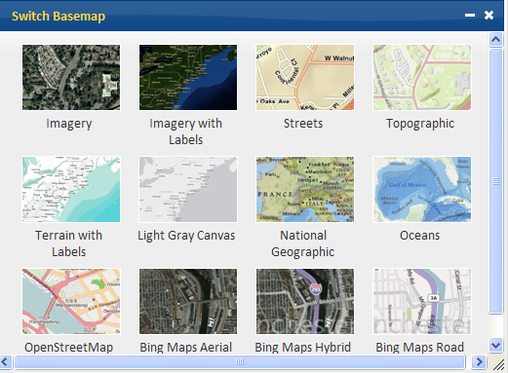
Spatial data for use with Biotics 5 map viewer

Slide 10


Spatial data for use with Biotics 5 map viewer
 | Basemaps | Reference Layer
Purpose | Visual background and geographical context; locational reference | Interactive use, as described below; Layers not available within Basemaps
Use | Alter visibility of layers Identify Search Filter Copy feature Spatial Calculation | Alter visibility of layers Identify Search Filter Copy feature Spatial Calculation
Provided by | esri (default) your agency Bing (requires valid usage key) | your agency

Slide 11
Which Layers Currently in Navigator?
Run following query in Tracker’s Query Builder to determine which themes are referenced in the Navigator:
  SELECT THEME.*, THEME_LOCATION.LOCATION FROM THEME, THEME_LOCATION WHERE THEME.LOCATION_KEY = THEME_LOCATION.LOCATION_KEY

Slide 12
Layers for use in Library (new Navigator)
The map Library requires map services
Prepare the map service(s) as described in the Prepare Map Document section
Only provide to NatureServe if you need NS to host the map service
To configure the map Library, provide the following for each map service:
  the map service's URL(s)
  a user-friendly title(s)
  Opacity
  Visible
  Add to map

Slide 13
Spatial Attribute Layers

Slide 14
Provide Layers for Spatial Attribute Calculations in YOUR Instance
Run following query in Tracker’s Query Builder to determine which themes are used in Biotics for spatial calculations (as defined in Designer Admin in Mapper):
SELECT THEME.THEME_ID, THEME.THEME_NAME, THEME.THEME_SRC, THEME_LOCATION.LOCATION FROM THEME, THEME_LOCATION WHERE THEME_ID>4999 AND THEME_ID IN (SELECT SOURCE_THEME_ID FROM AD_CALC_SPAT_ATT WHERE SOURCE_THEME_ID IS NOT NULL) AND THEME.LOCATION_KEY = THEME_LOCATION.LOCATION_KEY
Notes:
Biotics 4
Living with Aging system
Compatibility issues in new environments (Windows, Oracle)
Other common problems (DM comments)
Phasing out Biotics 4 – Support will continue through FY13 and be phased out in FY14 (discuss with Lori)
Four stages;
Market introduction / General Availability (2003- 2004)
Growth/Extended (2004 – 2010)
Maturity (2010 – 2013)
No new versions or patches
Standard support provided (helpdesk and email)
Continued expansion of online information and Knowledgebase
With release of Biotics 5 in 2013 we will enter the last 12 month of this stage
Limited support provided (helpdesk and email)
New environments not certified
Few updates to online information (i.e., Knowledgebase)
Saturation and decline/Retired (2014) – final phase of Biotics 4
Standard helpdesk and email support ends
Access to very limited support through Biotics 4 online help archives

Slide 15
Provide Layers for Spatial Attribute Calculations in YOUR Instance
Provide layers used for spatial calculation to NatureServe:
In a single file geodatabase named SpatialCalculations.gdb
In your Biotics projection
Named according to the THEME_SRC value defined in the query on the previous slide (i.e. QUADNHP.SHP should be named QUADNHP)
Zip geodatabase and send to NatureServe
Notes:
Biotics 4
Living with Aging system
Compatibility issues in new environments (Windows, Oracle)
Other common problems (DM comments)
Phasing out Biotics 4 – Support will continue through FY13 and be phased out in FY14 (discuss with Lori)
Four stages;
Market introduction / General Availability (2003- 2004)
Growth/Extended (2004 – 2010)
Maturity (2010 – 2013)
No new versions or patches
Standard support provided (helpdesk and email)
Continued expansion of online information and Knowledgebase
With release of Biotics 5 in 2013 we will enter the last 12 month of this stage
Limited support provided (helpdesk and email)
New environments not certified
Few updates to online information (i.e., Knowledgebase)
Saturation and decline/Retired (2014) – final phase of Biotics 4
Standard helpdesk and email support ends
Access to very limited support through Biotics 4 online help archives

Slide 16
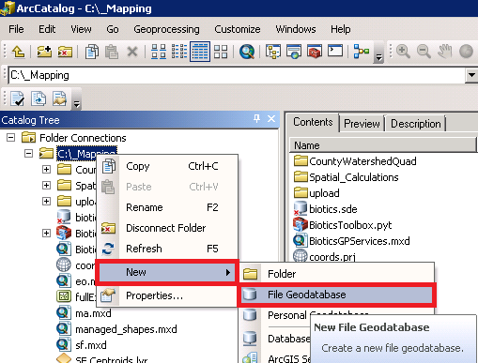
Create File Geodatabase
In ArcCatalog*, right click on folder in which to create the file geodatabase
Choose New
File Geodatabase
Name the geodatabase SpatialCalculations
ArcGIS licensing options available through NatureServe
Notes:
Biotics 4
Living with Aging system
Compatibility issues in new environments (Windows, Oracle)
Other common problems (DM comments)
Phasing out Biotics 4 – Support will continue through FY13 and be phased out in FY14 (discuss with Lori)
Four stages;
Market introduction / General Availability (2003- 2004)
Growth/Extended (2004 – 2010)
Maturity (2010 – 2013)
No new versions or patches
Standard support provided (helpdesk and email)
Continued expansion of online information and Knowledgebase
With release of Biotics 5 in 2013 we will enter the last 12 month of this stage
Limited support provided (helpdesk and email)
New environments not certified
Few updates to online information (i.e., Knowledgebase)
Saturation and decline/Retired (2014) – final phase of Biotics 4
Standard helpdesk and email support ends
Access to very limited support through Biotics 4 online help archives

Slide 17
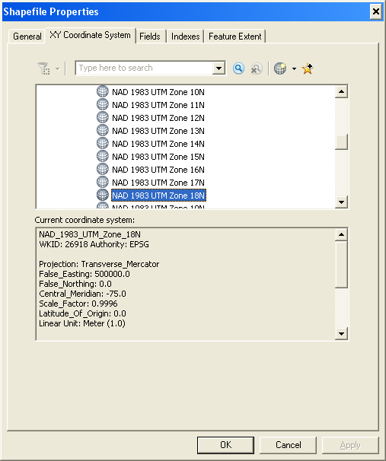
Verify Projection of Shapefile
In ArcCatalog, right click on shapefile
Choose Properties
Navigate to XY Coordinates System tab
Verify correct projection (i.e. projection used in B4)
Notes:
Biotics 4
Living with Aging system
Compatibility issues in new environments (Windows, Oracle)
Other common problems (DM comments)
Phasing out Biotics 4 – Support will continue through FY13 and be phased out in FY14 (discuss with Lori)
Four stages;
Market introduction / General Availability (2003- 2004)
Growth/Extended (2004 – 2010)
Maturity (2010 – 2013)
No new versions or patches
Standard support provided (helpdesk and email)
Continued expansion of online information and Knowledgebase
With release of Biotics 5 in 2013 we will enter the last 12 month of this stage
Limited support provided (helpdesk and email)
New environments not certified
Few updates to online information (i.e., Knowledgebase)
Saturation and decline/Retired (2014) – final phase of Biotics 4
Standard helpdesk and email support ends
Access to very limited support through Biotics 4 online help archives

Slide 18
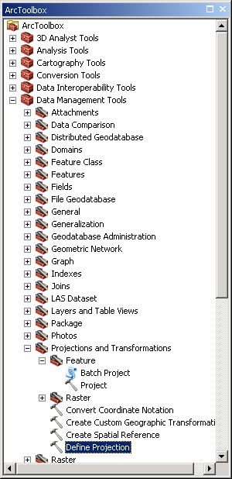
Project, if Necessary
In ArcCatalog, open the ArcToolbox
Navigate to Data Management Tools, Projections and Transformations
If no projection has been defined, double-click Define Projection
If the shapefile needs to be reprojected, the Project & Batch Project tools are found within the Feature subfolder
Notes:
Biotics 4
Living with Aging system
Compatibility issues in new environments (Windows, Oracle)
Other common problems (DM comments)
Phasing out Biotics 4 – Support will continue through FY13 and be phased out in FY14 (discuss with Lori)
Four stages;
Market introduction / General Availability (2003- 2004)
Growth/Extended (2004 – 2010)
Maturity (2010 – 2013)
No new versions or patches
Standard support provided (helpdesk and email)
Continued expansion of online information and Knowledgebase
With release of Biotics 5 in 2013 we will enter the last 12 month of this stage
Limited support provided (helpdesk and email)
New environments not certified
Few updates to online information (i.e., Knowledgebase)
Saturation and decline/Retired (2014) – final phase of Biotics 4
Standard helpdesk and email support ends
Access to very limited support through Biotics 4 online help archives

Slide 19
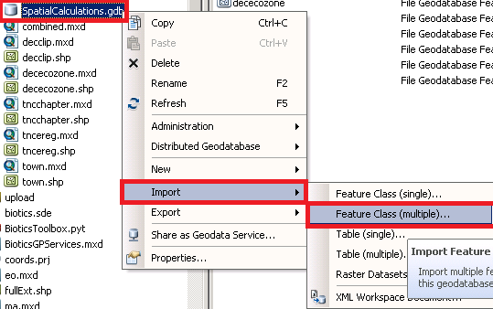
Import into Geodatabase
In ArcCatalog, right-click on the SpatialCalculations.gdb file
Choose Import
Feature Class (multiple)
If the shapefile needs to be reprojected, the Project & Batch Project tools are found within the Feature subfolder
Notes:
Biotics 4
Living with Aging system
Compatibility issues in new environments (Windows, Oracle)
Other common problems (DM comments)
Phasing out Biotics 4 – Support will continue through FY13 and be phased out in FY14 (discuss with Lori)
Four stages;
Market introduction / General Availability (2003- 2004)
Growth/Extended (2004 – 2010)
Maturity (2010 – 2013)
No new versions or patches
Standard support provided (helpdesk and email)
Continued expansion of online information and Knowledgebase
With release of Biotics 5 in 2013 we will enter the last 12 month of this stage
Limited support provided (helpdesk and email)
New environments not certified
Few updates to online information (i.e., Knowledgebase)
Saturation and decline/Retired (2014) – final phase of Biotics 4
Standard helpdesk and email support ends
Access to very limited support through Biotics 4 online help archives

Slide 20
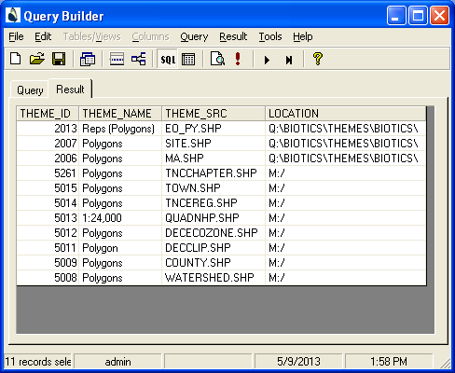
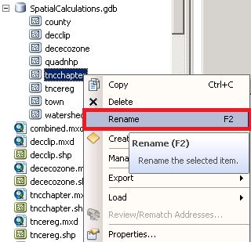
Rename Feature Classes, if Necessary
If necessary, rename the feature class(es) to reflect the THEME_SRC name
In ArcCatalog, right-click on the feature class to be renamed within the SpatialCalculations.gdb file
Choose Rename
Notes:
Biotics 4
Living with Aging system
Compatibility issues in new environments (Windows, Oracle)
Other common problems (DM comments)
Phasing out Biotics 4 – Support will continue through FY13 and be phased out in FY14 (discuss with Lori)
Four stages;
Market introduction / General Availability (2003- 2004)
Growth/Extended (2004 – 2010)
Maturity (2010 – 2013)
No new versions or patches
Standard support provided (helpdesk and email)
Continued expansion of online information and Knowledgebase
With release of Biotics 5 in 2013 we will enter the last 12 month of this stage
Limited support provided (helpdesk and email)
New environments not certified
Few updates to online information (i.e., Knowledgebase)
Saturation and decline/Retired (2014) – final phase of Biotics 4
Standard helpdesk and email support ends
Access to very limited support through Biotics 4 online help archives

Slide 21
Map Organization
Relative path names
Group Layers according to scale
Save Map Extent for use with Zoom To tool
Repeat layers to display multiple legends
Define map projection

Slide 22
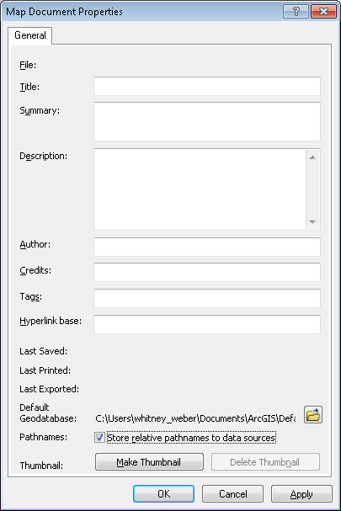
Use Relative path names
File menu
  Map Document Properties
    Pathnames: Store relative pathnames to data sources

Slide 23

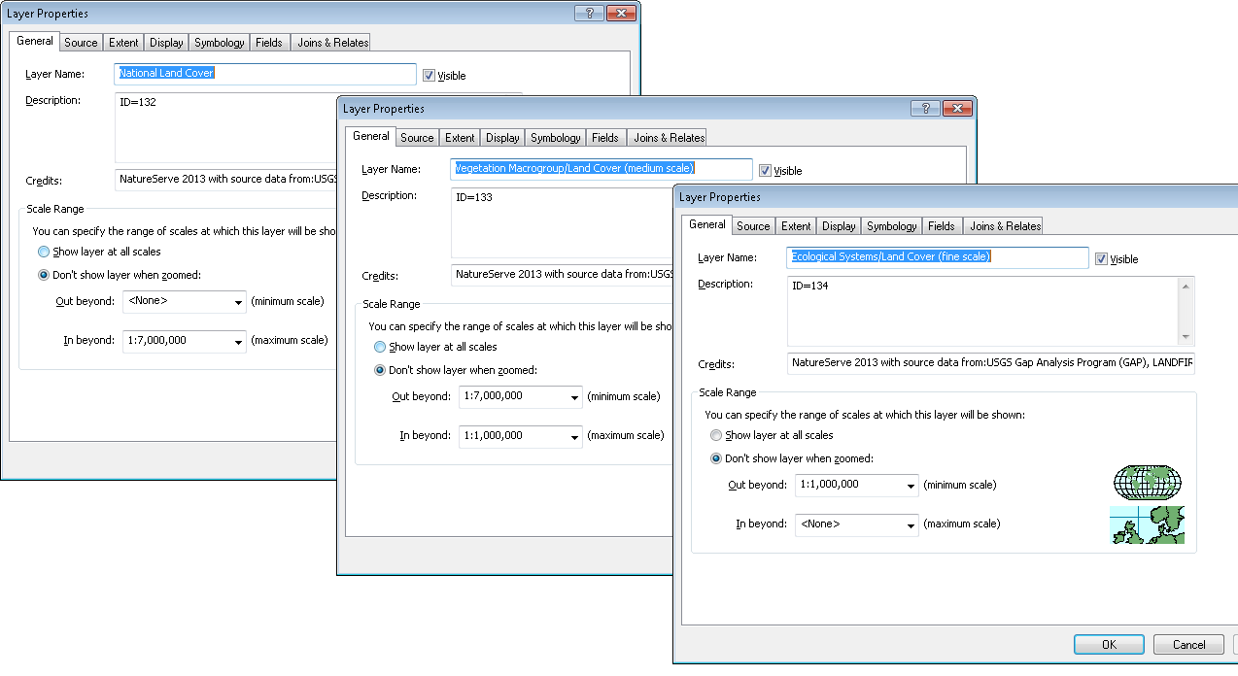
Group Layers to organize and display according to Scale

Slide 24
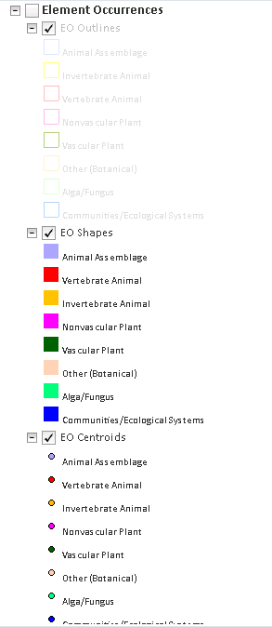
Repeat Layers to Display multiple Symbologies

Slide 25
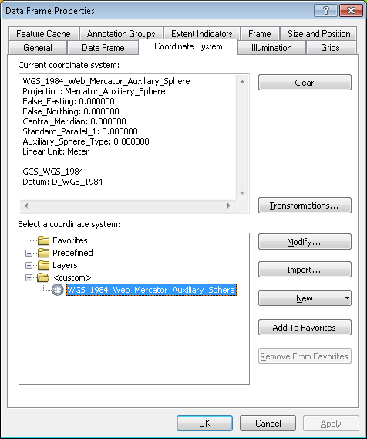
Define Map Projection:
WGS_1984_Web_Mercator_Auxiliary_Sphere
View menu
  Data Frame Properties
    Coordinate System tab

Slide 26
Defining the Layers
General tab
Symbology tab
Display tab
Fields tab
  Definition Query tab

Slide 27
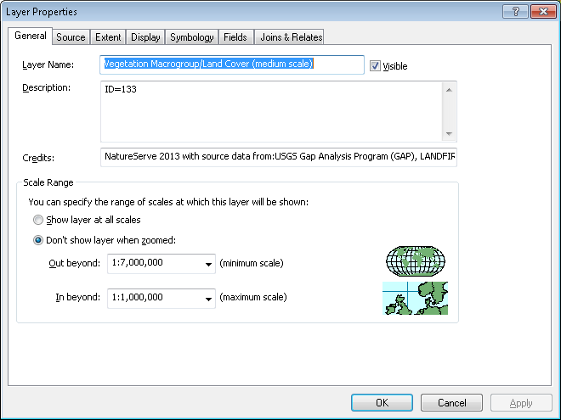
General tab
Define Layer Name
Set appropriate Scale Range

Slide 28
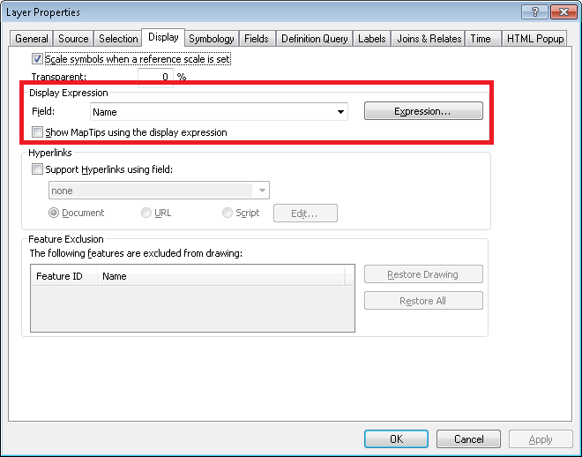
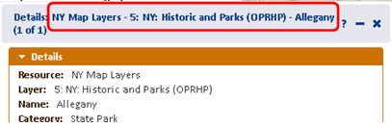
Display tab
Display Expression Field
Define field with unique data which distinguishes one record from another
Used in header of the Details dialog as such:
Details: Service Name – Layer name - value of display field for the given record.

Slide 29
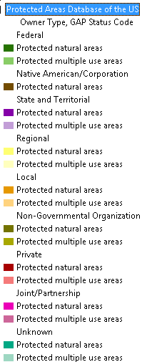
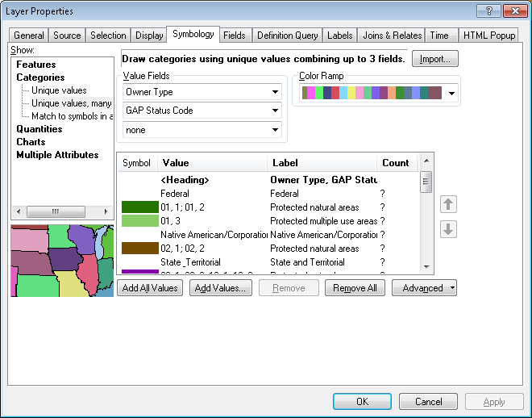
Symbology tab
Symbolize appropriately
Define legend Labels

Slide 30
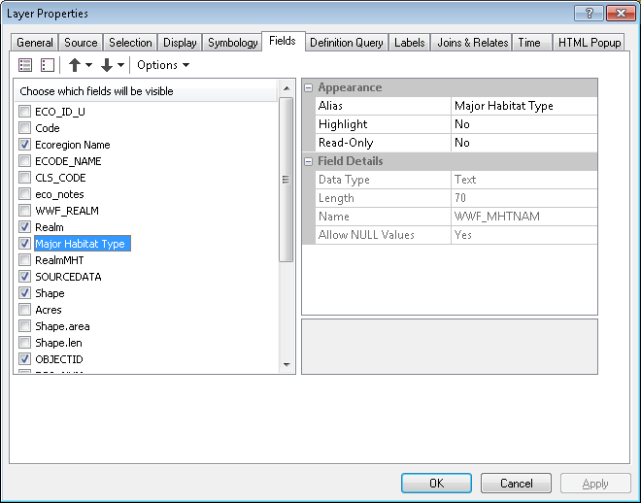
Fields tab
Define Aliases for fields
Indicate which fields should be VISIBLE for use via the Identify/Filter/Query tools.
Fields of Data Type Geometry and ObjectID must always be visible (typically Shape and OBJECTID)

Slide 31
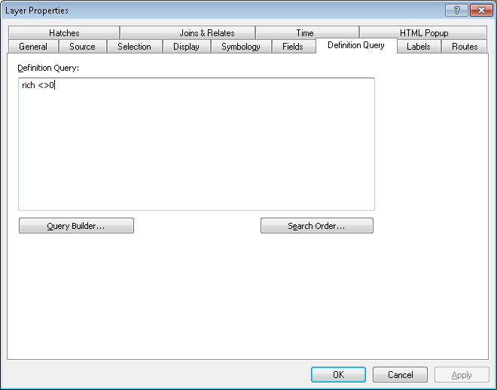
Definition Query tab
Provide Definition query, as appropriate

Slide 32
Publishing the Map Service(s)

Slide 33
Publish as Cached or Dynamic map service?
 | Cached | Dynamic
Application | Basemaps | Reference layers
Performance | Improved performance | Decreased performance because needs to draw map on the fly
Projection | Typically cannot be reprojected | Can be reprojected on-the-fly Reprojection negatively affects performance
Limitations | Alter visibility of layers Filter Copy | Alter visibility of layers Filter Copy

Slide 34
Biotics 5 Acceptance
Following your program’s conversion to Biotics 5, you will be asked to complete a comprehensive and systematic evaluation.
This Acceptance Review Period (ten business days) will provide the opportunity to:
Gain experience working with your own data in the new system
QC your final converted database within Biotics 5
Use the available Tutorial to actively and comprehensively test the system
Enter real data following your program’s typical workflow
Verify that the performance of Biotics 5 is acceptable
Review and accept the terms of service outlined in the Service Level Agreement (SLA)

Slide 35
Q & A

