Slide 1
Biotics 5 Development priorities – roadmap - results

Slide 2
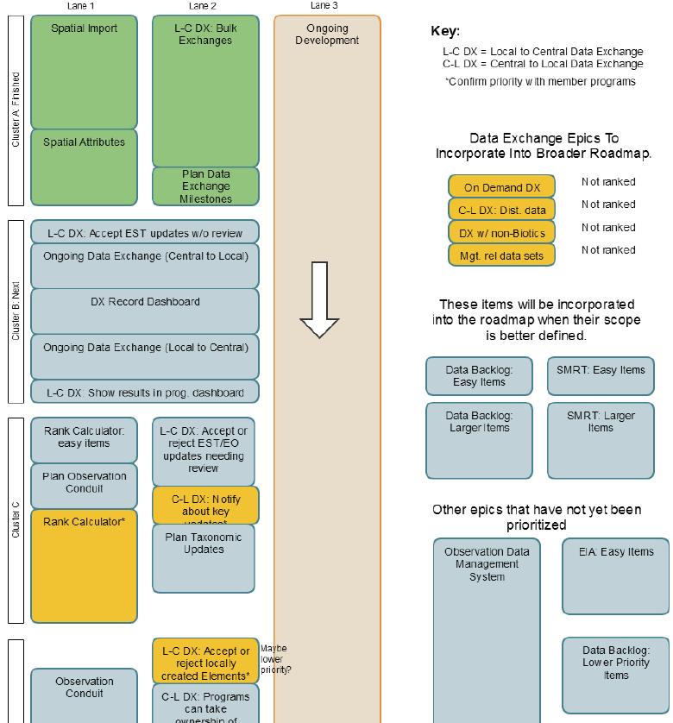
Biotics Roadmap
Outlines Development Priorities of epics (broad areas of development which require significant time/effort)
Updated with every new release to reflect progress
Description provided for each epic in details
30 responses to Biotics 5 Development Priorities – Roadmap survey
For more information on interpreting the roadmap and for details on each roadmap item see the Biotics Roadmap solution within the Biotics 5 Help Desk
Notes:
Coming in December – Biotics Roadmap Review webinar

Slide 3
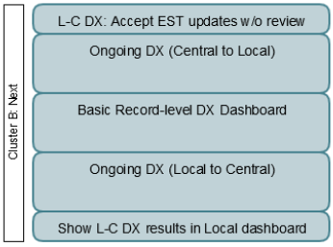
Cluster B
Lanes 1 & 2
Increase Priority: n/a
Maintain Existing Priority: 29
Decrease Priority: 1

Slide 4
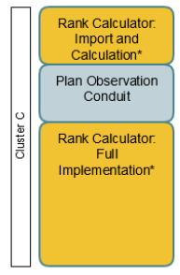
Cluster C, Lane 1
Rank Calculator Import & Calculation
Increase Priority: 1
Maintain Existing Priority: 20
Decrease Priority: 9

Slide 5
Cluster C, Lane 1
Plan Observation Conduit
Increase Priority: 2
Maintain Existing Priority: 21
Decrease Priority: 7

Slide 6
Cluster C, Lane 1
Rank Calculator: Full Implementation
Increase Priority: 0
Maintain Existing Priority: 17
Decrease Priority: 13

Slide 7
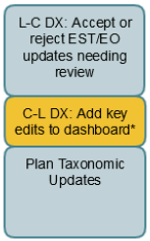
Cluster C, Lane 2
Accept or Reject EST/EO updates needing review
Increase Priority: 1
Maintain Existing Priority: 27
Decrease Priority: 2

Slide 8
Cluster C, Lane 2
Add Key Edits to Dashboard
Increase Priority: 1
Maintain Existing Priority: 25
Decrease Priority: 4

Slide 9
Cluster C, Lane 2
Plan Taxonomic Updates
Increase Priority: 0
Maintain Existing Priority: 27
Decrease Priority: 3

Slide 10
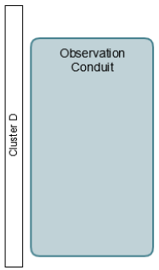
Cluster D, Lane 1
Observation Conduit
Feedback derived from survey comments, as the epic was mistakenly omitted from the survey.
Increase Priority: 3
Lack of comment: 20
Decrease Priority: 7

Slide 11
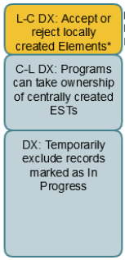
Cluster D, Lane 2
Accept or Reject Locally Created Elements
Increase Priority: 4
Maintain Existing Priority: 21
Decrease Priority: 5

Slide 12
Cluster D, Lane 2
Programs can Take Ownership of Centrally Created ESTs
Increase Priority: 3
Maintain Existing Priority: 24
Decrease Priority: 3

Slide 13
Cluster D, Lane 2
Temporarily Exclude Records Marked as
In Progress
Increase Priority: 1
Maintain Existing Priority: 23
Decrease Priority: 6

Slide 14
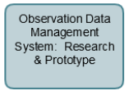
Cluster E, Lane 1
Observation Data Management System: Research & Prototype
Feedback derived from survey comments, as the epic was mistakenly omitted from the survey.
Increase Priority: 8
Lack of Comment: 16
Decrease Priority: 6

Slide 15
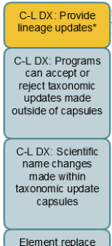

Cluster E, Lane 2
Provide Lineage Updates
Increase Priority: 1
Maintain Existing Priority: 25
Decrease Priority: 4

Slide 16
Cluster E, Lane 2
Programs can Accept or Reject Taxonomic Updates Made Outside of Capsules
Increase Priority: 6
Maintain Existing Priority: 23
Decrease Priority: 1

Slide 17
Cluster E, Lane 2
Scientific Name Changes made within Taxonomic Update Capsules
Increase Priority: 6
Maintain Existing Priority: 23
Decrease Priority: 1

Slide 18
Cluster E, Lane 2
Element Replace
Increase Priority: 5
Maintain Existing Priority: 24
Decrease Priority: 1

Slide 19
Cluster E, Lane 2
Element Lumps
Increase Priority: 4
Maintain Existing Priority: 25
Decrease Priority: 1

Slide 20
Cluster E, Lane 2
Element Splits
Increase Priority: 4
Maintain Existing Priority: 25
Decrease Priority: 1

Slide 21
Question 9
Are you ok with postponing non-DX epics until Cluster B DX epics are done?
Yes: 24
Lack of Comment: 6
No: 0

Slide 22
Question 10
Does slowing down DX after Cluster B make strategic sense to you in terms of priorities?
Yes: 19
Lack of Comment: 7
No: 4

Slide 23
Question 11
Does the proposed split of rank calculator development into “easy items” and “full implementation” work for you?
Yes: 24
Lack of Comment: 4
No: 2

Slide 24
Question 12
Are there any unprioritized Placeholder "Epics" (to right of roadmap) that you think need to be fleshed out very soon so they can be added to the roadmap?
count | Placeholder "Epic"
9 | Observation Data Management System (implementation)
6 | Data Backlog: Easy Items
2 | SMRT: Easy Items
2 | Data Backlog: Larger Items
1 | C-L DX: Dist Data (sharing species lists with neighboring states and provinces)
1 | On Demand DX
1 | EIA: Easy Items

Slide 25
Question 13
Are there any large development items that you feel are missing from the diagram? (These are things you guess would take longer than a couple weeks to implement.)
Response | NS Note
Mapping tools to share EO-or Observation-level data with neighboring states and provinces. [MT] | Is this a SMRT item?
Analysis pieces that programs can use to convert their data to useful management and planning products; Climate Change Vulnerability Index, Habitat Climate Change Vulnerability Index and the like. [TX] | Are you asking for the roadmap to include new tools or improvements to the existing tools?
Data Management for Latin America [TX] | Is this a development task or a funding need?
Other Identification integration [PA] | What does this mean?
Topology/Precision/Geometric Complexity issue [PA] | What does this mean?
Bulk loading of extensible tables through Mapper [ON] | What does this mean?
NatureServe supports a consistent taxonomy for all SWG species (any priority species listed in any state SWAP should be a trackable species in Heritage) [ME] | Is this a development task or a science (botany) task?
Support of Feature Services [VA] | Too small to be an epic; it’s in the ongoing development Q (Lane 3)
Spatial tolerance issues for MA and Site shapes [FL] | Too small to be an epic; it's in the Topology/Precision/Geometric Complexity epic

Slide 26
Summary
No results indicate overwhelming consensus to increase or decrease priority of epics
Most Reactions:
  Rank Calculator: Full Implementation
    Increase Priority: 0
    Maintain Priority: 17
    Decrease Priority: 3
  Observation Conduit
    Increase Priority: 3
    Maintain Priority: 20
    Decrease Priority: 7
  Observation Data Management System:
    Increase Priority: 8
    Maintain Priority: 16
    Decrease Priority: 6
Barring additional sources of funding (i.e. for Observation Data Management System or Conduit), survey responses do not justify changes in priority
Feedback derived from survey comments, as these epics were mistakenly omitted from the survey.

Slide 27
Discussion/Questions

