Slide 2
The Data Exchange Alerts Workbench
Tips for Efficient Use
(so you can get on with your day)
March 8, 2023
Gwen Davis, Margaret Ormes, Kristin Snow
Data and Methods, NatureServe

Slide 3
The DX Alerts Workbench
What is it for?
During imports from central: updates to global and national data
Identifies problems with incoming updates
Identifies important updates related to your local tracking records
Elcode
Global Rank
USESA (COSEWIC coming soon)
Global Scientific Name
Changes to Classification Status (especially changes to Nonstandard)
EGT RE-Activated

Slide 4
The DX Alerts Workbench
How does it do that?
Produces Alerts
Each alert added to top of Workbench at each exchange
Alert Type | Why? | Was data updated?
Rejection | Data Exchange Rule broken | NO
Error | Data Integrity Rule broken or other database error | NO
Notification | For Your Information | YES

Slide 5
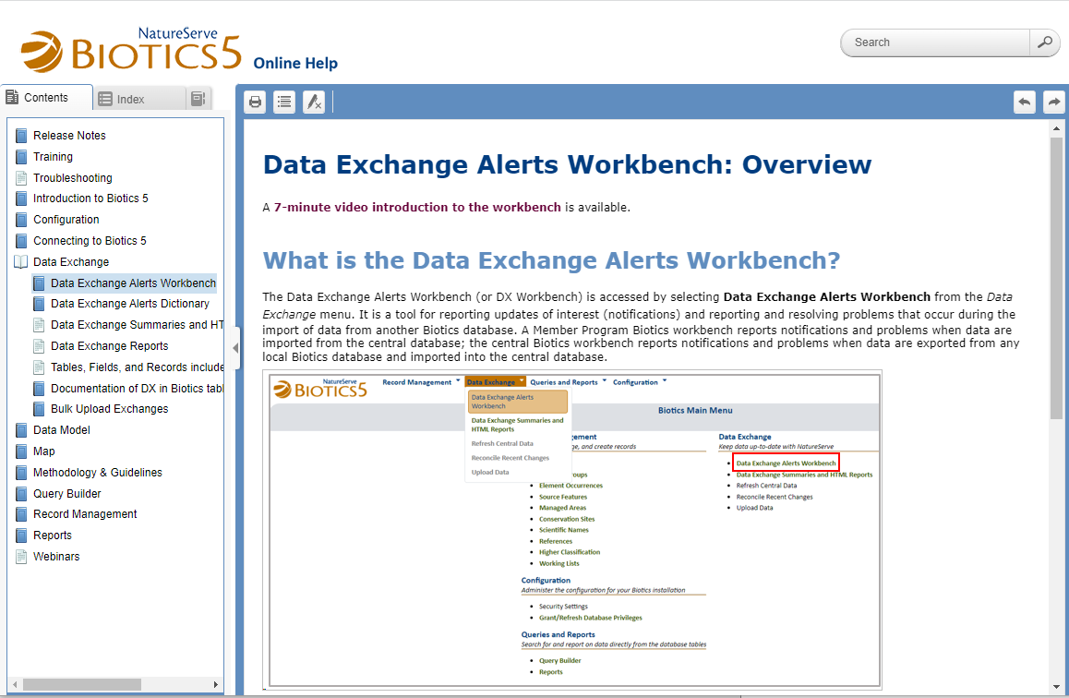
The DX Alerts Workbench
Where can I find Help?
Notes:
There are sections under Data Exchange in the Biotics5 Online Help, but it’s easier to get to the help from links in the WB which I’ll show.
Point out that at the top of the overview page there is a link to a 7 minute video that explains some of the things I’ll be skipping.

Slide 6
Using the Workbench
Filtering
Record Type and Table Name
Name Type and Category
Code or Name
UID
Source
in local workbench, always NTRSV (i.e., Central database)
DX ID
Alert Summary
Alert type (the 3 types)
Alert key (grouped into categories)
Notes:
Move to WB to cover this (NY test)
Just cover Table, Name Cat, Alert Summary

Slide 7
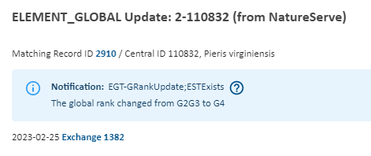
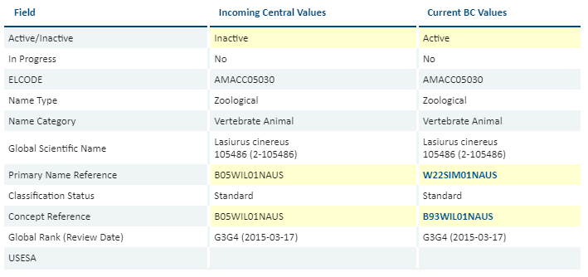
Using the Workbench
Detail Window
Links
Related Alerts
Comparison table
Additional Information
Notes:
Show in workbench: NY Test
Links: online Help, local records, dx report
Related Alerts - Some problems can cause a cascade of issues so there is more than one alert for what is really one problem. The detail window will tell you when there are alerts that are related and allow you to display them in the workbench by applying a filter.
***Scientific Name clash causes Element global update to fail
Comparison Table: Notifications – identical values – message has the old value
Rejections/Errors – highlight different values, incoming records with no match have only 1 column for incoming values
Additional Information: global data: lineage, related standard [help with updates to classification]
local EST: some data and LINK to open local record
Known issues with Detail window – Some improvements resulted in breaking a few things in the detail window. Should be corrected by the end of March.
In Table:
--Label Global Rank (Review Date)
--should be Change Date
(value is Change Date)
Current Global Element box:
--Label "Predecessors" should be "Successors"
(values are Successors)
Current Subnational Element box:
Number of Element Occurrences
Number of Source Features
--number not being reported

Slide 8
Using the Workbench
Dismissing Alerts
Notifications
can only be dismissed
can be dismissed in batches
Errors and Rejections
records that failed to update
most need fixes in central data
Dismiss & Exchange Again Later
added to a list of records to re-exchange
Notes:
Show in Workbench

Slide 9
Using the Workbench Efficiently
Filter by Alert Type: Errors
Filter for what you can fix:
Record Type: Scientific Name
Record Type: Reference
What you can’t fix:
almost everything else
submit Help Desk ticket
Biotics@natureserve.org
Dismiss & Exchange Again Later
Notes:
Show in Workbench
Best way to find and solve problems with Scientific Name error: Search for it in Element Search
Reference – Open Ref – link to ESTs that use the ref. To replace ref: Search for either the other centrally maint reference – or better: create a locally maint ref to replace it
Confused? Too many records to swap? Request help from Central Help Desk

Slide 10
Dealing with Scientific Name Errors
Scientific Name Clash
Central sent a new record with the same name and author as a record in your database
Search Element – include related names – for ESTs containing the clashing scientific name
If none found: delete the local Scientific Name record
If found: Remove clashing scientific name from those ESTs
Delete the local Scientific Name
Notes:
Show in Workbench

Slide 11
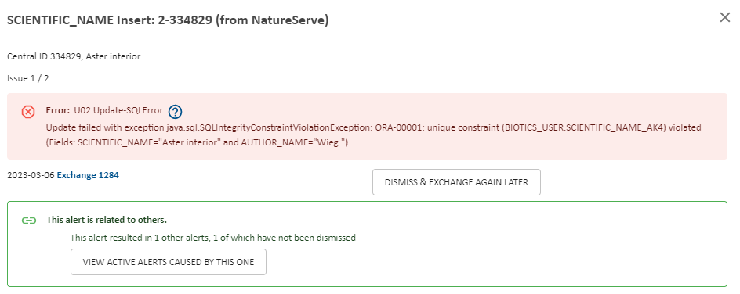
Dealing with Scientific Name Errors
Scientific Name Clash
In the Scientific Name alert:
Dismiss & Exchange Again Later
This will dismiss this alert and the alert it caused in the global synonym grid
After your next exchange you can re-add the Scientific Name to ESTs
Notes:
Show in Workbench

Slide 12
Dealing with Reference Errors
Reference Delete Error
A central Reference record that is used in your EST was deleted
Usually duplicates a record used in many more records
Notes:
Show in Workbench

Slide 13
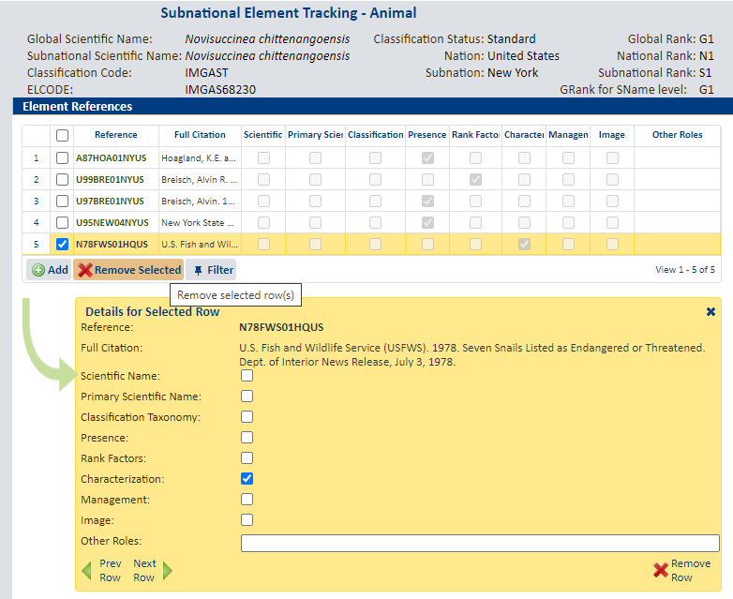
Dealing with Reference Errors
Reference Delete Error
Use Related Record Menu to find EST containing Reference
Remove Reference
Replace with a local copy or the central record this one duplicated
Dismiss Alert
Notes:
Show in Workbench

Slide 14
Using the Workbench Efficiently
Filter by Alert Type: Notifications
Further group by Alert Key
ELCODE
USESA (COSEWIC will be similar)
Global Rank
Global Scientific Name
Re-activated EGT
Classification Status
Changes to Nonstandard
Notes:
Show in Workbench
ELCODE – Rare – important to know if you maintain databases outside Biotics that rely on Elcode
USESA & COSEWIC – rare but important to know
Global Rank – can be important to know
open record (Villosa fabalis), link to EGR and EST to review and update local data if necessary
can tell a lot just from the message (Amnicola clarkei: Q removal, Liatris scariosa and varieties: the ‘real’ change is to var. nieuwlandii)
when there are changes in tax level – you get alerts for Grank and Gname changes
could help to include Gname changes in this set (Eupatorium subvenosum and Asplenium americanum)
– when level changes, Gname & Grank change, Gname change important, rank may not really be changing
- open details to see if local Sname matches Gname; if not consider an update
Remaining Scientific Names
Re-activated EGT – rare, but for any reason, you decide to maintain an EST on an Inactive record, you need to know if it gets re-activated
Changes to Classification Status – can quickly review any changes to Standard (not much here) or Provisional (usually a nonstandard being reconsidered for Standard)
The meat: Changes to Nonstandard

Slide 15
Why Do I Care about Changes to Nonstandard?
X
Nonstandard elements are NOT on Explorer
EOs attached to Nonstandard elements are NOT on Explorer Pro
And on top of that, for species:
You probably accept the STANDARD treatment
Nonstandards represent an older treatment
the concept in your jurisdiction may not have changed
moving your data to the standard may not even require a name change
X
Notes:
Community EOs aren’t Explorer Pro – yet
Species and communities have some important differences here. Nonstandard communities aren’t an older classification – just a different classification.

Slide 16
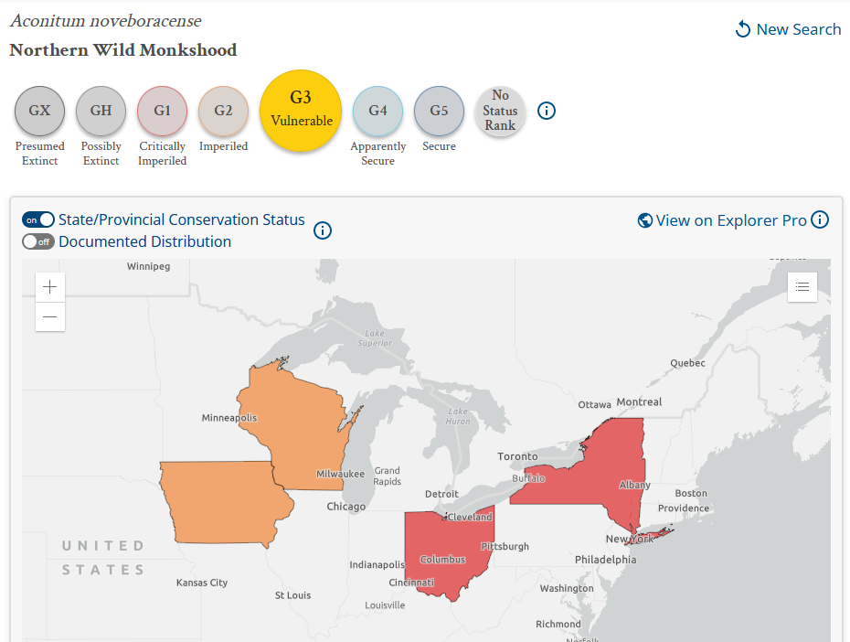
Dealing with Nonstandards
Example (fabricated)
Aconitum noveboracense
western populations distinguished as a separate species:
Aconitum waterlooense
eastern populations are now:
Aconitum noveboracense (sensu stricto)
Notes:
Show in Workbench
Hypothetical example where Aconitum noveboracense is divided into 2 species.
In central, we create records for the 2 new concepts and change the old concept to Nonstandard
We also enter the new concepts as successors of the old
The workbench lets you know about this if you have an EST on the Nonstandard – you get an alert.
From that alert you can see the successors, taxonomic comments, and if you open the record itself: termination comments (Lineage section).
We are still learning about how to document these as clearly as possible so you’ll know what to do.

Slide 17
Using the Workbench Efficiently
Filter by Alert Type: Rejections
EGT Inactivated/Deleted – related EST
R01 EGT/ENT-Deletion;ESTExists
R03 EGT-Inactivated;ESTExists
treat like a Change to Nonstandard Notification
EGT Inactivated/Deleted – related MA
R02 EGT/ENT-Deletion;MAExists
R04 EGT-Inactivated;MAExists
remove element from the Managed Area record
Notes:
Show in Workbench
Duplicate EGTs do get deleted.

Slide 18
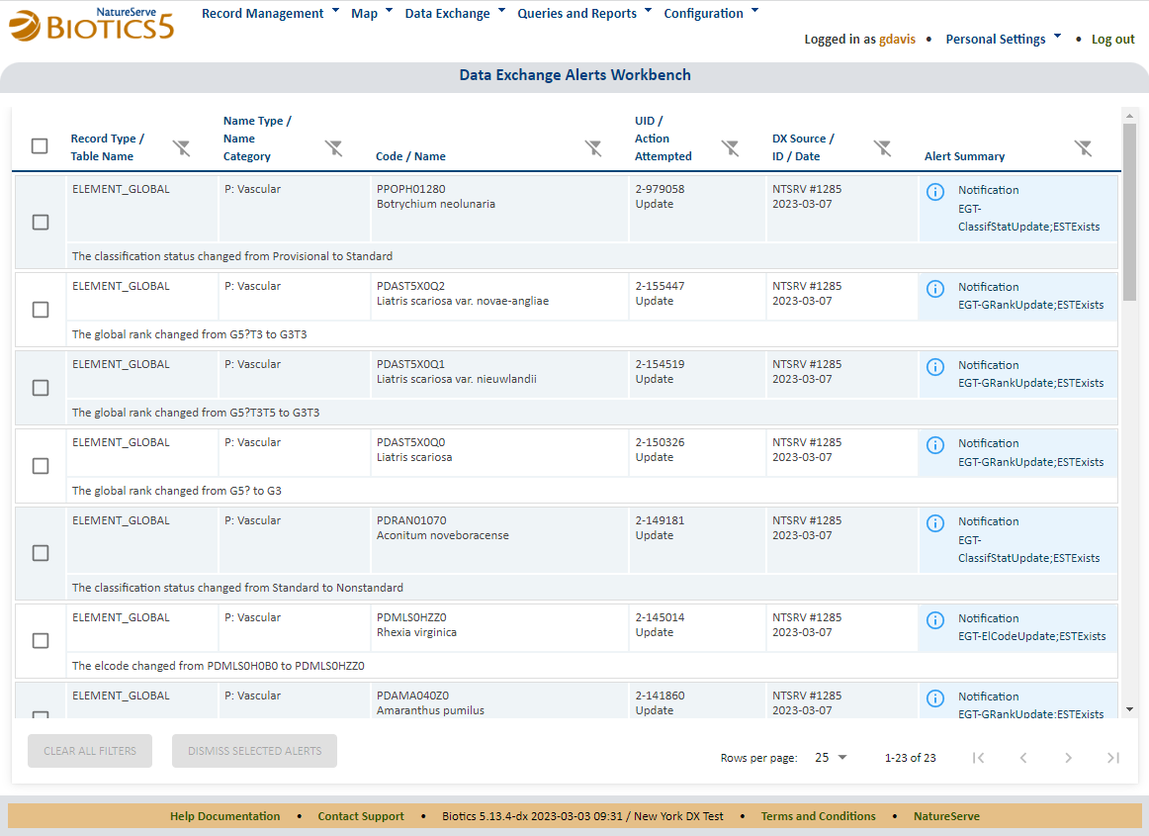

Slide 19
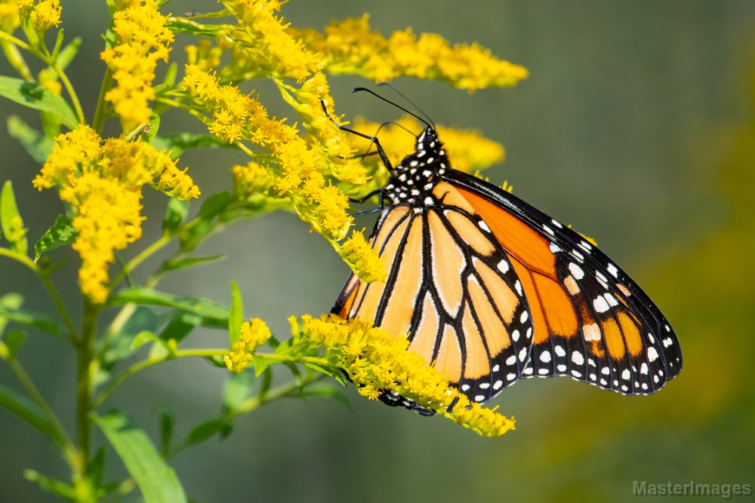
Monarch (Danaus plexippus) nectaring on Goldenrod (Solidago sp.)
NatureServe Global Status: Apparently Secure (G4)
Photo by Larry Master

Slide 20
Brown Bear (Ursus arctos)
NatureServe Global Status: Apparently Secure (G4)
Photo by Larry Master

