Slide 1
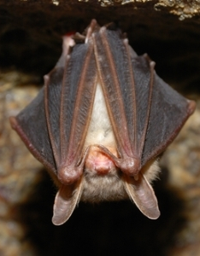
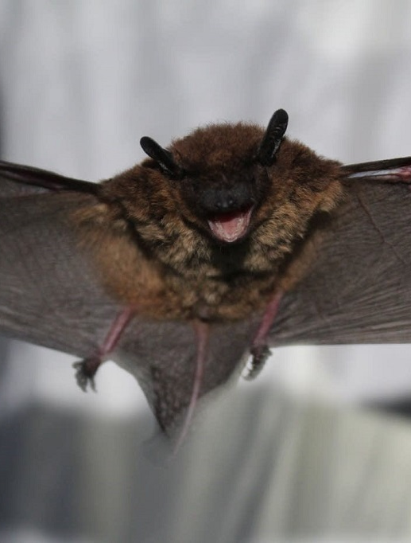
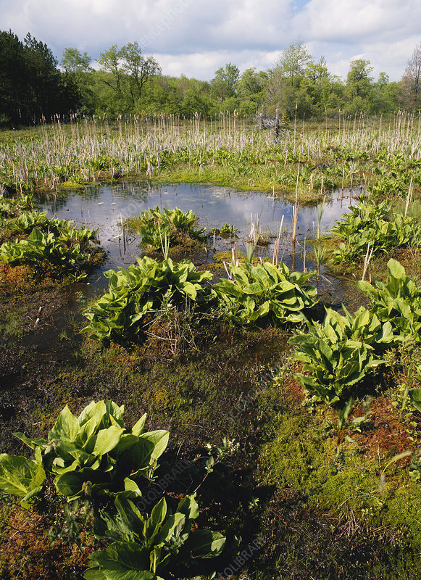
Goal of EO Ranks Session
To be able to describe the methods and benefits of assessing population viability of species and ecological integrity of ecosystems
How is it doing?
2023

Slide 2
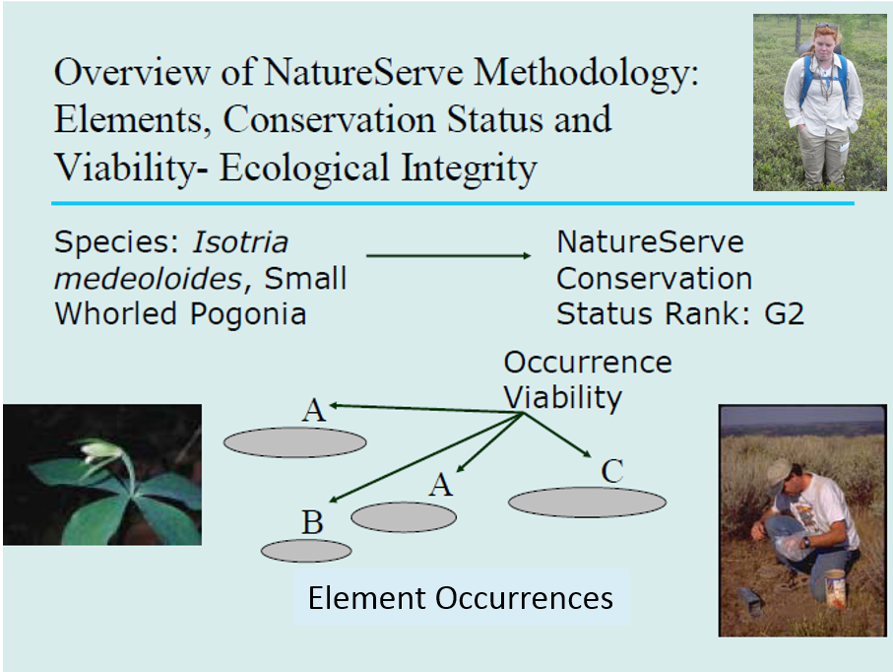
NatureServe Methodology: in a nutshell
Biotics

Slide 3
EO and EORANK
An Element Occurrence (EO) is an area of land and/or water in which a species or ecosystem Element is, or was, present. [Where is it?]
An EO should have practical conservation value for the Element as evidenced by potential continued (or historical) presence (viability, integrity) and/or regular recurrence at a given location. [How is it doing?]

Slide 4
EO and EO Ranking
EOSPECS help ensure that data on EOs are created according to standard processes that facilitate consistency. [Where is it?]
EORANKS: [How is it doing?]
EORANKS provide an estimate of the likelihood that the EO will persist for a period of time if current conditions prevail
  SPECIES: Estimate of viability
  ECOSYSTEMS: Estimate of ecological integrity
  Ranks depend on field or remote sensing data that describe viability / integrity
EORANKSPECS: provide guidance that ensures standard comparisons of estimated viability/integrity between EOs
Notes:
12

Slide 5
Use of EOs and EO Ranks
Prioritize occurrences for conservation/ management action (e.g., Key Biodiversity Areas, Potential Conservation Areas); i.e., focus on the more viable/healthy occurrences.
Determine target areas for survey work
Provide information that contributes to Heritage Conservation Status Ranks for Elements (global, national, and subnational ranks)
Indicate condition of an Element across its known distribution
Monitoring (if coupled with additional viability/integrity data)
Guide restoration

Slide 6
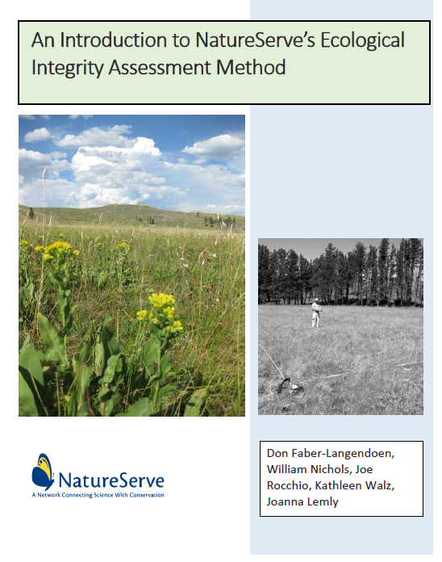
EOs and EORANKS:
Assessing Species Persistence / Ecological Integrity
Ecological Integrity = The ability of an ecosystem to support and maintain a community of organisms that has the biotic composition, diversity, and functional organization comparable to those of natural habitats within a region¹
Increasing ecological integrity
Restoration Milestones
A
“very good”
Key Factors or Attributes
B
“good”
C
“fair”
D
“poor”
Increasing disturbance by stressors
D., D. P. Braun, and R.S. Unnasch. 2003. Are we conserving what we say we are? Measuring ecological integrity within protected areas. BioScience 53: 851-860.
Notes:
KBA standard definition “A condition that supports intact species assemblages and ecological processes in their natural state, relative to an appropriate historical benchmark, and characterised by contiguous natural habitat with minimal direct industrial anthropogenic disturbance.”
See SER definition – accounting for dynamics of climate-induced change near-term. Not historic benchmark noir ‘current without alteration” but where could it be near term given emergent climate change.

Slide 7
Use of EOs and EORANKS:
Guiding Restoration
https://www.youtube.com/watch?v=C131PiiHQcs
In this presentation, what key factors are mentioned that provide the information (provide specifications for) successful restoration.

Slide 8
GENERAL EO GUIDANCE
 | ECOLOGY | ZOOLOGY | BOTANY
EOSPECS [Where is it?] | Generic* | Typically, custom by major groupings or species | Generic*
EORANK-SPECS [How is it doing?] | General to Specific: Customized by major ecosystem types | Generic* | Generic*
* Custom specs may be available for any element; see Biotics
Notes:
Why are these differences across the groupings.

Slide 9
REVIEW: EO SPECIFICATIONS
Element Occurrence Specifications (EOSPECS) are used to delineate and differentiate Source Features that may constitute EOs, based on:
  Minimum size: population size / ecosystem area
  Condition: species viability, ecosystem integrity
  Separation distance: Adjacent Habitat
    (Suitable- unsuitable habitat (species)
    (Dis-) similar habitat (cultural, semi-natural, natural)
  Barriers: e.g., roads, dams

Slide 10
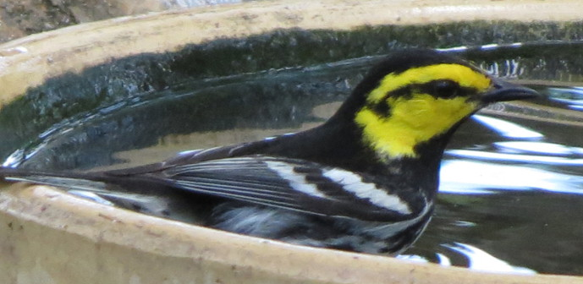
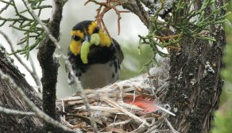
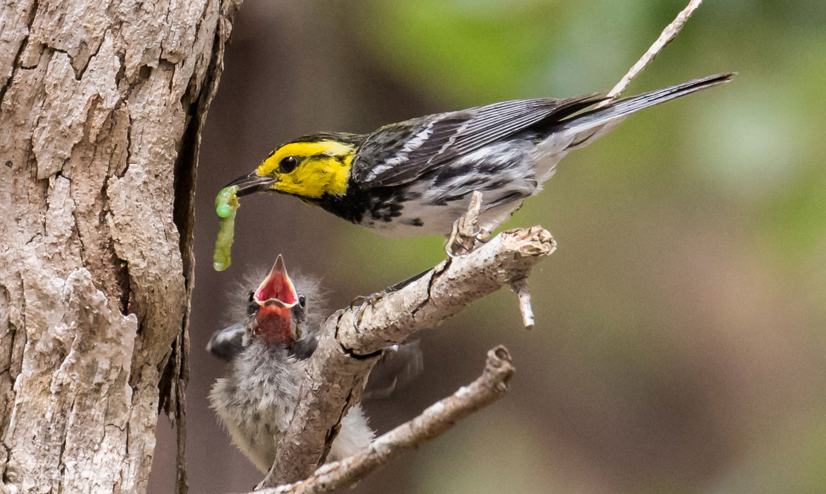
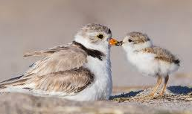
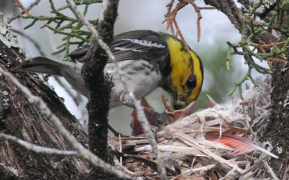
Observations & Element Occurrences
Golden-cheeked Warbler
Setophaga chrysoparia G2 - Imperiled
Observation
Nest 3
Observation
Bird in flight
Observation
Nest 1
Observation
Nest 2
Observation
Nest 4
Observation
Bird in yard
EO Standards
EO 1
EO 2
Observation
Nest 1
Observation
Nest 3
Observation
Nest 4
Observation
Nest 2
Photo credits: Gil Elrich,
Notes:
Same example – different species

Slide 11
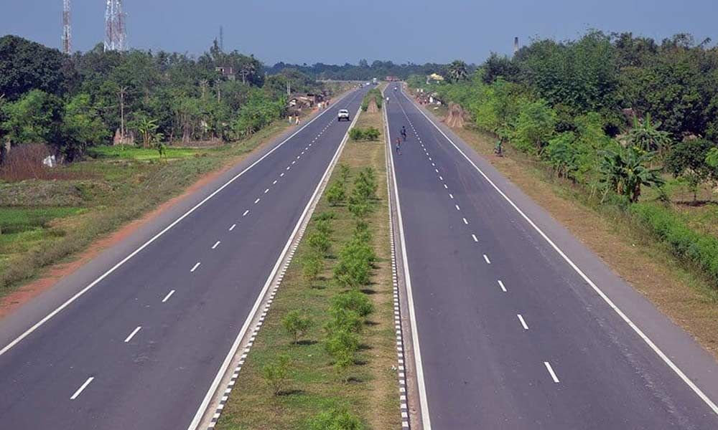
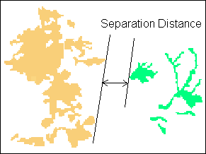
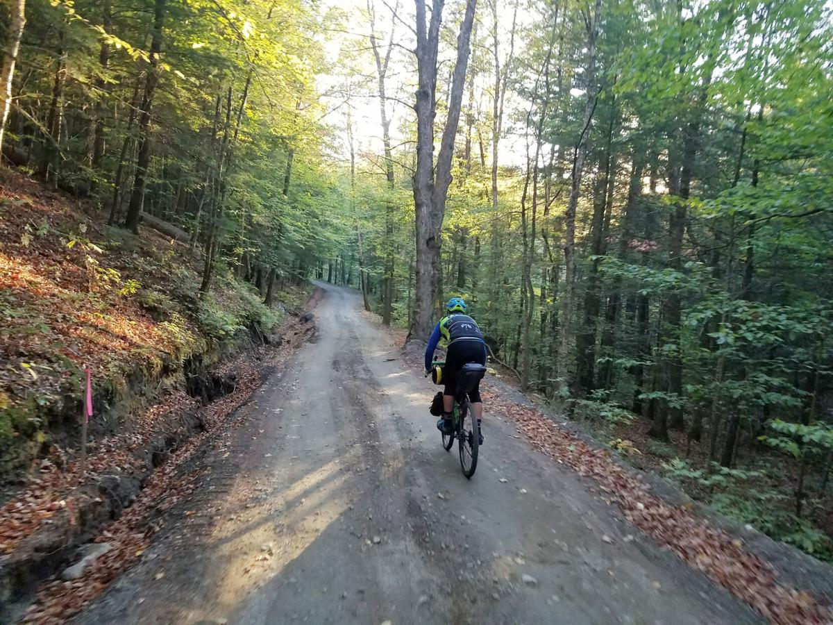
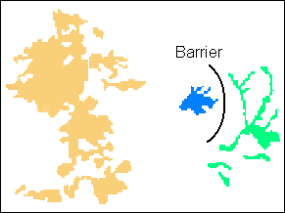
REVIEW:
EOSPECS: Separation Criteria
  Pre-determined separation distance
  Physical barrier acts as separation
Observation
Source Feature
Element Occurrence

Slide 12
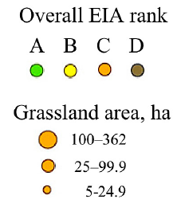
REVIEW: EOSPECS [Where is it?]
EORANKs [How is it doing?]

Slide 13
EO Rank Factors [How is it doing?]
Condition - assessment of reproduction/ health, maturity, composition and structure, ecological processes, abiotic physical/chemical processes, etc.
+ Landscape Context - assessment of spatial patterns of occurrence (fragmentation / connectivity), and condition components
(above)
+ Size - quantitative measure of area of occupancy, abundance, density, fluctuation
Estimated Viability / Ecological Integrity
Notes:
12

Slide 14
Basic EO Ranks
A Excellent
B Good
C Fair
D Poor
E Extant - verified as existing
H Historical - lack of current status data
F Failed to find - not found despite search
X Extirpated - evidence of eradication
U Unrankable - rank cannot be assigned
NR Not ranked - rank not yet assigned
Estimated viability/
ecological integrity
Notes:
12
Ask the audience to provide examples in their state of an A ranked EO.

Slide 15
Ecology EORANKS:
Ecological Integrity
Definition:
  Assessment of structure, composition, ecological processes and connectivity of an ecosystem, compared with the natural or historical range of variation for that ecosystem
Rating:
  Greater ecological integrity indicates that an occurrence is in good condition and more likely to withstand or recover from natural and anthropogenic impacts
Challenges:
  Determining the range of variation for indicators of ecological integrity and identifying the degree to which variation affects the integrity indicators.
Notes:
12

Slide 16
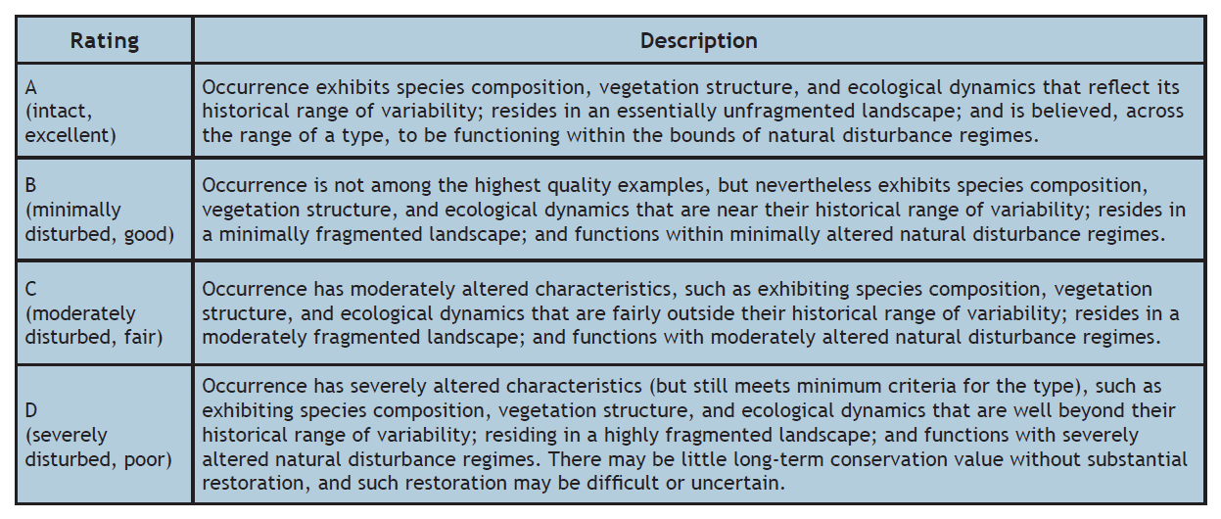
GENERIC ECOLOGY
EORANK SPECS

Slide 17
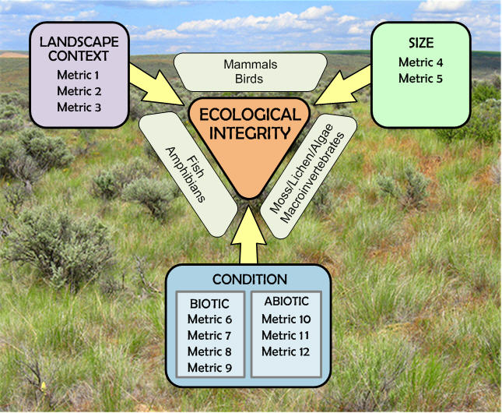
SPECIFIC ECOLOGY EORANKSPECS:
Conceptual Models and Metrics of Ecological Integrity
Temperate Grassland & Shrubland

Slide 18
CONDITION (on-site) METRICS
Native Plant Species Cover (VEG1 metric)
Relative cover of native vascular plant species across strata
Level 2 Metric
A - Excellent | B - Good | C - Fair | D - Poor
A+ >99% A- 95-99% | 85-94% | C- 50–84% | <50%

Slide 19
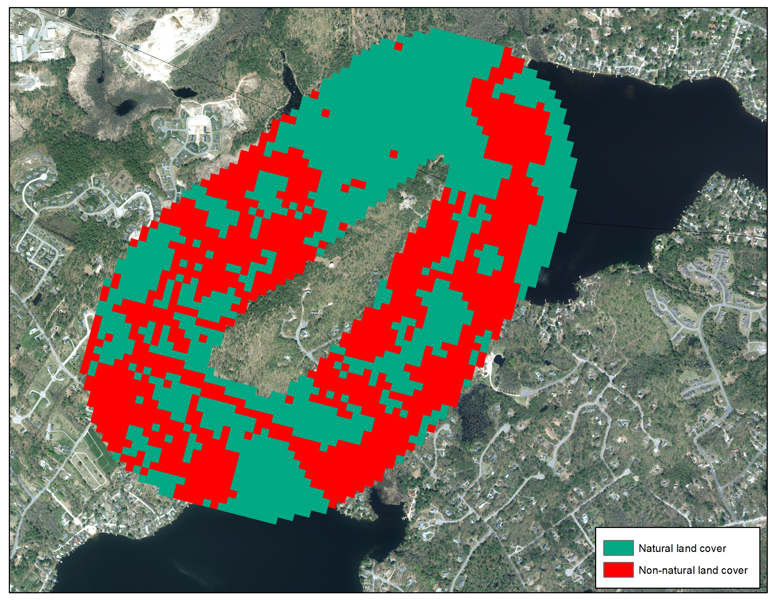
LANDSCAPE CONTEXT METRICS
LAN1: Natural Land Cover
Aerial Imagery Showing
Natural & Non-natural Land Cover Types
Clipped to the 500 m Landscape Envelope
A = >90%
B= 60-90%
C = 20-60%
D<20%

Slide 20
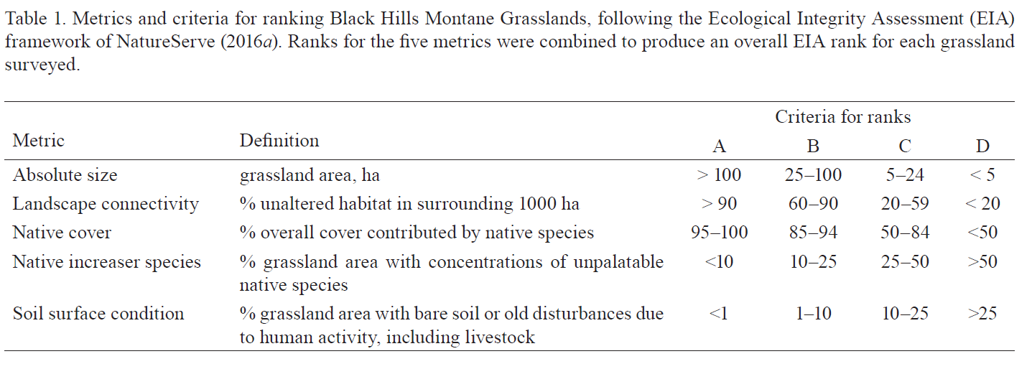
How to Rank Ecology EOs, using Ecological Integrity Concepts
Black Hills Montane Grassland
GOAL FOR ECOLOGY EORANKS
A consistent, repeatable method based on standardized metrics tailored to major ecosystem types

Slide 21
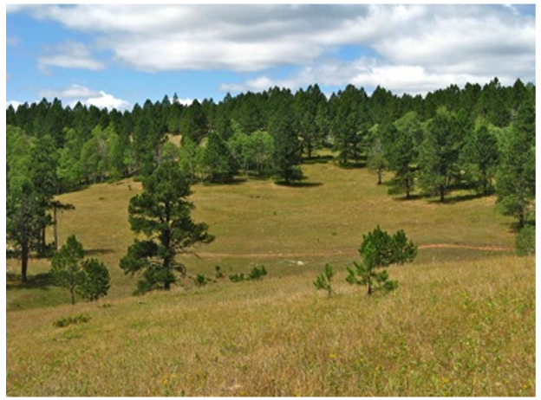
APPLICATION: EIA-based EORANKS

Slide 22

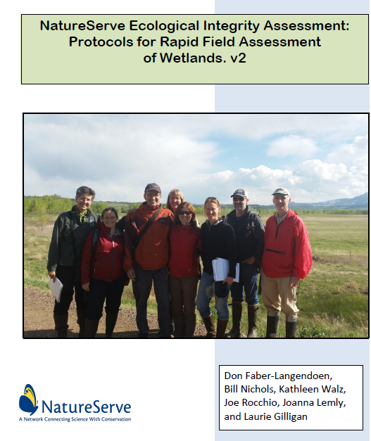
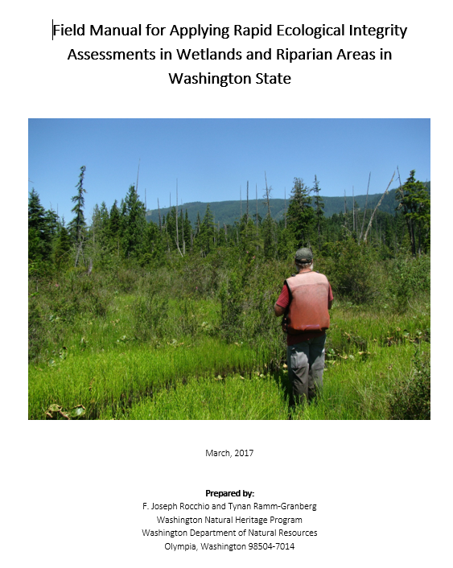
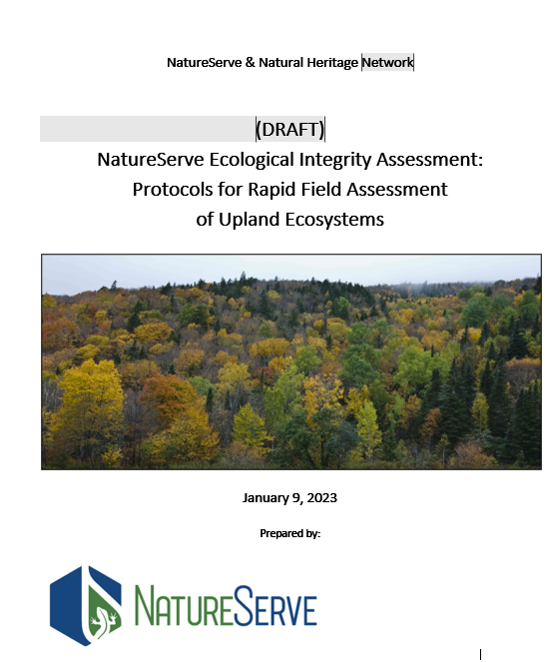

Slide 23
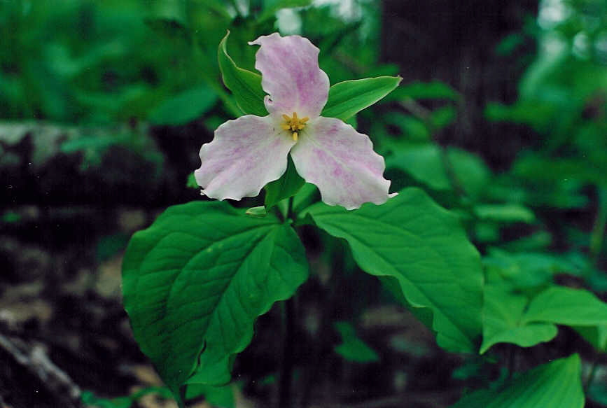
Species Population Viability
(EO Rank Specs and EO Ranks)
Notes:
Ask audience what an EO Rank specifications is?

Slide 24
Species Generic EO Ranking
  EO rank specs previously based on quantitative criteria (size, condition, landscape context): but such data are rarely available/obtainable.
  Generic approach:
    categorical, qualitatively-defined guidelines used to rank occurrences for most species
    focus on occurrences that are potentially rankable as A, B, C, and D – ranks that indicate estimated viability
  Occurrences with no recent observations and/or little data can be ranked as Extant, Historical, Extirpated, Unrankable, or Not Ranked
Notes:
12

Slide 25
Generic Rank Specs Advantages
  Effectively addresses ranking EOs for species that vary demographically according to habitat or region
  Accommodates evaluation of populations and other conservation units (e.g., demes, metapopulations)
  Are less likely to change over time
  Provide EO ranks sufficient for conservation prioritization
Notes:
12
Don, I pasted words from original slide below and shorten the actual slide here:
Qualitative guidelines are used to evaluate probability of persistence instead of precise quantitative criteria for three EO rank factors, which:
Effectively addresses ranking EOs for species that vary demographically according to habitat or region, without different sets of rank specs
Accommodates EOs that represent populations as well as those that define other conservation units
(e.g., demes, metapopulations)
Are less likely to change over time
Are a simplified approach that will provide EO ranks sufficient for conservation prioritization

Slide 26
Supplementing Generic Species EO Ranks
For most species, the new generic EO rank specs guidelines will be used, however
Some species will continue to have individual rank specs providing detailed criteria
A single set of EO rank specs is shared by species belonging to element groups
In these cases, criteria are used to determine estimated viability and an A, B, C, or D rank is assigned if sufficient data are available

Slide 27
How to Rank Species EOs
Evaluate current data on the EO, including size, condition, landscape context as available
Review other ranked occurrences of the species
Decide on likelihood of viability/persistence of EO into foreseeable future, and identify basis for determination
Use Occurrence Ranking Key
Record a rank for the EO
Document rationale for the rank assigned

Slide 28
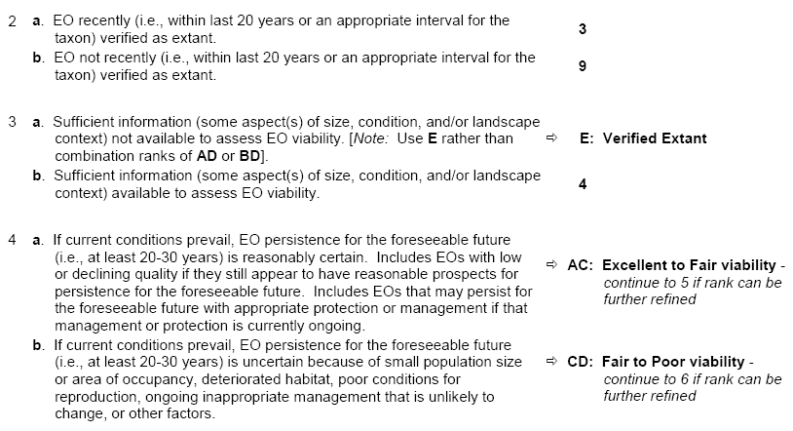
Occurrence Ranking Key
Consistency in generic ranking approach is fostered by use of a newly developed key
Notes:
12

Slide 29
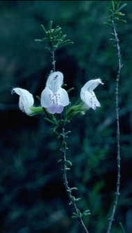
Example 1: Ranking an EO for a…
Perennial plant (Marshallia pulchra)
Isolated relict species of rocky river pavement
Population of many 1,000s of mature individuals in multiple clumps along one section that is part of series of sites along a longer 90-km stretch of river corridor, observed between 2016 and 2021.
Negatively affected by hydrological and sediment transport alterations due to present dam operations; and by recreation.
Suggested rank: BC
Good size, but circumstances indicate a decline
Possible that it could either: persist in good or excellent condition, or undergo continued decline due to current circumstances, jeopardizing viability
Steps in Key:
1b, 2a, 3b,
4a, 5b (BC)
(8a = B rank)

Slide 30
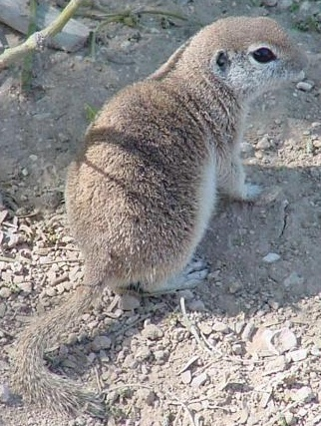
Example 2: Ranking an EO for a…
Small mammal of arid basins
Occurrence extends over at least 100 square kilometers based on random surveys completed in 2018 – 2020.
Habitat condition appears to be relatively unaltered, stable, and compatibly managed
Population size and density are unknown, but the species is readily detected
Suggested rank: AB
Good probability of continued persistence in present condition or better
No factors appear to compromise viability
Steps in Key:
1b, 2a, 3b,
4a, 5a = AB
(7 A or B rank)

Slide 31
EORANK EXERCISE
SPECIES
Marshallia pulchra
Beautiful Barbara's-Buttons
ECOSYSTEM: Association
Common Name: Appalachian Acidic Sandstone Rivershore Prairie
(Betula nigra, Ilex verticillata) / Andropogon gerardii - Solidago simplex var. racemosa Riverscour Wet Meadow

Slide 32
Example 1: Ranking an EO for a… perennial plant: Marshallia pulchra
https://natureserve01.sharepoint.com/:v:/g/teamsites/BWB/Eb23GlpExqdNvMtsBQbECXMBXKhAv6JC0Ujx1GJ3H1sHmg?e=BceXrh

Slide 33

EORANK EXERCISE
Documents:
Assess the information for each of the EOs
Run the information through the Generic Species EORANK key
Assign an EORANK and record it in the spreadsheet, for each EO.
We’ll record your EORANK for each EO using a poll.
2023!
2023!

Slide 34
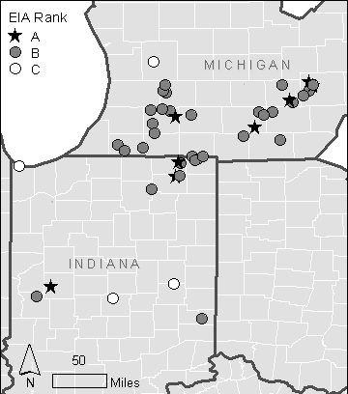
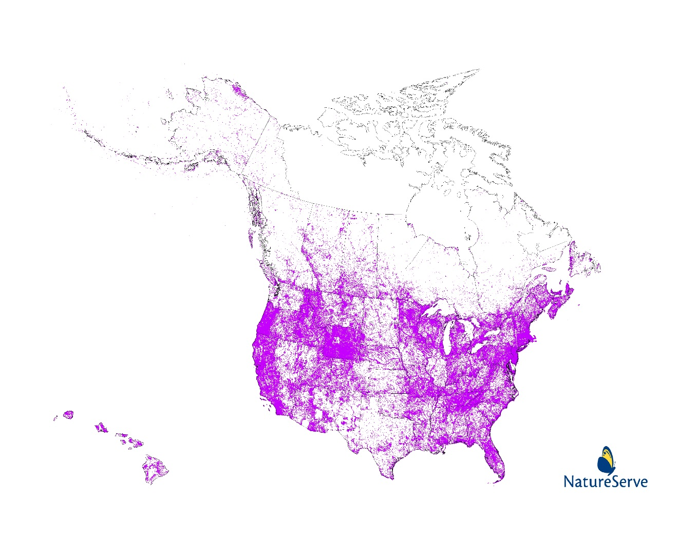
EOs and Conservation Biology
Figure 3. Distribution and EIA ratings of reference wetland sites for Midwest Prairie Alkaline Fen (NVC G183 on usnvc.org). Forty-four sites were visited, (A=9, B=31, C= 4),

Slide 35

EOs and CONSERVATION BIOLOGY:
Fulfilling the mission of maintaining biodiversity.
Ecological Integrity (EI) and the Persistence of Species and Ecosystems.
Can EORANKS (EIAs) tell us which EOs are going to persist in the face of global change (from pollution to poverty), including climate change.
Condition tells us which EOs have survived so far.
Landscape Context – connectivity tells us which ones are likely to persist.
But it means putting EOs into a larger landscape setting. But that’s another workshop.

Slide 36
NatureServe Methodology: in a nutshell

Slide 37
Conclusion
We have described the methods and benefits of assessing population viability of species and ecological integrity of ecosystems.

Slide 38
Sites: Areas of Biodiversity Significance
Site = Potential Conservation Area (PCA)
A potential conservation area is a best estimate of the primary area required to support the long-term survival of targeted species or ecosystems. (CO NHP 2002).
The size and configuration of a PCA will be dictated by the conservation targets (i.e., those species and ecosystems we seek to conserve at a given location) and their sustaining physical features and/or ecological processes greatly influenced by them.

Slide 39
Sites and Biodiversity Ranks
Biodiversity significance ranks (B-ranks) are applied to PCAs. They summarize the global rank and element occurrence rank of the driving element(s) (or the state rank).
Biodiversity Ranks
    B1 – Outstanding biodiversity significance (irreplaceable)
    B2 – Very high biodiversity significance (nearly irreplaceable)
    B3 – High biodiversity significance
    B4 – Moderate biodiversity significance
    B5 – General or local biodiversity significance

Slide 40
Biodiversity Site Ranking Criteria
B1 – Outstanding biodiversity significance (irreplaceable)
• Only known occurrence of an element
• A-ranked occurrence of a G1 element (or at least C-ranked if best available)
• Concentration of A or B-ranked occurrences of G1 or G2 elements (4 or more)
B2 – Very high biodiversity significance (nearly irreplaceable)
…
• One of the most outstanding occurrences rangewide (at least A or B-ranked) of a G3 element
• Concentration of A or B-ranked G3 elements (4 or more)

