Slide 1
AZ ERT 0.10 release tuesday, july 8, 2014 1:30 – 2:30 PM EST

Slide 2
Agenda
New Release – 0.10
Demo
Development Release Plan
Pending Items
Submit Feedback
Discussion/Questions
Notes:
Biotics 4
Living with Aging system
Compatibility issues in new environments (Windows, Oracle)
Other common problems (DM comments)
Phasing out Biotics 4 – Support will continue through FY13 and be phased out in FY14 (discuss with Lori)
Four stages;
Market introduction / General Availability (2003- 2004)
Growth/Extended (2004 – 2010)
Maturity (2010 – 2013)
No new versions or patches
Standard support provided (helpdesk and email)
Continued expansion of online information and Knowledgebase
With release of Biotics 5 in 2013 we will enter the last 12 month of this stage
Limited support provided (helpdesk and email)
New environments not certified
Few updates to online information (i.e., Knowledgebase)
Saturation and decline/Retired (2014) – final phase of Biotics 4
Standard helpdesk and email support ends
Access to very limited support through Biotics 4 online help archives

Slide 3
Release 0.8 - 0.10 Highlights
Map
Add Select a Layer option as default to Resource dropdown in Feature Search tab
Enable Feature Search for map service added via Add Resource tool
Feature Search not returning correct results
Project creation/editing: Select multiple graphics from Upload Shape & Annotations
Project creation: Point & Line features via Upload Shapes
Edit Mode not working in Draw/Edit toolbar
Project Analysis
Add message indicating limited to single Project Type below field title
AGFD Internal Project Compliance
Attach generated shapefile to project
Resolve Counties, Quads, Regions and Township/Ranges for project site during analysis
Refer to FWS attribute instead of ESA in Project Report table
Project Review considered revision and attributed to Anonymous user
Administrative/Miscellaneous
Add acceptance of terms during account creation and prior to viewing map (for non-logged in users)
Admin functionality to assign User Roles
Notes:
Biotics 4
Living with Aging system
Compatibility issues in new environments (Windows, Oracle)
Other common problems (DM comments)
Phasing out Biotics 4 – Support will continue through FY13 and be phased out in FY14 (discuss with Lori)
Four stages;
Market introduction / General Availability (2003- 2004)
Growth/Extended (2004 – 2010)
Maturity (2010 – 2013)
No new versions or patches
Standard support provided (helpdesk and email)
Continued expansion of online information and Knowledgebase
With release of Biotics 5 in 2013 we will enter the last 12 month of this stage
Limited support provided (helpdesk and email)
New environments not certified
Few updates to online information (i.e., Knowledgebase)
Saturation and decline/Retired (2014) – final phase of Biotics 4
Standard helpdesk and email support ends
Access to very limited support through Biotics 4 online help archives

Slide 4
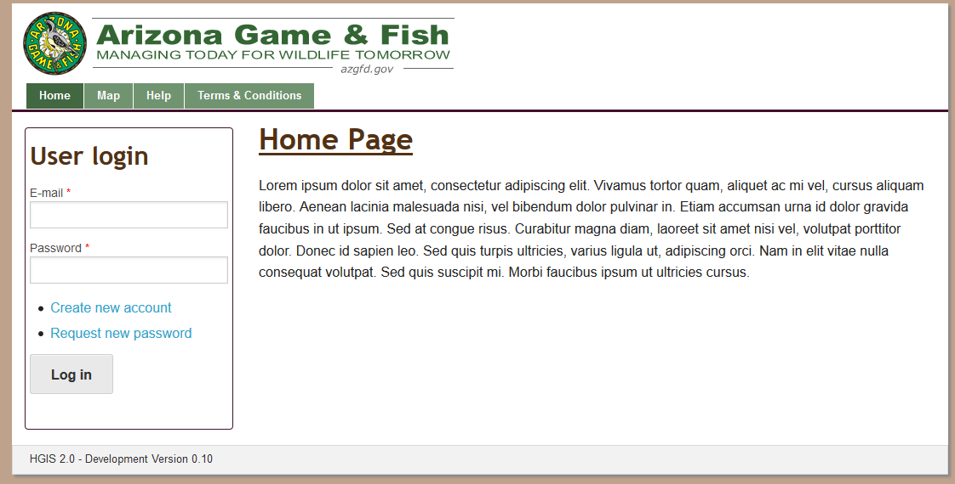
ERT Demo Versions 0.8 – 0.10

Slide 5
Development Release Plan – 0.11
Within Account Details e-mail, use First & Last Name
Alter Find Users page
HGIS site styling
HabiMap integration
Map Help Links
Upload Shapes button click region broken in Firefox and IE
Project shapefiles not generating
Disallow Project Type Edit
Rename Save button in Submit Project (Create Project) dialog to Submit
Pro-forma email functions
Create a single Feature Service for all project boundaries
Notes:
Biotics 4
Living with Aging system
Compatibility issues in new environments (Windows, Oracle)
Other common problems (DM comments)
Phasing out Biotics 4 – Support will continue through FY13 and be phased out in FY14 (discuss with Lori)
Four stages;
Market introduction / General Availability (2003- 2004)
Growth/Extended (2004 – 2010)
Maturity (2010 – 2013)
No new versions or patches
Standard support provided (helpdesk and email)
Continued expansion of online information and Knowledgebase
With release of Biotics 5 in 2013 we will enter the last 12 month of this stage
Limited support provided (helpdesk and email)
New environments not certified
Few updates to online information (i.e., Knowledgebase)
Saturation and decline/Retired (2014) – final phase of Biotics 4
Standard helpdesk and email support ends
Access to very limited support through Biotics 4 online help archives

Slide 6
Development Release Plan – 0.12
Include IBA, SERI & SGCN layers in project analysis
Integrate new map template into report
Complete project configuration (notes)
Provide tab or link to Administrative Tasks
Support Identify tool for raster layers (with attributes)
Identify and Query tool behavior when no fields published
'Loading Page' in IE 10 for map page
Remove items from Edit User page
Tidy up of items on homepage
Make requirement for email verification more obvious
Improve performance with map loading
Notes:
Biotics 4
Living with Aging system
Compatibility issues in new environments (Windows, Oracle)
Other common problems (DM comments)
Phasing out Biotics 4 – Support will continue through FY13 and be phased out in FY14 (discuss with Lori)
Four stages;
Market introduction / General Availability (2003- 2004)
Growth/Extended (2004 – 2010)
Maturity (2010 – 2013)
No new versions or patches
Standard support provided (helpdesk and email)
Continued expansion of online information and Knowledgebase
With release of Biotics 5 in 2013 we will enter the last 12 month of this stage
Limited support provided (helpdesk and email)
New environments not certified
Few updates to online information (i.e., Knowledgebase)
Saturation and decline/Retired (2014) – final phase of Biotics 4
Standard helpdesk and email support ends
Access to very limited support through Biotics 4 online help archives

Slide 7
Development Release Plan – 0.13
Update Project Type buffer configuration
Administration functionality for Project Types, Rules, Triggers, and Report Texts
Save spatial feature edit upon clicking ACCEPT, regardless of user action in Edit Project page
Add are you sure you want to cancel project submission message when X or Cancel out of Create Project
Reflect edit with message indicating edits have been successfully saved
Print to PDF button in Feature Search Results window is smaller than others
Display Review Status on My Project page
Open project PDF to new tab
Notes:
Biotics 4
Living with Aging system
Compatibility issues in new environments (Windows, Oracle)
Other common problems (DM comments)
Phasing out Biotics 4 – Support will continue through FY13 and be phased out in FY14 (discuss with Lori)
Four stages;
Market introduction / General Availability (2003- 2004)
Growth/Extended (2004 – 2010)
Maturity (2010 – 2013)
No new versions or patches
Standard support provided (helpdesk and email)
Continued expansion of online information and Knowledgebase
With release of Biotics 5 in 2013 we will enter the last 12 month of this stage
Limited support provided (helpdesk and email)
New environments not certified
Few updates to online information (i.e., Knowledgebase)
Saturation and decline/Retired (2014) – final phase of Biotics 4
Standard helpdesk and email support ends
Access to very limited support through Biotics 4 online help archives

Slide 8
Pending Items
HabiMap URL
Environmental Review Layer
Important Bird Areas
SGCN layer
SERI layer
Notes:
Biotics 4
Living with Aging system
Compatibility issues in new environments (Windows, Oracle)
Other common problems (DM comments)
Phasing out Biotics 4 – Support will continue through FY13 and be phased out in FY14 (discuss with Lori)
Four stages;
Market introduction / General Availability (2003- 2004)
Growth/Extended (2004 – 2010)
Maturity (2010 – 2013)
No new versions or patches
Standard support provided (helpdesk and email)
Continued expansion of online information and Knowledgebase
With release of Biotics 5 in 2013 we will enter the last 12 month of this stage
Limited support provided (helpdesk and email)
New environments not certified
Few updates to online information (i.e., Knowledgebase)
Saturation and decline/Retired (2014) – final phase of Biotics 4
Standard helpdesk and email support ends
Access to very limited support through Biotics 4 online help archives

Slide 9
Needs Input
Integrate new map template into report
Guidance requested related to what map sizing, what map content would be desired in reports, and under what conditions, etc.
Add acceptance of terms during account creation
As-implemented: Terms and Conditions of Use language is versioned; each user must agree to the latest version upon registration and/or login; version management and agreements are maintained. Administration of T&C language coming in v0.14. Is this sufficient?
AGFD project compliance
Is AOCC (essentially) the only AGFD Special Management layer? We have incorporated logic treating AOCC as a special case, but can redesign if a more generic AGFD Compliance mechanism is needed.
HGIS site styling
Tidy up of items on homepage
Notes:
Biotics 4
Living with Aging system
Compatibility issues in new environments (Windows, Oracle)
Other common problems (DM comments)
Phasing out Biotics 4 – Support will continue through FY13 and be phased out in FY14 (discuss with Lori)
Four stages;
Market introduction / General Availability (2003- 2004)
Growth/Extended (2004 – 2010)
Maturity (2010 – 2013)
No new versions or patches
Standard support provided (helpdesk and email)
Continued expansion of online information and Knowledgebase
With release of Biotics 5 in 2013 we will enter the last 12 month of this stage
Limited support provided (helpdesk and email)
New environments not certified
Few updates to online information (i.e., Knowledgebase)
Saturation and decline/Retired (2014) – final phase of Biotics 4
Standard helpdesk and email support ends
Access to very limited support through Biotics 4 online help archives

Slide 10
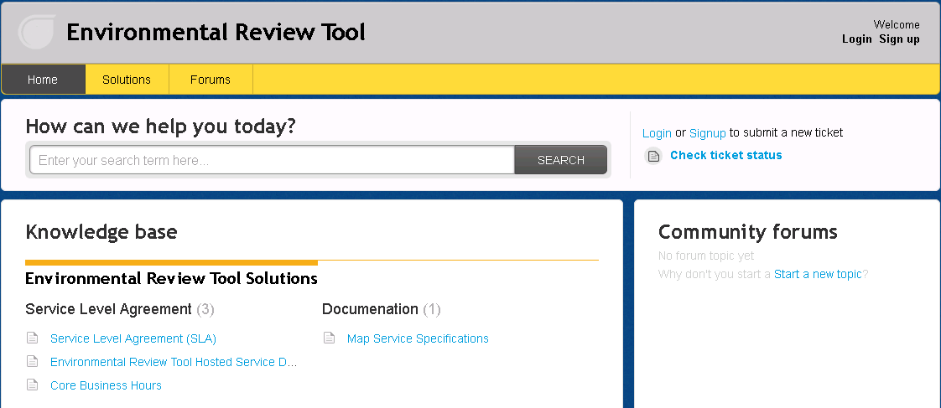
Submit Feedback
Ertsupport.natureserve.org

Slide 11
Discussion/Questions

