Slide 1
Arizona ERT 0.12 release tuesday, july 22, 2014 2:00 – 3:00 PM EST

Slide 2
Agenda
New Release – 0.12
Demo
Development Release Plan
Pending Items
Submit Feedback
Discussion/Questions
Notes:
Biotics 4
Living with Aging system
Compatibility issues in new environments (Windows, Oracle)
Other common problems (DM comments)
Phasing out Biotics 4 – Support will continue through FY13 and be phased out in FY14 (discuss with Lori)
Four stages;
Market introduction / General Availability (2003- 2004)
Growth/Extended (2004 – 2010)
Maturity (2010 – 2013)
No new versions or patches
Standard support provided (helpdesk and email)
Continued expansion of online information and Knowledgebase
With release of Biotics 5 in 2013 we will enter the last 12 month of this stage
Limited support provided (helpdesk and email)
New environments not certified
Few updates to online information (i.e., Knowledgebase)
Saturation and decline/Retired (2014) – final phase of Biotics 4
Standard helpdesk and email support ends
Access to very limited support through Biotics 4 online help archives

Slide 3
Release 0.11 - 0.12 Highlights
Map
Resize Print to PDF button in Feature Search Results window
Provide user friendly error message when no .prj file included in uploaded shapefile
Support Identify tool for raster layers (with attributes)
Disable Identify and Feature Search tools when no fields published
Upload Shapes button click region broken in Firefox and IE
Project Analysis
Set timing expectation in Create Project confirmation
Add SGCN column to species tables
Add widow/orphan control to the species tables in the report.
Project report – sort tabular results on Scientific Name; remove watermark from map page; include feature results from all analysis layers
Integrate new maps into Project report
Remove Security and Signature sections from report
Administrative/Miscellaneous
List All Projects – Add Project ID to table and search option
Disable Project Type edit for all but Evaluators/Administrators
Pro-forma email functions
Within Account Details e-mail, use First & Last Name, not User ID
New user defaults to Customer Role
Notes:
Biotics 4
Living with Aging system
Compatibility issues in new environments (Windows, Oracle)
Other common problems (DM comments)
Phasing out Biotics 4 – Support will continue through FY13 and be phased out in FY14 (discuss with Lori)
Four stages;
Market introduction / General Availability (2003- 2004)
Growth/Extended (2004 – 2010)
Maturity (2010 – 2013)
No new versions or patches
Standard support provided (helpdesk and email)
Continued expansion of online information and Knowledgebase
With release of Biotics 5 in 2013 we will enter the last 12 month of this stage
Limited support provided (helpdesk and email)
New environments not certified
Few updates to online information (i.e., Knowledgebase)
Saturation and decline/Retired (2014) – final phase of Biotics 4
Standard helpdesk and email support ends
Access to very limited support through Biotics 4 online help archives

Slide 4
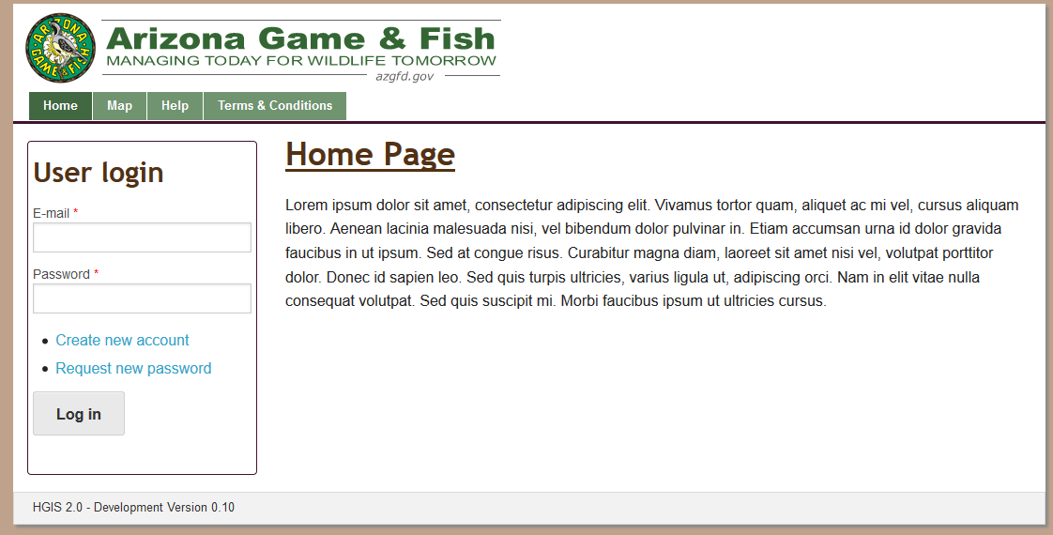
ERT Demo Versions 0.11 – 0.12

Slide 5
Development Release Plan – 0.13
HGIS site styling
Tidy up of items on homepage
Upgrade to ArcGIS Server 10.2.2
Investigate possible export of Feature Search tabular result to CSV
'Loading Page' in IE 10 for map page
Include IBA layer into project analysis
Configure domain values for Project Submission Feature Search
Project shapefiles not generating for all projects
Save spatial feature edit upon clicking ACCEPT, regardless of user action in Edit Project page
Add Notes to complete project configuration
Begin transition process to Esri hosting environment
Display Review Status on My Project page
Administration functionality for Project Types, Rules, Triggers, Report Texts, E-mail templates
Update Project Type buffer configuration
Notes:
Biotics 4
Living with Aging system
Compatibility issues in new environments (Windows, Oracle)
Other common problems (DM comments)
Phasing out Biotics 4 – Support will continue through FY13 and be phased out in FY14 (discuss with Lori)
Four stages;
Market introduction / General Availability (2003- 2004)
Growth/Extended (2004 – 2010)
Maturity (2010 – 2013)
No new versions or patches
Standard support provided (helpdesk and email)
Continued expansion of online information and Knowledgebase
With release of Biotics 5 in 2013 we will enter the last 12 month of this stage
Limited support provided (helpdesk and email)
New environments not certified
Few updates to online information (i.e., Knowledgebase)
Saturation and decline/Retired (2014) – final phase of Biotics 4
Standard helpdesk and email support ends
Access to very limited support through Biotics 4 online help archives

Slide 6
Development Release Plan – 0.14
Sync up content permissions for all functions and roles
Improve Admin menu tab with breadcrumbs and dropdown
Admin support for Terms & Conditions language
Alter User pages to show relevant content
Add are you sure you want to cancel project submission message when X or Cancel out of Create Project
Investigate SGCN layer data restructure
Save Spatial Bookmarks per user
Investigate performance improvements with map loading
Make requirement for email verification more obvious
E-mail Subject not handling ' correctly
Support Access Levels
Incorporate Help Links
Notes:
Biotics 4
Living with Aging system
Compatibility issues in new environments (Windows, Oracle)
Other common problems (DM comments)
Phasing out Biotics 4 – Support will continue through FY13 and be phased out in FY14 (discuss with Lori)
Four stages;
Market introduction / General Availability (2003- 2004)
Growth/Extended (2004 – 2010)
Maturity (2010 – 2013)
No new versions or patches
Standard support provided (helpdesk and email)
Continued expansion of online information and Knowledgebase
With release of Biotics 5 in 2013 we will enter the last 12 month of this stage
Limited support provided (helpdesk and email)
New environments not certified
Few updates to online information (i.e., Knowledgebase)
Saturation and decline/Retired (2014) – final phase of Biotics 4
Standard helpdesk and email support ends
Access to very limited support through Biotics 4 online help archives

Slide 7
Pending Items
Important Bird Areas
SGCN data restructure
Notes:
Biotics 4
Living with Aging system
Compatibility issues in new environments (Windows, Oracle)
Other common problems (DM comments)
Phasing out Biotics 4 – Support will continue through FY13 and be phased out in FY14 (discuss with Lori)
Four stages;
Market introduction / General Availability (2003- 2004)
Growth/Extended (2004 – 2010)
Maturity (2010 – 2013)
No new versions or patches
Standard support provided (helpdesk and email)
Continued expansion of online information and Knowledgebase
With release of Biotics 5 in 2013 we will enter the last 12 month of this stage
Limited support provided (helpdesk and email)
New environments not certified
Few updates to online information (i.e., Knowledgebase)
Saturation and decline/Retired (2014) – final phase of Biotics 4
Standard helpdesk and email support ends
Access to very limited support through Biotics 4 online help archives

Slide 8
Needs Input
Add acceptance of terms during account creation – is this still necessary?
HGIS site styling, including logo colors in site styling
Tidy up of items on homepage
Notes:
Biotics 4
Living with Aging system
Compatibility issues in new environments (Windows, Oracle)
Other common problems (DM comments)
Phasing out Biotics 4 – Support will continue through FY13 and be phased out in FY14 (discuss with Lori)
Four stages;
Market introduction / General Availability (2003- 2004)
Growth/Extended (2004 – 2010)
Maturity (2010 – 2013)
No new versions or patches
Standard support provided (helpdesk and email)
Continued expansion of online information and Knowledgebase
With release of Biotics 5 in 2013 we will enter the last 12 month of this stage
Limited support provided (helpdesk and email)
New environments not certified
Few updates to online information (i.e., Knowledgebase)
Saturation and decline/Retired (2014) – final phase of Biotics 4
Standard helpdesk and email support ends
Access to very limited support through Biotics 4 online help archives

Slide 9
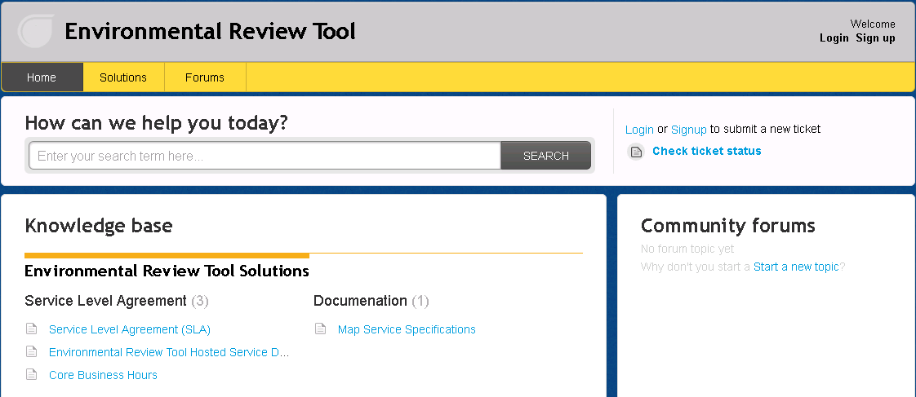
Submit Feedback
Ertsupport.natureserve.org

Slide 10
Discussion/Questions

