Slide 1
Arizona ERT 0.14 release wednesday, august 6, 2014 2:00 – 3:00 PM EST

Slide 2
Agenda
New Release – 0.14
Demo
Development Release Plan
Pending Items
Submit Feedback
Discussion/Questions
Notes:
Biotics 4
Living with Aging system
Compatibility issues in new environments (Windows, Oracle)
Other common problems (DM comments)
Phasing out Biotics 4 – Support will continue through FY13 and be phased out in FY14 (discuss with Lori)
Four stages;
Market introduction / General Availability (2003- 2004)
Growth/Extended (2004 – 2010)
Maturity (2010 – 2013)
No new versions or patches
Standard support provided (helpdesk and email)
Continued expansion of online information and Knowledgebase
With release of Biotics 5 in 2013 we will enter the last 12 month of this stage
Limited support provided (helpdesk and email)
New environments not certified
Few updates to online information (i.e., Knowledgebase)
Saturation and decline/Retired (2014) – final phase of Biotics 4
Standard helpdesk and email support ends
Access to very limited support through Biotics 4 online help archives

Slide 3
Release 0.13 - 0.14 Highlights
Map
Snap Tool
Add Cancel Edit button in Edit boundary map page
List UTM Zone 12 in Projection dropdown rather than UTM Zone 17 & 18
Disable Identify and Feature Search tools when no fields published
Project Analysis
Repeat table header if table continues on multiple pages
Remove project location details from report body – instead, add them to maps
Remove Overview Map (map 1) – add as inset in 1st map
Include SERI, SGCN, & IBA layers into project analysis
Updates to Project Report table, per document provided by AZGFD
Administrative/Miscellaneous
Login page updated
Background replaced with green gradient
Tab to Administrative tasks
Administrative functionality for Home & Contact pages
Administrative functionality for Layer Groups & Layers
Administrative functionality for Rules & Triggers
Administrative functionality for Report Text, Email templates
Notes:
Biotics 4
Living with Aging system
Compatibility issues in new environments (Windows, Oracle)
Other common problems (DM comments)
Phasing out Biotics 4 – Support will continue through FY13 and be phased out in FY14 (discuss with Lori)
Four stages;
Market introduction / General Availability (2003- 2004)
Growth/Extended (2004 – 2010)
Maturity (2010 – 2013)
No new versions or patches
Standard support provided (helpdesk and email)
Continued expansion of online information and Knowledgebase
With release of Biotics 5 in 2013 we will enter the last 12 month of this stage
Limited support provided (helpdesk and email)
New environments not certified
Few updates to online information (i.e., Knowledgebase)
Saturation and decline/Retired (2014) – final phase of Biotics 4
Standard helpdesk and email support ends
Access to very limited support through Biotics 4 online help archives

Slide 4
ERT Demo Versions 0.13 – 0.14

Slide 5
Development Release Plan – 0.15
Admin function for Project Types
List All Projects: add Primary Project Type search and add to table
Update Project Type buffer configuration
Configure domain values within Feature Search tool for Project Submission layer
Add Notes to Project
Improve performance with map loading
Complete project configuration
Investigate possible export to CSV of tabular results
'Loading Page' in IE 10 for map page
Make requirement for email verification more obvious
Transition to Esri hosting environment – ongoing
Notes:
Biotics 4
Living with Aging system
Compatibility issues in new environments (Windows, Oracle)
Other common problems (DM comments)
Phasing out Biotics 4 – Support will continue through FY13 and be phased out in FY14 (discuss with Lori)
Four stages;
Market introduction / General Availability (2003- 2004)
Growth/Extended (2004 – 2010)
Maturity (2010 – 2013)
No new versions or patches
Standard support provided (helpdesk and email)
Continued expansion of online information and Knowledgebase
With release of Biotics 5 in 2013 we will enter the last 12 month of this stage
Limited support provided (helpdesk and email)
New environments not certified
Few updates to online information (i.e., Knowledgebase)
Saturation and decline/Retired (2014) – final phase of Biotics 4
Standard helpdesk and email support ends
Access to very limited support through Biotics 4 online help archives

Slide 6
Development Release Plan – 0.16
Report maps - legend not showing and/or labeled
Change font for Project Review Results, Project Type headers
Remove elements from Edit User page
Add are you sure you want to cancel project submission message when X or Cancel out of Create Project
Alter Find Users page
Admin Terms & Conditions language
Map Help Links
Add ? with link to context sensitive help topic to every dialog
E-mail Subject not handling ' correctly
System error handling
Guard against multiple Project Submissions entries for forced reruns
Confirmation email not sent upon project review completion
Notes:
Biotics 4
Living with Aging system
Compatibility issues in new environments (Windows, Oracle)
Other common problems (DM comments)
Phasing out Biotics 4 – Support will continue through FY13 and be phased out in FY14 (discuss with Lori)
Four stages;
Market introduction / General Availability (2003- 2004)
Growth/Extended (2004 – 2010)
Maturity (2010 – 2013)
No new versions or patches
Standard support provided (helpdesk and email)
Continued expansion of online information and Knowledgebase
With release of Biotics 5 in 2013 we will enter the last 12 month of this stage
Limited support provided (helpdesk and email)
New environments not certified
Few updates to online information (i.e., Knowledgebase)
Saturation and decline/Retired (2014) – final phase of Biotics 4
Standard helpdesk and email support ends
Access to very limited support through Biotics 4 online help archives

Slide 7
Development Release Plan – 0.17
Add link to Email Template form for token help
Redirect after node deletion
Create Internal Staging Env
Upgrade to ArcGIS Server 10.2.2
Open project PDF to new tab
Annotation text not displayed correctly with selected color, size, bolding in Print layout
Handling of legacy data (AZHGIS 1.0 project files)
User customized Help Docs
Any remaining site styling issues
Notes:
Biotics 4
Living with Aging system
Compatibility issues in new environments (Windows, Oracle)
Other common problems (DM comments)
Phasing out Biotics 4 – Support will continue through FY13 and be phased out in FY14 (discuss with Lori)
Four stages;
Market introduction / General Availability (2003- 2004)
Growth/Extended (2004 – 2010)
Maturity (2010 – 2013)
No new versions or patches
Standard support provided (helpdesk and email)
Continued expansion of online information and Knowledgebase
With release of Biotics 5 in 2013 we will enter the last 12 month of this stage
Limited support provided (helpdesk and email)
New environments not certified
Few updates to online information (i.e., Knowledgebase)
Saturation and decline/Retired (2014) – final phase of Biotics 4
Standard helpdesk and email support ends
Access to very limited support through Biotics 4 online help archives

Slide 8
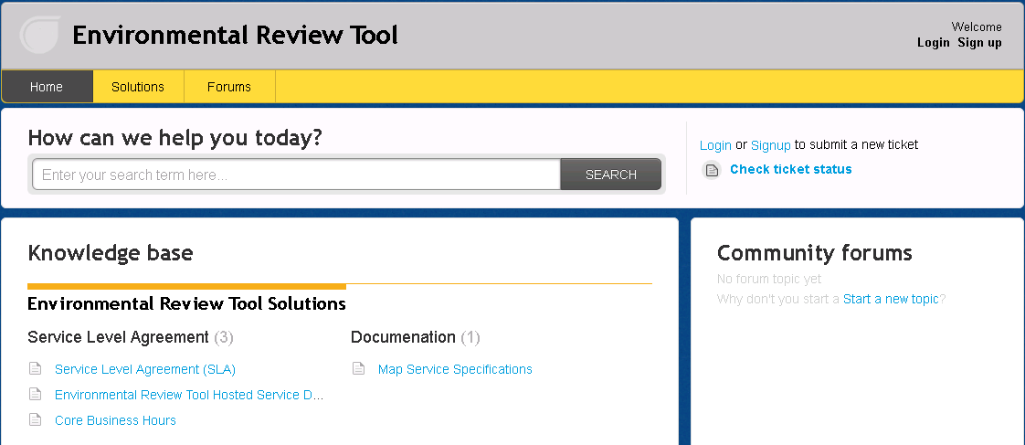
Submit Feedback
Ertsupport.natureserve.org

Slide 9
Discussion/Questions

