Slide 1
AZ ERT 0.7 release tuesday, june 17, 2014 4:00 – 5:00 PM EST

Slide 2
Agenda
New Release – 0.7
Demo
Development Release Plan
Pending
Submit Feedback
Discussion/Questions
Notes:
Biotics 4
Living with Aging system
Compatibility issues in new environments (Windows, Oracle)
Other common problems (DM comments)
Phasing out Biotics 4 – Support will continue through FY13 and be phased out in FY14 (discuss with Lori)
Four stages;
Market introduction / General Availability (2003- 2004)
Growth/Extended (2004 – 2010)
Maturity (2010 – 2013)
No new versions or patches
Standard support provided (helpdesk and email)
Continued expansion of online information and Knowledgebase
With release of Biotics 5 in 2013 we will enter the last 12 month of this stage
Limited support provided (helpdesk and email)
New environments not certified
Few updates to online information (i.e., Knowledgebase)
Saturation and decline/Retired (2014) – final phase of Biotics 4
Standard helpdesk and email support ends
Access to very limited support through Biotics 4 online help archives

Slide 3
Release 0.7 Highlights
Site theme look/colors updated to AZGFD
Incorporated new map layers
Created layer domain tables & configured Feature Search to use domain tables
Allow multi-part feature projects
Allow project area to be defined by Point, Line, and/or Polygon
Create Project from Annotations in Make a Map tool
Zoom to appropriate extent (data no longer being truncated)
Allow editing of project, including versioning & Save/Final Status
Rename Project Report to reflect Report Title, Version, and Status
Help Documentation opens in new tab
Registration e-mail verification link moved to bottom of e-mail
Help Documentation: How To, About AZGFD
Notes:
Biotics 4
Living with Aging system
Compatibility issues in new environments (Windows, Oracle)
Other common problems (DM comments)
Phasing out Biotics 4 – Support will continue through FY13 and be phased out in FY14 (discuss with Lori)
Four stages;
Market introduction / General Availability (2003- 2004)
Growth/Extended (2004 – 2010)
Maturity (2010 – 2013)
No new versions or patches
Standard support provided (helpdesk and email)
Continued expansion of online information and Knowledgebase
With release of Biotics 5 in 2013 we will enter the last 12 month of this stage
Limited support provided (helpdesk and email)
New environments not certified
Few updates to online information (i.e., Knowledgebase)
Saturation and decline/Retired (2014) – final phase of Biotics 4
Standard helpdesk and email support ends
Access to very limited support through Biotics 4 online help archives

Slide 4
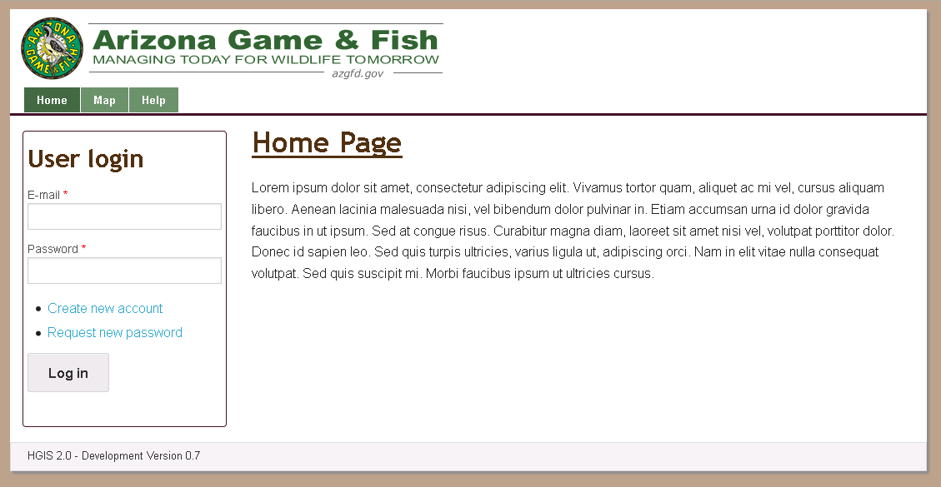
ERT 0.7 Demo

Slide 5
Development Release Plan
Release 0.8
Select multiple graphics from Upload Shape & Annotations during Project creation/editing
Integrate new map template into report
Add acceptance of terms during account creation and prior to viewing map (for non-logged in users)
Attach generated shapefile to project
‘Loading Page’ in IE 10 for map page
Notes:
Biotics 4
Living with Aging system
Compatibility issues in new environments (Windows, Oracle)
Other common problems (DM comments)
Phasing out Biotics 4 – Support will continue through FY13 and be phased out in FY14 (discuss with Lori)
Four stages;
Market introduction / General Availability (2003- 2004)
Growth/Extended (2004 – 2010)
Maturity (2010 – 2013)
No new versions or patches
Standard support provided (helpdesk and email)
Continued expansion of online information and Knowledgebase
With release of Biotics 5 in 2013 we will enter the last 12 month of this stage
Limited support provided (helpdesk and email)
New environments not certified
Few updates to online information (i.e., Knowledgebase)
Saturation and decline/Retired (2014) – final phase of Biotics 4
Standard helpdesk and email support ends
Access to very limited support through Biotics 4 online help archives

Slide 6
Development Release Plan
Release 0.9
Allow Create Project from Point & Line features via Upload Shapes
Resolve Counties & Quads for project site during analysis
Move message indicating limited to single Project Type below field title
HabiMap integration
Change project review ‘revision’ from ‘Anonymous’ user to ‘Project Review’
Notes:
Biotics 4
Living with Aging system
Compatibility issues in new environments (Windows, Oracle)
Other common problems (DM comments)
Phasing out Biotics 4 – Support will continue through FY13 and be phased out in FY14 (discuss with Lori)
Four stages;
Market introduction / General Availability (2003- 2004)
Growth/Extended (2004 – 2010)
Maturity (2010 – 2013)
No new versions or patches
Standard support provided (helpdesk and email)
Continued expansion of online information and Knowledgebase
With release of Biotics 5 in 2013 we will enter the last 12 month of this stage
Limited support provided (helpdesk and email)
New environments not certified
Few updates to online information (i.e., Knowledgebase)
Saturation and decline/Retired (2014) – final phase of Biotics 4
Standard helpdesk and email support ends
Access to very limited support through Biotics 4 online help archives

Slide 7
Development Release Plan
Release 0.10
Integrate Project e-mail functionality for Evaluators
Create a single Feature Service to include all Project spatial boundaries
Incorporate administration functionality for Rules, Triggers, & Report Texts
Complete remaining HGIS site styling
AGFD Internal Project Compliance
Notes:
Biotics 4
Living with Aging system
Compatibility issues in new environments (Windows, Oracle)
Other common problems (DM comments)
Phasing out Biotics 4 – Support will continue through FY13 and be phased out in FY14 (discuss with Lori)
Four stages;
Market introduction / General Availability (2003- 2004)
Growth/Extended (2004 – 2010)
Maturity (2010 – 2013)
No new versions or patches
Standard support provided (helpdesk and email)
Continued expansion of online information and Knowledgebase
With release of Biotics 5 in 2013 we will enter the last 12 month of this stage
Limited support provided (helpdesk and email)
New environments not certified
Few updates to online information (i.e., Knowledgebase)
Saturation and decline/Retired (2014) – final phase of Biotics 4
Standard helpdesk and email support ends
Access to very limited support through Biotics 4 online help archives

Slide 8
Pending
HabiMap URL
Environmental Review Layer
Important Bird Areas
SGCN layer
SERI layer
AGFD Project Compliance Rules
Notes:
Biotics 4
Living with Aging system
Compatibility issues in new environments (Windows, Oracle)
Other common problems (DM comments)
Phasing out Biotics 4 – Support will continue through FY13 and be phased out in FY14 (discuss with Lori)
Four stages;
Market introduction / General Availability (2003- 2004)
Growth/Extended (2004 – 2010)
Maturity (2010 – 2013)
No new versions or patches
Standard support provided (helpdesk and email)
Continued expansion of online information and Knowledgebase
With release of Biotics 5 in 2013 we will enter the last 12 month of this stage
Limited support provided (helpdesk and email)
New environments not certified
Few updates to online information (i.e., Knowledgebase)
Saturation and decline/Retired (2014) – final phase of Biotics 4
Standard helpdesk and email support ends
Access to very limited support through Biotics 4 online help archives

Slide 9
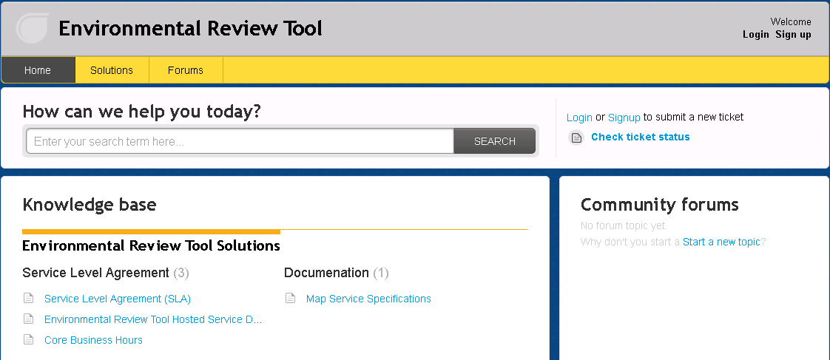
Submit Feedback
Ertsupport.natureserve.org

Slide 10
Discussion/Questions

