Slide 1
Arizona ERT site styling friday, july 25, 2014 11:30 – 12:30 PM EST

Slide 2
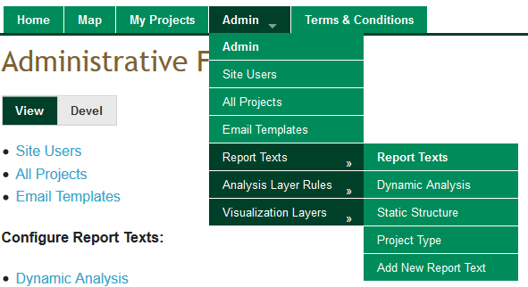
Release 0.13
Breadcrumbs removed
Menu dropdowns
Notes:
Biotics 4
Living with Aging system
Compatibility issues in new environments (Windows, Oracle)
Other common problems (DM comments)
Phasing out Biotics 4 – Support will continue through FY13 and be phased out in FY14 (discuss with Lori)
Four stages;
Market introduction / General Availability (2003- 2004)
Growth/Extended (2004 – 2010)
Maturity (2010 – 2013)
No new versions or patches
Standard support provided (helpdesk and email)
Continued expansion of online information and Knowledgebase
With release of Biotics 5 in 2013 we will enter the last 12 month of this stage
Limited support provided (helpdesk and email)
New environments not certified
Few updates to online information (i.e., Knowledgebase)
Saturation and decline/Retired (2014) – final phase of Biotics 4
Standard helpdesk and email support ends
Access to very limited support through Biotics 4 online help archives

Slide 3
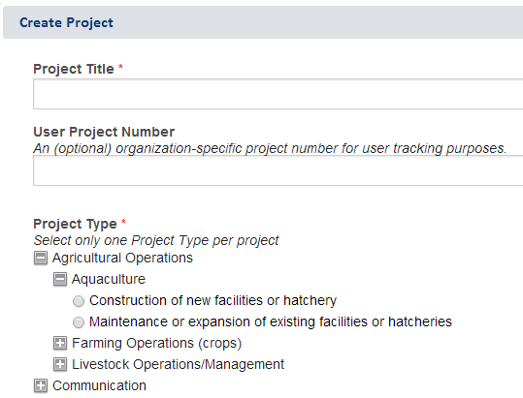
Release 0.13
Create Project dialog updated
Notes:
Biotics 4
Living with Aging system
Compatibility issues in new environments (Windows, Oracle)
Other common problems (DM comments)
Phasing out Biotics 4 – Support will continue through FY13 and be phased out in FY14 (discuss with Lori)
Four stages;
Market introduction / General Availability (2003- 2004)
Growth/Extended (2004 – 2010)
Maturity (2010 – 2013)
No new versions or patches
Standard support provided (helpdesk and email)
Continued expansion of online information and Knowledgebase
With release of Biotics 5 in 2013 we will enter the last 12 month of this stage
Limited support provided (helpdesk and email)
New environments not certified
Few updates to online information (i.e., Knowledgebase)
Saturation and decline/Retired (2014) – final phase of Biotics 4
Standard helpdesk and email support ends
Access to very limited support through Biotics 4 online help archives

Slide 4
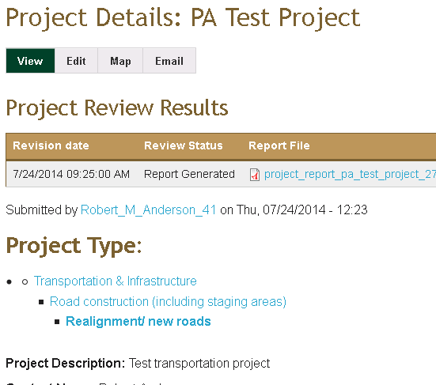
Identified for future release
Project Details
Project Review Results
Project Type
Project Type values
Grey out disabled form fields
Notes:
Biotics 4
Living with Aging system
Compatibility issues in new environments (Windows, Oracle)
Other common problems (DM comments)
Phasing out Biotics 4 – Support will continue through FY13 and be phased out in FY14 (discuss with Lori)
Four stages;
Market introduction / General Availability (2003- 2004)
Growth/Extended (2004 – 2010)
Maturity (2010 – 2013)
No new versions or patches
Standard support provided (helpdesk and email)
Continued expansion of online information and Knowledgebase
With release of Biotics 5 in 2013 we will enter the last 12 month of this stage
Limited support provided (helpdesk and email)
New environments not certified
Few updates to online information (i.e., Knowledgebase)
Saturation and decline/Retired (2014) – final phase of Biotics 4
Standard helpdesk and email support ends
Access to very limited support through Biotics 4 online help archives

Slide 5
Needs Input
Background?
Colors?
Any feedback regarding styling
Review Report follow-up questions:
Submitted By
Include a brief header when no documented conflicts found?
Would SERI or SGCN ever have Report Text associated for including in the Recommendations Section?
Notes:
Biotics 4
Living with Aging system
Compatibility issues in new environments (Windows, Oracle)
Other common problems (DM comments)
Phasing out Biotics 4 – Support will continue through FY13 and be phased out in FY14 (discuss with Lori)
Four stages;
Market introduction / General Availability (2003- 2004)
Growth/Extended (2004 – 2010)
Maturity (2010 – 2013)
No new versions or patches
Standard support provided (helpdesk and email)
Continued expansion of online information and Knowledgebase
With release of Biotics 5 in 2013 we will enter the last 12 month of this stage
Limited support provided (helpdesk and email)
New environments not certified
Few updates to online information (i.e., Knowledgebase)
Saturation and decline/Retired (2014) – final phase of Biotics 4
Standard helpdesk and email support ends
Access to very limited support through Biotics 4 online help archives

Slide 6
Discussion/Questions

