Slide 1
Pennsylvania
Conservation Opportunity Area Tool
Development Kickoff
June 8, 2018

Slide 2
Overview
Review Environmental Review Tool History and Platform
Proposed Project Schedule
ERT Help Desk Support and GIS Data Preparation Guidelines
Questions

Slide 3
NatureServe ERT History
Development lineage
  1st Generation ERT – VA NHDE (2013)
  2nd Generation ERT Core
    2014: AZ & NC
    2015: MO
    2016: PA
    2017: NE & VA (v2.0)
    2018: NM & KY

Slide 4
ERT Platform
Website : Apache/PHP/Drupal
GIS : ArcGIS Server 10.x
  Secure GIS Assets
  Review geoprocessing
  Map Utility Services
Database : MS SQLServer

Slide 5
COA Tool Near-Term Development
Phase 1:
  Stand up environment
  Obtain and publish GIS data, as available
  Deploy ERT Core with basic functions
Phase 2:
  Iteratively Develop Custom COA Functionality
  Frequent Releases for Review and Feedback
  Periodic check-in meetings

Slide 6
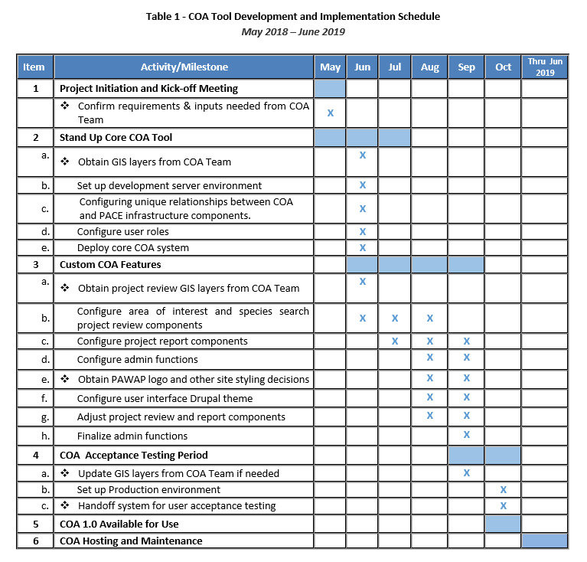
Proposed Project Schedule

Slide 7
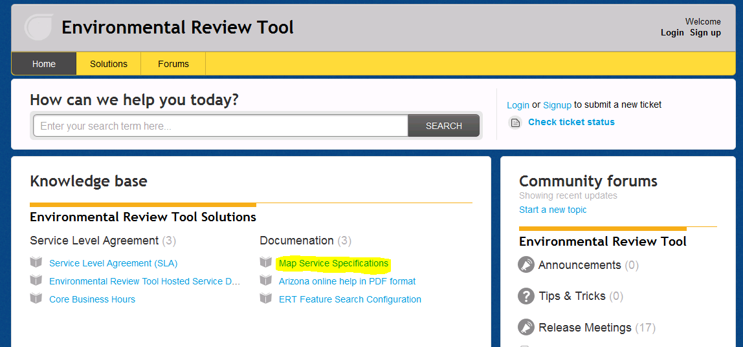
ERT Help Desk Support http://ertsupport.natureserve.org

