Slide 1
Pennsylvania Conservation Opportunity Area Tool
Development Release v0.1
July 3, 2018

Slide 2
Agenda
Review Base Functionality Items
Demo Site Release v0.1
Review Next Release v0.2
Pending Items
Questions

Slide 3
Base Functionality v0.1
Phase 1:
Stand Up Development Site
Map Viewer with core functionality
User management
Site Admin functionality

Slide 4
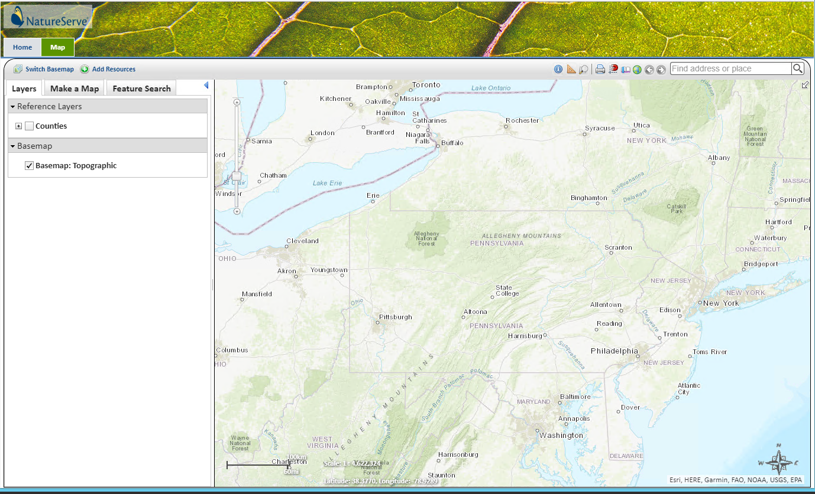
Demo Dev Site https://coapadev.natureserve.org

Slide 5
Development Release v0.2
Project Type Selection
Begin AOI workflow
AOI geoprocessing to obtain results
First draft of AOI project report

Slide 6
Pending Items / Questions
Site specific map layers
Site Theme background
SSS Review
Sample Report
Multiple Species per Report?

Slide 7
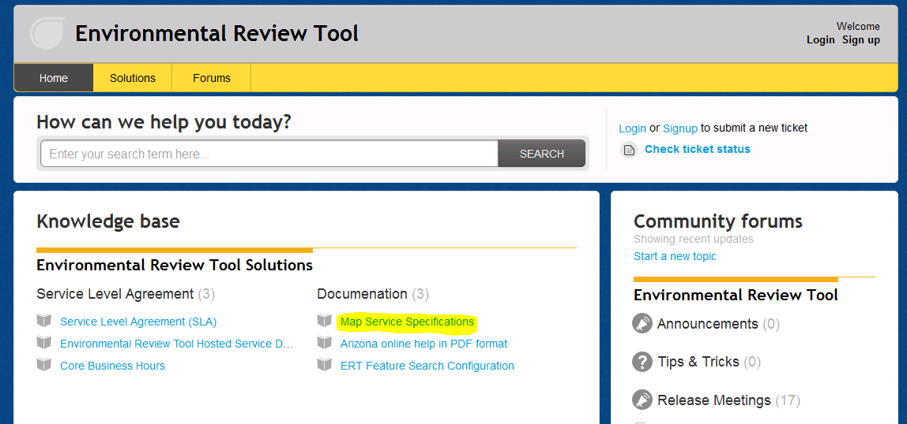
ERT Help Desk Support http://ertsupport.natureserve.org

