Slide 1
Pennsylvania Conservation Opportunity Area Tool
Check-In v0.3
August 21, 2018

Slide 2
Agenda
Review New Development
Demo
Discussion / Questions

Slide 3
Functionality v0.3
AOI report structure complete - still working on logic for listing results
CSV Tabular Results
Site Theme

Slide 4
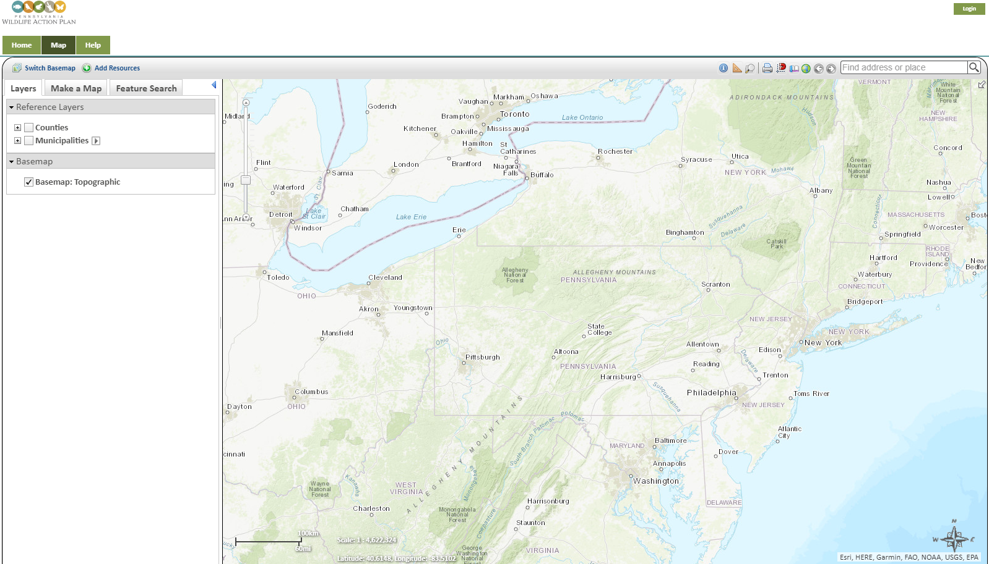
Demo Dev Site https://coapadev.natureserve.org

Slide 5
Development Release v0.3
Complete algorithms/logic for determining AOI tabular results
Statewide Species Search workflow

Slide 6
Discussion / Questions
Notes:
Review requirements
- Use Cases
3.1, 3.2, 3.3, 3.4,3.6, 3.13
Project Submission
- Target audience

Slide 7
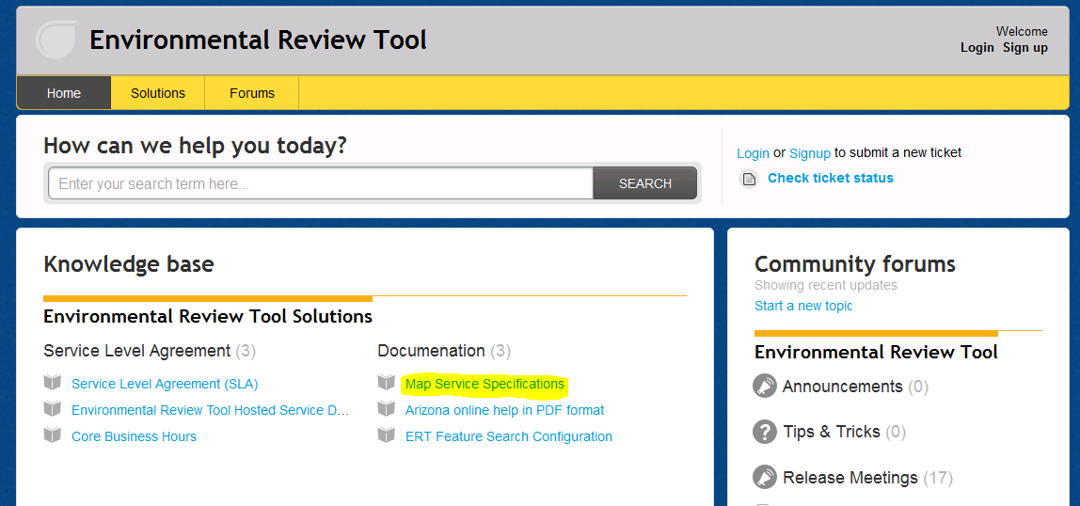
ERT Help Desk Support http://ertsupport.natureserve.org

