Slide 1
Kentucky State Nature Preserves Commission Environmental Review Tool
Project Introduction
November 30, 2017

Slide 2
Overview
Team Introductions
NatureServe’s Environmental Review Tool “Core” Fundamentals
Production Site Demos/Questions
Proposed Project Schedule
ERT Help Desk Support
GIS Data Preparation Guidelines

Slide 3
NatureServe Team Introductions
Rob Solomon – Project Coordinator
Michele Bottiaux – Technical Lead Developer
Trang Nguyen – Technical Developer
Whitney Weber – GIS Data Support, Documentation, and Testing
Allen Anselmo – Map Viewer Customizations
Todd Parks – Site Styling

Slide 4
KSNPC Team Introductions
Zeb Weese – Director, Kentucky State Nature Preserve Commission
Martina Hines – Project lead/Natural Heritage Program Manager
Ian Horn – Technical Lead
Evelyn Pickett - Geographic Information Specialist

Slide 5
NatureServe ERT History
Development lineage
Surveyor (multi-jurisdiction screening tool)
Biotics version 5
1st Generation ERT – VA NHDE
LA, Parks Canada (Beta phases)
ERT Core, 2nd Generation Technology
2nd Generation Sites for:
Production: AZ, NC, MO, PA, NE
Development:, NM, VA(v2.0)

Slide 6
ERT Primary Technologies
Website : Apache/PHP/Drupal
GIS : ArcGIS Server 10.x
Secure GIS Assets
Review geoprocessing
Map Utility Services
Database : MySQL

Slide 7
ERT Software Components
NatureServe ERT = 2 Primary Components
ERT Core – Common Functionality
Good amount of functionality “out of the box”
All sites benefit from improvements
ERT Custom – Kentucky Configuration
Analysis review
Report generation
Site specific theming (look and feel)

Slide 8
ERT Near-Term Development
Phase 1:
Stand up environment
Obtain and publish GIS data, as available
Deploy ERT Core with basic functions
Phase 2:
Iteratively Develop Custom Functionality
Frequent Releases for Review and Feedback
Periodic check-in meetings

Slide 9
Demonstrations
Demo of select ERT production systems
Missouri: https://naturalheritagereview.mdc.mo.gov
North Carolina:
https://ncnhde.natureserve.org
Links to other production ERT sites can be found at,
Environmental Review Community- ERT Site Comparison
(logon to NatureServe Connected SharePoint site required)

Slide 10
Proposed Project Schedule

Slide 11
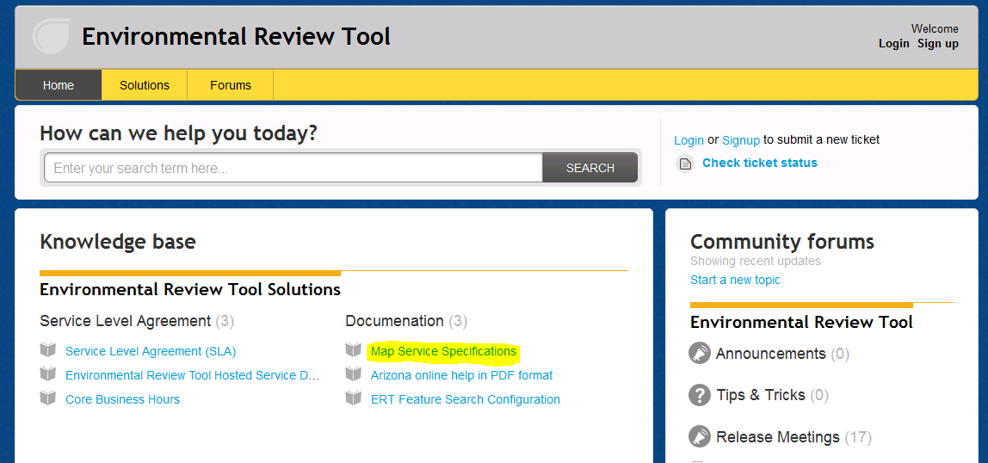
ERT Help Desk Support http://ertsupport.natureserve.org

