Slide 1
Kentucky State NPC
Environmental Review Tool
Dev Release v.02
March 14, 2018

Slide 2
Agenda
Dev Release v0.2
Release v0.3
Review Schedule
Pre-Production Plan
Questions
Submit Feedback
Discussion

Slide 3
Dev Release v0.2
Project review analysis (includes project type buffer input)
Report and shapefile generation
Admin functions

Slide 4
Dev Release 0.3
Site Theme
Finalize review analysis and project report

Slide 5
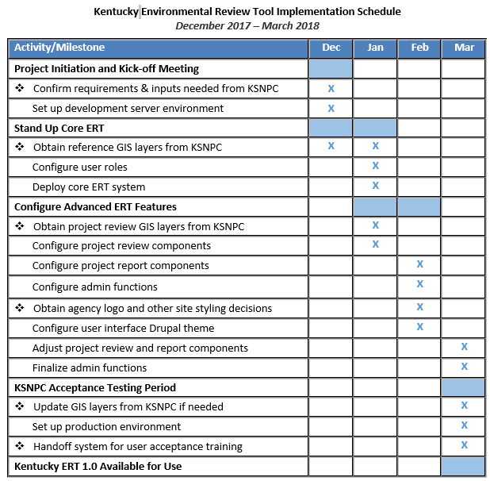
Proposed Project Schedule

Slide 6
Pre-Production Plan
  Prepare environment for UAT/production:
    GIS Updates
    ArcGIS for Server license
      1 ArcGIS Enterprise Standard (Windows) Up to Four Cores License – if you need to purchase
      ArcGIS Enterprise 10.5.1 Enterprise Standard, core, no extensions – when issuing provisioning file
    Domain name
    Site Email Address
    SSL Certification
    Google Analytics Account and ID
    Privacy Policies
    Project ID format

Slide 7
Questions
Projects created during dev\testing phase

Slide 8
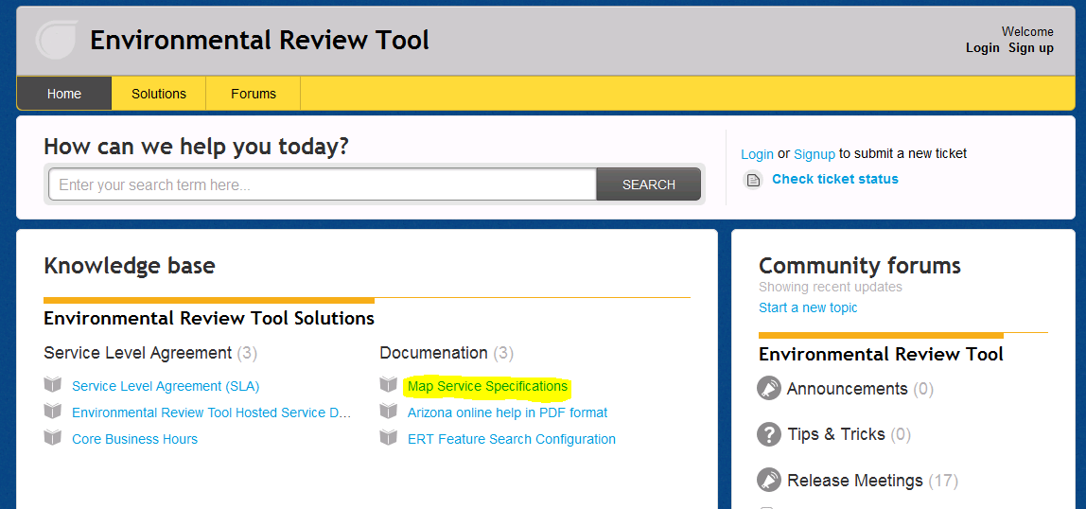
ERT Help Desk Support http://ertsupport.natureserve.org

