Slide 1
Kentucky State NPC Environmental Review Tool
Dev Release v.03
March 28, 2018

Slide 2
Agenda
Dev Release v0.3
Pending Items
Review Schedule
Pre-Production Plan
Submit Feedback
Discussion

Slide 3
Dev Release v0.3
Site Theme
Project Type Recommendations

Slide 4
Pending Items
Maximum Project Size Restriction
Species/Community Search

Slide 5
Proposed Project Schedule

Slide 6
Pre-Production Plan
Prepare environment for UAT/production:
GIS Updates
ArcGIS for Server license
1 ArcGIS Enterprise Standard (Windows) Up to Four Cores License – if you need to purchase
ArcGIS Enterprise 10.5.1 Enterprise Standard, core, no extensions – when issuing provisioning file
Domain name
Site Email Address
SSL Certification
Google Analytics Account and ID
Privacy Policies
Project ID format

Slide 7
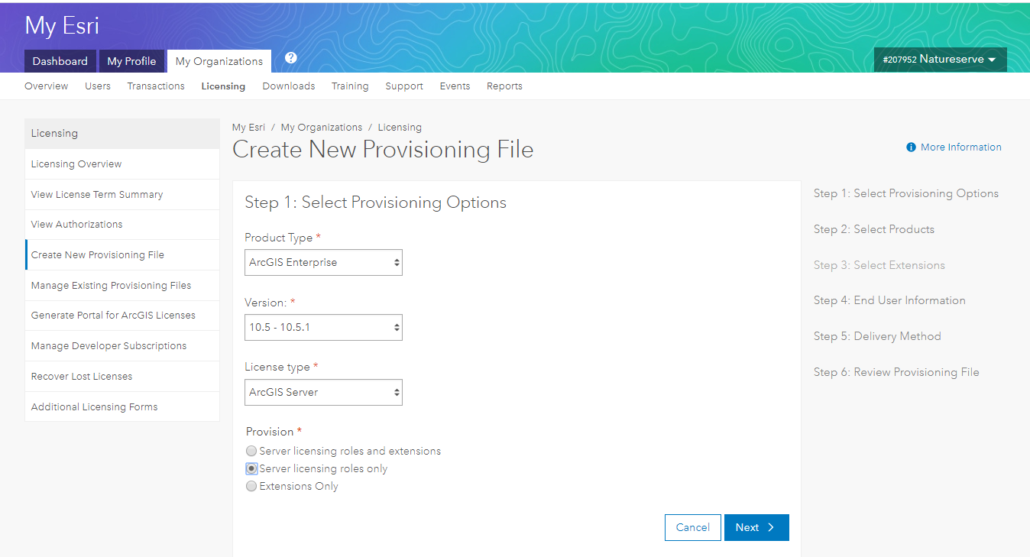
ArcGIS Server Provisioning File
ArcGIS for Server license
ArcGIS Enterprise 10.5.1 Enterprise Standard, core, no extensions – when issuing provisioning file

Slide 8
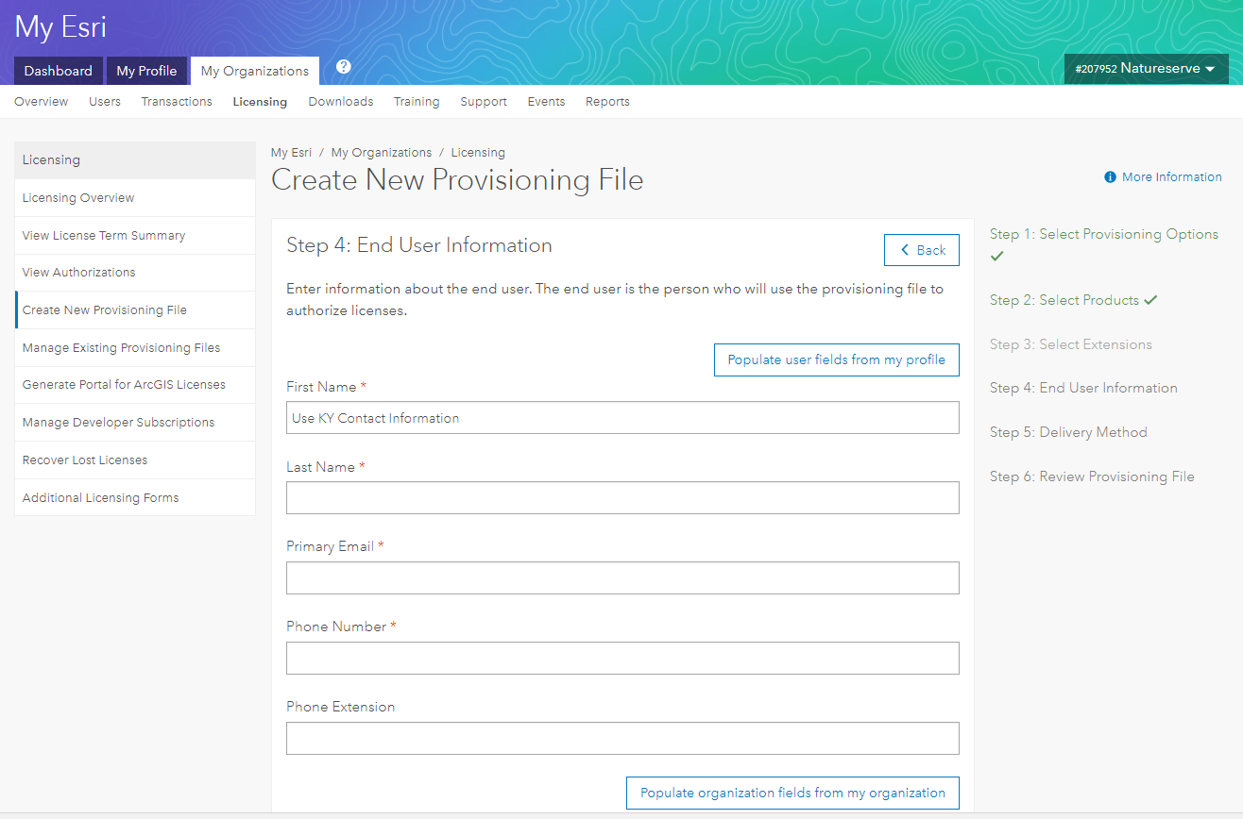
ArcGIS Server Provisioning File
ArcGIS for Server license
KYERT_Prod_Server_10_5_
Fill in with KY contact information
Email direct to rob_solomon@natureserve.org
Fill in Note

Slide 9
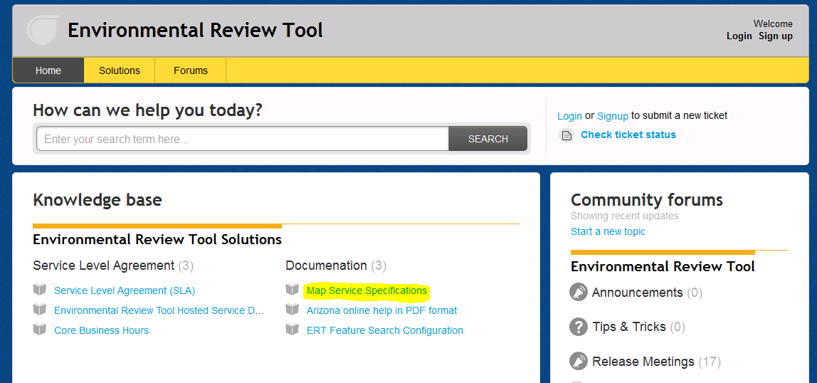
ERT Help Desk Support http://ertsupport.natureserve.org

Slide 10
Discussion

