Slide 1
MiSSOURI ERT 2.0 release Wednesday, january 18, 2017 11:00 – 12:00 AM EST

Slide 2
Agenda
January spatial data updated
ERT Core Highlights Review
Staging Demo
Discussion
Notes:
Biotics 4
Living with Aging system
Compatibility issues in new environments (Windows, Oracle)
Other common problems (DM comments)
Phasing out Biotics 4 – Support will continue through FY13 and be phased out in FY14 (discuss with Lori)
Four stages;
Market introduction / General Availability (2003- 2004)
Growth/Extended (2004 – 2010)
Maturity (2010 – 2013)
No new versions or patches
Standard support provided (helpdesk and email)
Continued expansion of online information and Knowledgebase
With release of Biotics 5 in 2013 we will enter the last 12 month of this stage
Limited support provided (helpdesk and email)
New environments not certified
Few updates to online information (i.e., Knowledgebase)
Saturation and decline/Retired (2014) – final phase of Biotics 4
Standard helpdesk and email support ends
Access to very limited support through Biotics 4 online help archives

Slide 3
ERT Core Highlights Review
Map Viewer
JSAPI upgrade
Disable all tools when loading initially
Use Esri search component to find address/place – better GUI with info window
Fix map keyboard navigation after mouse panning
Remove redundant checkbox from single-layer services in TOC
Filter:
Progress on get unique values
Shape field is removed from fields list
Unique values should display dates as dates.

Slide 4
ERT Core Highlights Review
Map Viewer
Zoom To:
Default extent is fixed and no longer shifts the coordinate
No longer can click the map for coordinate. Only allow zooming by typing in coordinate and only refresh it when initially open.
Details window:
Better drag line symbology and dynamic drawing ad you drag the map or drag the details window
Better selected features symbology (outlines rather than solid polygons)
Drawing:
new edit option – Merge Shapes
buffer prompting when drawing or selecting points/lines

Slide 5
ERT Core Highlights Review
Admin and Miscellaneous:
Ability to export tabular view results to CSV
Add Reset buttons for relevant Views exposed filters
Apache’s security upgrade and Drupal upgrade
Bug fix when cancel editing project’s shape.

Slide 6
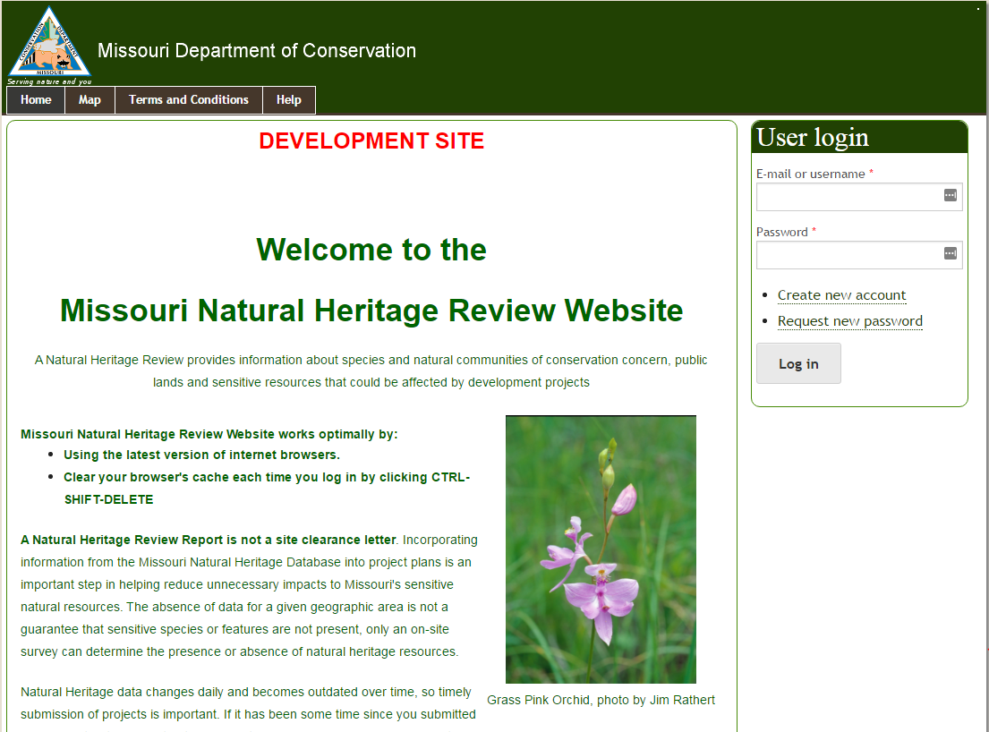
ERT Staging Demo v2.0 https://ertmodev.natureserve.org/

Slide 7
Discussion/Questions

