Slide 1
NE ERT Review MEETING v0.1
TUESDAY, MAY 24, 2018
11:00 – 12:00 PM EST

Slide 2
Agenda
Major Milestones
New Release – Core (v0.1) – Demo
Subscriptions – Demo
Development Release Plan
Items To Be Provided
Meeting Schedule
Submit Feedback
Discussion/Questions
Notes:
Biotics 4
Living with Aging system
Compatibility issues in new environments (Windows, Oracle)
Other common problems (DM comments)
Phasing out Biotics 4 – Support will continue through FY13 and be phased out in FY14 (discuss with Lori)
Four stages;
Market introduction / General Availability (2003- 2004)
Growth/Extended (2004 – 2010)
Maturity (2010 – 2013)
No new versions or patches
Standard support provided (helpdesk and email)
Continued expansion of online information and Knowledgebase
With release of Biotics 5 in 2013 we will enter the last 12 month of this stage
Limited support provided (helpdesk and email)
New environments not certified
Few updates to online information (i.e., Knowledgebase)
Saturation and decline/Retired (2014) – final phase of Biotics 4
Standard helpdesk and email support ends
Access to very limited support through Biotics 4 online help archives

Slide 3
Major Milestones
NE ERT Core/User Functions
Subscription User Management
Custom Features – Activities, Analysis Rules, Questions
Admin Functions
Project Report Generation
Production Set up
Notes:
Biotics 4
Living with Aging system
Compatibility issues in new environments (Windows, Oracle)
Other common problems (DM comments)
Phasing out Biotics 4 – Support will continue through FY13 and be phased out in FY14 (discuss with Lori)
Four stages;
Market introduction / General Availability (2003- 2004)
Growth/Extended (2004 – 2010)
Maturity (2010 – 2013)
No new versions or patches
Standard support provided (helpdesk and email)
Continued expansion of online information and Knowledgebase
With release of Biotics 5 in 2013 we will enter the last 12 month of this stage
Limited support provided (helpdesk and email)
New environments not certified
Few updates to online information (i.e., Knowledgebase)
Saturation and decline/Retired (2014) – final phase of Biotics 4
Standard helpdesk and email support ends
Access to very limited support through Biotics 4 online help archives

Slide 4
Development Release Plan v0.1 - 0.3
0.1 Core and User Functions
0.2 Subscriptions and Project Types
0.3 Begin project review components
Notes:
Biotics 4
Living with Aging system
Compatibility issues in new environments (Windows, Oracle)
Other common problems (DM comments)
Phasing out Biotics 4 – Support will continue through FY13 and be phased out in FY14 (discuss with Lori)
Four stages;
Market introduction / General Availability (2003- 2004)
Growth/Extended (2004 – 2010)
Maturity (2010 – 2013)
No new versions or patches
Standard support provided (helpdesk and email)
Continued expansion of online information and Knowledgebase
With release of Biotics 5 in 2013 we will enter the last 12 month of this stage
Limited support provided (helpdesk and email)
New environments not certified
Few updates to online information (i.e., Knowledgebase)
Saturation and decline/Retired (2014) – final phase of Biotics 4
Standard helpdesk and email support ends
Access to very limited support through Biotics 4 online help archives

Slide 5
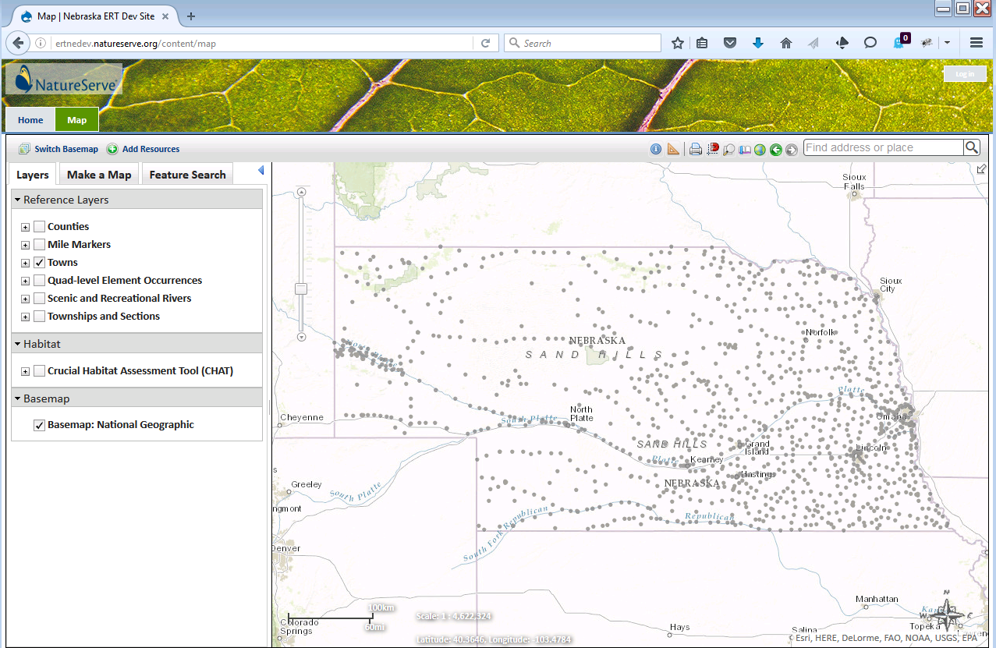
ERT Core Demo
https://ertnedev.natureserve.org/
Available 8:00 AM – 5:00 PM (Central)

Slide 6
Items To Be Provided
  GIS data – visualization & spatial
  Report structure – layout, images (watermark/logo), map image(s)
  Analysis rules and report texts (as importable)
  Site styling
  Any errors found through site testing
Notes:
Biotics 4
Living with Aging system
Compatibility issues in new environments (Windows, Oracle)
Other common problems (DM comments)
Phasing out Biotics 4 – Support will continue through FY13 and be phased out in FY14 (discuss with Lori)
Four stages;
Market introduction / General Availability (2003- 2004)
Growth/Extended (2004 – 2010)
Maturity (2010 – 2013)
No new versions or patches
Standard support provided (helpdesk and email)
Continued expansion of online information and Knowledgebase
With release of Biotics 5 in 2013 we will enter the last 12 month of this stage
Limited support provided (helpdesk and email)
New environments not certified
Few updates to online information (i.e., Knowledgebase)
Saturation and decline/Retired (2014) – final phase of Biotics 4
Standard helpdesk and email support ends
Access to very limited support through Biotics 4 online help archives

Slide 7
Meeting Schedule
Regular check-ins (GoTo Meeting)
  Tied to testable releases
  When input required
  Biweekly – Monthly
Notes:
Biotics 4
Living with Aging system
Compatibility issues in new environments (Windows, Oracle)
Other common problems (DM comments)
Phasing out Biotics 4 – Support will continue through FY13 and be phased out in FY14 (discuss with Lori)
Four stages;
Market introduction / General Availability (2003- 2004)
Growth/Extended (2004 – 2010)
Maturity (2010 – 2013)
No new versions or patches
Standard support provided (helpdesk and email)
Continued expansion of online information and Knowledgebase
With release of Biotics 5 in 2013 we will enter the last 12 month of this stage
Limited support provided (helpdesk and email)
New environments not certified
Few updates to online information (i.e., Knowledgebase)
Saturation and decline/Retired (2014) – final phase of Biotics 4
Standard helpdesk and email support ends
Access to very limited support through Biotics 4 online help archives

Slide 8
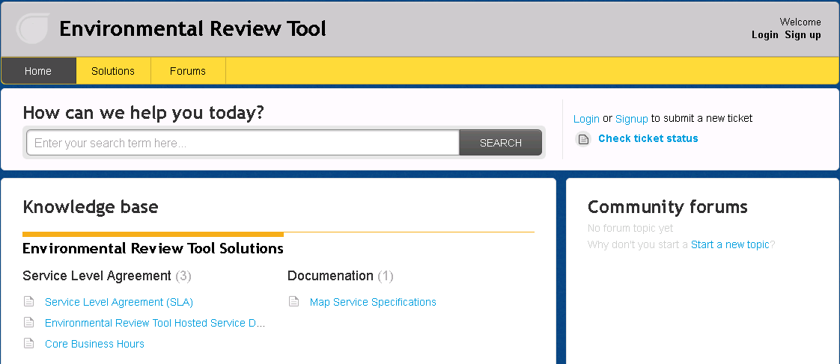
Submit Feedback
ertsupport.natureserve.org

Slide 9
Discussion/Questions

