Slide 1
NE ERT Review MEETING v0.5 TUESDAY, JUNE 28, 2016 11:00 – 12:30 PM EST

Slide 2
Agenda
Latest Release Review - v0.4 & 0.5
Demo
Development Release Plan
Items To Be Provided
Discussion
Notes:
Biotics 4
Living with Aging system
Compatibility issues in new environments (Windows, Oracle)
Other common problems (DM comments)
Phasing out Biotics 4 – Support will continue through FY13 and be phased out in FY14 (discuss with Lori)
Four stages;
Market introduction / General Availability (2003- 2004)
Growth/Extended (2004 – 2010)
Maturity (2010 – 2013)
No new versions or patches
Standard support provided (helpdesk and email)
Continued expansion of online information and Knowledgebase
With release of Biotics 5 in 2013 we will enter the last 12 month of this stage
Limited support provided (helpdesk and email)
New environments not certified
Few updates to online information (i.e., Knowledgebase)
Saturation and decline/Retired (2014) – final phase of Biotics 4
Standard helpdesk and email support ends
Access to very limited support through Biotics 4 online help archives

Slide 3
Development Release Plan v0.4 - 0.5
0.4 : Imported Project Types and Attributes
0.5 :
Project Type Attribute Triggers
Analysis Questions configuration
First draft of site theming
Notes:
Biotics 4
Living with Aging system
Compatibility issues in new environments (Windows, Oracle)
Other common problems (DM comments)
Phasing out Biotics 4 – Support will continue through FY13 and be phased out in FY14 (discuss with Lori)
Four stages;
Market introduction / General Availability (2003- 2004)
Growth/Extended (2004 – 2010)
Maturity (2010 – 2013)
No new versions or patches
Standard support provided (helpdesk and email)
Continued expansion of online information and Knowledgebase
With release of Biotics 5 in 2013 we will enter the last 12 month of this stage
Limited support provided (helpdesk and email)
New environments not certified
Few updates to online information (i.e., Knowledgebase)
Saturation and decline/Retired (2014) – final phase of Biotics 4
Standard helpdesk and email support ends
Access to very limited support through Biotics 4 online help archives

Slide 4
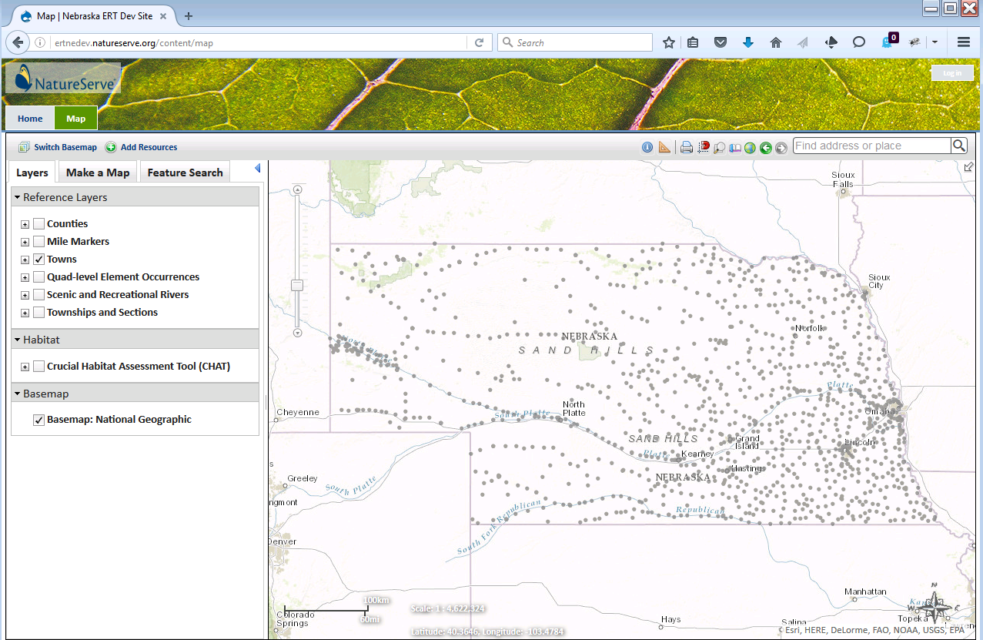
ERT Demo
https://ertnedev.natureserve.org/
Available 8:00 AM – 6:00 PM (Central)

Slide 5
Development Release Plan and Items To Be Provided
v0.6 - v0.7
Import rules and/or report texts, as provided
Begin analysis review process
Continue site theming
Items To Be Provided
Analysis layer data
Rules datasets
Report structure – layout, images (watermark/logo), map image(s)
Notes:
Biotics 4
Living with Aging system
Compatibility issues in new environments (Windows, Oracle)
Other common problems (DM comments)
Phasing out Biotics 4 – Support will continue through FY13 and be phased out in FY14 (discuss with Lori)
Four stages;
Market introduction / General Availability (2003- 2004)
Growth/Extended (2004 – 2010)
Maturity (2010 – 2013)
No new versions or patches
Standard support provided (helpdesk and email)
Continued expansion of online information and Knowledgebase
With release of Biotics 5 in 2013 we will enter the last 12 month of this stage
Limited support provided (helpdesk and email)
New environments not certified
Few updates to online information (i.e., Knowledgebase)
Saturation and decline/Retired (2014) – final phase of Biotics 4
Standard helpdesk and email support ends
Access to very limited support through Biotics 4 online help archives

Slide 6
Discussion

