Slide 1
NE ERT Review MEETING v0.9 tuesday, august 2, 2016 11:00 – 12:30 PM EST

Slide 2
Agenda
Latest Release Review – v0.8 & v0.9
Demo
Development Release Plan
Items To Be Provided
Discussion
Notes:
Biotics 4
Living with Aging system
Compatibility issues in new environments (Windows, Oracle)
Other common problems (DM comments)
Phasing out Biotics 4 – Support will continue through FY13 and be phased out in FY14 (discuss with Lori)
Four stages;
Market introduction / General Availability (2003- 2004)
Growth/Extended (2004 – 2010)
Maturity (2010 – 2013)
No new versions or patches
Standard support provided (helpdesk and email)
Continued expansion of online information and Knowledgebase
With release of Biotics 5 in 2013 we will enter the last 12 month of this stage
Limited support provided (helpdesk and email)
New environments not certified
Few updates to online information (i.e., Knowledgebase)
Saturation and decline/Retired (2014) – final phase of Biotics 4
Standard helpdesk and email support ends
Access to very limited support through Biotics 4 online help archives

Slide 3
Latest Release Review v0.8 – v0.9
0.8 : Import Report Texts
0.9 : Phase 2 for report structure
Tabular details
Remainder of static report text sections
Started dynamic analysis results
Most modifications from 7/29/2016 document
Notes:
Biotics 4
Living with Aging system
Compatibility issues in new environments (Windows, Oracle)
Other common problems (DM comments)
Phasing out Biotics 4 – Support will continue through FY13 and be phased out in FY14 (discuss with Lori)
Four stages;
Market introduction / General Availability (2003- 2004)
Growth/Extended (2004 – 2010)
Maturity (2010 – 2013)
No new versions or patches
Standard support provided (helpdesk and email)
Continued expansion of online information and Knowledgebase
With release of Biotics 5 in 2013 we will enter the last 12 month of this stage
Limited support provided (helpdesk and email)
New environments not certified
Few updates to online information (i.e., Knowledgebase)
Saturation and decline/Retired (2014) – final phase of Biotics 4
Standard helpdesk and email support ends
Access to very limited support through Biotics 4 online help archives

Slide 4
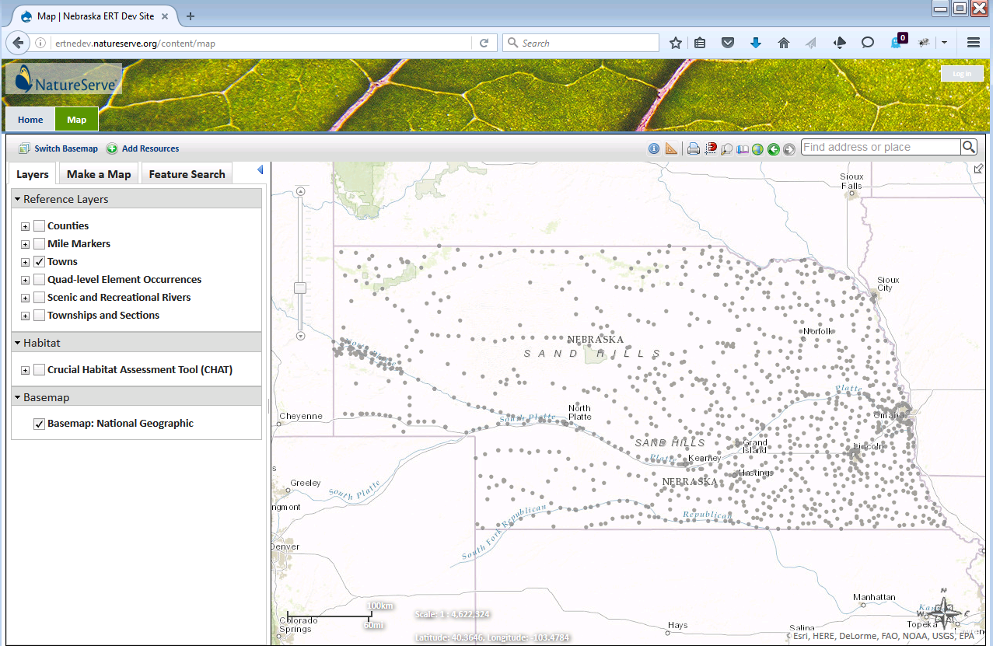
ERT Demo
https://ertnedev.natureserve.org/
Available 8:00 AM – 6:00 PM (Central)

Slide 5
Development Release Plan and Items To Be Provided
v0.11
Import dynamic analysis rules
Verify analysis rules processing and reporting
Items To Be Provided
Rules and report text, as available
Feedback on site theme
Status of Visualization Layers
Notes:
Biotics 4
Living with Aging system
Compatibility issues in new environments (Windows, Oracle)
Other common problems (DM comments)
Phasing out Biotics 4 – Support will continue through FY13 and be phased out in FY14 (discuss with Lori)
Four stages;
Market introduction / General Availability (2003- 2004)
Growth/Extended (2004 – 2010)
Maturity (2010 – 2013)
No new versions or patches
Standard support provided (helpdesk and email)
Continued expansion of online information and Knowledgebase
With release of Biotics 5 in 2013 we will enter the last 12 month of this stage
Limited support provided (helpdesk and email)
New environments not certified
Few updates to online information (i.e., Knowledgebase)
Saturation and decline/Retired (2014) – final phase of Biotics 4
Standard helpdesk and email support ends
Access to very limited support through Biotics 4 online help archives

Slide 6
Discussion

