Slide 1
NM ERT Review MEETING v0.1 Thursday January 12, 2017 3:00 – 4:30 PM EST

Slide 2
Agenda
Major Milestones
New Release – Core (v0.1) – Demo
Development Release Plan
Items To Be Provided
Meeting Schedule
Submit Feedback
Discussion/Questions
Notes:
Biotics 4
Living with Aging system
Compatibility issues in new environments (Windows, Oracle)
Other common problems (DM comments)
Phasing out Biotics 4 – Support will continue through FY13 and be phased out in FY14 (discuss with Lori)
Four stages;
Market introduction / General Availability (2003- 2004)
Growth/Extended (2004 – 2010)
Maturity (2010 – 2013)
No new versions or patches
Standard support provided (helpdesk and email)
Continued expansion of online information and Knowledgebase
With release of Biotics 5 in 2013 we will enter the last 12 month of this stage
Limited support provided (helpdesk and email)
New environments not certified
Few updates to online information (i.e., Knowledgebase)
Saturation and decline/Retired (2014) – final phase of Biotics 4
Standard helpdesk and email support ends
Access to very limited support through Biotics 4 online help archives

Slide 3
Major Milestones
NM ERT Core/User Functions
Admin Functions
Project Report Generation
Production Set up
Notes:
Biotics 4
Living with Aging system
Compatibility issues in new environments (Windows, Oracle)
Other common problems (DM comments)
Phasing out Biotics 4 – Support will continue through FY13 and be phased out in FY14 (discuss with Lori)
Four stages;
Market introduction / General Availability (2003- 2004)
Growth/Extended (2004 – 2010)
Maturity (2010 – 2013)
No new versions or patches
Standard support provided (helpdesk and email)
Continued expansion of online information and Knowledgebase
With release of Biotics 5 in 2013 we will enter the last 12 month of this stage
Limited support provided (helpdesk and email)
New environments not certified
Few updates to online information (i.e., Knowledgebase)
Saturation and decline/Retired (2014) – final phase of Biotics 4
Standard helpdesk and email support ends
Access to very limited support through Biotics 4 online help archives

Slide 4
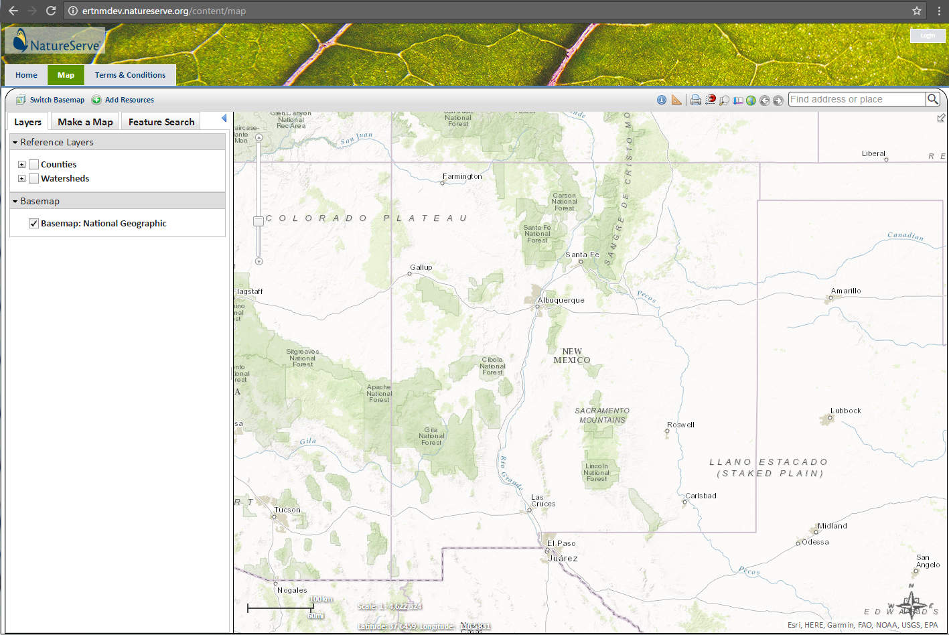
ERT NM Core Demo
https://ertnmdev.natureserve.org/
Available 24/7

Slide 5
Development Release Plan v0.1 - 0.2
0.1 – Core and User Functions
0.2 – Begin project review/report components
Notes:
Biotics 4
Living with Aging system
Compatibility issues in new environments (Windows, Oracle)
Other common problems (DM comments)
Phasing out Biotics 4 – Support will continue through FY13 and be phased out in FY14 (discuss with Lori)
Four stages;
Market introduction / General Availability (2003- 2004)
Growth/Extended (2004 – 2010)
Maturity (2010 – 2013)
No new versions or patches
Standard support provided (helpdesk and email)
Continued expansion of online information and Knowledgebase
With release of Biotics 5 in 2013 we will enter the last 12 month of this stage
Limited support provided (helpdesk and email)
New environments not certified
Few updates to online information (i.e., Knowledgebase)
Saturation and decline/Retired (2014) – final phase of Biotics 4
Standard helpdesk and email support ends
Access to very limited support through Biotics 4 online help archives

Slide 6
Items To Be Provided
GIS data – visualization & analysis
Report structure – layout, images (watermark/logo), map image(s)
Project Types, analysis rules and report texts (for importing, if available)
Site styling
Any errors found through site testing
Notes:
Biotics 4
Living with Aging system
Compatibility issues in new environments (Windows, Oracle)
Other common problems (DM comments)
Phasing out Biotics 4 – Support will continue through FY13 and be phased out in FY14 (discuss with Lori)
Four stages;
Market introduction / General Availability (2003- 2004)
Growth/Extended (2004 – 2010)
Maturity (2010 – 2013)
No new versions or patches
Standard support provided (helpdesk and email)
Continued expansion of online information and Knowledgebase
With release of Biotics 5 in 2013 we will enter the last 12 month of this stage
Limited support provided (helpdesk and email)
New environments not certified
Few updates to online information (i.e., Knowledgebase)
Saturation and decline/Retired (2014) – final phase of Biotics 4
Standard helpdesk and email support ends
Access to very limited support through Biotics 4 online help archives

Slide 7
Meeting Schedule
Regular check-ins (GoTo Meeting)
Tied to testable releases
When input required
Biweekly – Monthly
Notes:
Biotics 4
Living with Aging system
Compatibility issues in new environments (Windows, Oracle)
Other common problems (DM comments)
Phasing out Biotics 4 – Support will continue through FY13 and be phased out in FY14 (discuss with Lori)
Four stages;
Market introduction / General Availability (2003- 2004)
Growth/Extended (2004 – 2010)
Maturity (2010 – 2013)
No new versions or patches
Standard support provided (helpdesk and email)
Continued expansion of online information and Knowledgebase
With release of Biotics 5 in 2013 we will enter the last 12 month of this stage
Limited support provided (helpdesk and email)
New environments not certified
Few updates to online information (i.e., Knowledgebase)
Saturation and decline/Retired (2014) – final phase of Biotics 4
Standard helpdesk and email support ends
Access to very limited support through Biotics 4 online help archives

Slide 8
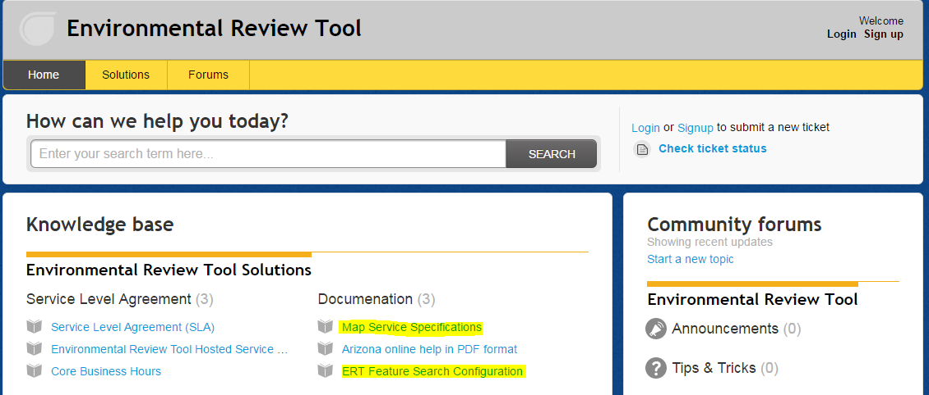
Submit Feedback
ertsupport.natureserve.org

Slide 9
Discussion/Questions

