Slide 1
North carolina ERT 0.4 release friday, july 11, 2014
1:00 – 2:00 PM EST

Slide 2
Agenda
New Release – 0.4
    Demo
Development Release Plan
Pending Items
Submit Feedback
Discussion/Questions
Notes:
Biotics 4
Living with Aging system
Compatibility issues in new environments (Windows, Oracle)
Other common problems (DM comments)
Phasing out Biotics 4 – Support will continue through FY13 and be phased out in FY14 (discuss with Lori)
Four stages;
Market introduction / General Availability (2003- 2004)
Growth/Extended (2004 – 2010)
Maturity (2010 – 2013)
No new versions or patches
Standard support provided (helpdesk and email)
Continued expansion of online information and Knowledgebase
With release of Biotics 5 in 2013 we will enter the last 12 month of this stage
Limited support provided (helpdesk and email)
New environments not certified
Few updates to online information (i.e., Knowledgebase)
Saturation and decline/Retired (2014) – final phase of Biotics 4
Standard helpdesk and email support ends
Access to very limited support through Biotics 4 online help archives

Slide 3
Release 0.4 Highlights
  Map
  Reference layers added
  Filter function for NHEO, SNHA, and MAREA
  Configuration of Feature Search
  Shapefile upload working for project creation
  Project Analysis
  Project boundary shapefile corresponding to each project review process
  PDF Report name reflects project title
  Customer Project # added to My Projects and List All Projects
  Sortable columns for My Projects and List All Projects
  View of Project page altered related to (behind-the-scenes) improvements to the project review process
  Administrative/Miscellaneous
  Home page text updated – image pending
  Link to Species/Community Search
  Readable path name generation
  Tooltips replaced with text
Notes:
Biotics 4
Living with Aging system
Compatibility issues in new environments (Windows, Oracle)
Other common problems (DM comments)
Phasing out Biotics 4 – Support will continue through FY13 and be phased out in FY14 (discuss with Lori)
Four stages;
Market introduction / General Availability (2003- 2004)
Growth/Extended (2004 – 2010)
Maturity (2010 – 2013)
No new versions or patches
Standard support provided (helpdesk and email)
Continued expansion of online information and Knowledgebase
With release of Biotics 5 in 2013 we will enter the last 12 month of this stage
Limited support provided (helpdesk and email)
New environments not certified
Few updates to online information (i.e., Knowledgebase)
Saturation and decline/Retired (2014) – final phase of Biotics 4
Standard helpdesk and email support ends
Access to very limited support through Biotics 4 online help archives

Slide 4
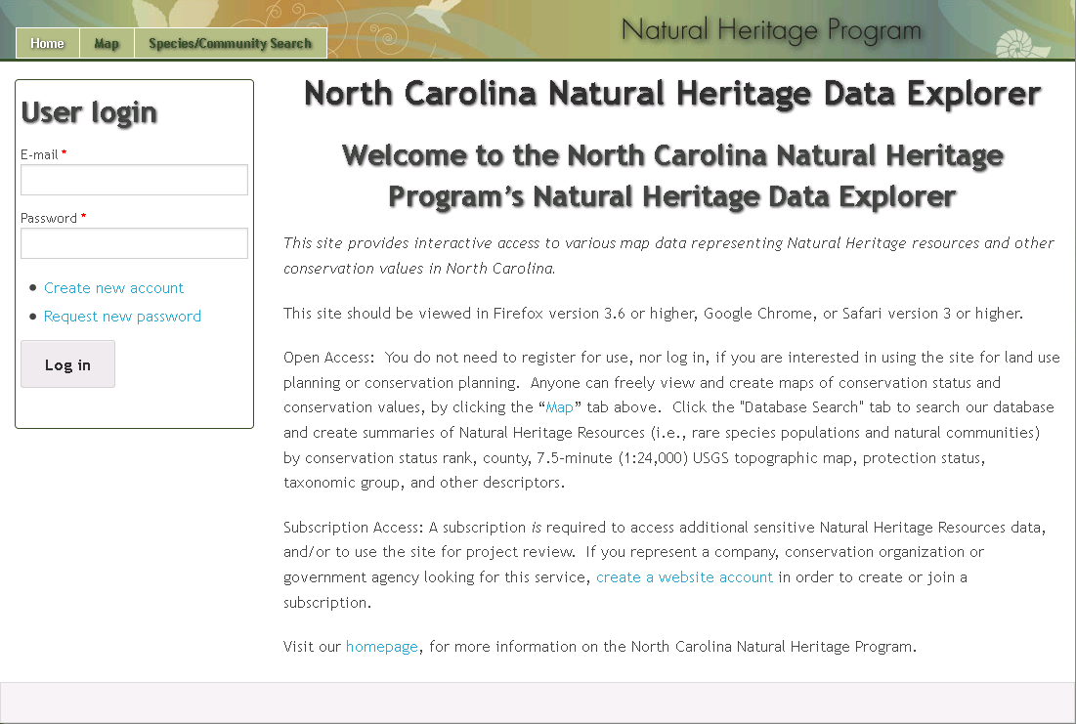
ERT Demo
Version 0.4

Slide 5
Development Release Plan – 0.5
Adjust reporting based on review analysis feedback
Admin Notification for Projects of Interest
Subscriptions
NC ERT Site Styling
NC ERT Home Page
B/WA Identify
Terms and Conditions
Monthly Reports - TBD
Notes:
Biotics 4
Living with Aging system
Compatibility issues in new environments (Windows, Oracle)
Other common problems (DM comments)
Phasing out Biotics 4 – Support will continue through FY13 and be phased out in FY14 (discuss with Lori)
Four stages;
Market introduction / General Availability (2003- 2004)
Growth/Extended (2004 – 2010)
Maturity (2010 – 2013)
No new versions or patches
Standard support provided (helpdesk and email)
Continued expansion of online information and Knowledgebase
With release of Biotics 5 in 2013 we will enter the last 12 month of this stage
Limited support provided (helpdesk and email)
New environments not certified
Few updates to online information (i.e., Knowledgebase)
Saturation and decline/Retired (2014) – final phase of Biotics 4
Standard helpdesk and email support ends
Access to very limited support through Biotics 4 online help archives

Slide 6
Needs Input
  NC ERT Home Page – Image
  Terms of Use
  Response letter updates
    Analysis/reporting logic changes
    Tabular updates
    Signature block
    Project Details
  Monthly Reports – Rob is sorting this out based on VA practices and feedback
Notes:
Biotics 4
Living with Aging system
Compatibility issues in new environments (Windows, Oracle)
Other common problems (DM comments)
Phasing out Biotics 4 – Support will continue through FY13 and be phased out in FY14 (discuss with Lori)
Four stages;
Market introduction / General Availability (2003- 2004)
Growth/Extended (2004 – 2010)
Maturity (2010 – 2013)
No new versions or patches
Standard support provided (helpdesk and email)
Continued expansion of online information and Knowledgebase
With release of Biotics 5 in 2013 we will enter the last 12 month of this stage
Limited support provided (helpdesk and email)
New environments not certified
Few updates to online information (i.e., Knowledgebase)
Saturation and decline/Retired (2014) – final phase of Biotics 4
Standard helpdesk and email support ends
Access to very limited support through Biotics 4 online help archives

Slide 7
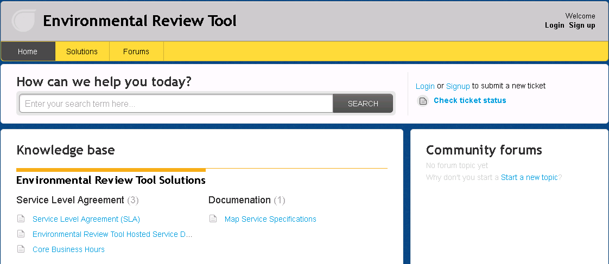
Submit Feedback
Ertsupport.natureserve.org

Slide 8
Discussion/Questions

