Slide 1
NC NHDE 1.5 DEV release 1 Monday june 11, 2018 3:00 – 4:00 pM EdT

Slide 2
Agenda
Project Payment Workflow
Dev Site Demo
Next Up
Discussion
Notes:
Biotics 4
Living with Aging system
Compatibility issues in new environments (Windows, Oracle)
Other common problems (DM comments)
Phasing out Biotics 4 – Support will continue through FY13 and be phased out in FY14 (discuss with Lori)
Four stages;
Market introduction / General Availability (2003- 2004)
Growth/Extended (2004 – 2010)
Maturity (2010 – 2013)
No new versions or patches
Standard support provided (helpdesk and email)
Continued expansion of online information and Knowledgebase
With release of Biotics 5 in 2013 we will enter the last 12 month of this stage
Limited support provided (helpdesk and email)
New environments not certified
Few updates to online information (i.e., Knowledgebase)
Saturation and decline/Retired (2014) – final phase of Biotics 4
Standard helpdesk and email support ends
Access to very limited support through Biotics 4 online help archives

Slide 3
Payment Functionality
Project Payment Workflow
Non-Subscription Users project submit workflow
User Payment Status
User Orders
Admin Orders
Admin Payment Configuration
Admin Order Logging
Questions:
User role setting when not in subscription
Notes:
Biotics 4
Living with Aging system
Compatibility issues in new environments (Windows, Oracle)
Other common problems (DM comments)
Phasing out Biotics 4 – Support will continue through FY13 and be phased out in FY14 (discuss with Lori)
Four stages;
Market introduction / General Availability (2003- 2004)
Growth/Extended (2004 – 2010)
Maturity (2010 – 2013)
No new versions or patches
Standard support provided (helpdesk and email)
Continued expansion of online information and Knowledgebase
With release of Biotics 5 in 2013 we will enter the last 12 month of this stage
Limited support provided (helpdesk and email)
New environments not certified
Few updates to online information (i.e., Knowledgebase)
Saturation and decline/Retired (2014) – final phase of Biotics 4
Standard helpdesk and email support ends
Access to very limited support through Biotics 4 online help archives

Slide 4
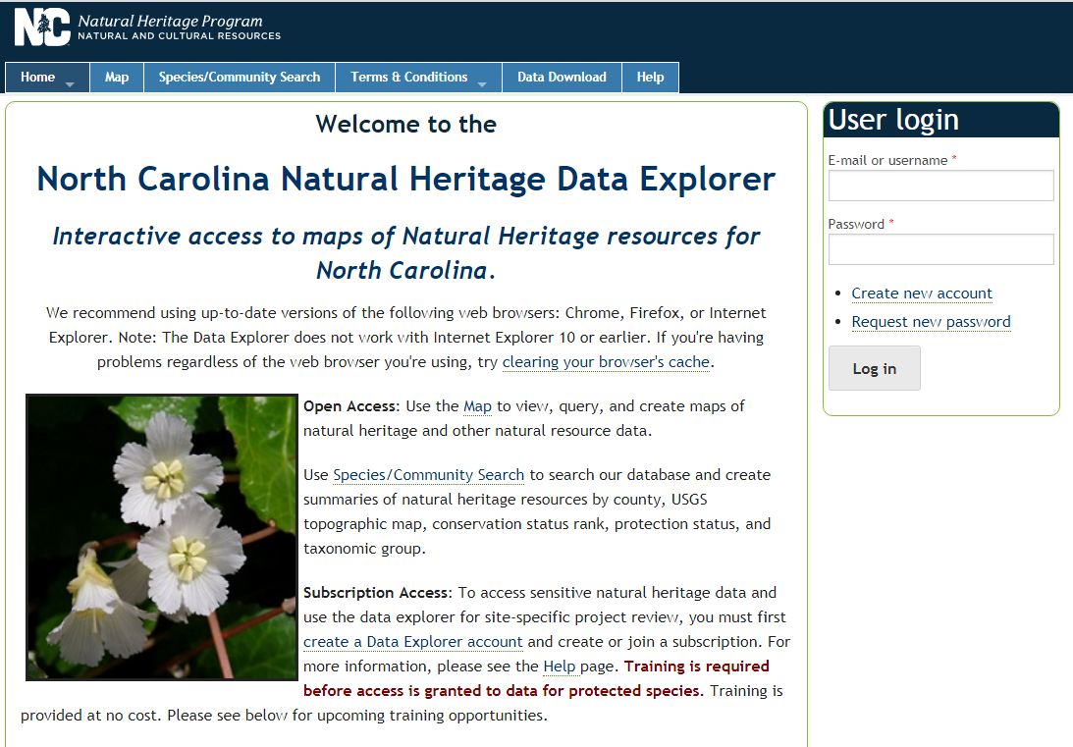
Dev Site Demo v1.5 https://ertncdev.natureserve.org

Slide 5
Next Up
Subscription Enhancements
Subscription Payment Workflows
Exempt organizations from payment
Subscription deactivation (manual)
Subscription expiration (automated), with pre-notify
Notes
Questions:
Subscription migration to payments – automated or manual?
Notes:
Biotics 4
Living with Aging system
Compatibility issues in new environments (Windows, Oracle)
Other common problems (DM comments)
Phasing out Biotics 4 – Support will continue through FY13 and be phased out in FY14 (discuss with Lori)
Four stages;
Market introduction / General Availability (2003- 2004)
Growth/Extended (2004 – 2010)
Maturity (2010 – 2013)
No new versions or patches
Standard support provided (helpdesk and email)
Continued expansion of online information and Knowledgebase
With release of Biotics 5 in 2013 we will enter the last 12 month of this stage
Limited support provided (helpdesk and email)
New environments not certified
Few updates to online information (i.e., Knowledgebase)
Saturation and decline/Retired (2014) – final phase of Biotics 4
Standard helpdesk and email support ends
Access to very limited support through Biotics 4 online help archives

Slide 6
Discussion/Questions

