Slide 1
NC NHDE 1.5 DEV release 2 Monday JULY 12, 2018 3:30 – 5:00 pM EdT

Slide 2
Agenda
Release 2 Functionality
Dev Site Demo
Next Up
Discussion
Notes:
Biotics 4
Living with Aging system
Compatibility issues in new environments (Windows, Oracle)
Other common problems (DM comments)
Phasing out Biotics 4 – Support will continue through FY13 and be phased out in FY14 (discuss with Lori)
Four stages;
Market introduction / General Availability (2003- 2004)
Growth/Extended (2004 – 2010)
Maturity (2010 – 2013)
No new versions or patches
Standard support provided (helpdesk and email)
Continued expansion of online information and Knowledgebase
With release of Biotics 5 in 2013 we will enter the last 12 month of this stage
Limited support provided (helpdesk and email)
New environments not certified
Few updates to online information (i.e., Knowledgebase)
Saturation and decline/Retired (2014) – final phase of Biotics 4
Standard helpdesk and email support ends
Access to very limited support through Biotics 4 online help archives

Slide 3
Release 2 Functionality
Subscription Functionality
Activation and Deactivation
Expiration and Notification
Exempt Organizations from Payment
Payment Workflow with Status
Subscription Orders
Subscription Notes
Admin Configuration
Pending:
Increasing number of paid members – need input
Migrating existing subscriptions
Notes:
Biotics 4
Living with Aging system
Compatibility issues in new environments (Windows, Oracle)
Other common problems (DM comments)
Phasing out Biotics 4 – Support will continue through FY13 and be phased out in FY14 (discuss with Lori)
Four stages;
Market introduction / General Availability (2003- 2004)
Growth/Extended (2004 – 2010)
Maturity (2010 – 2013)
No new versions or patches
Standard support provided (helpdesk and email)
Continued expansion of online information and Knowledgebase
With release of Biotics 5 in 2013 we will enter the last 12 month of this stage
Limited support provided (helpdesk and email)
New environments not certified
Few updates to online information (i.e., Knowledgebase)
Saturation and decline/Retired (2014) – final phase of Biotics 4
Standard helpdesk and email support ends
Access to very limited support through Biotics 4 online help archives

Slide 4
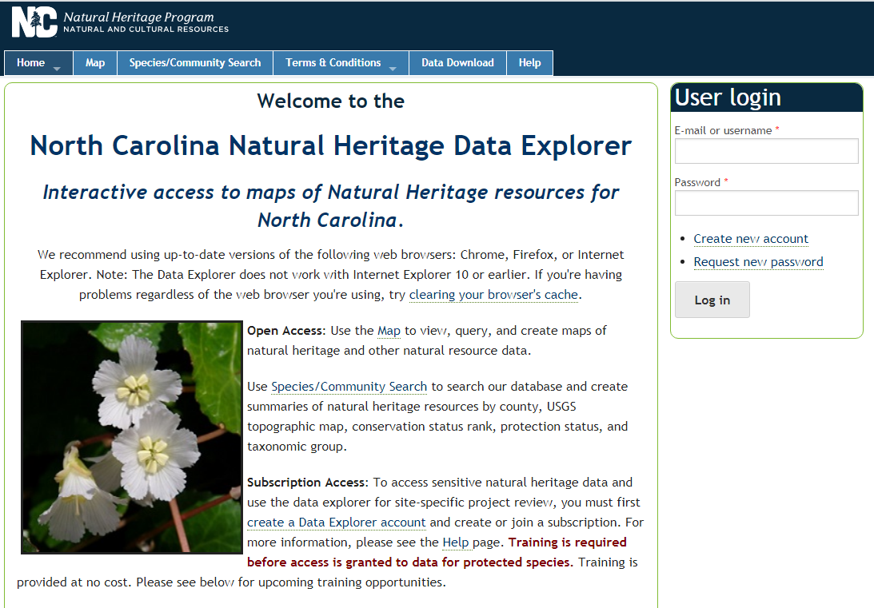
Dev Site Demo v1.5 https://ertncdev.natureserve.org

Slide 5
Next Up
Subscription Enhancements
Allow group manager(s) to view member projects
Data Requests
Submission Form
Submission confirmation and payment workflow
Misc
Support Production Merchant Account configuration
Notes:
Biotics 4
Living with Aging system
Compatibility issues in new environments (Windows, Oracle)
Other common problems (DM comments)
Phasing out Biotics 4 – Support will continue through FY13 and be phased out in FY14 (discuss with Lori)
Four stages;
Market introduction / General Availability (2003- 2004)
Growth/Extended (2004 – 2010)
Maturity (2010 – 2013)
No new versions or patches
Standard support provided (helpdesk and email)
Continued expansion of online information and Knowledgebase
With release of Biotics 5 in 2013 we will enter the last 12 month of this stage
Limited support provided (helpdesk and email)
New environments not certified
Few updates to online information (i.e., Knowledgebase)
Saturation and decline/Retired (2014) – final phase of Biotics 4
Standard helpdesk and email support ends
Access to very limited support through Biotics 4 online help archives

Slide 6
Payment Module Milestones
Sprint | Sprint End Date | Targeted Items
2 | July 6 | Release review dates: July 12th
 |  | I-5 | Allow subscription expiration and notification to renew
 |  | I-6 | Support field setting for Non-Government (fee)
 |  | I-7 | Support configurable fee for subscriptions
 | Input needed | I-8 | Support number of members
 |  | I-9 | Support subscription upgrade for more members
 |  | I-10 | Customize workflow for subscriptions payment processing
 |  | I-11 | Backwards compatible support for existing subscriptions – No testing required.
 |  | I-13 | Support deactivating a subscription - remove role from members
 |  | NCHP | Initiate payment gateway account setup with FirstData Pyeezy merchant account reps and\or state merchant account support staff**
3 | July 31 | Tentative release review dates: August 3rd
 |  | I-12 | Give subscription admins ability to view members projects
 |  | II-14 | Set up data request submission form
 |  | II-15 | Set up forms to confirm data request, generate invoice, send notifications, accept invoice number and route for payment
 |  | II-16 | Handle successful payment response and send notification
 |  | II-17 | Modified workflow & entry forms to support customized ERs & biological field surveys.
4 | August 27 | Check in dates: As needed
 |  | NS | Revisions and defect corrections based on testing results
 |  | NCHP | Finalize set up with FirstData Pyeezy merchant payment gateway account, tested and confirmed – in coordination with NS
5 | Sep. 21 | Check in dates: As needed during acceptance testing
 |  | NCHP | Acceptance testing August 28- Sep. 14, and module approval
 |  | NS | Final adjustments based on results of acceptance testing
 | Oct. 1 | NS / NCHP | Switch over to live gateway account and test, payment module in production mode.

Slide 7
Discussion/Questions

