Slide 1
North carolina ERT 1.2 release friday, july 8, 2016 11:00 – 12:00 aM EST

Slide 2
Agenda
Review New Functionality
Demo/Discuss Site Theme
Demo Remaining Tasks
Discussion
Notes:
Biotics 4
Living with Aging system
Compatibility issues in new environments (Windows, Oracle)
Other common problems (DM comments)
Phasing out Biotics 4 – Support will continue through FY13 and be phased out in FY14 (discuss with Lori)
Four stages;
Market introduction / General Availability (2003- 2004)
Growth/Extended (2004 – 2010)
Maturity (2010 – 2013)
No new versions or patches
Standard support provided (helpdesk and email)
Continued expansion of online information and Knowledgebase
With release of Biotics 5 in 2013 we will enter the last 12 month of this stage
Limited support provided (helpdesk and email)
New environments not certified
Few updates to online information (i.e., Knowledgebase)
Saturation and decline/Retired (2014) – final phase of Biotics 4
Standard helpdesk and email support ends
Access to very limited support through Biotics 4 online help archives

Slide 3
New Functionality
June 2016 data updates
Replace EOStatus with EORank in report table
Remove email address from review letter
Notify for projects with CWMTF conflict (not tested)
Enhance User, Subscription, and Project admin views
Support phone extension in registration/user profile
Update project review letterhead
Add North Arrow to map images
Site Admin Create/Reassign Subscription
Update Site Theme
Notes:
Biotics 4
Living with Aging system
Compatibility issues in new environments (Windows, Oracle)
Other common problems (DM comments)
Phasing out Biotics 4 – Support will continue through FY13 and be phased out in FY14 (discuss with Lori)
Four stages;
Market introduction / General Availability (2003- 2004)
Growth/Extended (2004 – 2010)
Maturity (2010 – 2013)
No new versions or patches
Standard support provided (helpdesk and email)
Continued expansion of online information and Knowledgebase
With release of Biotics 5 in 2013 we will enter the last 12 month of this stage
Limited support provided (helpdesk and email)
New environments not certified
Few updates to online information (i.e., Knowledgebase)
Saturation and decline/Retired (2014) – final phase of Biotics 4
Standard helpdesk and email support ends
Access to very limited support through Biotics 4 online help archives

Slide 4
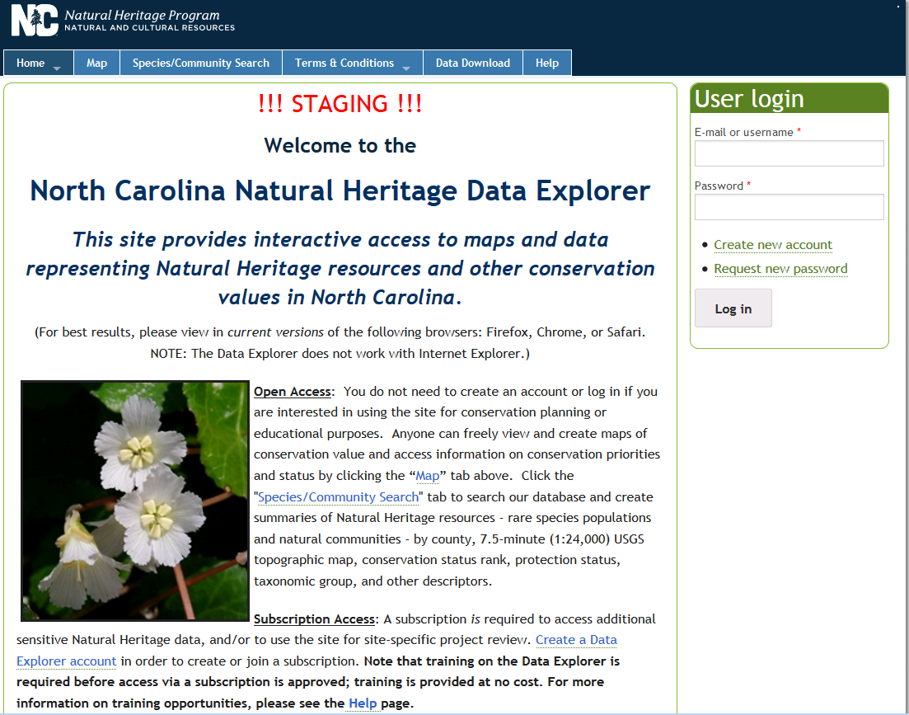
ERT Staging Demo v1.2 https://ncnhde-stg.natureserve.org

Slide 5
Remaining Items
Site Theme Updates
Add North Arrow to report map image
Support Site Admin creating Subscription on user behalf
Updated June GIS Data
Notes:
Biotics 4
Living with Aging system
Compatibility issues in new environments (Windows, Oracle)
Other common problems (DM comments)
Phasing out Biotics 4 – Support will continue through FY13 and be phased out in FY14 (discuss with Lori)
Four stages;
Market introduction / General Availability (2003- 2004)
Growth/Extended (2004 – 2010)
Maturity (2010 – 2013)
No new versions or patches
Standard support provided (helpdesk and email)
Continued expansion of online information and Knowledgebase
With release of Biotics 5 in 2013 we will enter the last 12 month of this stage
Limited support provided (helpdesk and email)
New environments not certified
Few updates to online information (i.e., Knowledgebase)
Saturation and decline/Retired (2014) – final phase of Biotics 4
Standard helpdesk and email support ends
Access to very limited support through Biotics 4 online help archives

Slide 6
Discussion/Questions

