Slide 1
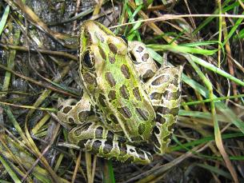
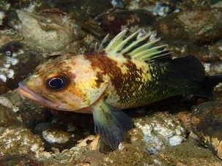
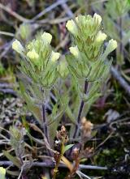
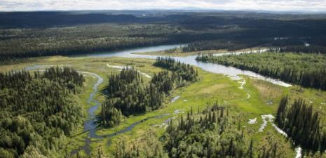
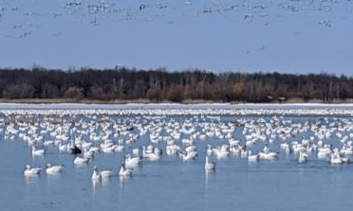
Implementing KBAs in Canada -
Ecosystem Criteria
British Columbia KBA RLE workshop
November 20, 2020
Notes:
1. Intro to KBAs and the ecosystem criteria A2 and B4 - with some results from the prairies
2. The need for IUCN red listing of ecosystem and how it works
3. Global extent vs national extent
3. Deciding on what classification system to use and which ecosystems to cover
4. Data availability
5. A path forward
Northern leopard frog
Quillback rockfish (coast north Pacific)
Victoria’s owl clover
Northern Criterion C landscape
snowgeese

Slide 2
A. THREATENED BIODIVERSITY
A1. Threatened species
A2. Threatened ecosystems types
B. GEOGRAPHICALLY RESTRICTED BIODIVERSITY
B1. Individual geographically restricted species
B2. Co-occurring geographically restricted species
B3. Geographically restricted assemblages
B4. Geographically restricted ecosystem types
C. ECOLOGICAL INTEGRITY
D. BIOLOGICAL PROCESSES
D1. Demographic aggregations
D2. Ecological refugia
D3. Recruitment sources
E. IRREPLACEABILITY THROUGH QUANTITATIVE ANALYSIS
Notes:
Stephen

Slide 3
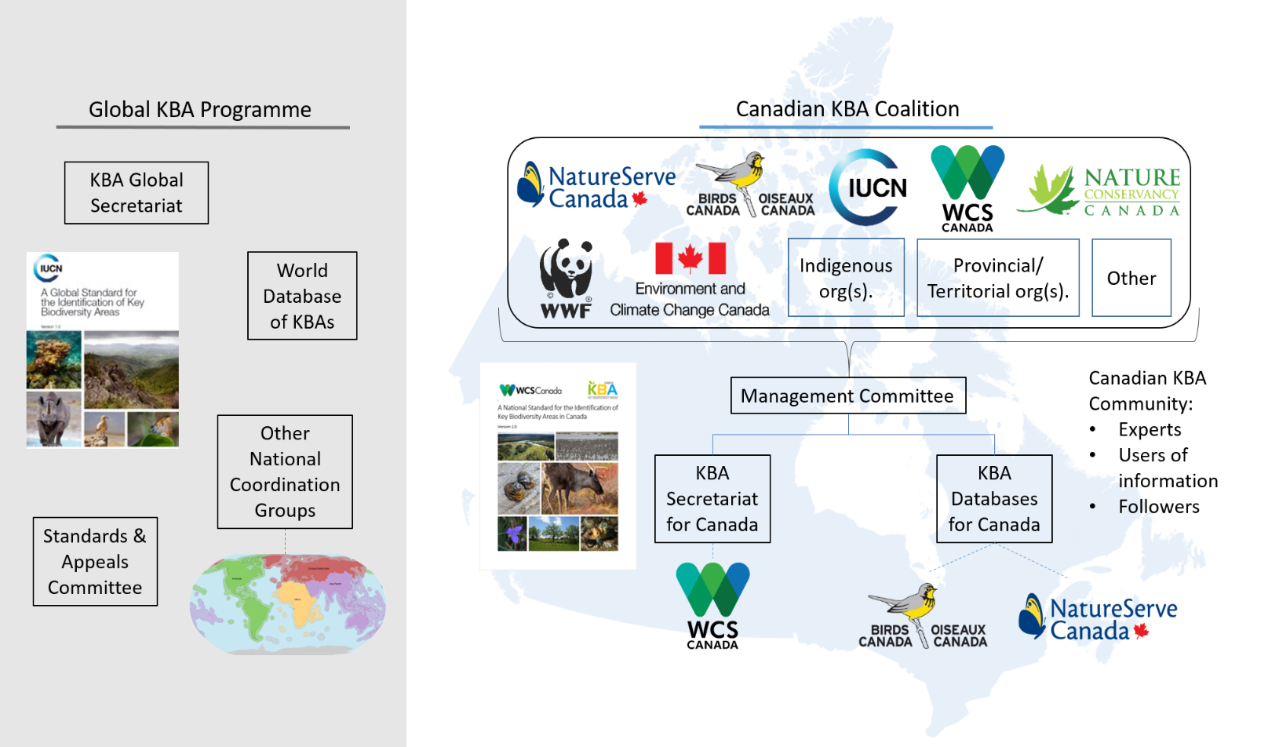
Global KBA Programme
Canada KBA Programme
Notes:
Stephen

Slide 4
KBA Identification is the Locus of Activity
Regional focus requires local “champions” and coordination capacity
Expert engagement through P/T governments and universities
Partnerships with universities on some analytical components
We are generating tons of derived data that have use outside KBAs and require a management strategy
Non-government stakeholders require separate outreach efforts to prepare for protection
Robust training is essential to success and on-going
Notes:
Stephen
Bottom line is that there are many people involved and getting educated in KBAs but progress relies on managing the process and decision making in the background

Slide 5
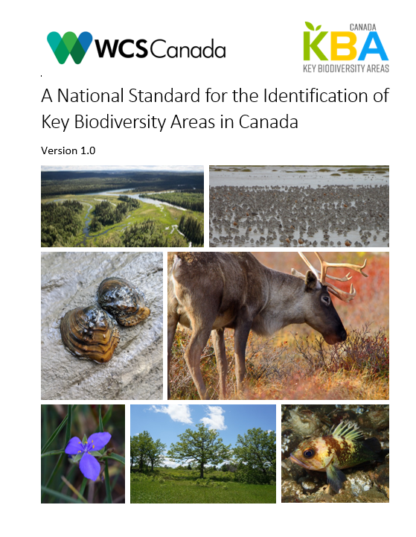
Introducing the KBA National Standard for Canada
Notes:
Stephen

Slide 6
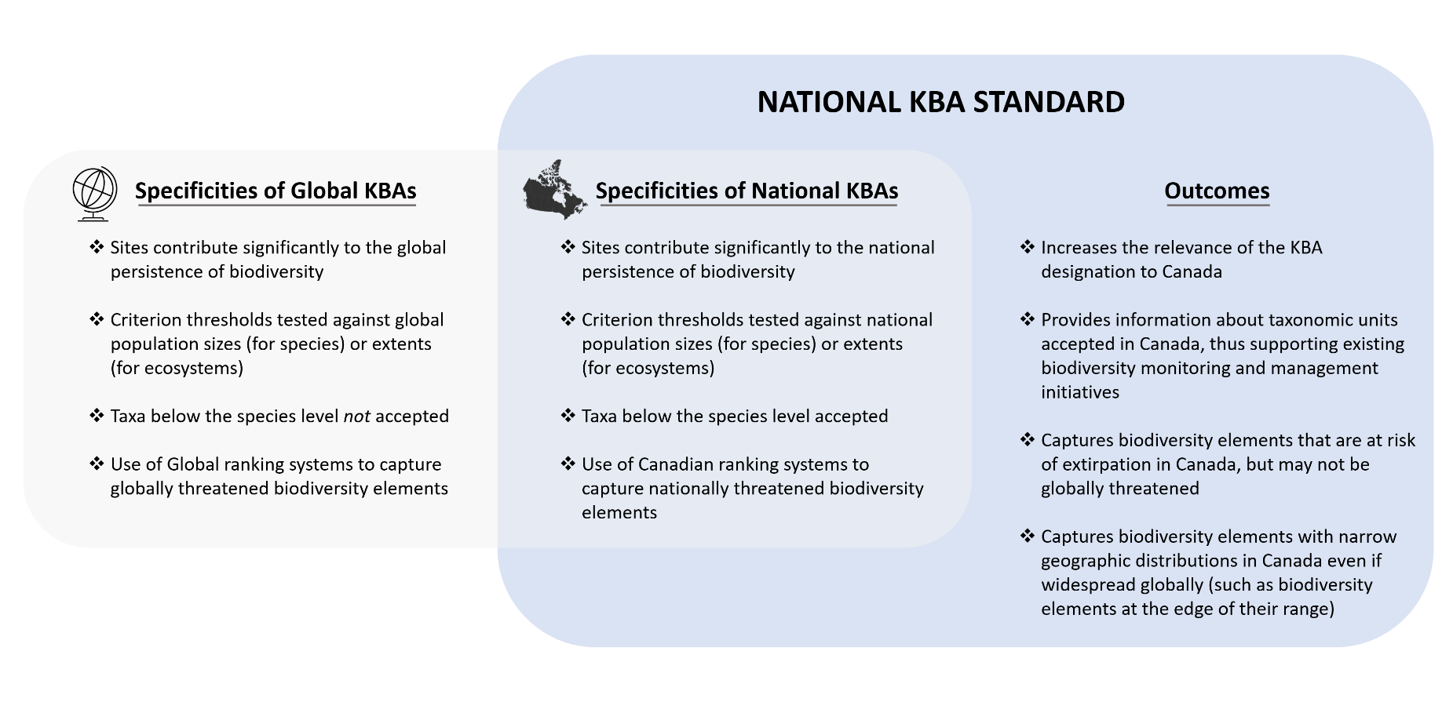
National KBA Standard: distinguishing features
Notes:
Stephen

Slide 7
Ecosystem Criteria
A2 and B4 - lessons from the Prairies
A. THREATENED BIODIVERSITY
A1. Threatened species
A2. Threatened ecosystems types
B. GEOGRAPHICALLY RESTRICTED BIODIVERSITY
B1. Individual geographically restricted species
B2. Co-occurring geographically restricted species
B3. Geographically restricted assemblages
B4. Geographically restricted ecosystem types
C. ECOLOGICAL INTEGRITY
D. BIOLOGICAL PROCESSES
D1. Demographic aggregations
D2. Ecological refugia
D3. Recruitment sources
E. IRREPLACEABILITY THROUGH QUANTITATIVE ANALYSIS
Notes:
Pat

Slide 8

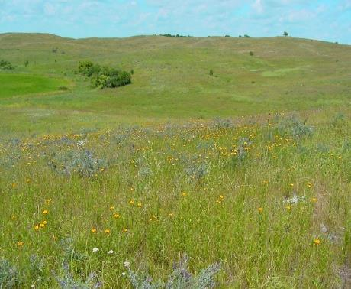
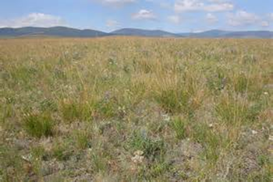
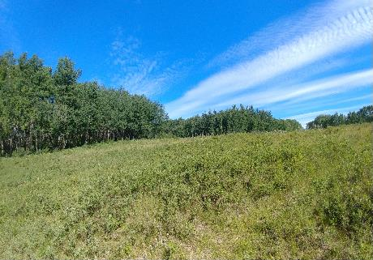
Ecosystem Criteria
A2. Threatened ecosystem types -
Site holds one or more of the following:
a) ≥5% of the global extent of a CR or EN ecosystem type
b) ≥10% of the global extent of a VU ecosystem type
Northern Tallgrass Prairie
Northern Great Plains Fescue Mixed-Grass Prairie
B4: Geographically restricted ecosystem types
Site holds ≥20% of the global extent of an ecosystem type
Northwestern Great Plains Aspen Parkland

Slide 9


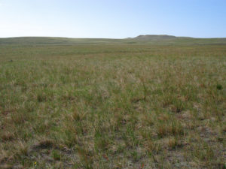
Vegetation-Based Hierarchy
Example from the Canadian Prairies
Hierarchy Levels | Example
Upper
L1 – Formation Class | Shrub & Herb Vegetation
L2 – Form. Subclass | Temperate & Boreal Grassland & Shrubland
L3 - Formation | Temperate Grassland & Shrubland
Mid
L4 – Division | Central North American Grassland & Shrubland
L5 – Macrogroup | Great Plains Mixedgrass & Fescue Prairie
L6 – Group | Northern Great Plains Rough Fescue Prairie
Lower
L7 – Alliance | Festuca altaica Northern Great Plains Grassland Alliance
L8 – Association | Festuca altaica - Danthonia intermedia Grassland
Level 1 Terrestrial
Level 2 Biome
Level 3 EFG
NA Red List units§ approximate these levels
Level 4 BioEcotype
*Faber-Langendoen, D., T. Keeler-Wolf, D. Meidinger, D. Tart, C. Josse, G. Navarro, B. Hoagland, S. Ponomarenko, J-P. Saucier, A. Weakley, and P. Comer. 2014. Eco-Veg: a new approach to Vegetation Description and Classification. Ecological Monographs 84(4):533-561.
Level 5 Global EcoType
Level 6 Subglobal Type
§ NatureServe Ecological Systems Classification: Comer, P., et al. 2003. Ecological Systems of the United States: A Working Classification of U.S. Terrestrial Systems. NatureServe, Arlington, VA.
Notes:
Vegetation-based classification hierarchy, as one example to define terrestrial ecosystems for red listing. As you go down in the hierarchy, each classification unit describes a more specific unit that applies to increasingly localized areas.
One example worked through the hierarchy that occurs in the SE. Multiple alliances make up the “Western Interior Riparian Forest & Woodland” group, and many associations make up each of those alliances.
For our current work in temperate North America, the classification units fall into the Group to Alliance level of this vegetation hierarchy; around 90 units falling within the state.

Slide 10
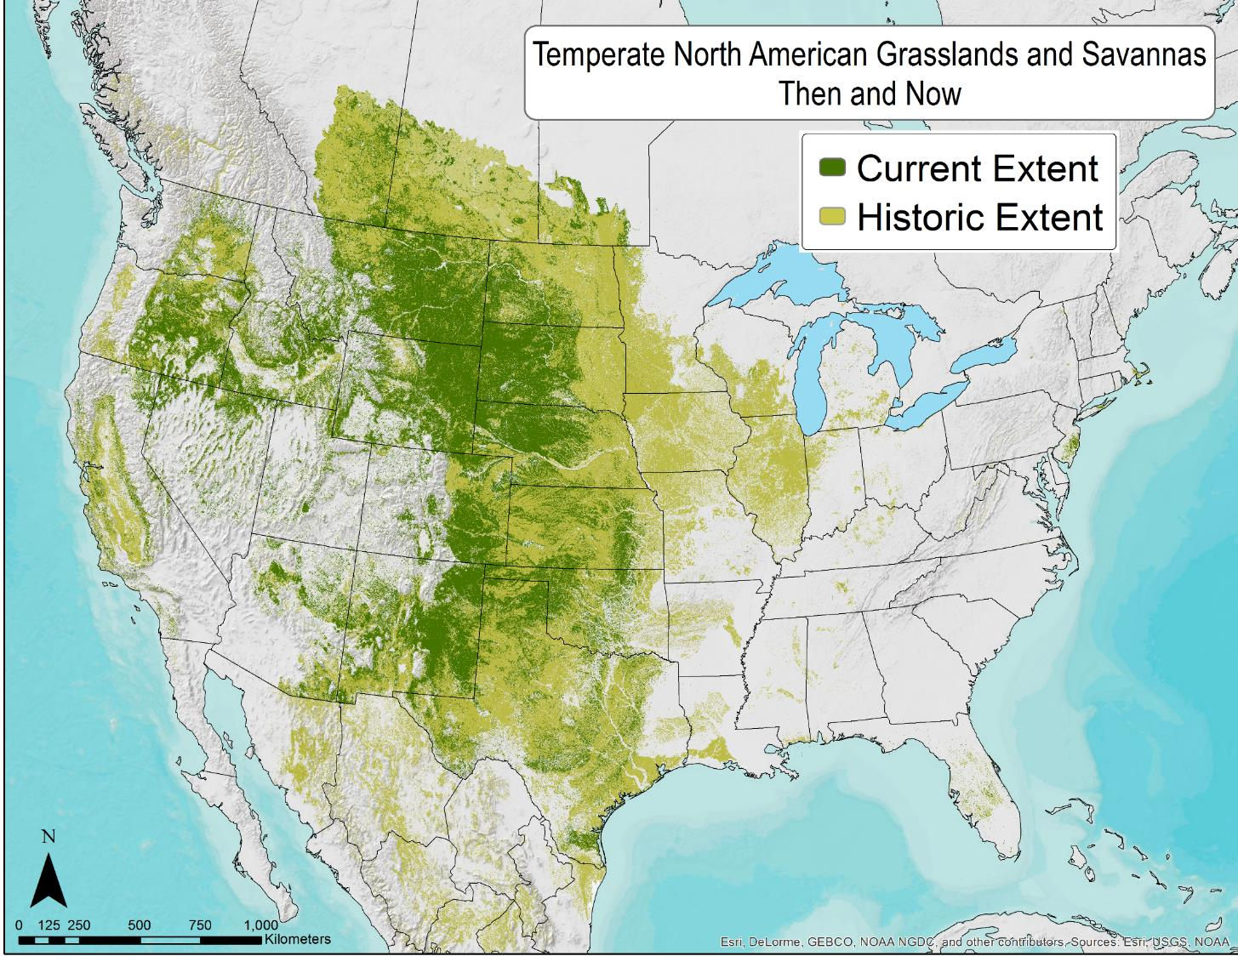

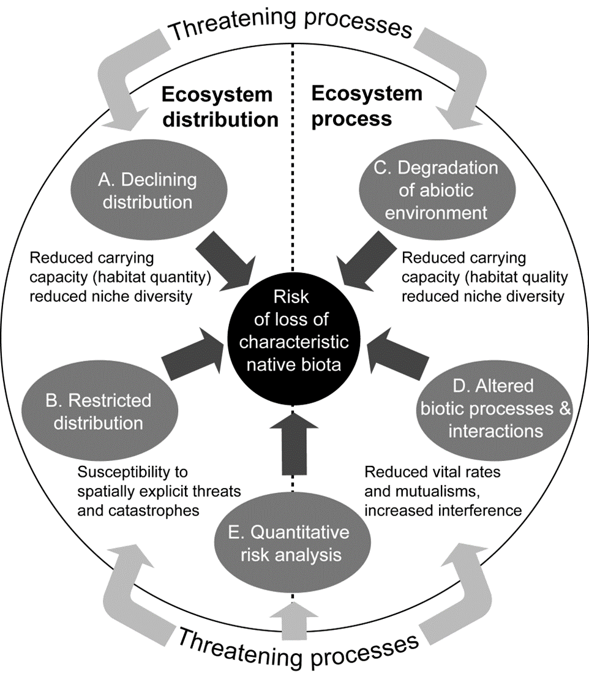

NatureServe terrestrial ecological system types @ Level 6 of vegetation hierarchy
Analysis of 107 grassland and savanna ecosystems in temperate North America, 63% of grassland and savanna ecosystem types scored as threatened.
Comer, P.J., J.C. Hak, et al.. in prep. Documenting At-risk Status of Terrestrial Ecosystems in Temperate and Tropical North America. For Conservation Biology
Comer, P.J. 2020. Red Listing Temperate Grasslands and Savannas in North America. Imperiled: The Encyclopedia of Conservation. Elsevier.
Notes:
Overall results, mapped on historical extent and current footprint.

Slide 11
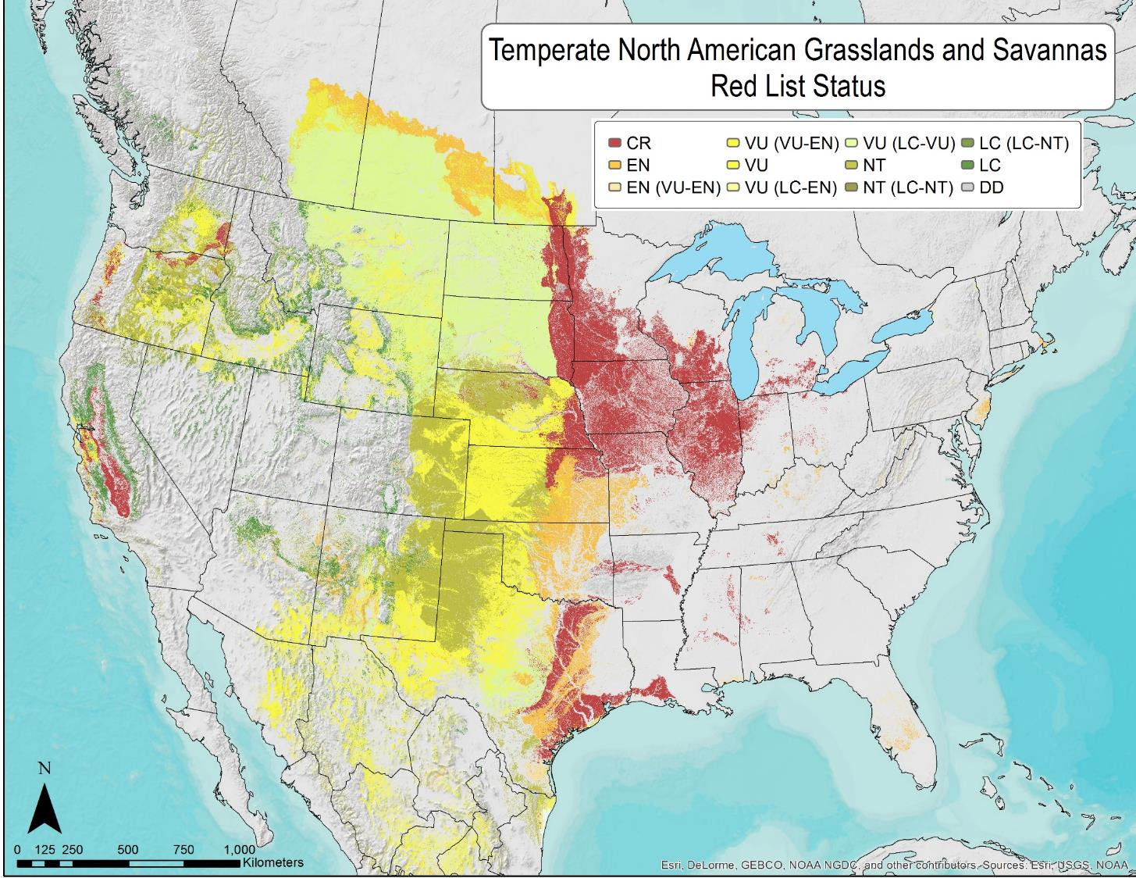
NatureServe terrestrial ecological system types @ Level 6 of vegetation hierarchy
Analysis of 107 grassland and savanna ecosystems in temperate North America, 63% of grassland and savanna ecosystem types scored as threatened.
Comer, P.J., J.C. Hak, et al.. in prep. Documenting At-risk Status of Terrestrial Ecosystems in Temperate and Tropical North America. For Conservation Biology
Comer, P.J. 2020. Red Listing Temperate Grasslands and Savannas in North America. Imperiled: The Encyclopedia of Conservation. Elsevier.
Notes:
Overall results, mapped on historical extent and current footprint.

Slide 12
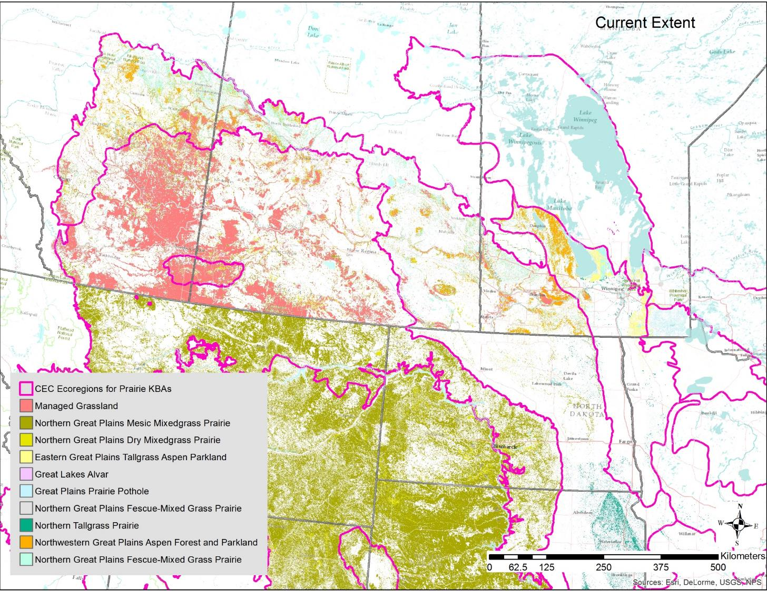

Updated Ecosystem Distributions
Canadian side:
Agriculture and Agri-Food Canada Land use/land cover:
“managed” vs. unmanaged” grassland
- Sandy vs. loamy soils
USA side:
LANDFIRE EVT
2016: USNVC Groups

Slide 13
A2 & B4 Minimum Area Requirements
Targeted Ecosystem Type | RLE Status | Current Global Extent Estimate (km²) | Current National Extent Estimate (km²) | KBA% | A2 KBA Global Target (km2) | A2 KBA National Target (km2) | B4 KBA Global Target (@20%) (km2)
Northern Tallgrass Prairie | CR | 6,213 | 582 | 5% | 311 | 29 | 1,242
Northern Great Plains Fescue Mixedgrass Prairie | EN | 19,981 | 19,800 | 5% | 999 | 990 | 3,996
Northwestern Great Plains Dry Mixedgrass Prairie | EN | 57,897 | 38,166 | 5% | 2,895 | 1,908 | 11,580
Eastern Great Plains Tallgrass Aspen Parkland | VU | 4,515 | 3,986 | 10% | 451 | 399 | 902
Northwestern Great Plains Aspen Forest and Parkland | VU | 23,055 | 23,002 | 10% | 2,305 | 2,300 | 4,610
Great Plains Prairie Pothole | VU | 6,457 | 4,329 | 10% | 646 | 433 | 1,290
Great Lakes Alvar (MB disjunct) | VU | 181 | 44 | 10% | 18 | 4 | 36

Slide 14
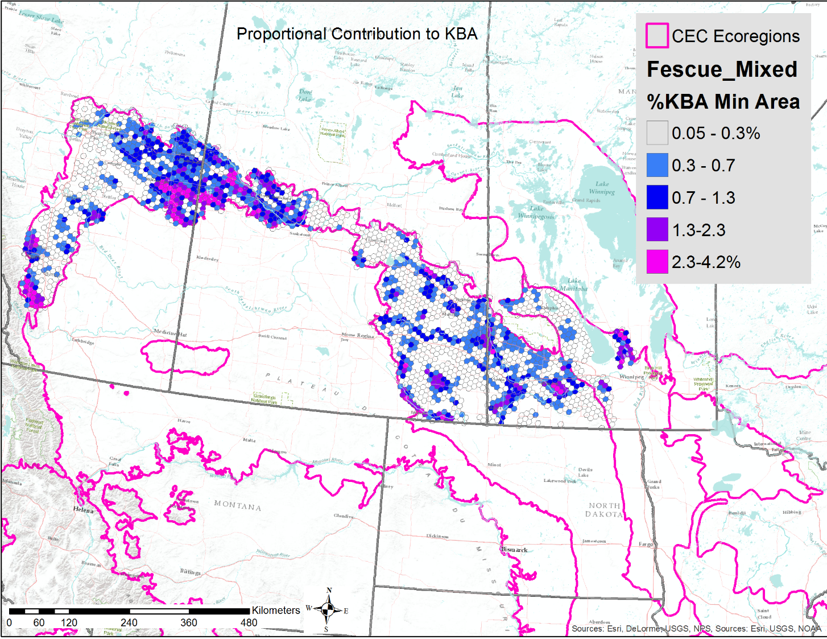
Draft KBA Identification
100km² hexagon spatial analysis units

Slide 15
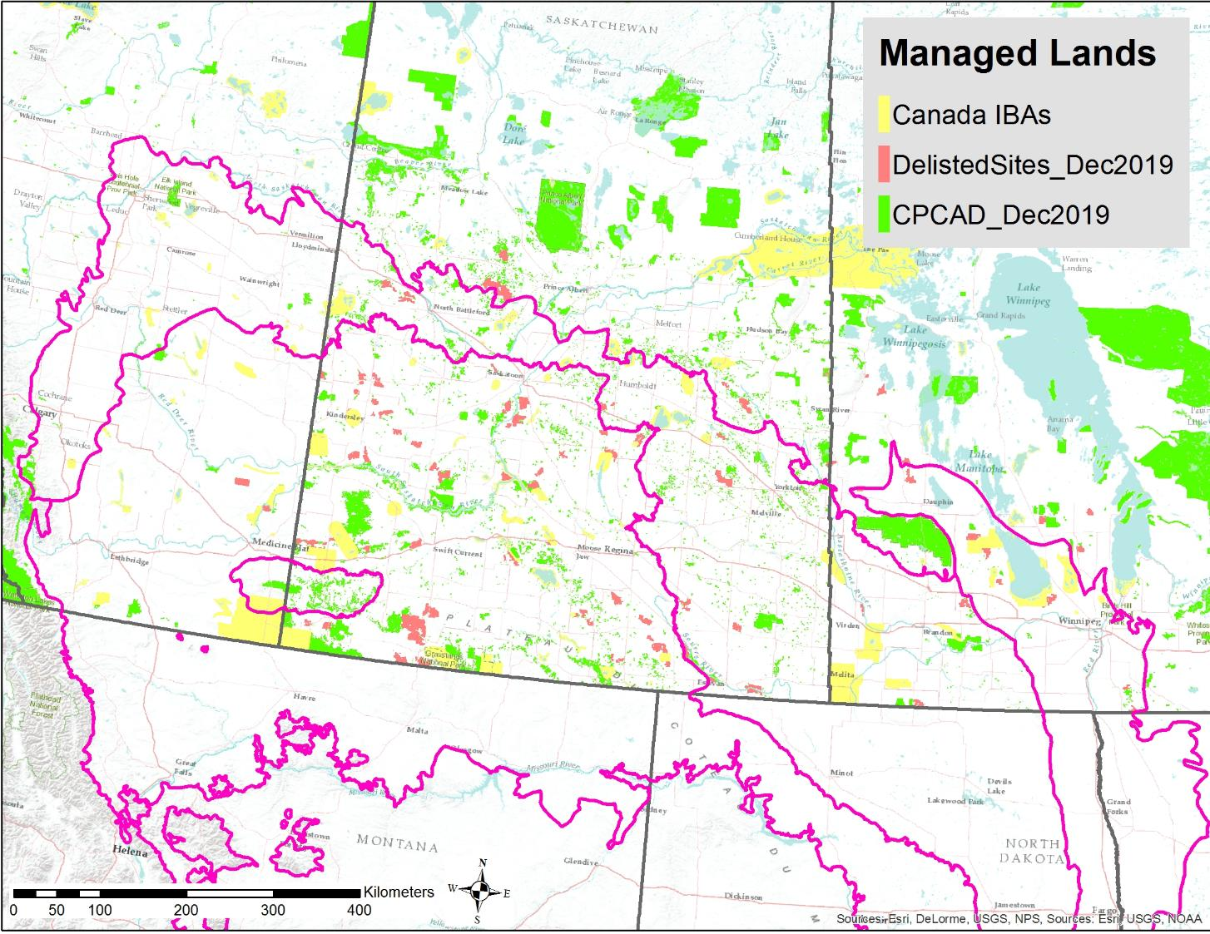
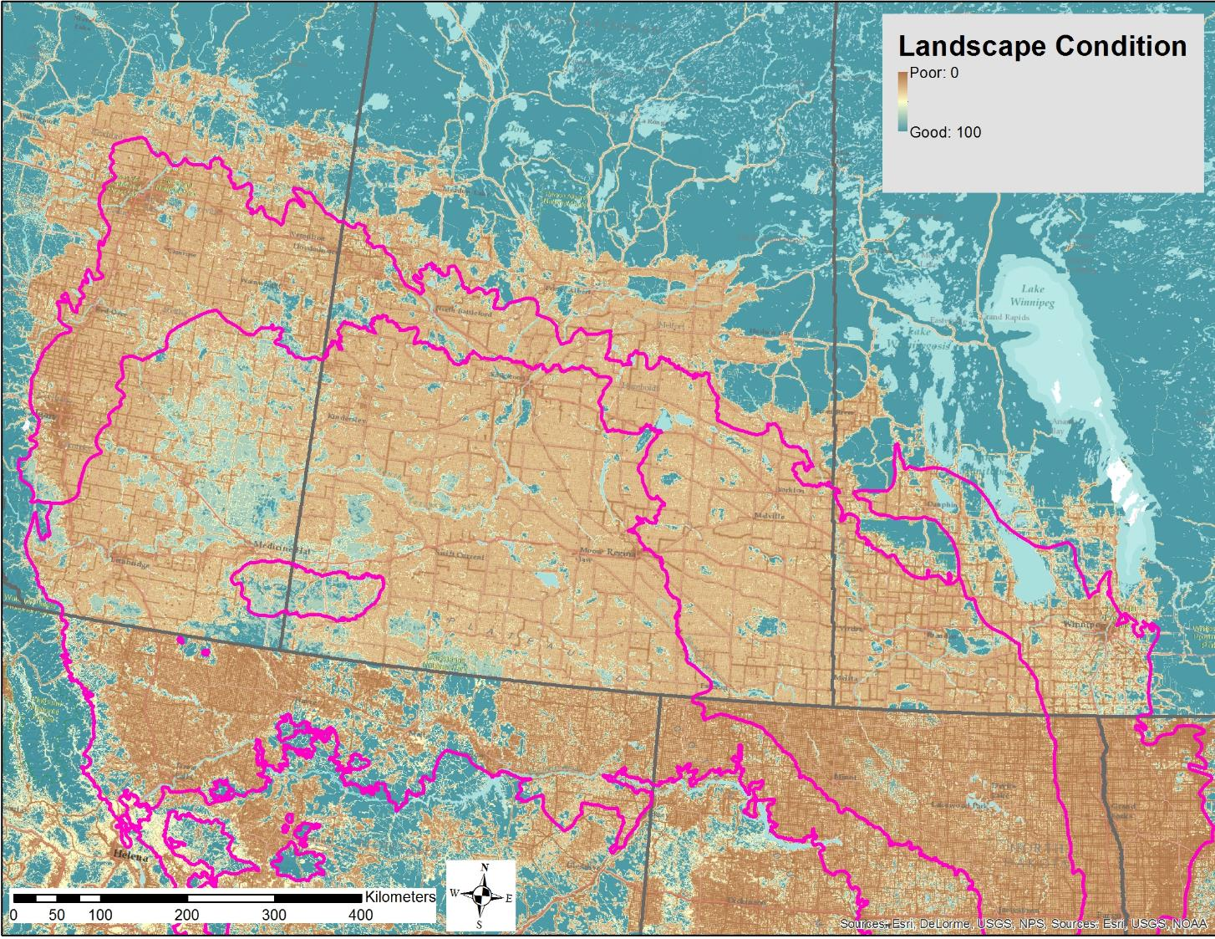
Draft KBA Identification
Landscape Condition
Managed Lands
Hak, J.C. and P.J. Comer. 2017. Modeling Landscape Condition for Biodiversity Assessment – Application in Temperate North America. Ecological Indicators Vol. 82:206-216

Slide 16
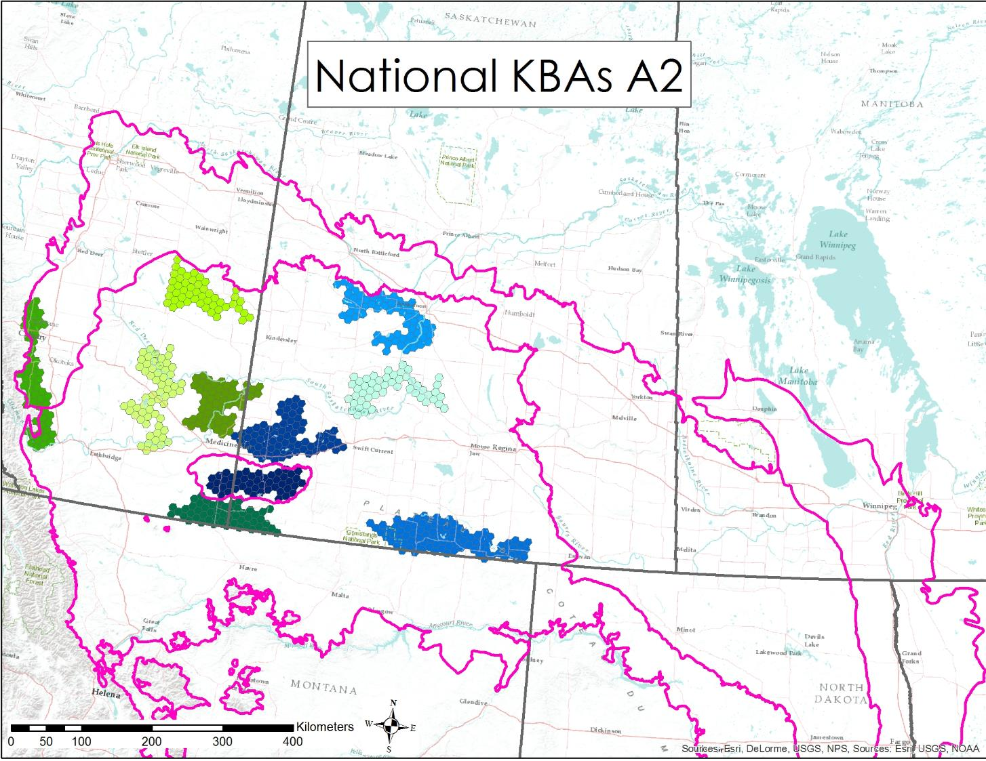
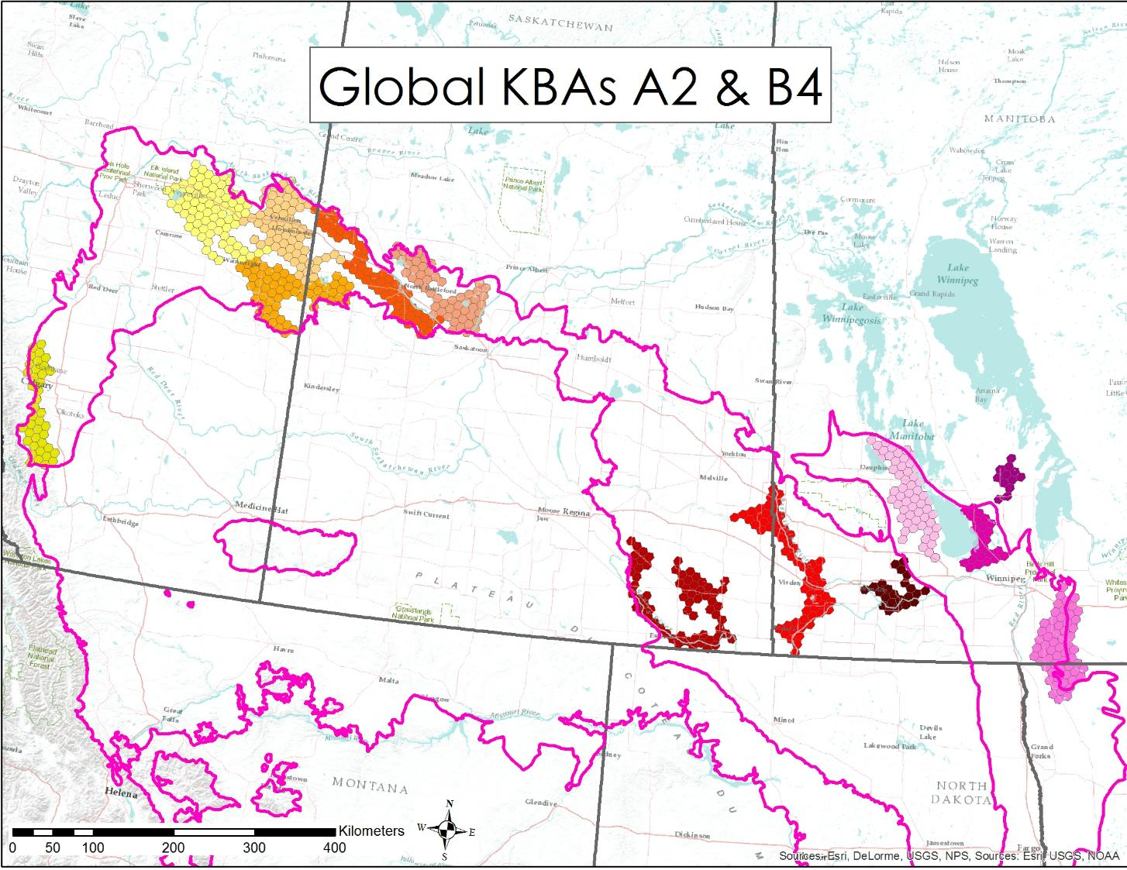
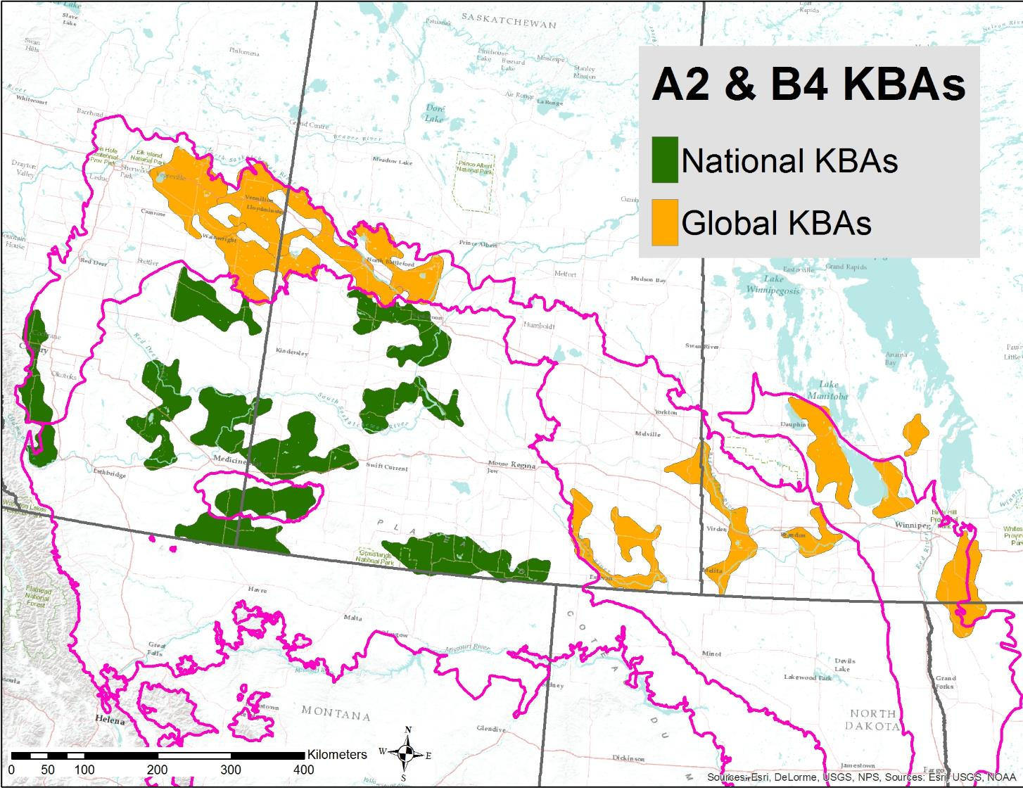
Draft KBA Identification
Hex-based Draft Boundaries
Smoothed Boundaries

Slide 17

KBA Delineation
Definitions
Site = A geographical area on land and/or in water with defined ecological, physical, administrative or management boundaries that is actually or potentially manageable as a single unit
Manageability = The possibility of some type of effective management across the site.

Slide 18
Results & Lessons Learned from Applying Ecosystem Criteria A2 and B4 in Canada
Lessons
A2 - Red Listing ecosystems is challenging because it requires:
  Common classification systems and mapping to look at both national and global extent
  Data are limited on ecological condition (plowing, grazing, planted pasture)
Designation of KBA boundaries in heavily modified landscapes
- Measuring size of unit is challenging in fragmented grasslands – very large and irregular
- Follow up needed to determine actual ecological integrity
- In an agricultural landscape of private lands, there are few discernible “manageable units” for use in delineation
National KBAs will likely be as important or more important for national conservation goals - e.g., A2 – Dry Mixedgrass Prairie severely reduced in Canada but more common in USA

Slide 19
IUCN Red List of Ecosystems
British Columbia KBA RLE workshop
November 20, 2020
Notes:
Pat
1. Intro to KBAs and the ecosystem criteria A2 and B4 - with some results from the prairies
2. The need for IUCN red listing of ecosystem and how it works
3. Global extent vs national extent
3. Deciding on what classification system to use and which ecosystems to cover
4. Data availability
5. A path forward
Northern leopard frog
Quillback rockfish (coast north Pacific)
Victoria’s owl clover
Northern Criterion C landscape
snowgeese

Slide 20

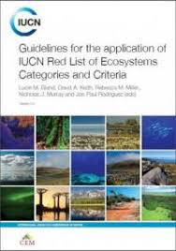
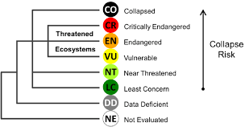
Keith, D.A., J.P. Rodríguez, K. M. Rodríguez-Clark, K. Aapala, A.Alonso, M.Asmussen, S. Bachman, A., Bassett, E.G. Barrow, J.S. Benson, M.J. Bishop, R. Bonifacio, T.M. Brooks, M.A. Burgman, P.J. Comer, F., Comín, F. Essl, D. Faber-Langendoen, P.G. Fairweather, R. Holdaway, M. Jennings, R. T. Kingsford, R.E. Lester, R. Mac Nally, M.A. McCarthy, J. Moat, E. Nicholson, M.A. Oliveira-Miranda, P. Pisanu, B. Poulin, U. Riecken, M.D. Spalding, S. Zambrano-Martínez.
2013.
Scientific Foundations for an IUCN Red List of Ecosystems. PLoS ONE. Vol. 8 Issue 5
Ecosystem Collapse is the transformation of identity, loss of defining features, and replacement by a novel ecosystem or cultural system.
Notes:
Scientific foundations for the RLE were based on a series of global expert forums and publications. It is intended to work in parallel to the Red List of Species (networks of populations for a given taxa), but addresses aspects relevant to ecosystem types (made up of many taxa all interacting with each other and their environment).
They primarily focus on 4 criteria, two based on trends in ecosystem area, or susceptibilities due to spatially-explicit threats. The other two based on trends in ecosystem quality (condition, function, or integrity from both abiotic and biotic perspectives).
A fifth criterion may be applied in circumstances where sufficient data exist to quantitatively predict rangewide ecosystem “collapse” (e.g., like a population viability model for species).

Slide 21
Vegetation-Based Hierarchy
Example from British Columbia
Hierarchy Levels | Example
Upper
L1 – Formation Class | Forest and Woodland
L2 – Form. Subclass | Temperate & Boreal Forest & Woodland
L3 - Formation | Cool Temperate Forest & Woodland
Mid
L4 – Division | Vancouverian Forest & Woodland
L5 – Macrogroup | Southern Vancouverian Dry Foothill Forest & Woodland
L6 – Group | Cascadian Oregon White Oak - Conifer Forest & Woodland
Lower
L7 – Alliance | Quercus garryana - Pseudotsuga menziesii / Toxicodendron diversilobum Forest & Woodland Alliance
L8 – Association | Pseudotsuga menziesii - Quercus garryana / Melica subulata Forest
Level 1 Terrestrial
Level 2 Biome
Level 3 EFG
NA Red List units§ approximate these levels
Level 4 BioEcotype
*Faber-Langendoen, D., T. Keeler-Wolf, D. Meidinger, D. Tart, C. Josse, G. Navarro, B. Hoagland, S. Ponomarenko, J-P. Saucier, A. Weakley, and P. Comer. 2014. Eco-Veg: a new approach to Vegetation Description and Classification. Ecological Monographs 84(4):533-561.
Level 5 Global EcoType
Level 6 Subglobal Type
§ NatureServe Ecological Systems Classification: Comer, P., et al. 2003. Ecological Systems of the United States: A Working Classification of U.S. Terrestrial Systems. NatureServe, Arlington, VA.
Notes:
Vegetation-based classification hierarchy, as one example to define terrestrial ecosystems for red listing. As you go down in the hierarchy, each classification unit describes a more specific unit that applies to increasingly localized areas.
One example worked through the hierarchy that occurs in the SE. Multiple alliances make up the “Western Interior Riparian Forest & Woodland” group, and many associations make up each of those alliances.
For our current work in temperate North America, the classification units fall into the Group to Alliance level of this vegetation hierarchy; around 90 units falling within the state.

Slide 22
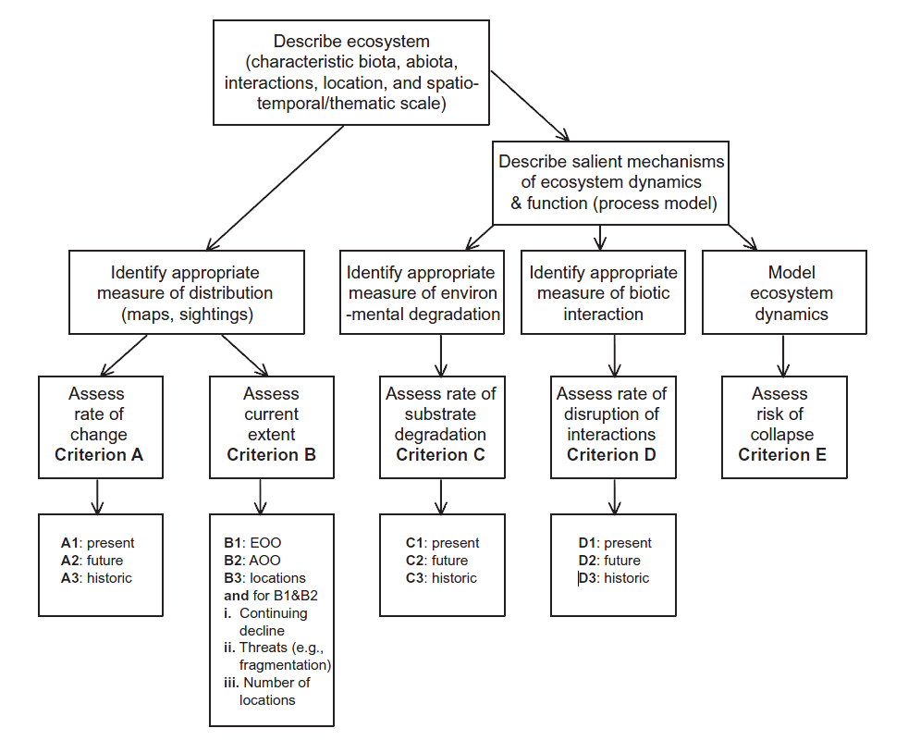

environmental
Notes:
A decision tree for RLE: starting with the classification units, then identifying appropriate data for measures pertaining to area and distribution (A, B).
A second pathway first involves documenting key ecosystem processes and threats, and then selecting rangewide indicators for measuring criteria for environmental degradation and biotic disruption (C and D)

Slide 23
Red Listing Ecosystems - Criterion A: Change In Distribution
Trends in Ecosystem Loss Through Land Conversion
 |  | Criterion A |  | Critically Endangered | Endangered | Vulnerable
A | Reduction in geographic distribution over ANY of following periods:
 | 1 |  | Present (over the past 50 years) | 80% | 50% | 30%
 | 2a |  | Future (over the next 50 years) | 80% | 50% | 30%
 | 2b |  | Future (over any 50 year period including the present and future) | 80% | 50% | 30%
 | 3 |  | Historic (since 1750 or pre-industrial land use intensity) | 90% | 70% | 50%
Notes:
Once primary criterion we’ve used in the in temperate North America addresses long-term trends in ecosystem extent due to land conversion; basically since about 1600. This criterion A3 then includes a series of thresholds of loss to determine which category is appropriate for red list status…

Slide 24
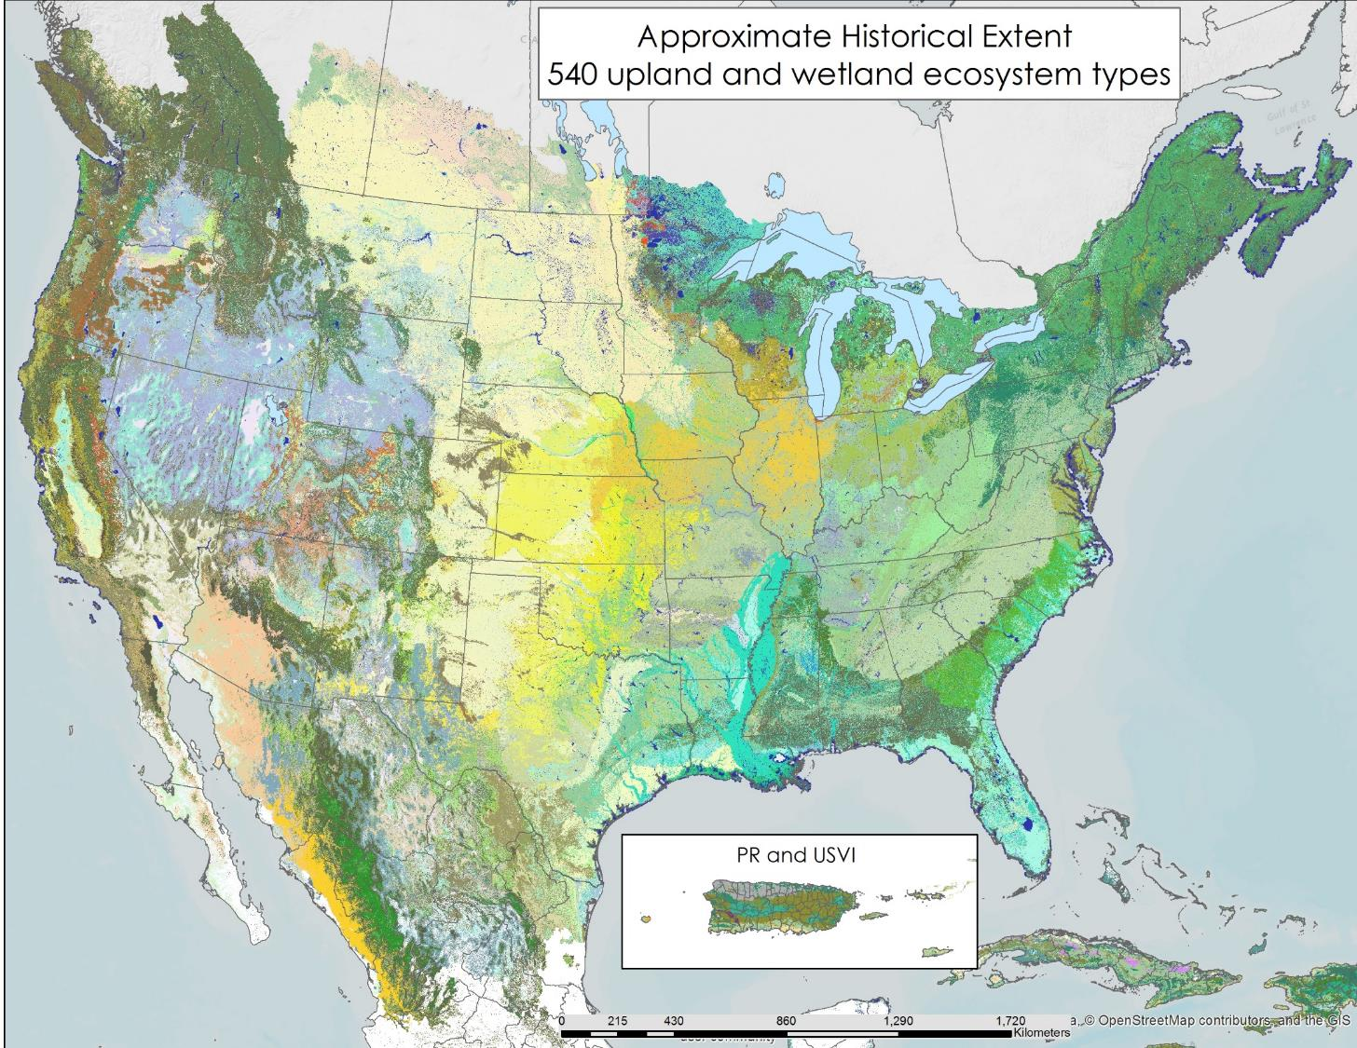

>500,000 field observations of classified ecosystem types were combined with map information on climate, landform, soil, drainage, and wildfire simulations to model approximate historical extent.
Maps: Comer PJ, Hak JC, Josse C, Smyth R. 2020. Long-term loss in extent and current protection of terrestrial ecosystem diversity in the temperate and tropical Americas. PLoS ONE 15(6): e0234960.
Classification: Comer, P., D. Faber-Langendoen, R. Evans, S. Gawler, C. Josse, G. Kittel, S. Menard, M. Pyne, M. Reid, K. Schulz, K. Snow, and J. Teague. 2003. Ecological Systems of the United States: A Working Classification of U.S. Terrestrial Systems. NatureServe, Arlington, VA.
Notes:
In parallel to mapping current extent and land use, models have now been developed (@90m pixel resolution) that do not use current satellite imagery, but do utilize other geophysical layers to make predictive distributions of the “potential/historical” extent. This model, using the NatureServe classification, forms the basis for documenting long-term trends in ecosystem extent under the RLE criterion A3. Box shows the historic distribution, in orange-brown, of Central Tallgrass Prairie.

Slide 25
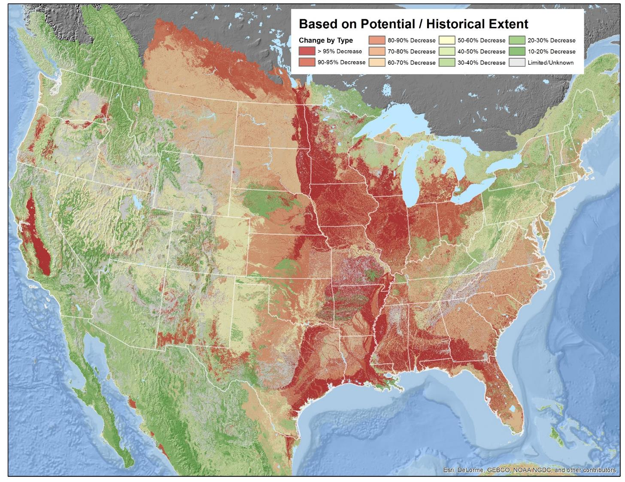
Grassland, forest, and wetland types, concentrated in most productive agricultural regions score as most endangered due to long-term trends in land conversion.
Comer PJ, Hak JC, Josse C, Smyth R. 2020. Long-term loss in extent and current protection of terrestrial ecosystem diversity in the temperate and tropical Americas. PLoS ONE 15(6): e0234960.
Notes:
Box shows how the change in extent for Central Tallgrass Prairie is > 95% decrease, which it shares with other ecosystem types in the same area and elsewhere.

Slide 26
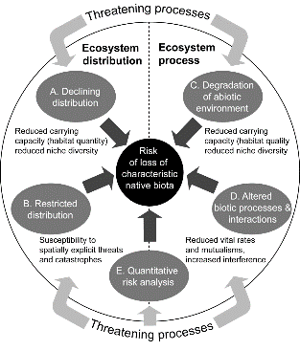


Red Listing Ecosystems - Criterion C & D: Degradation & Biotic Disruption
Continuum of Ecological Integrity
Decreasing ecological integrity
A =“excellent”
30% Severity
“assessment of an ecosystem as compared to reference ecosystems operating within the bounds of natural or historical disturbance regimes”
B =“good”
50% Severity
C =“fair”
90% Severity
D =“poor”
Increasing severity of alteration/ecological disruption
Notes:
NatureServe has been engaged in relative measures of ecological integrity or condition, identifying practical indicators to place any given example of an ecosystem types along this continuum of “excellent” to “poor” (and now “collapsed”). IUCN framework is attempting to do the same, with some alternative terminology, focused on the “percent severity” of threatening conditions…
Ecological integrity:

Slide 27
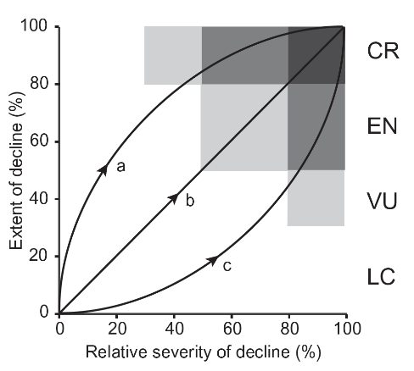
Red Listing Ecosystems: Criteria C & D
Long-Term Trends in Ecosystem Degradation and Biotic Disruption
Criteria C (& D) | Critically Endangered | Endangered | Vulnerable
Environmental degradation (or Biotic disruption) since 1750 based on change in (a)biotic variables affecting the native biota of the ecosystem type… | ≥ 90% extent with ≥ 90% relative severity | ≥ 70% extent with ≥ 90% relative severity | ≥ 70% extent with ≥ 70% relative severity
 |  | ≥ 90% extent with ≥ 70% relative severity | ≥ 90% extent with ≥ 50% relative severity
 |  |  | ≥ 50% extent with ≥ 90% relative severity
Notes:
Given the relatively “mature” land use history of temperate North America, many degrading and disrupting land uses have been in place for greater >50 years, and therefore, many of our measures apply only to this third timeframe (“long-term trends”) among the IUCN criteria C & D.
From here, you can see that we are using measures to score the proportional of rangewide extent of the ecosystem type that is impacted at one or more levels of relative severity.

Slide 28
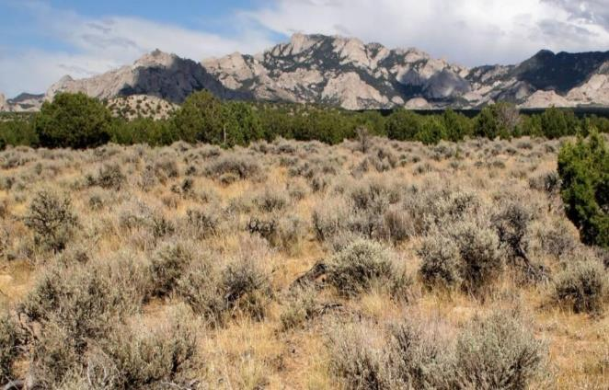
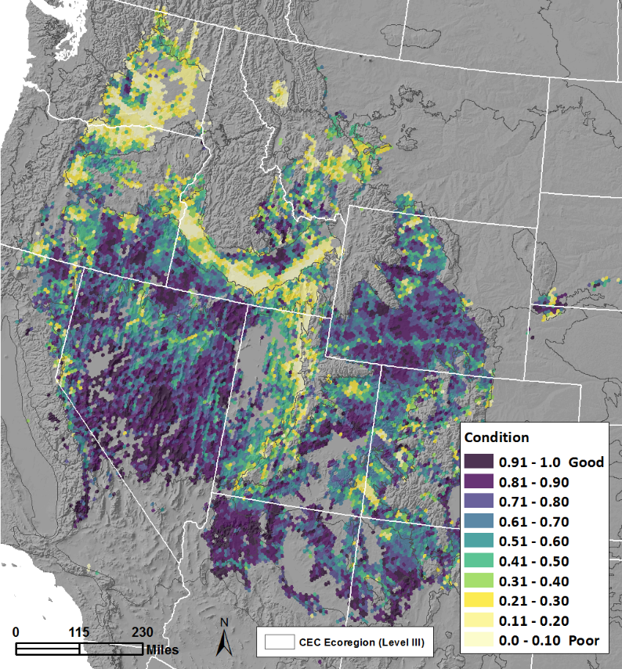
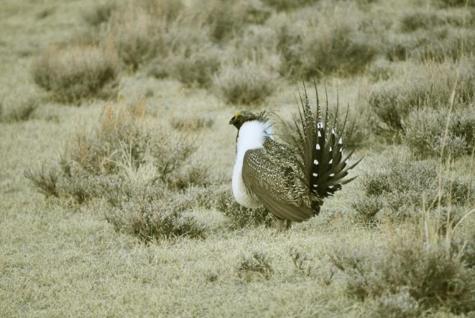
Red Listing Ecosystems: Criteria C & D
Hak, J.C. and P.J. Comer. 2017. Modeling Landscape Condition for Biodiversity Assessment – Application in Temperate North America. Ecological Indicators Vol. 82:206-216
D3. Landscape Fragmentation
D3. Invasive Annual Grasses
C3. Altered Fire Regime
Severity
30%
50%
90%
Notes:
For illustration using big sagebrush shrubland, we have applied rangewide indicators of landscape condition/fragmentation vs. invasive plants vs. fire regime alteration. Each of these are summarized here by 100km hexagon across the range. It therefore enables a direct measure of proportional area affected at varying levels of severity by each measure.
In this case, landscape fragmentation and invasive plants each get combined to score for “biotic disruption” while fire regime alteration scores for “environmental degradation”

Slide 29
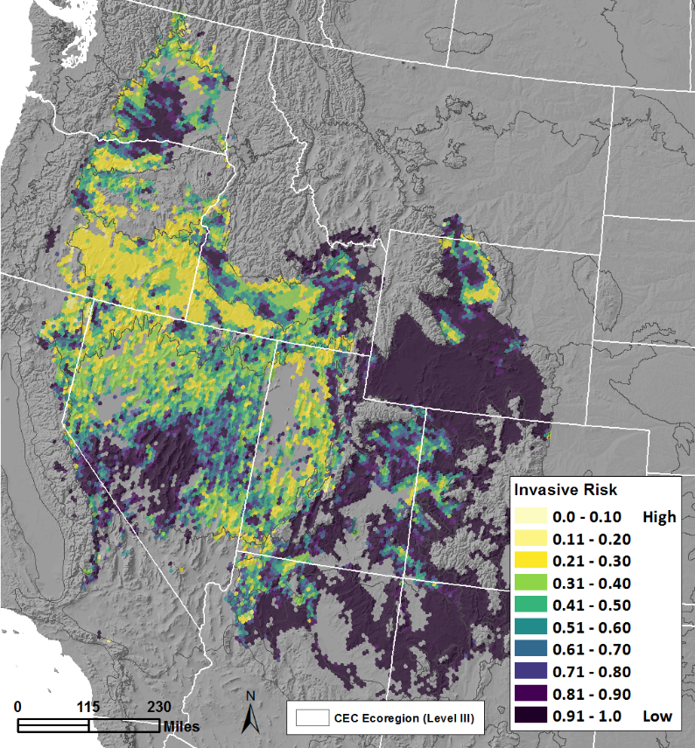
Red Listing Ecosystems: Criteria C & D
Hak, J.C. and P.J. Comer. 2017. Modeling Landscape Condition for Biodiversity Assessment – Application in Temperate North America. Ecological Indicators Vol. 82:206-216
Hak, J.C. and P.J. Comer. 2020. Modeling Invasive Annual Grass Vulnerability in the Cold Deserts of the Intermountain West. For Rangeland Ecology and Management 73 171-180
D3. Landscape Fragmentation
D3. Invasive Annual Grasses
C3. Altered Fire Regime
Severity
30%
50%
90%
Severity
90%
50%
30%
Notes:
For illustration using big sagebrush shrubland, we have applied rangewide indicators of landscape condition/fragmentation vs. invasive plants vs. fire regime alteration. Each of these are summarized here by 100km hexagon across the range. It therefore enables a direct measure of proportional area affected at varying levels of severity by each measure.
In this case, landscape fragmentation and invasive plants each get combined to score for “biotic disruption” while fire regime alteration scores for “environmental degradation”

Slide 30
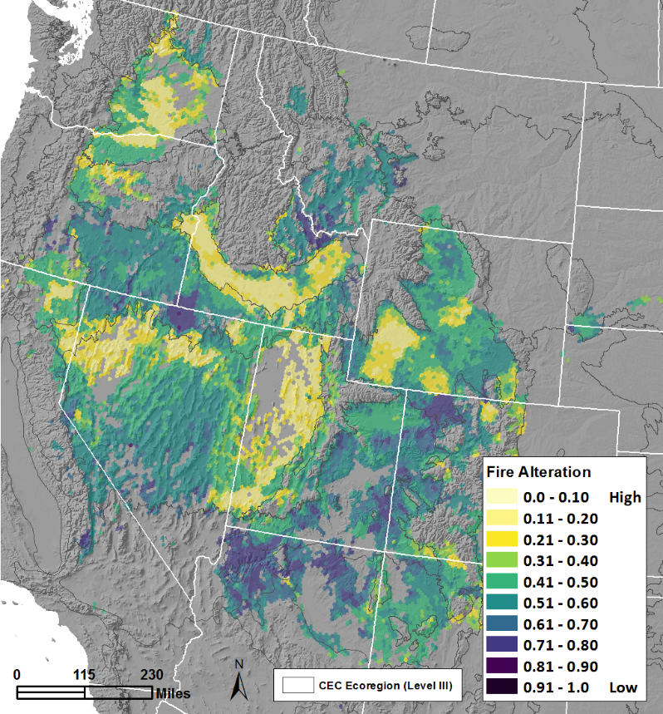
Red Listing Ecosystems: Criteria C & D
Hak, J.C. and P.J. Comer. 2017. Modeling Landscape Condition for Biodiversity Assessment – Application in Temperate North America. Ecological Indicators Vol. 82:206-216
Rollins, M.G., 2009. LANDFIRE: a nationally consistent vegetation, wildland fire, and fuel assessment. International Journal of Wildland Fire, 18(3), pp.235-249.
Hak, J.C. and P.J. Comer. in review. Modeling Invasive Annual Grass Vulnerability in the Cold Deserts of the Intermountain West. For Rangeland Ecology and Management
D3. Landscape Fragmentation
D3. Invasive Annual Grasses
C3. Altered Fire Regime
Severity
30%
50%
90%
Severity
90%
50%
30%
Severity
90%
50%
30%
Notes:
For illustration using big sagebrush shrubland, we have applied rangewide indicators of landscape condition/fragmentation vs. invasive plants vs. fire regime alteration. Each of these are summarized here by 100km hexagon across the range. It therefore enables a direct measure of proportional area affected at varying levels of severity by each measure.
In this case, landscape fragmentation and invasive plants each get combined to score for “biotic disruption” while fire regime alteration scores for “environmental degradation”

Slide 31
Criterion C2 | Critically Endangered | Endangered | Vulnerable
Environmental degradation over the next 50 years or any 50-year period including the present and future, based on change in abiotic variables affecting a fraction of the extent of the ecosystem type and with relative severity, as indicated by the following table. | ≥ 80% extent with ≥ 80% relative severity | ≥ 50% extent with ≥ 80% relative severity | ≥ 80% extent with ≥ 30% relative severity
 |  | ≥ 80% extent with ≥ 50% relative severity | ≥ 50% extent with ≥ 50% relative severity
 |  |  | ≥ 30% extent with ≥ 80% relative severity
environmental
e.g., effects of sea level rise on coastal salt marshes
Climate Change Vulnerability within 50 years
Notes:
Going back to our decision tree for the RLE, one might ask where climate change is treated. Within the RLE framework, climate change is addressed mainly under “environmental degradation” over the upcoming 50 years.
In some limited cases, such as sea level rise impacts on coastal marshes and mangrove,, it might be treated as the predicted loss in areal extent over the next 50 years.

Slide 32
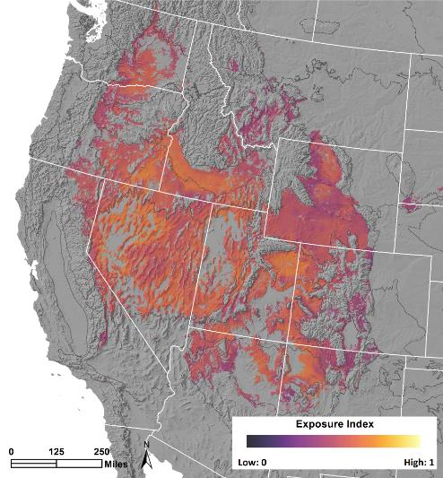
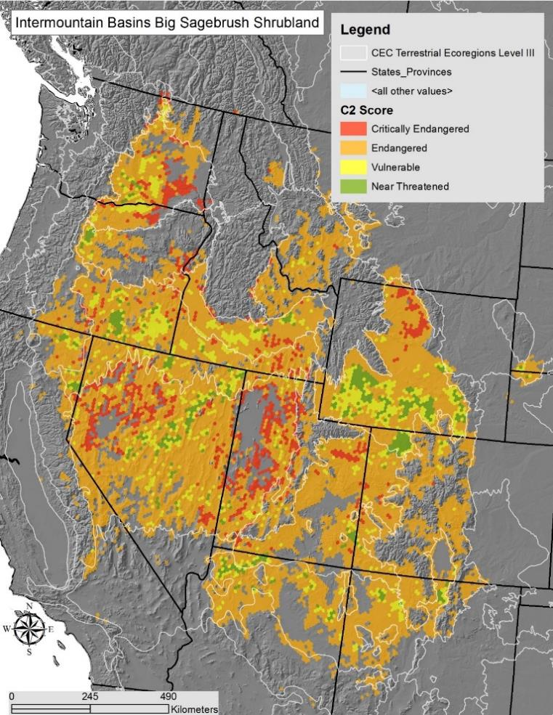
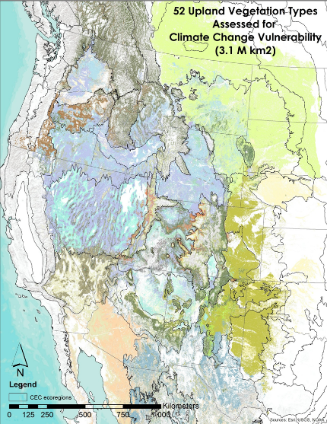
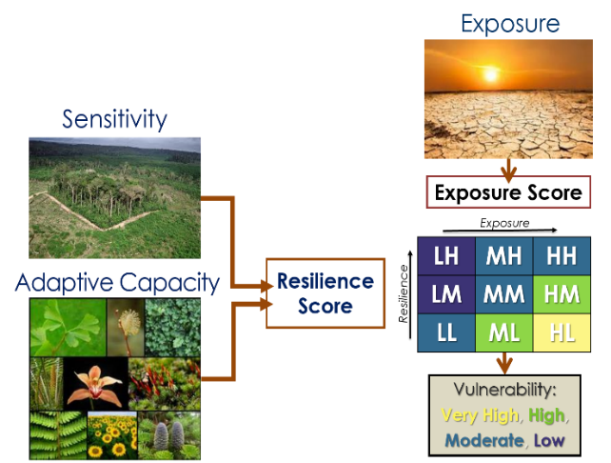

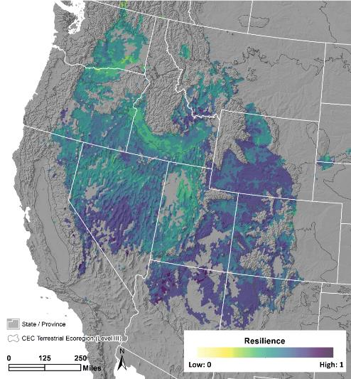
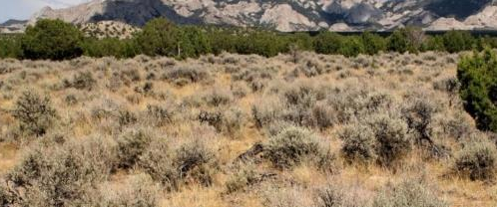
Red Listing Ecosystems:
Addressing Climate Change: Criterion C2: Environmental Degradation over next 50 years
NatureServe’s Climate Change Vulnerability Assessment Framework for Ecosystems can be applied to gauge relative CC Severity for the mid-21st century.
HCCVI by 2040-70 | IUCN % Severity
Very High | 80%
High | 50%
Moderate | 30%
Low | <30%
Comer, P.J., J.C. Hak, M.S. Reid, S.L. Auer, K.A. Schulz, H.H. Hamilton, R.L. Smyth and M.M. Kling. 2019. Habitat Climate Change Vulnerability Index Applied to Major Vegetation Types of the Western Interior United States. Land 2019, Volume 8, Issue 7, 108; doi:10.3390/land8070108
Notes:
NatureServe has developed a climate change vulnerability index approach that can directly measure the relative severity of climate change vulnerability (Very high, high, moderate, low) by 100km2 area for the mid-21st century. Vulnerability is a proxy for Severity. (E.g. Very High Vulnerability = 90% Relative Severity). This one example with big sagebrush shrubland illustates how the index results can be translated to relative severity scores for ecosystem red listing.
In this case, it indicates that this type could score as Endangered based on criterion C2.

Slide 33
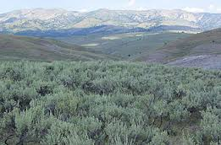
IUCN Criteria and Categories
Intermountain Basins Big Sagebrush Shrubland
 | CRITERIA
 | A Reduced Extent | B Restricted Distribution | C Environmental Degradation | D Biotic Process Disruption | E | overall
Subcrit.1 (past 50 yrs) | DD | LC (current extent) | NE | NE | NE | NT
Subcrit. 2 (next 50 yrs) | DD |  | NE | NE
Subcrit. 3 (since 1750) | LC |  | NT (fire regime alteration) | NT (fragmentation and invasives)
EN
EN
(climate change vulnerability)
CR= Critically Endangered, EN = Endangered, VU = Vulnerable, NT = Near Threatened LC = Least Concern, DD = Data Deficient, NE = Not Evaluated
Notes:
Jumping back to the red listing process, this table illustrates an example of scoring several RLE criteria for this big sagebrush shrubland in western North America.
Not yet accounting for climate change, this type approaches the thresholds for VU status, but will be scored for now as NT.
And as with Red Listing for species, the “worst” score for one criterion translates to the overall score.

Slide 34
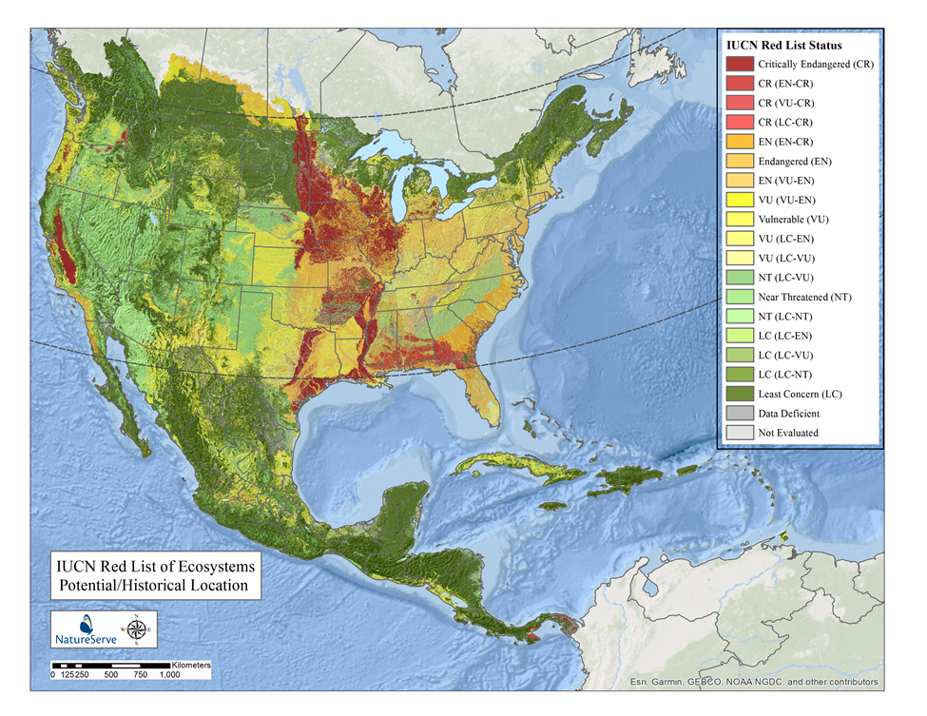
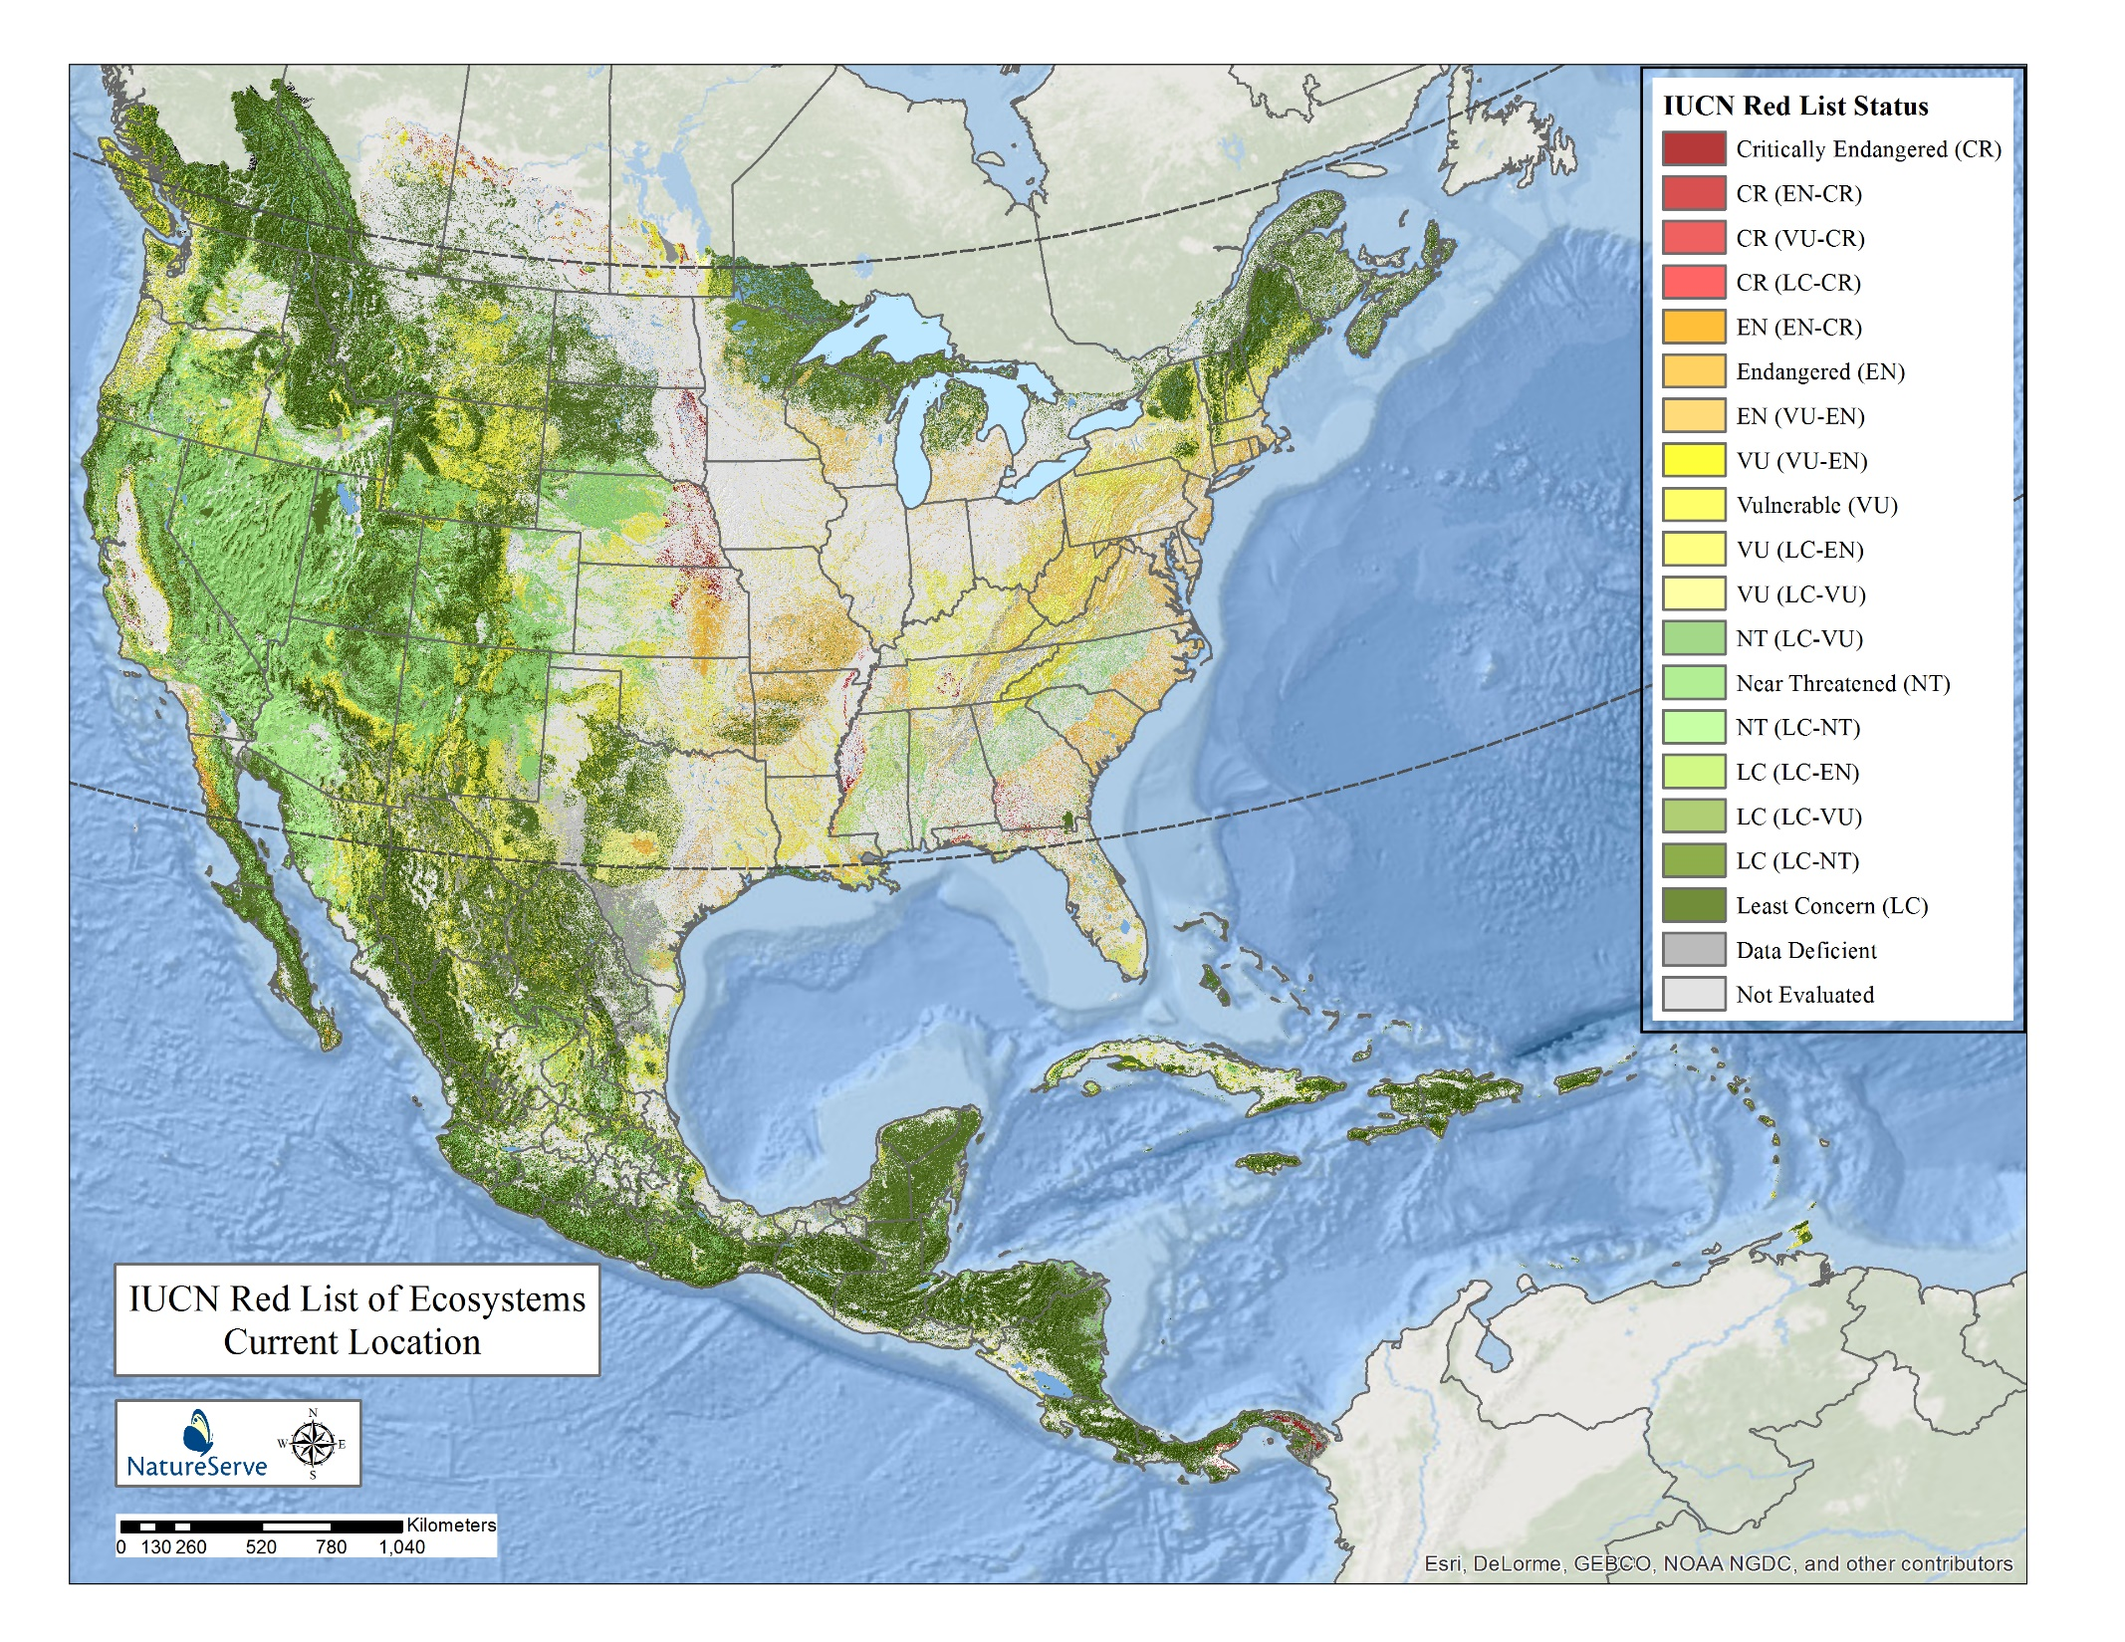

~640 terrestrial ecological system types (uplands and wetlands)
@ IUCN Level 5
~22% of current land surface area includes CR, EN or VU ecosystems
Comer, P.J., J.C. Hak, et al.. in prep. Documenting At-risk Status of Terrestrial Ecosystems in Temperate and Tropical North America. For Conservation Biology
Notes:
Our initial results from North America show distinct patterns with extensive areas historically dominated by temperate grasslands, wetlands, and eastern forests converted for agriculture resulting in a large proportions of types scoring within the range of CR, EN or VU under IUCN criteria.
Here we show these results mapped on historical extent and current footprint.
About 22% of current land area includes ecosystems scoring as CR, EN or VU.

Slide 35
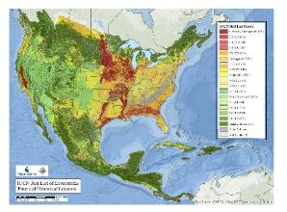

Summary Findings – North America
Subset of L3, L4, plus L5 type status
IUCN Global Ecosystem Typology (v1.0) - Code and Name (L3) Ecosystem Functional Group | Number of IVC Macrogroup (IUCN L4) | Number of Assessed Ecosystems (IUCN L5) | CR | EN | VU | NT | LC | DD
T2.1 Temperate-boreal montane forests and woodlands | 18 | 46 |  |  | 9 | 10 | 21 | 6
T2.2 Deciduous temperate forests | 10 | 38 | 3 | 15 | 8 | 2 | 5 | 5
T4.4 Temperate woodlands | 18 | 49 | 6 | 6 | 6 | 7 | 16 | 8
T4.5 Temperate subhumid grassland | 13 | 53 | 15 | 4 | 9 | 4 | 11 | 10
TF1.2 Subtropical/temperate forested wetlands | 14 | 79 | 4 | 15 | 9 | 8 | 15 | 28
TF1.3 Permanent marshes | 10 | 41 | 2 | 1 | 8 | 1 | 6 | 23
MT1.3 Sandy shorelines | 10 | 25 | 1 | 3 | 6 | 1 | 6 | 8
Notes:
A summary subset of the 640 ecosystems assessed (52% of types) include most diverse L3s in terms of L4s and L5s to provide an indication of the relationship among these classification levels
Note the high variation in red list scores within each Macrogroup (L4) and certainly within individual L3 functional groups.
Each macrogroup, and certainly L3 functional group, encompasses a wide range of types, some occurring across large to small area, in locations where threats stemming from land use vary from very intense to very limited.
See one extreme in particular, Temperate subhumid grasslands, embody such a range from CR (tallgrass prairies) to LC types (montane grasslands and shrublands).
Therefore the broader the classification concept, the more likely one is to mask underlying patterns of more extreme threat expressed in finer-grained classification concepts.

Slide 36

Classification Scale Effects
Types assessed at L4 clearly “mask” underlying risk patterns
L5 (and L6) define the “sweet spot” for assessment
Northern Tallgrass Prairie (CR)
Notes:
In applying at-risk criteria to standardized classifications, we provide one important focus for governments and civil society to prioritize conservation effort. However, users of ecosystem risk assessment systems should be aware of the implications of classification approach and thematic detail on risk assessment outcomes.
Using these two examples, we demonstrate a clear effect of classification scale on assessment results, so this is an important consideration for anyone applying these sorts of assessment frameworks.
Types assessed at IUCN L3 or L4 clearly “mask” underlying status patterns that manifest themselves when finer-grain concepts are assessed.
Using the IUCN global typology, the L5 and L6 define the “sweet spot” for assessment that, at least considering conditions in North America and South Africa, strike a balance between identifying important patterns in status with available data.

Slide 37
Our key tasks
Deciding on what classification and types to focus on
Data availability
A path forward

Slide 38
Vegetation-Based Hierarchy
Example from British Columbia
Hierarchy Levels | Example
Upper
L1 – Formation Class | Forest and Woodland
L2 – Form. Subclass | Temperate & Boreal Forest & Woodland
L3 - Formation | Cool Temperate Forest & Woodland
Mid
L4 – Division | Vancouverian Forest & Woodland
L5 – Macrogroup | Southern Vancouverian Dry Foothill Forest & Woodland
L6 – Group | Cascadian Oregon White Oak - Conifer Forest & Woodland
Lower
L7 – Alliance | Quercus garryana - Pseudotsuga menziesii / Toxicodendron diversilobum Forest & Woodland Alliance
L8 – Association | Pseudotsuga menziesii - Quercus garryana / Melica subulata Forest
Level 1 Terrestrial
Level 2 Biome
Level 3 EFG
NA Red List units§ approximate these levels
Level 4 BioEcotype
*Faber-Langendoen, D., T. Keeler-Wolf, D. Meidinger, D. Tart, C. Josse, G. Navarro, B. Hoagland, S. Ponomarenko, J-P. Saucier, A. Weakley, and P. Comer. 2014. Eco-Veg: a new approach to Vegetation Description and Classification. Ecological Monographs 84(4):533-561.
Level 5 Global EcoType
Level 6 Subglobal Type
§ NatureServe Ecological Systems Classification: Comer, P., et al. 2003. Ecological Systems of the United States: A Working Classification of U.S. Terrestrial Systems. NatureServe, Arlington, VA.
Notes:
Vegetation-based classification hierarchy, as one example to define terrestrial ecosystems for red listing. As you go down in the hierarchy, each classification unit describes a more specific unit that applies to increasingly localized areas.
One example worked through the hierarchy that occurs in the SE. Multiple alliances make up the “Western Interior Riparian Forest & Woodland” group, and many associations make up each of those alliances.
For our current work in temperate North America, the classification units fall into the Group to Alliance level of this vegetation hierarchy; around 90 units falling within the state.

Slide 39
A2 & B4 Minimum Area Requirements
Targeted Ecosystem Type | RLE Status | Current Global Extent Estimate (km²) | Current National Extent Estimate (km²) | KBA% | A2 KBA Global Target (km2) | A2 KBA National Target (km2) | B4 KBA Global Target (@20%) (km2)
Northern Tallgrass Prairie | CR | 6,213 | 582 | 5% | 311 | 29 | 1,242
Northern Great Plains Fescue Mixedgrass Prairie | EN | 19,981 | 19,800 | 5% | 999 | 990 | 3,996
Northwestern Great Plains Dry Mixedgrass Prairie | EN | 57,897 | 38,166 | 5% | 2,895 | 1,908 | 11,580
Eastern Great Plains Tallgrass Aspen Parkland | VU | 4,515 | 3,986 | 10% | 451 | 399 | 902
Northwestern Great Plains Aspen Forest and Parkland | VU | 23,055 | 23,002 | 10% | 2,305 | 2,300 | 4,610
Great Plains Prairie Pothole | VU | 6,457 | 4,329 | 10% | 646 | 433 | 1,290
Great Lakes Alvar (MB disjunct) | VU | 181 | 44 | 10% | 18 | 4 | 36

Slide 40
Temperate BC ecosystems
- some candidate red listed ecosystems to trigger KBAs
Cascadian Oregon White Oak - Conifer Forest & Woodland (IVC Group)
  North Pacific Oak Woodland [ecological system] (VU)
  East Cascades Oak-Ponderosa Pine Forest and Woodland [ecological system] (DD)
North Pacific Maritime Douglas-fir - Western Hemlock Rainforest (IVC Group)
  North Pacific Maritime Dry-Mesic Douglas-fir-Western Hemlock Forest [ecological system] (VU)
  North Pacific Maritime Mesic-Wet Douglas-fir-Western Hemlock Forest [ecological system] (VU)
North-Central Pacific Western Hemlock - Sitka Spruce Rainforest (IVC Group)
  North Pacific Sitka Spruce Forest [system] (VU)
  North Pacific Hypermaritime Western Red-cedar-Western Hemlock Forest (LC)

Slide 41
Temperate BC ecosystems
- some candidate red listed ecosystems to trigger KBAs
Northern Rocky Mountain Whitebark Pine - Subalpine Larch Woodland (IVC Group)
  North Pacific Interior Lodgepole Pine-Whitebark Pine Forest [ecological system] (DD)
  Northern Rocky Mountain Subalpine Woodland and Parkland [ecological system] (NT)
Central Rocky Mountain Ponderosa Pine Open Woodland (IVC Group)
  Northern Rocky Mountain Ponderosa Pine Woodland and Savanna [ecological system] (NT)
  Northern Rocky Mountain Foothill Conifer Wooded Steppe [ecological system] (DD)

Slide 42
Temperate BC ecosystems
- some candidate red listed ecosystems to trigger KBAs
Intermountain Dry Tall Sagebrush Steppe & Shrubland (IVC Group)
  Intermountain Big Sagebrush Steppe [ecological system] (VU)
  Intermountain Big Sagebrush Shrubland [ecological system] (NT)
Temperate Pacific Salt Marsh (IVC Group)
  Temperate Pacific Tidal Salt and Brackish Marsh [ecological system] (LC)

Slide 43
Discussion

Slide 44
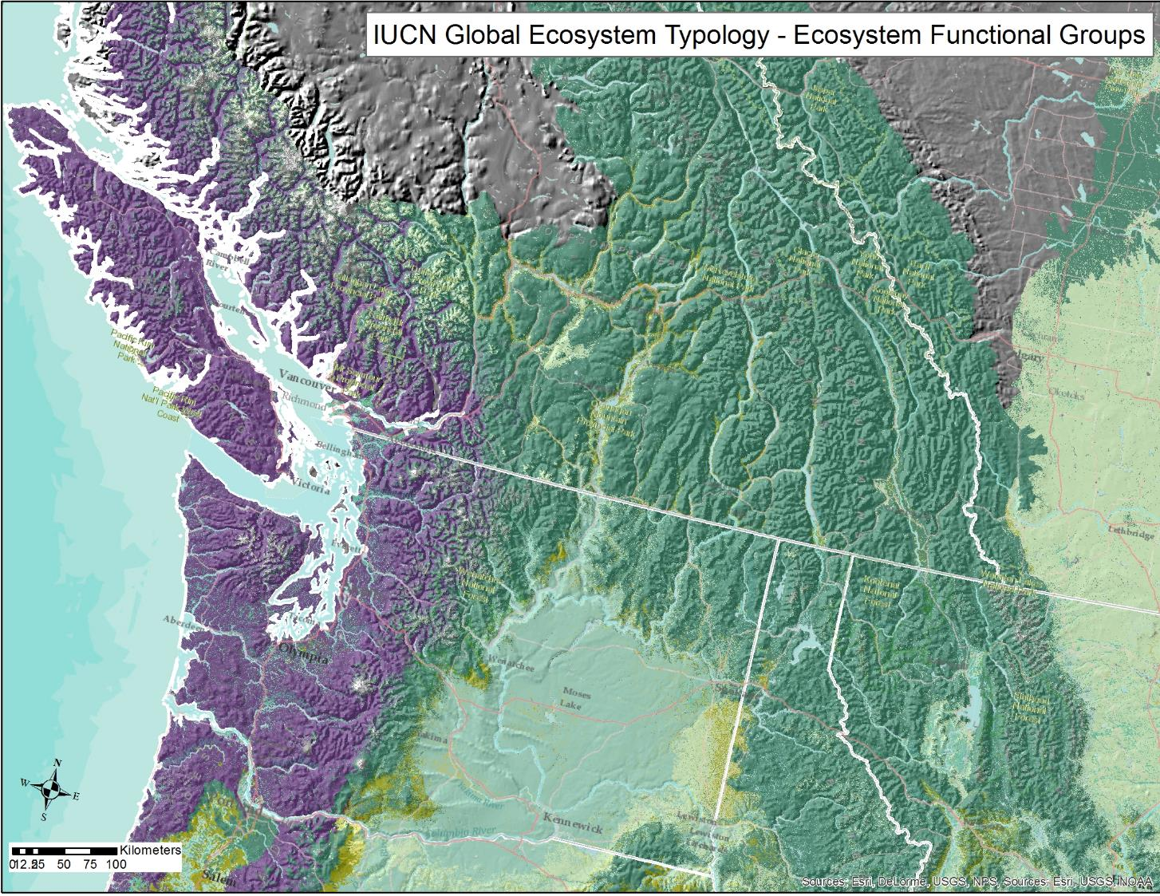

Slide 45
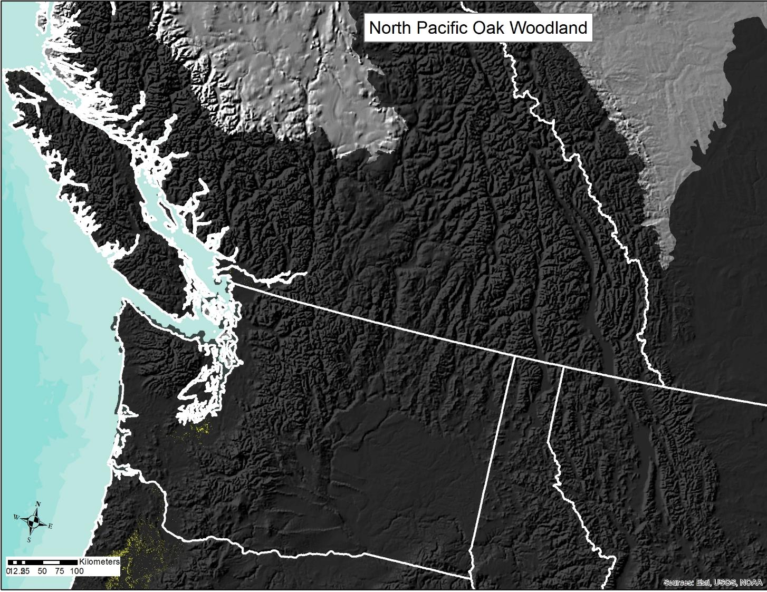
VU

Slide 46
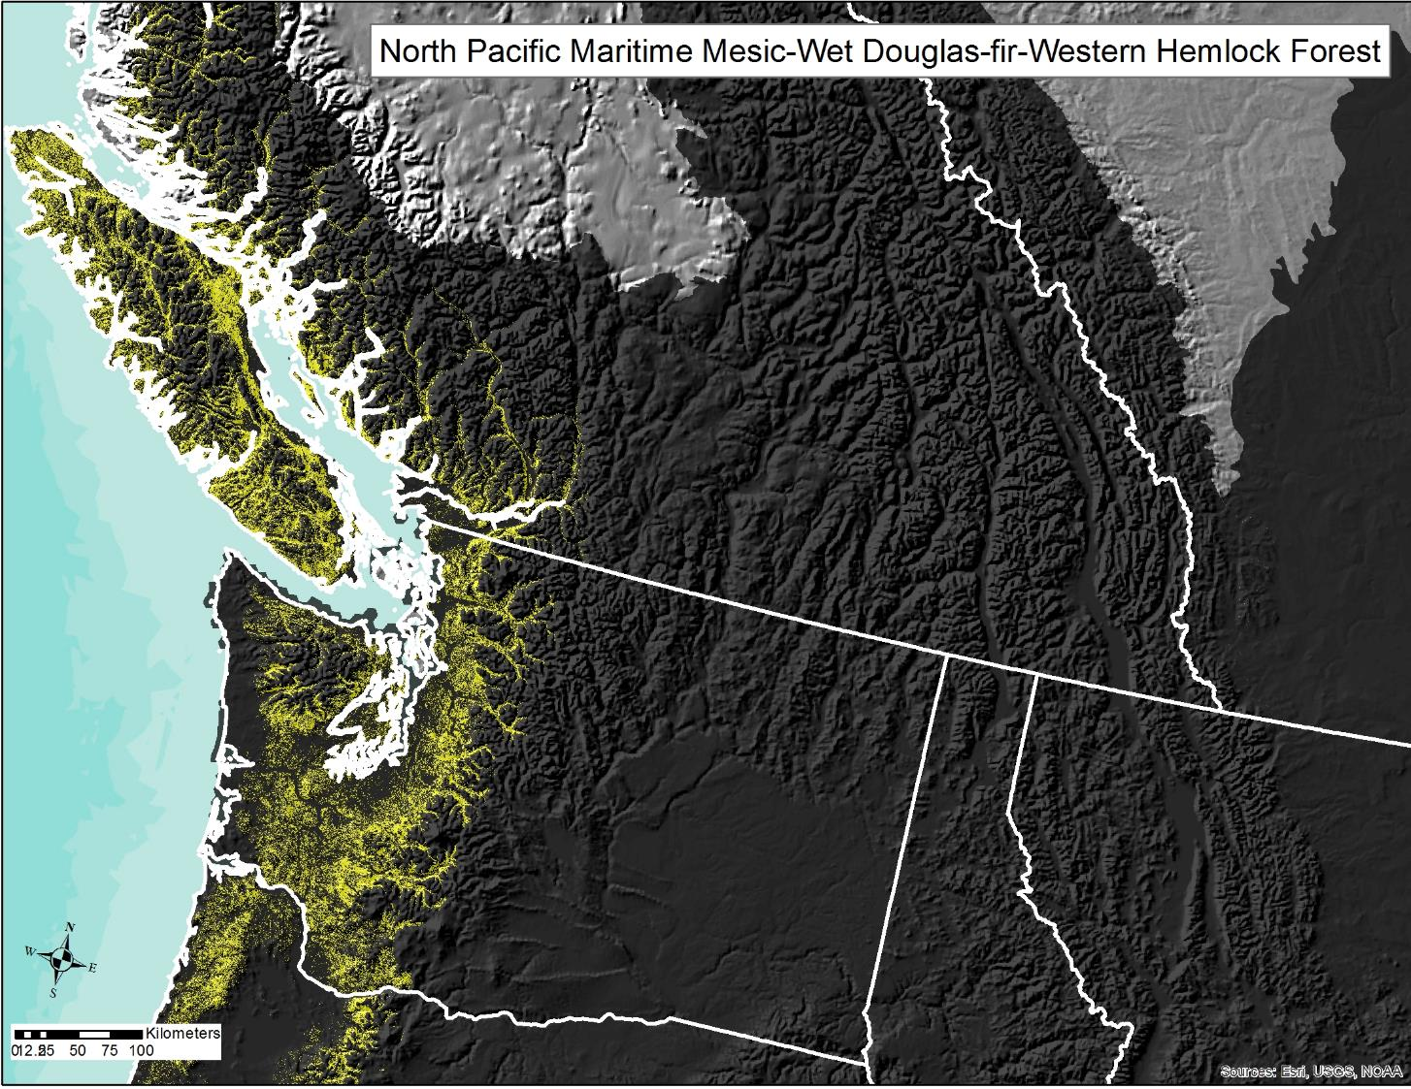
VU

Slide 47
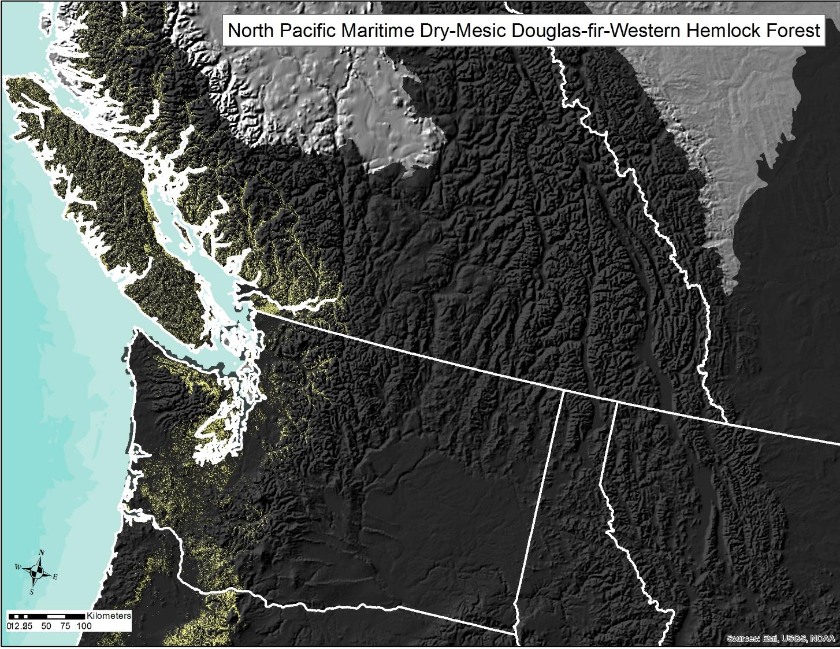
VU

Slide 48
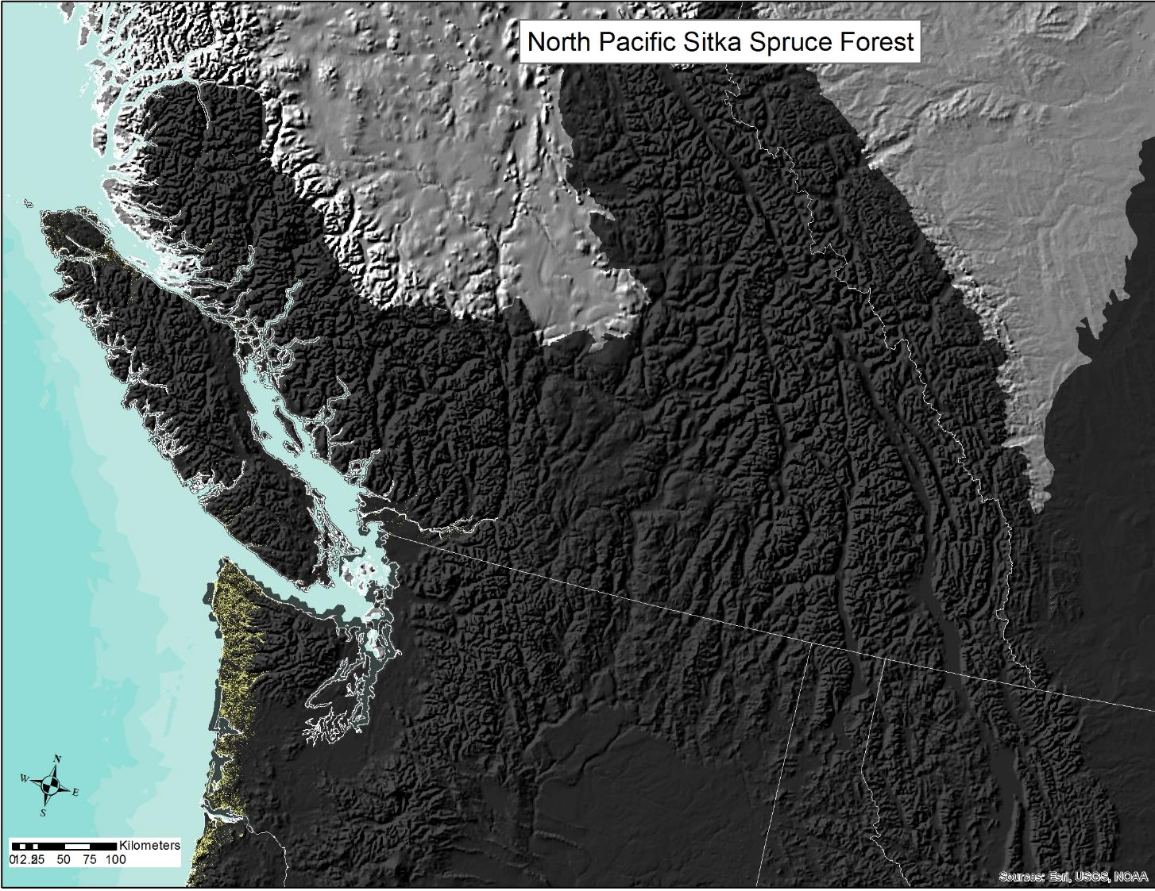
VU

Slide 49
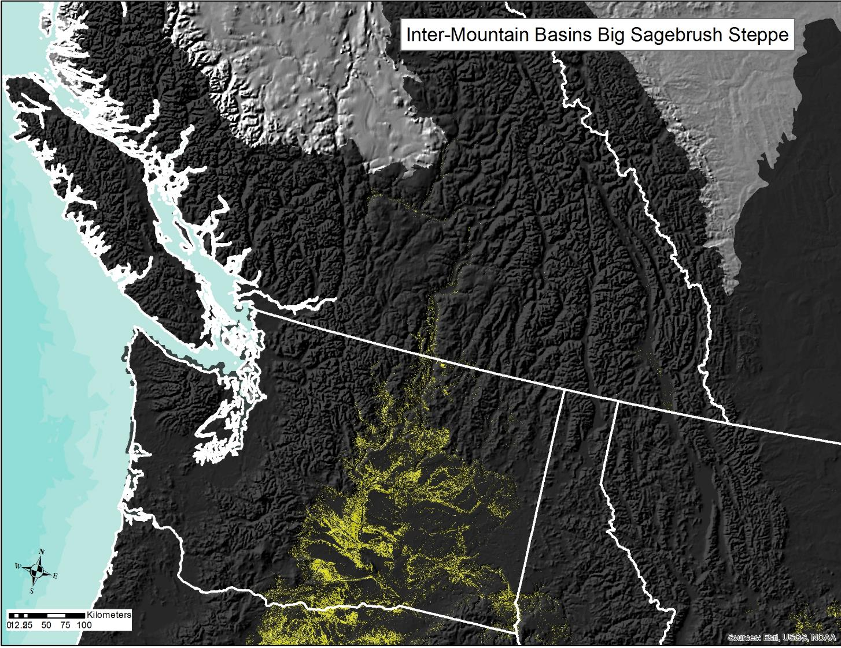
VU

Slide 50

NT

Slide 51

NT

Slide 52

LC

Slide 53

2020 refresh current distribution
Natural, ruderal, cultural land cover
NatureServe ecological systems
US NVC Groups

Slide 54


