Slide 1
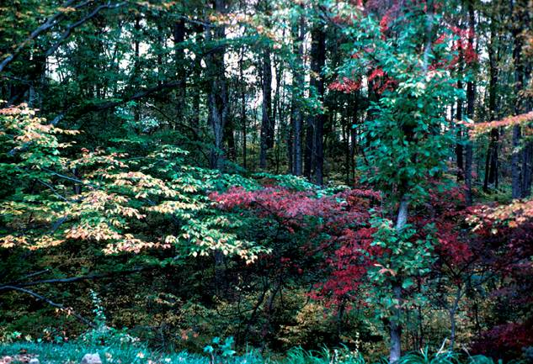
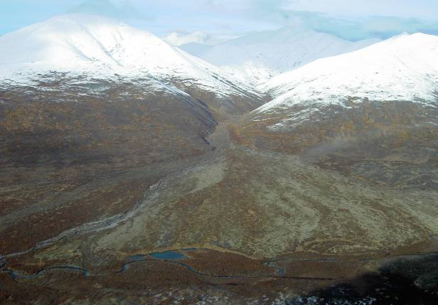
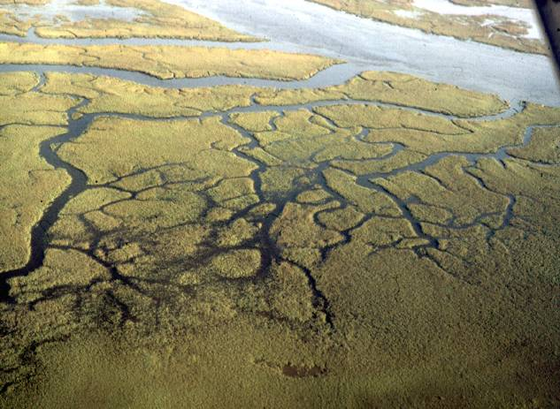
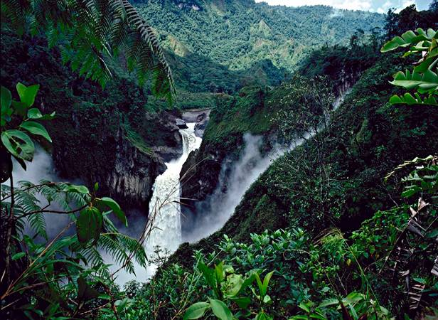
NATURESERVE ECOLOGY
DISCUSSION SECTION
Natural Heritage Methodology Training
Pat Comer, Chief Terrestrial Ecologist

Slide 2
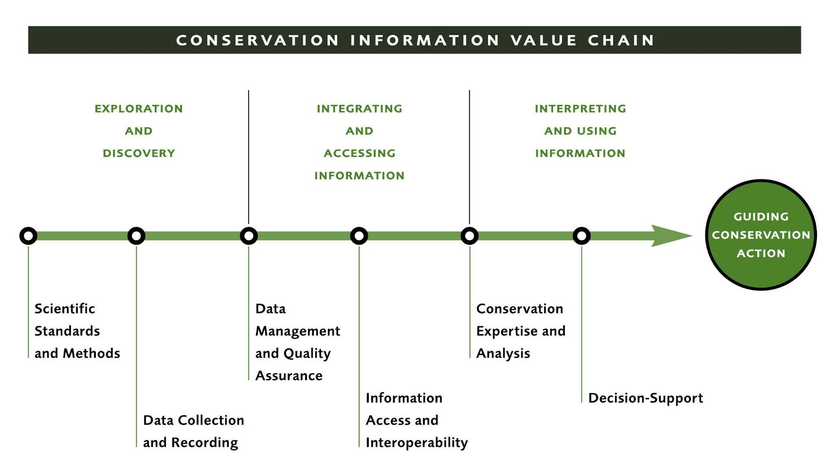


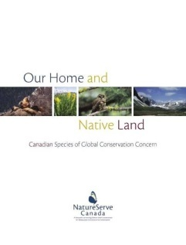
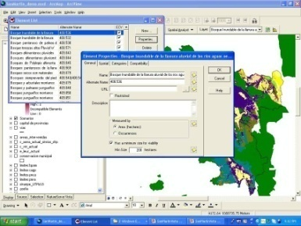
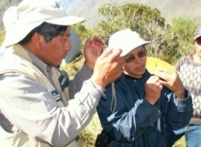
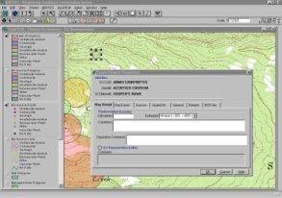

Notes:
NatureServe’s work can be organized into several phases of activity.
The first phase focuses on exploration and discovery.
In order to organize this phase effectively, we need scientific standards and methods for gathering and describing biological diversity.
The second phase focuses on integration and distributing this information.
This phase includes technical tools and procedures for standardizing, exchanging, and ensuring the quality of data within databases. It also includes our use to the internet for display, distribution, and exchange of information.
The third phase of our work involves scientific interpretation and use of this information for making resource management decisions.
This phase includes our many status assessments, reporting on status and trends of species and ecosystems. It also includes the integration of biodiversity data with other information to assist with environmental assessment and land use planning.

Slide 3
Agenda
Program Perspectives
Topic Discussions
NatureServe Methodology

Slide 4
Core NatureServe Methodology
What is it?
Where is it?
What are status and trends of each (element) type?
What is the quality/condition of each occurrence?
(ecological classification)
(element mapping/occurrence)
(G/N/S Status Ranks)
(ecological integrity)
Notes:
Our core methodology. By answering these questions, we can move on to many conservation applications…

Slide 5
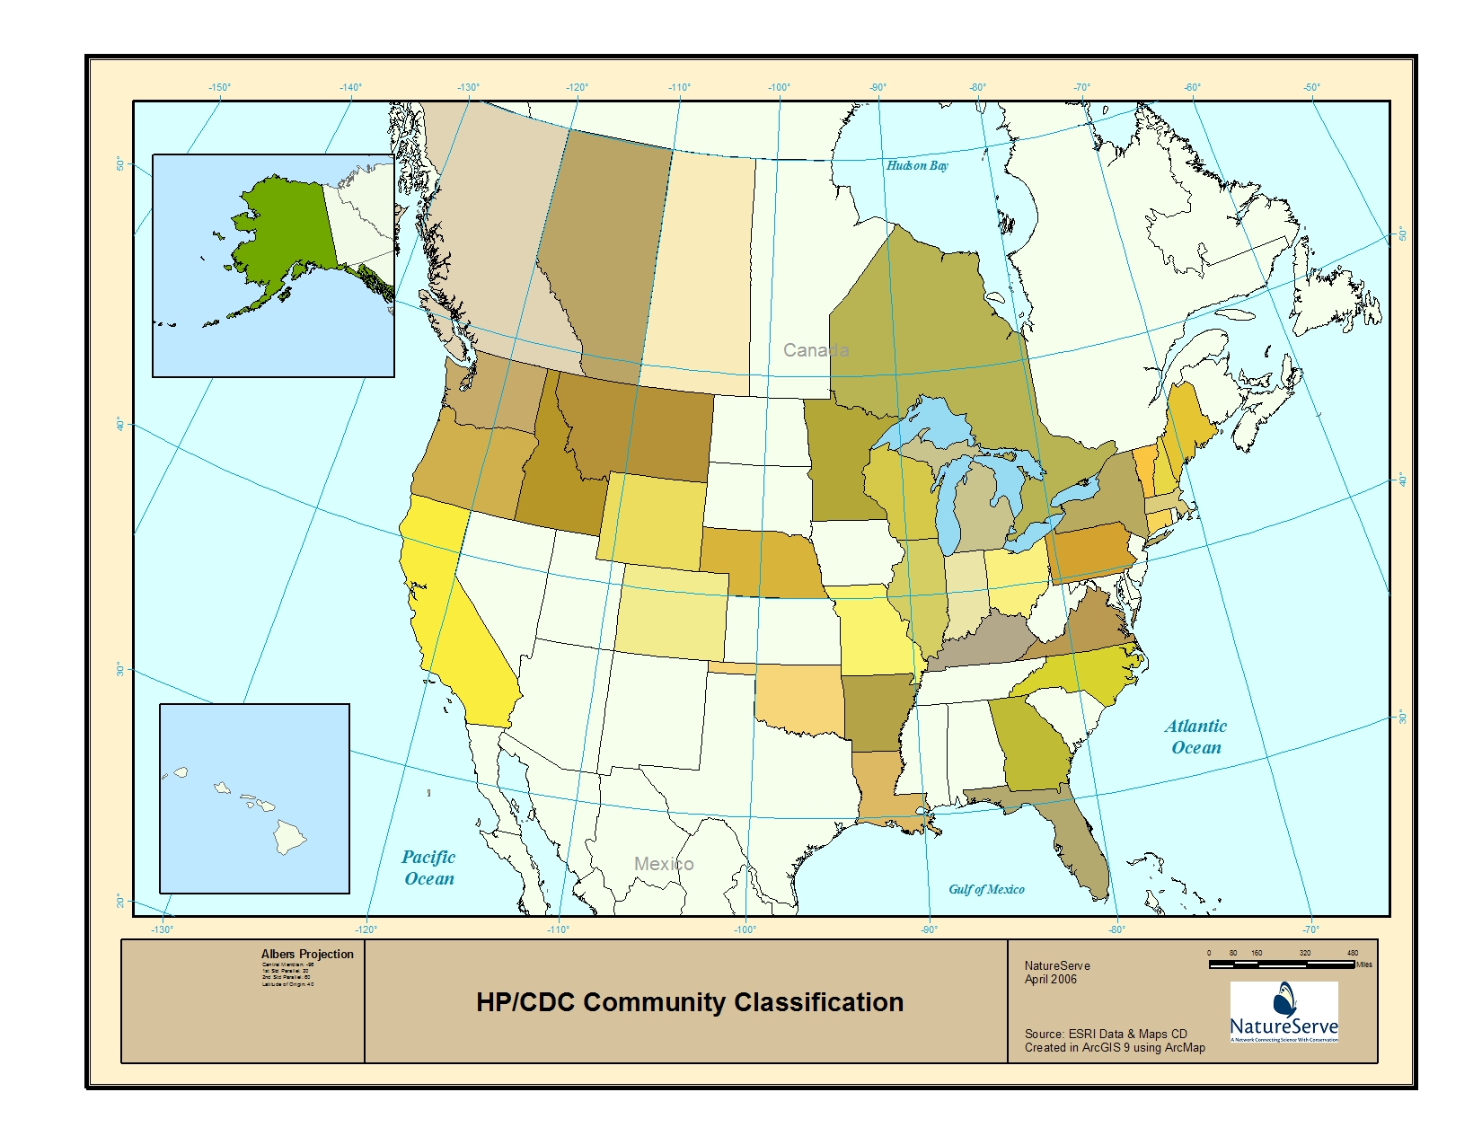
NHP/CDC Community Classifications
Notes:
Member programs maintaining local classification

Slide 6
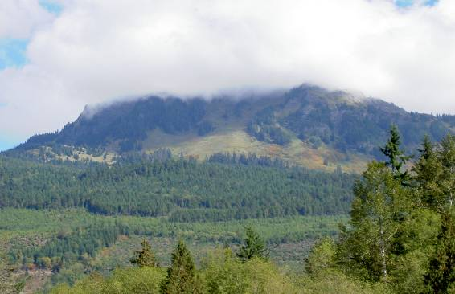
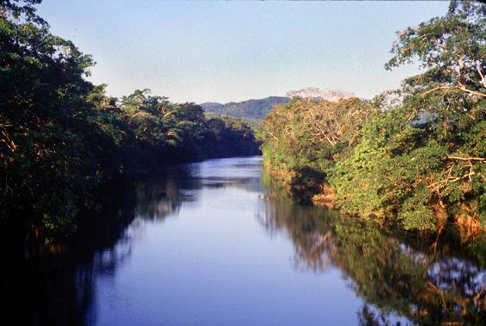
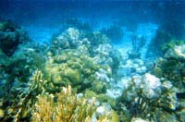
Internationally Standardized Ecological Classifications
Terrestrial
  Uplands
  Wetlands
  Subterranean
Aquatic
  Freshwater
    Riverine
    Estuarine
    Subterranean
  Marine
    Coastal
    Pelagic
Notes:
Our focus has mostly been in terrestrial environments.
In recent years TNC and selected member programs have advanced freshwater classification.
Just in th epast few years, we have begun to work in coastal marine ecological classification.

Slide 7
Terrestrial Classification Approaches
Climatic/Physiographic Ecoregions
Major Habitat-Based Ecoregions
US FS ECOMAP landscape units
UNESCO Vegetation Formations
Potential Natural Vegetation
Holdridge Life Zones
Hydrogeomorphic wetland classification
Forest and Rangeland Cover Types
BLM/NRCS Ecological Site Descriptions
US National Wetland Inventory
Notes:
Beyond the network, terrestrial classification approaches have developed to meet a variety of land management needs.
The diversity of approaches led us to spearhead development of the US-NVC, that later became the FGDC standard, and we continue to engage in refinement of the US-NVC, along with international veg classification.
Ecological systems classification was born from our experience in applying the NVC on the ground, and the need to integrate multiple factors into the definition of units that are practically scaled for many common conservation applications.

Slide 8
Three Major Approaches
Classifying Biophysical Setting
Classifying Existing Vegetation
Integrating Biophysical Setting and Existing Vegetation
Notes:
Background on terrestrial ecological classification approaches

Slide 9
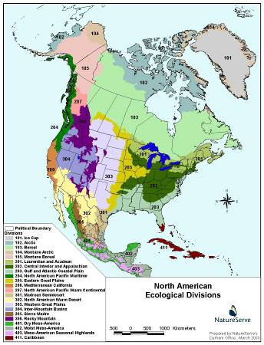
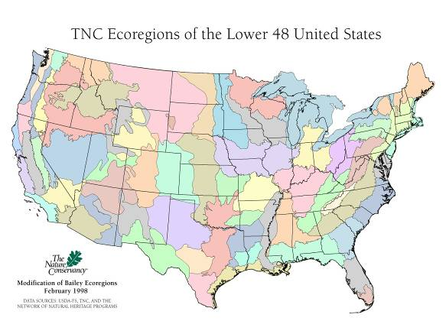
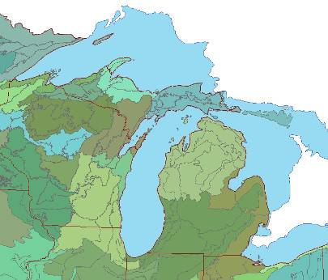
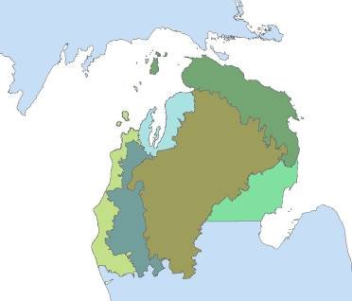
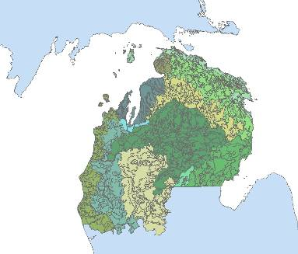
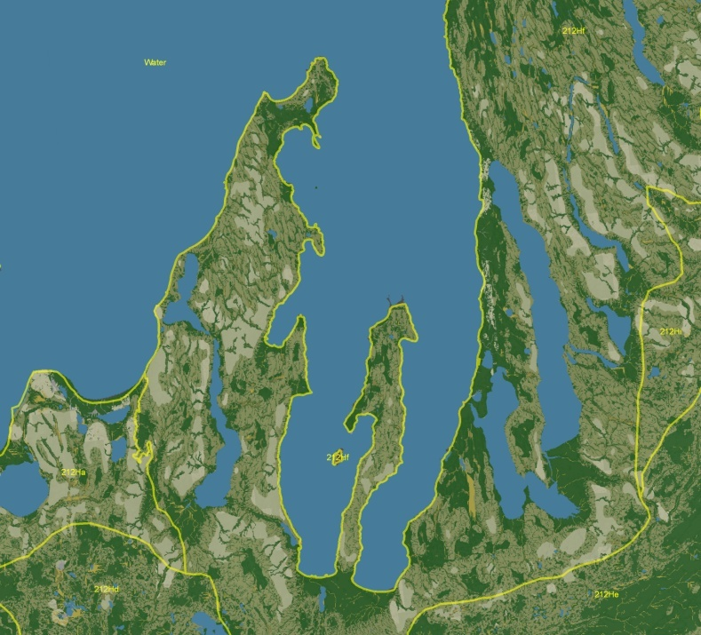
Terrestrial Landscape (spatial) Hierarchy
Subcontinental
Regional Landscape
Local Landscape
Domain Scale
Division Scale
ECOMAP Province and Section
Ecological Land Type
Notes:
Mapped Classification
Emphasize abiotic attributes (climate, landform, soil, hydrology, etc.)
Commonly applied to describe site productivity for forestry and range management
Applications to predictive range mapping and ecological restoration

Slide 10
Terrestrial Landscape (spatial) Hierarchy
Mapped Classification
Emphasize abiotic attributes (climate, landform, soil, hydrology, etc.)
Commonly applied to describe site productivity for forestry and range management
Applications to predictive range mapping and ecological restoration
Notes:
Land classification

Slide 11
Original US-NVC Classification (taxonomic) Hierarchy
Formation Class
Woodland
Formation Subclass
Evergreen Woodland
Formation Group
Temperate or Subpolar needle-leaved…
Formation Subgroup
Natural vs. Cultural
physiognomic levels
Formation
Rounded-crowned…
floristic levels
Alliance
Pinus palustris / Quercus spp. Woodland Alliance
Association
Pinus palustris - Pinus taeda / Quercus geminata - Quercus hemisphaerica - Osmanthus americanus var. americanus / Aristida stricta Woodland
(Grossman et al. 1998; UNESCO 1973)
Notes:
Taxonomic hierarchy of existing vegetation concepts; this is the original hierarchy (now changed). Most have focused on the finest level of units because they include floristic composition.

Slide 12
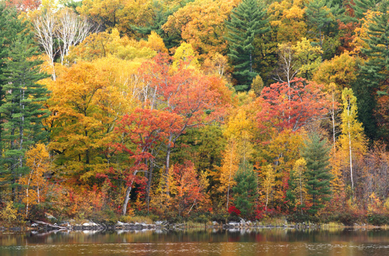
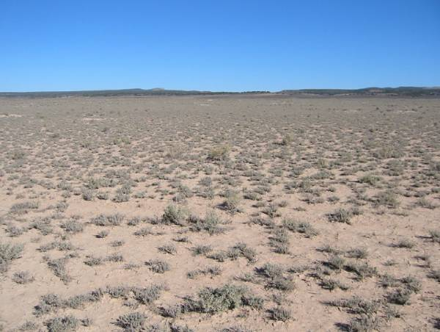
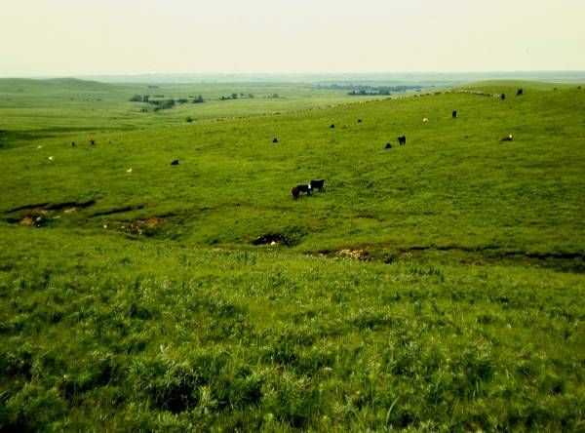
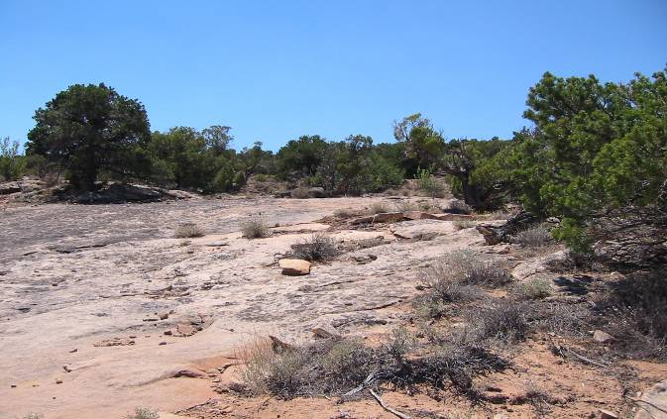
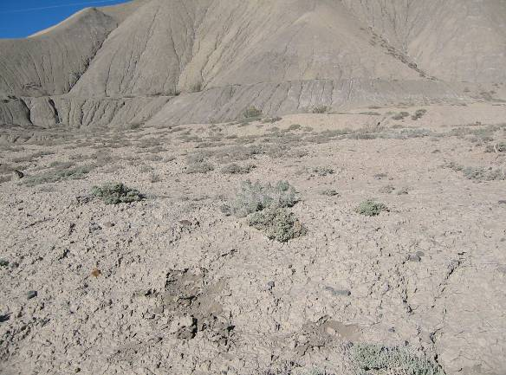
Formations Nested within Formation Classes
Forest (>60% tree canopy [>5 m])
Woodland (25-60% canopy)
Shrubland (0.5-5m h.)
(25-100% shrub canopy)
Dwarf-shrubland (<0.5 m h)
Herbaceous Nonvascular Sparse Vegetation
(>10%)
(Dominant)
(<10%)
Notes:
Vegetation formation units are nested within these broad Formation Classes.

Slide 13
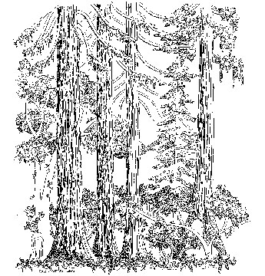
US-NVC Association
US-NVC Alliance
e.g. Pseudotsuga menziesii Forest Alliance
e.g. Pseudotsuga menziesii – Abies concolor / Acer glabrum Forest
Notes:
Alliances defined with dominant and/or diagnostic species in the upper-most vegetative canopy
Associations consider diagnostics from all canopy layers.
This approach results in spatially fine units in the field, with both good and bad consequences….

Slide 14
Association: Quantitative Analysis
Notes:
A taxonomic hierarchy is truly most suited to analysis of sample plot data. This is a dendrogram resulting from analysis of compoistion among many samples, grouping them by relative similarity.
Again, quantitative methods are desireable to help us understand natural patterns in composition among units…. But it does not alway result in practical units for mapping, resource management, and conservation.
We’re always looking to combine good data, and rigorous analysis, with practicalities of describing nature in ways that facilitate conservation. No easy task!

Slide 15

International Vegetation Classification
CNVC
USNVC
Eastern Region
Midwestern Region
Western Region
Southeastern Region
Latin American Classifications
Notes:
The US-NVC, and later IVC have been derived from regional classifications over the past 2 decades.

Slide 16
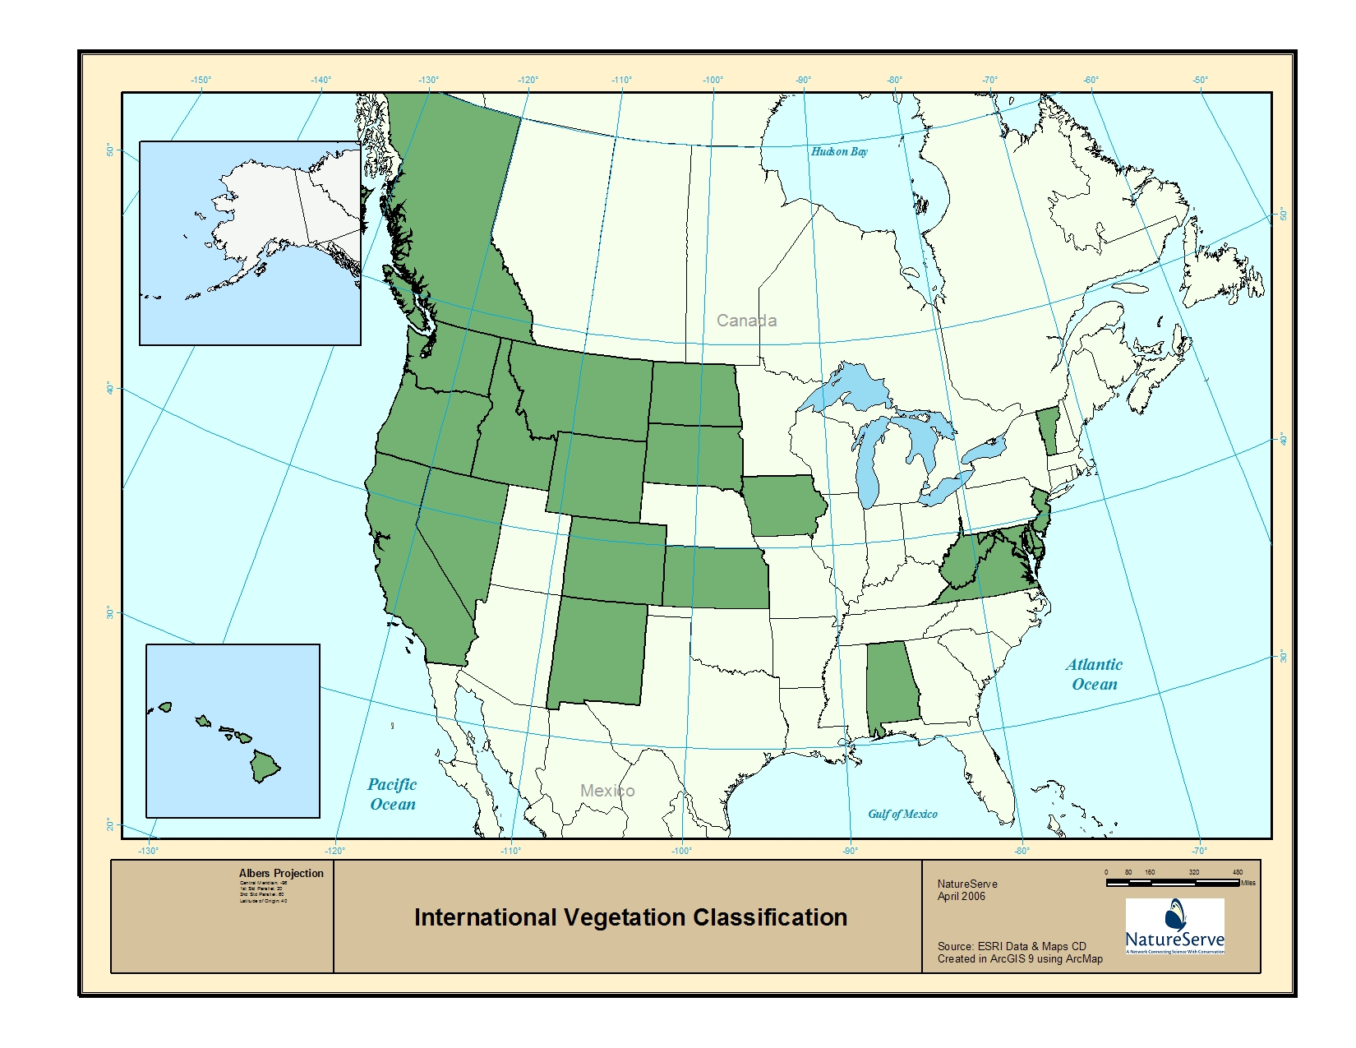
IVC Users
Notes:
Member programs currently using the IVC

Slide 17
Original Structure of the IVC
Formation Class
Woodland
Formation Subclass
Evergreen Woodland
Formation Group
Temperate or Subpolar needle-leaved…
Formation Subgroup
Natural vs. Cultural
physiognomic levels
Formation
Rounded-crowned…
floristic levels
Alliance
Pinus palustris / Quercus spp. Woodland Alliance
Association
Pinus palustris - Pinus taeda / Quercus geminata - Quercus hemisphaerica - Osmanthus americanus var. americanus / Aristida stricta Woodland
(Grossman et al. 1998; UNESCO 1973)
Notes:
There are some issues we have encountered with IVC units over the years.
1) a rather large conceptual break between the formation alliance levels
In many instances, it is not practical to map the alliance concepts, but users don’t want to jump up to the formation level (lacking any floristic composition) for mapping. This has led to many circumstances where people abandon the classification all together in mapping projects and just create ad-hoc classification units, perhaps later to create a clunky ‘crosswalk’ back to the IVC units. NOT a desirable situation.
2) much of this clunkiness – in the actual expression of the vegetation concept on the ground – comes from many of the physiognomic attributes included in upper levels of the hierarchy. These result in formations and alliances that area too finely defined, and impractical for common applications.

Slide 18
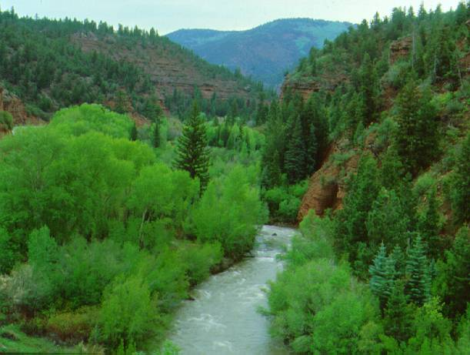
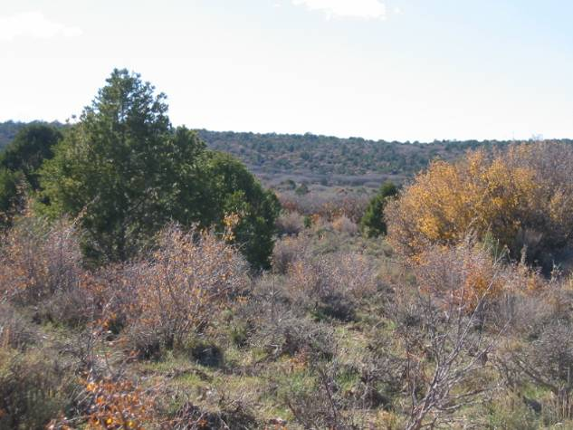
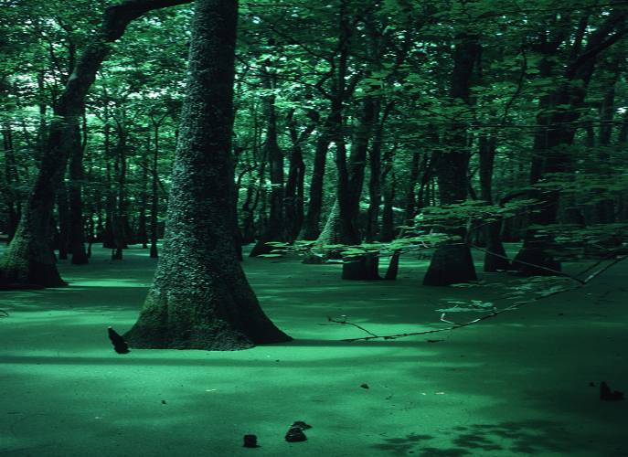
Mapping the IVC: Difficulties
Distinguishing vegetation of mixed physiognomy occurring within areas smaller map unit (e.g., floodplain woodland-shrubland mosaics; Forest vs. Woodland)
  Mixed leaf type (broadleaf evergreen vs. deciduous, etc.)
  Hydrologic Modifiers
  Many Floristic Distinctions
Notes:
Some of the more significant difficulties we encounter with mapping alliances result from the structure of the IVC hierarchy, and aspects of defining formations using vegetative physionomy.
Mixed physionomy
Mixed leaf type
Hydrologic modifiers
Florsitic distinctions in herbaceous types

Slide 19
Terrestrial Landscape (spatial) Hierarchy
Vegetation (taxonomic) Hierarchy (2007)
Subcontinental Subcontinental Upper
Regional Landscape Mid
Local Landscape Lower
IVC Class
Domain Scale
IVC Subclass
Division Scale
IVC Formation
IVC Division
ECOMAP Province and Section
IVC Macrogroup IVC Group
Ecological System
IVC Alliance
Ecological Land Type
IVC Association
Notes:
Though in the end, we are still coping with very complex interactions of classification concept and the spatial expression of ecological units on the ground.
This was the reality we were dealing with when we developed terrestrial ecological systems concepts. They take aspects of both spatially nested hierachies and taxonomic hierarchies to define pracical units for mapping and conservation.

Slide 20

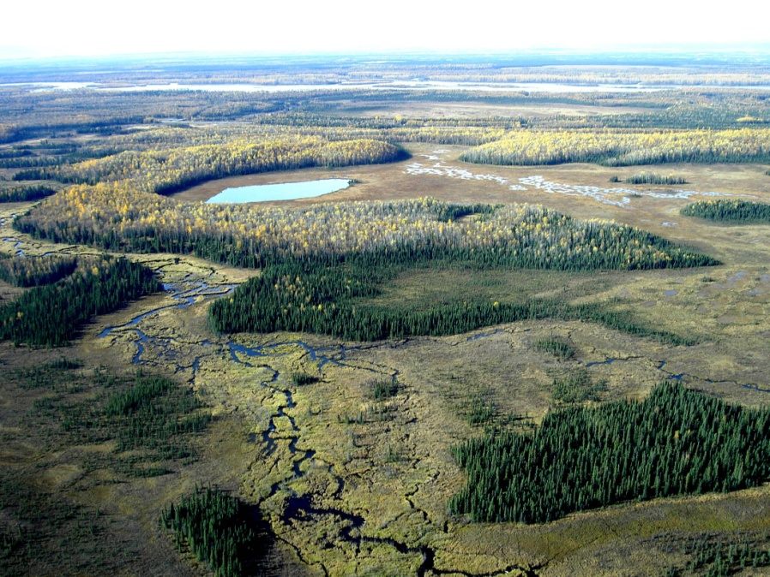
Terrestrial Ecological System
Group of IVC communities that tend to co-occur within landscapes with similar ecological processes, substrates, and/or environmental gradients.
Multi-factor Classification
Biogeography and Bioclimate
Local Environment
Ecological Dynamics
Landscape Juxtaposition
Vegetation Structure, Composition, and Abundance
Notes:
Ecological Systems are driven by floristics at relatively local scales, but may expand beyond alliances by relaxing physiognomic criteria. This supports consistent development of map units down in the 1-5 hectare mmu range.

Slide 21
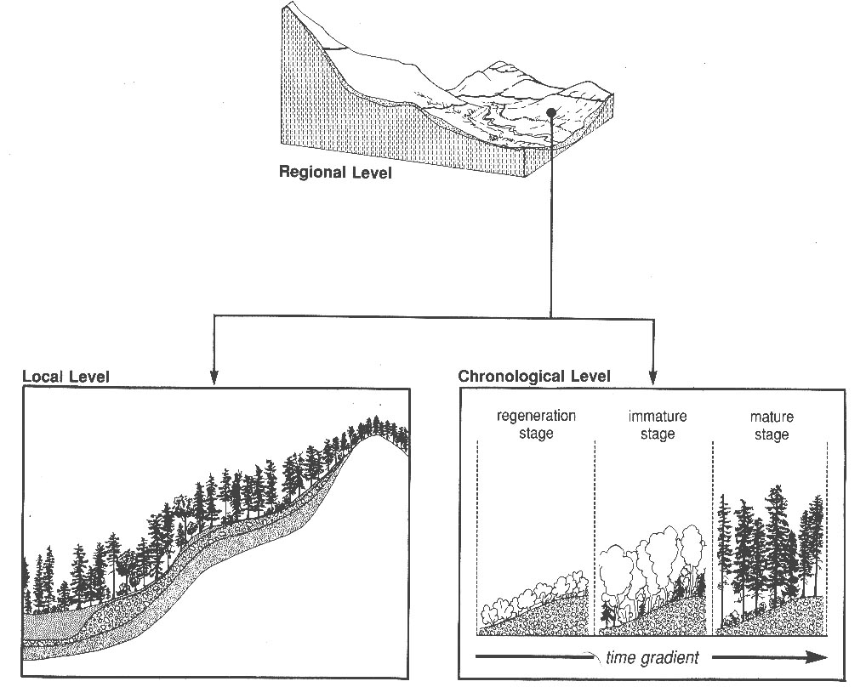
Spatial and Temporal Bounds on the systems concept
Notes:
For any ecosystem unit, it is important to consider both space and time dimensions.
Terrestrial systems will occupy a given range of environments characteristic of multiple associations that tend to recur across a given biophyscial setting, much like a soil catena.
Systems also encompass recurring communities in the same space over time periods of 50-100 years. i.e., we intend to capture typical 50-100 year succesional pathways within the concept of a given classification unit. This is what distinguishes systems from the IVC. Basically IVC associations would describe each of those successional stages as distinct vegetation units. The systems concepts combines them into one unit because they tend to co-occur in space and time; again, at relatively local scales.

Slide 22

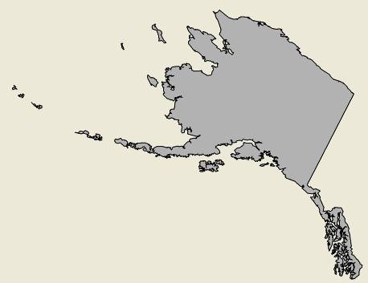
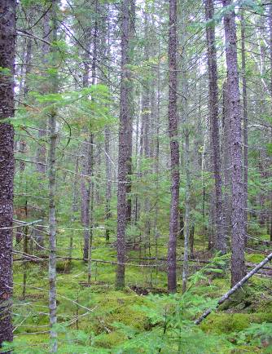
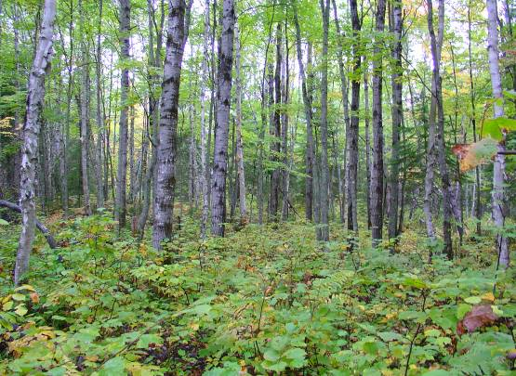
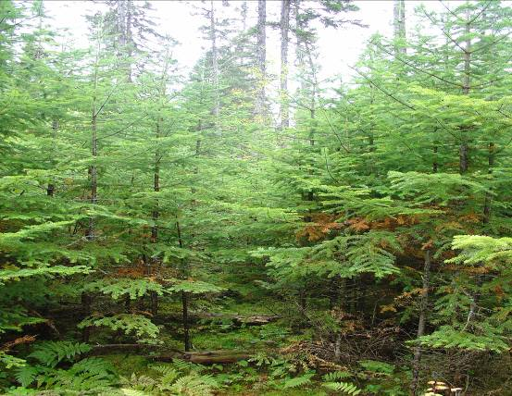
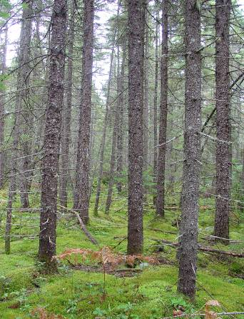
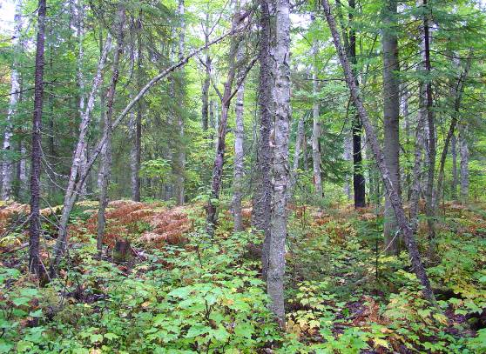
State and Transition Model
Ecological System and component
Vegetative States
Class B
(Mid Closed)
Class C (Mid Open)
Class A (herb/shrub/treed)
Class D (Late Open)
Succession
Disturbance
Class E
(Late Closed)
Notes:
Graphic representation of a VDDT model – quantitative state and transition model – NE Lowland Spruce-Fir Forest
Grey arrows represent successional pathways.
Red arrows represent disturbance transitions.

Slide 23
Descriptive, Multi-Factor Classification
Notes:
Like most classifications, tehre is a combination of quantitative as well as qualitative method being applied.
Ecological systems are mostly qualitatively described, in this instance, using a tabular framework to express presumed relationships among biophysical attributes that lead to distinctive floristic assemblages. This chart could add layers belwo to describe characteristic associations within each system concept.

Slide 24
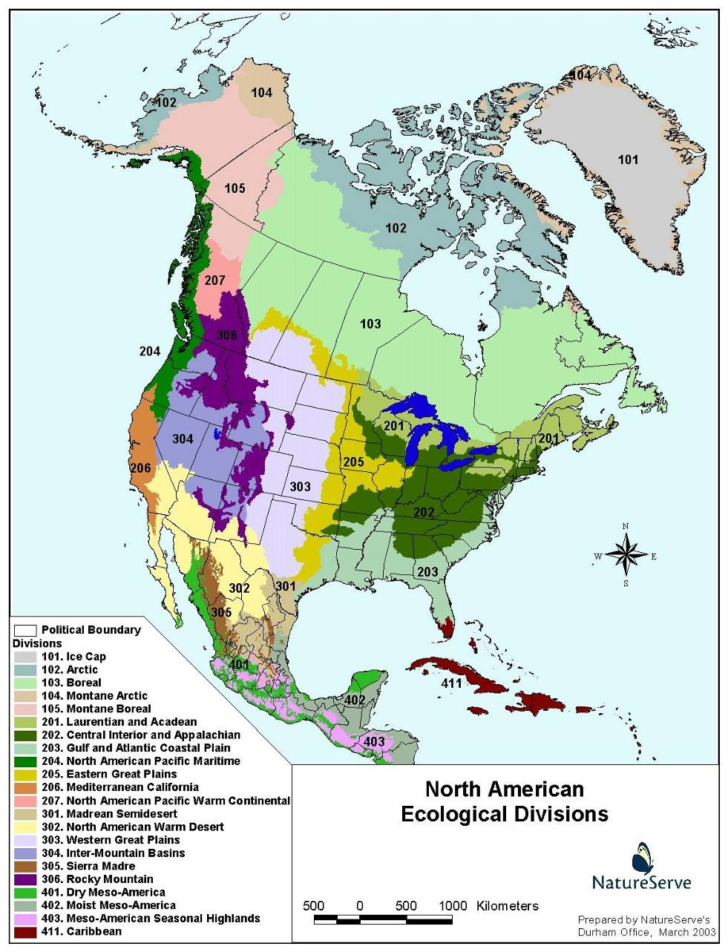
“Laurentian-Acadian Pine-Hemlock-Hardwood Forest”
“Western Great Plains Wooded Draw and Ravine”
“Rocky Mountain Dry-Mesic Spruce-Fir Forest and Woodland”
Standard Nomenclature:
Name of the Ecological Divisions or nested Provinces that describe the distribution of the type.
Characteristic vegetative composition and physionomy
Environmental modifiers
Notes:
Ecological Divisions are modified from USFS ECOMAP Divisions to describe eco-climatic variation across the hemisphere.
We’ve established a standard nomenclature that brings in the ecological Divisions of the type’s distribution, along with characteristic vegetative composition and physionomy, and often adds characteristic local environmental modifiers.

Slide 25
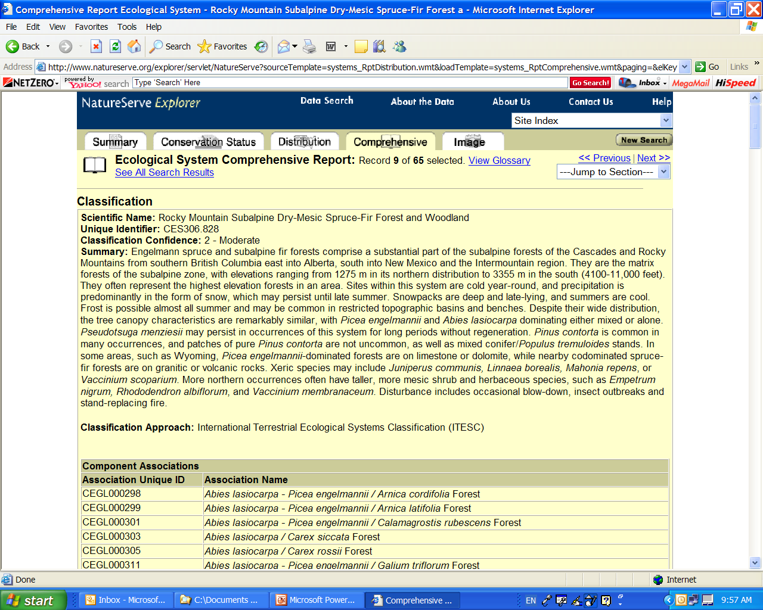
Notes:
Current brief descriptions in Explorer (also listing component associations) and Infonatura

Slide 26
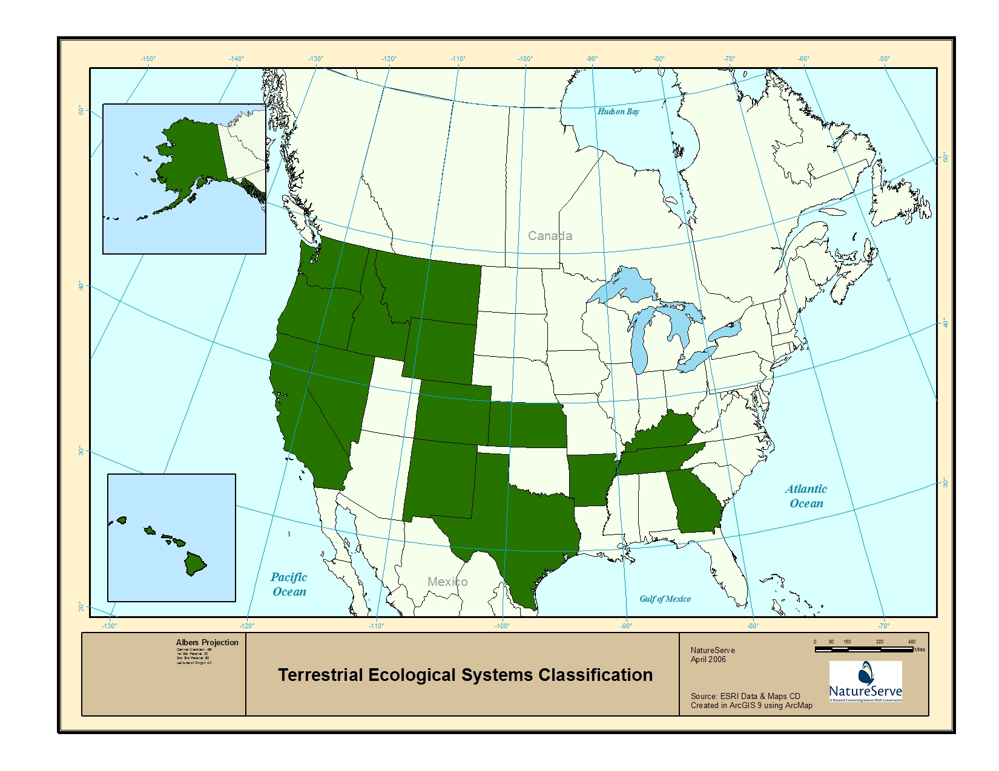
Notes:
Member programs currently using the terrestrial ecological systems classification

Slide 27
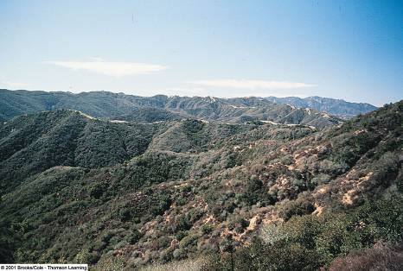

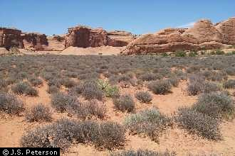
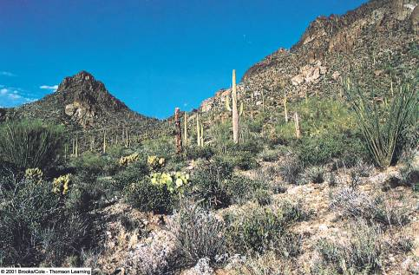
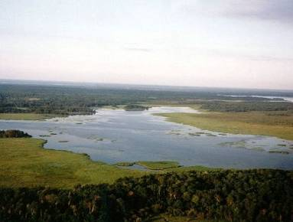
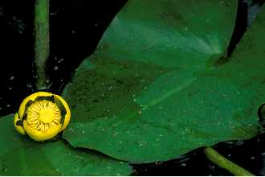
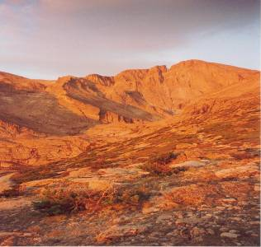
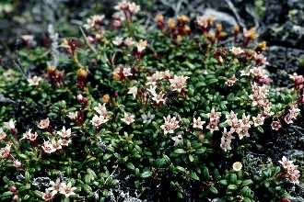
Forest & Woodland (Mesomorphic) Shrubland & Grassland
Semi-Desert Vegetation (Xeromorphic Vegetation)
Aquatic Vegetation
(Hydromorphic Vegetation)
Nonvascular Vegetation (Lithomorphic Vegetation)
Loiseleuria procumbens
Polar and High Mountain Vegetation (Cryomorphic Vegetation)
CULTURAL VEGETATION

Slide 28
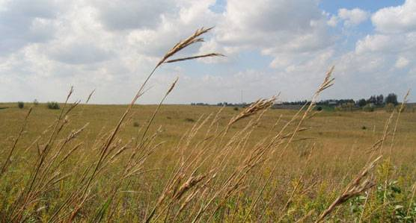
USNVC Hierarchy:
Provisional/Pilot types for all levels
Revised Hierarchy | Example
Upper
Level 1 – Formation Class | Shrubland & Grassland [mesomorphic]
Level 2 – Formation Subclass | Temperate & Boreal Shrubland & Grassland
Level 3 - Formation | Temperate Grassland & Shrubland
Mid
Level 4 – Division | Great Plains Grassland & Shrubland
Level 5 – Macrogroup | Tallgrass Prairie Grassland & Shrubland
Level 6 – Group | Central Tallgrass Mesic Grassland
Lower
Level 7 – Alliance | Big Bluestem – Indian grass Grassland
Level 8 – Association | Big Bluestem – Indian grass / Gayfeather Grassland
Ecological Systems
Notes:
Just to review – by upper and mid levels we are referring to Levels 1 – 6.
[Shannon – don’t spend anytime explaining the hierarchy]
Top three levels L1-L3, were defined by the HRWG already back in 2003-2004, and most of the subsequent work has focused on L4-L6.
Systems are separate from but very much informing how the NVC is developed, particularly at the Group level. We’ll return to that relationship.

Slide 29
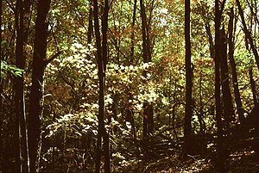
Cool Temperate Forest Formation (L3)
(ecoregions distribution)
Vegetation ecologists have long defined broad formations that require little knowledge of alliances or associations– yet ultimately, the formation boundaries can be refined using these lower levels.
Ecoregions where Cool Temperate Forest is or was the dominant vegetation
Map based on Olson et al. (2001), produced by M. Jennings.
Cool Temperate Forest
Broad-leaved cold-deciduous trees;
Needle-leaved evergreen trees;
Broad-leaved deciduous shrubs;
Seasonally evergreen shrubs.
Notes:
Examples of Level 3 types. We know a lot about this formation world wide because of the long history of vegetation ecology.

Slide 30
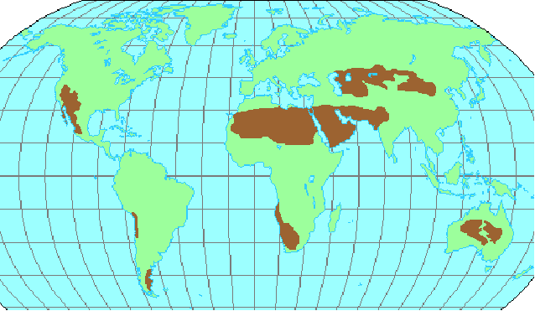



Cool and Warm Semi-Desert Formations (L3)
And Divisions (L4)
L4. Mongolian Steppe
L4. Great Basin Steppe
L3. Cool Semi-Desert
L3. Warm Semi-Desert
L4. Patagonian Steppe
Notes:
Same with Cool and Warm-Deserts.

Slide 31


NVC Hierarchy: Mid-Levels:
Division (L4) & Macrogroup (L5)
Division level based on broad biogeographic / floristic differences among otherwise similar formations.
Takhtajan (1986)
Map created by Priscilla Crawford, Oklahoma University
Notes:
At the mid-levels there’s more work to do. L4 draws on the long history of mid-scale vegetation pattern based on biogeography. Here e.g, the eastern cool temperate forest are in a different Division from the western temperate. And this makes sense in terms of classification, because e.g., the number of tree species shared between these regions is less than 2%. So, any vegetations defined at the mid-levels are not going to overlap between these regions.
For North American Warm Semi-Deserts – we have one Division = Sonoran Province, includes Chihuahuan and Sonoran
We don’t build in the regionalization, because biogeography varies by formation. Salt marshes have a different regional species poor or biogeography from cool temperate forests or bog and fens.

Slide 32





NVC Hierarchy Mid Levels
(L5 Macrogroup)
L4. Great Basin Cool Semi-Desert
L4. Sonoran & Chihuahuan Warm
No. Great Basin Steppe & Grassland
So. Great Basin Desert Scrub
Mojave-Sonoran Desert Scrub
Viscaino-Baja California Desert Scrub
Chihuahuan Desert Scrub / Chihuahuan Desert Grassland
Notes:
Going back to the deserts, we can see that somewhat finer biogeographic categories of deserts also generally reflect distinct species assemblages within North America, helping inform the Macrogroup level.
However the Mojave and Sonoran regions are more similar and may be treated as one unit at the L5 macrogroup level.

Slide 33
NVC Hierarchy –
Hooking up lower to mid-levels
(getting air-borne)
Notes:
Having defined pilot examples of L4- L5, the HRWG has been working with NatureServe alliances and associations to hook the whole thing together, with the Group (L6) level still very much in development.
This is still very much a work in progress (but funding is on the way). [Landfire, EPA, NPS]

Slide 34
Revised Hierarchy | Applications
Upper
Level 1 – Formation Class
Level 2 – Formation Subclass | U.S. Army Corps of Engineers – Stewardship (FGDC 1997)
Level 3 - Formation | U.S. Army Corps of Engineers & EPA - Mitigation EPA – Nat’l Wetland Condition Assessment, TNC - Conservation Planning (WWF Major Habitats)
Mid
Level 4 – Division | EPA?, USFS FIA
Level 5 – Macrogroup | Landfire, GAP, NEAFWA (NE Assn F&W Agency), EPA
Level 6 – Group | NOAA - Coastal Wetlands, USFS FIA, Landfire, GAP NPS Veg Inventory Program,
Lower
Level 7 – Alliance | USFS FIA Program, GAP, NPS Veg Mapping Program, State Heritage Programs
Level 8 – Association | NPS Veg Inventory Program, State Heritage Programs
Ecological Systems
Notes:
Lots of agencies and organizations are finding the revised NVC attractive to use and are interested in paying for some of its development in order to improve their applications.

Slide 35
Core NatureServe Methodology
What is it?
Where is it?
What are status and trends of each (element) type?
What is the quality/condition of each occurrence?
(ecological classification)
(element mapping/ occurrence)
(G/N/S Status ranks)
(ecological integrity)

Slide 36

Occurrence Specifications
Barrier
5
0.3 km
10
2
10
0.5 km
2
10
separation distance (500m) for other natural land cover; 0.3 km for cultural vegetation;
…and then there are distinct barriers
Notes:
EOSPECS determines a separation distance (1 km natural, 0.5 km cultural veg.), a minimum polygon size (2 ha), and an aggregate polygon size (25 ha). Stepping-stones present an issue, where it meets the minimum polygon size. But a barrier is introduced forcing all combinations to fall below the 25 ha aggregate; so we have NO EOs (all are observations).
Under existing criteria we would have 3 10 ha EOs.
Most of our effort in the past has focused on applying these criteria in the field.

Slide 37





What is it?
Where is it?
Taxonomy & Classification
Maps and Surfaces
Occurrences through Field Inventory
Field Observations
Notes:
So our core methodology has been expanding over time. Because field samples – community observations are gathered first for classification development; they also get used a georeferenced locations to support map development. So these two componants, field observations and maps are becoming fundamental aspects of our work.

Slide 38


Gathering Samples
Notes:
They form the foundation; and these ongoing national efforts have incorporated well over 500,000 samples, most derived from ground observations, but not entirely. Here up in Alaska, Tina Boucher of AK NHP is shown flying in a small plane at about 800ft altitude to observe and document ecological systems types she has described throughout the AK interior. AK along used some 50,00 samples in their map development.
Tina and other ecologists are most expert in recognizing the various community types, and are uniquely suited to gather and maintain these types of observation data for use in mapping.

Slide 39

Modern Mapping Methods
Observations (point/poly)
Imagery: Landsat 7 ETM (1999-2002) for spring, summer & fall
NDVI, SAVI, Brightness,Greeness, Wetness, Landsat 7 Bands
DEM: Elevation, Aspect, Slope, Landform
Vector: Geology, Soils
Meteorological: DAYMET
Bioclimate
Image Indices
Landform
Lithology
Output translates
to map product
Notes:
Just to get techy for a moment, modern remote sensing is all about modeling; models that combine information from multiple mapped layers using statistical analysis to identify recurrent pattern.
Field samples form the foundation of these mapping techniques.

Slide 40


Sample Data
Colorado Plateau Blackbrush-Morman Tea Shrubland (ecological system)

Slide 41

Mapped Distribution
Colorado Plateau Blackbrush-Morman Tea Shrubland (ecological system)

Slide 42

Inputs for Inventory and Occurrence Delineation
Field sample
Colorado Plateau Blackbrush-Morman Tea Shrubland (ecological system)
Notes:
One might use TM-derived data, subsequent GIS processing, then perhaps aerial photos and/or additional field visits, to establish EO boundaries.

Slide 43




Glacier National Park

Slide 44

Standard Classification Units for
Mapping and Assessment
(U.S.) National Land Cover Classes (~17 types)
Terrestrial Ecological System (~500 in U.S.)
Vegetation Structure
Canopy Density
Canopy Height
IVC Alliance
(~1800 in US; map where feasible)
IVC Association (emphasize G1-G3)
(~5,000 in US, mainly applicable to local conservation/mapping applications)
Notes:
Levels of map classes for mapping

Slide 45



US-NVC Hierarchy & Ecological Systems
e.g., Cool Temperate Forest
~130 macrogroups in USA
~700 ecological systems in USA
Notes:
e.g., the relatively few formation, down to macrogroups, ini addition to the most-detailed ecological system types.

Slide 46
Occurrence Specifications
5
0.3 km
10
2
10
2
10
separation distance (500m) for other natural land cover; 0.3 km for cultural vegetation;
…and then there are distinct barriers
Notes:
EOSPECS determines a separation distance (1 km natural, 0.5 km cultural veg.), a minimum polygon size (2 ha), and an aggregate polygon size (25 ha). Stepping-stones present an issue, where it meets the minimum polygon size. But a barrier is introduced forcing all combinations to fall below the 25 ha aggregate; so we have NO EOs (all are observations).
Under existing criteria we would have 3 10 ha EOs.
Most of our effort in the past has focused on applying these criteria in the field.

Slide 47





Rapid Occurrence Delineation
Notes:
But the need to have more comprehensive ecology EO-type data is great, and we need to perfect methods to apply EO specs with spatial data, perhaps in advance of field checking…or just field sampling….

Slide 48
Core NatureServe Methodology
What is it?
Where is it?
What are status and trends of each (element) type?
What is the quality/condition of each occurrence?
(ecological classification)
(element mapping/ occurrence)
(G/N/S Status ranks)
(ecological integrity)

Slide 49






NatureServe
Factors and Categories of Conservation Status
Number of Occurrences/Area
Number of Occurrences/Area
w/Good Quality
Range Extent
Area of Occupancy
Long-term Trend
Short-term Trend
Threats (Severity, Scope, and Immediacy)
Apply to portion of range; e.g., N = Nation S=Subnation
N/S1 Critically Imperiled
N/S2 Imperiled
N/S3 Vulnerable
N/S4 Apparently Secure
N/S5 Demonstrably Secure
G1 Critically Imperiled
G2 Imperiled
G3 Vulnerable
G4 Apparently Secure
G5 Demonstrably Secure
Notes:
NatureServe has done rule based assessments for both species and ecological ‘elements’ of biodiversity to arrive at a ‘conservation status’ rank; with criteria applicable not only to global perspectives, but also for any subset of the range.

Slide 50

IUCN-like Ecosystem Rules
Rule A. Reduction in area
A.1: Long Term Reduction in area
A.2: Short Term Reduction in area
Rule B: Restricted range or area and a combination of:
  severely fragmented or # of occurrences
  continuing decline in area, condition, number
Rule C: Not applicable (Small population size with a continuing decline)
Rule D: Small community size (area or no.of occurrences)
Rule E: Not applicable (Risk of Extinction estimate from PVA)
Rodriguez, J.P., J.K. Balch, K.M. Rodriguez-Clark. (in press). Assessing extinction risk in the absence of species-level data: quantitative criteria for terrestrial ecosystems, Biodiversity and Conservation
Notes:
Some of the IUCN categories apply directly to ecosystems, while others do not.
We are moving towards new standards applicable to ecological units to enable IUCN ‘red listing’ of ecosystems on a global scale.

Slide 51

NatureServe Upland and Wetland Ecological Systems of Michigan
circa 1800
Notes:
How might this apply in a given area where we have a lot of data on long-term trend; in this case, from the midwest U.S.?
In MI, during the 1990s, we used detailed historical records from land surveys conducted between 1815-1855 to make a detailed map of terrestrial ecosystems from that point in time.
Extensive Native American settlements existed across the region at the time, and their populations were undoubtedly impacted by Euro-American contact between 1500-1800, but this still provides a valuable snapshot of major patterns among terrestrial ecosystems for comparison with later dates.

Slide 52

Land Cover of Michigan circa 2000
Notes:
USGS GAP data for state, also crosswalked to current standard concepts for comparison with historic data;
Then completed direct overlays of statewide data to quantify patterns of change over 200 years.
Note major variation in agriculture and urban land conversion in southern portion of the state, where climate has historically supported intensive agriculture.
Although, this state’s northern forests also experienced major changes in composition through intensive logging and altered disturbance regimes.

Slide 53

Laurentian-Acadian Northern Hardwoods Forest
(4,059,000 hectares)
% change since 1800 | - 38%
% converted to agricultural land use | 14%
% old field | 12%
% conversion to aspen-birch forest | 12%
Notes:
“near threatened’ status looking just at long-term trend…

Slide 54
North-Central Interior Dry-Mesic Oak Forest and Woodland
(760,000 hectares)
% change since 1800 | - 76%
% converted to agricultural land use/old field | 58%
% converted to urban land use | 10%
% succession to beech-maple forest | 8%
Notes:
‘endangered” no doubt

Slide 55


Long-Term Trend in Extent
Unaltered Extent Estimate
Current Extent Estimate
Notes:
Estimating long-term trend is exceedingly difficult. Fortunately, recently developed data on terrestrial ecological systems is providing useful input to approximate extent for each type we might have today if substantial land conversion had not taken place.
In addition to current extent, the inter-agency LANDFIRE effort also developed models of ‘biophysical settings’ for each of over 500 ecological system types – a model of predicted distribution of each type given assumptions about natural disturbance regimes.
We can also approximate historic extent by type by segmenting the nation into ecoregional landscapes and estimating proportional contribution of natural types to the total area of lands that have been converted.
So we are now well-postioned to apply Granks to ecological systems and many vegetation types.

Slide 56


Slide 57



Critical Habitat Designation
Extent - Long-Term Trend
Habitat Designation
Quality of Current Extent

Slide 58

Gauging Ecological Integrity
Provide an estimate of current ecological integrity
Help prioritize occurrences/sites for conservation attention
Highlight indicators to be used in management and monitoring
Provides basis for describing relative compatibilities between land uses/management practices with ecological requirements
Notes:
Our most information-intensive work relates to gauging ecological integrity.
This is clearly where we meet the limits of our knowledge, but where we can develop this information, it has the greatest payoff in terms of guiding resource management and conservation on the ground.

Slide 59
Organizing Factors that Affect Integrity
Condition – assessment of reproduction/ health, maturity, composition and structure, ecological processes, abiotic physical/chemical processes, etc.
+ Landscape Context - assessment of spatial patterns of occurrence (fragmentation / connectivity) and supporting landscape
+ Size - quantitative measure of patch size, area of occupancy, abundance, density, etc.
Estimated Integrity
Notes:
12

Slide 60
Measurable Indicators for Each Key Attribute
EIA RANK | RANK FACTOR | KEY ECOLOGICAL ATTRIBUTE | INDICATOR
A, B, C, or D | Condition - Biotic | Stand Development / Maturity | e.g. coarse woody debris
 |  | Biotic Composition | e.g. IBI/FQI
 |  | Ecological Processes | e.g. herbivory
 | Condition –Abiotic | Abiotic Physical/Chemical Attributes and variability | e.g. nutrient input
 | Size | Area supporting patch dynamics | e.g. minimum dynamic area
 | Landscape Context | Landscape Structure | e.g. fragmentation
 |  | Landscape Dynamics | e.g. disturbance size and return interval
Notes:
Our methodology in this area has been in flux for Ecology, mainly because we can go deeper with valuable information on the ground, applicable to many aspects of ecological conservation, restoration, management, and mitigation.
Our basic framework includes
1) identifying a minimum set of key ecological attributes that drive the function of the given classification unit.
2) We then clarify indicators we would use to measure the status pf each unit.
3) we then need rules to ‘roll up’ scores from measuring each indicator, first to provide composite scores for each rank factor, and if needed, to create a composite EO rank.

Slide 61

Variability in Nature
Notes:
Nature is variable. We need to understand that variability – as it has occurred historically (sometimes called ‘historical reference conditions’) – and as it is effected by our land uses. There are thresholds crossed where land uses have impacted biodiversity, degrading conditions, first to moderate degrees, than to severe and irreversible degrees.
We want to look at scores from each indicators and place them somewhere within these conceptual bounds. Is this key ecological attribute within my expected range of variation? Have I crossed a critical threshold?
We typically DO NOT KNOW where those thresholds really are. But we can formulate hypotheses, gather the right types of data and – from the outset – take and adaptive approach to planning and management.
But again, understanding this variability, and as possible, these critical thresholds, forms the basis for assessing current conditions and clarifying desired conditions.

Slide 62
Integrated Tasks Across Scales for Ecological Assessments
 |  | Assessment / EIA | Applications
Level 1 – | Remote Sensing | Landscape around occurrences On-site indicators visible remotely | Level 1 EO Rank. Identify priority sites Support Status and Trends Implementation monitoring
Level 2 - | Rapid Field Observation | Relatively simple field indicators (stressor / condition metrics) | Level 2 EO Rank Conservation planning Integrated scorecard Restoration, mitigation, and management monitoring
Level 3 - | Intensive sampling | Detailed quantitative field indicators. Calibrated indicators (e.g., indices of biotic or ecological integrity, FQA). | Level 3 EO Rank Reference Sites for specific indicators
Integration
Notes:
We also don’t typically have the ability to do rigorous measurement of all indicators all of the time.
So, our framework is designed to organize indicators in 3 levels, along a gradient of investment needed for their measurement.

Slide 63


Landscape Condition Model
Spatial Index
  Combines land use, roads/traffic volume, infrastructure, pollution, etc.
  Model weights effects, adds distance-decay function
  Can be customized to wildlife of interest
  Can be recalculated with new proposals for change to land cover/land use
Notes:
Stand alone tools that function as extensions to common GIS software, like ArcGIS 9.x

Slide 64
Landscape Condition
Land use | Point Impact
4-lane highway | 0.005
2-lane road | 0.1
Local road | 0.2
2-track trail | 0.5
Urban/Industrial | 0.001
Exurban zone | 0.5
Intensive Agriculture | 0.3
Vinyard-Plantations | 0.5
Intensive Pasture | 0.5
Extensive Pasture | 0.7
Pieline/Powerline | 0.7
Open space/park | 0.9
Distance Decay
Heavy Impact
Rapid Decay
Moderate Impact
Moderate Decay
Limited Impact
Gradual Decay
Effect on impact?

Slide 65
Landscape Condition
Land use | Point of Impact
4-lane highway | 0.005
2-lane road | 0.1
Local road | 0.2
2-track trail | 0.5
Urban/Industrial | 0.001
Exurban zone | 0.5
Intensive Agriculture | 0.3
Vinyard-Plantations | 0.5
Intensive Pasture | 0.5
Extensive Pasture | 0.7
Pieline/Powerline | 0.7
Open space/park | 0.9
Combined Surface
Each pixel gets a value

Slide 66
Level 2: USA - RAM
Contract with Dr. Siobhan Fennessy (ORAM) and Dr. Josh Collins (CRAM)
  USA-RAM ‘Field Sheet’
Regional Review and Testing – 2008-09
  States, Tribes, Academics, EPA
Draft USA-RAM Manual by September 30, 2009
Notes:
We’re in the process of developing a USA Rapid Assesment Method, under contract with Dr. Fennessy and Dr. Collins.
They will build on their experience with ORAM and CRAM, plus the work of other states, to produce a USA RAM Field Sheet by September, 2008.
Over the next year, we’ll then provide this field sheet to our state and tribal partners to test and review the draft method.
Based on this feedback, we’ll draft the final field manual by September 30, 2009.

Slide 67
VALIDATING LEVEL 1 MODELS WITH LEVEL 2 DATA:
LANDSCAPE CONDITION MODEL (L1) & HERITAGE EOs (L2)

Slide 68
Potential 1-2-3 Approach For the NWCA
Level 1
ID Reference Sites
Supplement S&T Plots
Land Use Stressors
Level 2
Verify Reference Sites
Condition Assessment
Stressors
Level 3 Surrogates
Calibration &
Verification
Level 3
Reference Condition
Condition Assessment
Notes:
We plan to use indicators across the Three Levels.
Right now, we’re not sure how that will come together.
One possibility, illustrated here, is that each Level will have a different role.

Slide 69


Tracking Wetland Condition
Sampling Wetland Types
Sampling Wetland Conditions

Slide 70
LANDSCAPE INTEGRITY MODEL and HERITAGE OCCURRENCES
Heritage Rank = B
Heritage Wetland occurrence
LIM Rank = ?
Map produced with the assistance of Joe Rocchio and Joanna Lemly

Slide 71





Level 3 Indicators
Plants
Portland Work Shop: March 2008
  Prioritize Indicator
DC Workshop: Dec. 2008
  Draft List Review
State and Tribes (2008-09):
  ID Candidate Metrics
  Develop & Test Field Methods
Finalize Methods & Metrics:
September 30, 2009
Hydrology
Soils
Stressors
Algae
Macroinvertebrates
Notes:
Based on the initial feedback from the Portland Work Shop, we anticipate our Level 3 indicators will include (but not necessarily limited to):
Plants, Wildlife Habitat, Hydrology, Soils, and Pollutants.
As mentioned earlier, we’ll be working with states and tribes over the next two years to finalize indicators, metrics, and field methods.

Slide 72


Assessing Wetland Condition / Ecological Integrity
Landscape Context
  Connectivity
  Buffer
  Surrounding Land Use
Size
  Absolute Size
  Size Condition
Condition
  Vegetation
  Vegetation Structure
  Vegetation Composition
  Invasive Exotics
  Hydrology
  Hydroperiod
  Water Source
  Hydrological Connectivity
  Soils
  Soil Surface Condition
  Physical Patch Types
Wetland Condition Assessments should be completed using specific metrics – practical, cost-effective measures that show an ecologically meaningful and interpretable response to stressors.
Notes:
EO is the georeference of a significant conservation object.

Slide 73





What are Compatible Land Uses and Management Practices?
NRCS Conservation Incentives
Wetland Restoration and Mitigation
… and how will I know that they are indeed compatible?
Energy Development
Notes:
We also have the basis for characterizing what forms of land use and management are likely to be compatibel with ecological processes driving conditions in any given area.
This is especially critical when we get spatially explicit with land use plans.
What types of soil conservation practices could be said to be compatible, or in fact restorative, to which types of natural ecosystems and species habitats?
What types of restorative practices should support recovery of this type of wetland in this location?
And how will I know when I’ve succeeded?
And in any case, what other examples of this wetland type would serve to mitigate for unavoidable loss (i.e., should the regulatory agency require taht mitigating wetlands all have A-B quality? And how will they prove that?
How could we best address energy development, where some impacts are short term and narrow in scope, while others are much more far-reaching and long term in their impact?

Slide 74
Key Ecological Attribute | Level 1-2 Indicators | Indicator Description | Rating Criteria
 |  |  | Poor | Fair | Good | Very Good | Current Value | Current Rank | Desired Conditions
Fire Regime | Fire Frequency (2) | Average percent of ecosystem acreage burned within last 7 years. | <25 | 25-50 | 51-75 | >75 | 44 | Fair | Objective: Burn at least 50% of oak woodland acreage on no more than 7 yr return interval. Design Criteria: Allow at least 2 years between burns in oak woodland.
 | Fire Season/ Intensity (1) | Percent of burned areas burned during either March/April or Aug/Sept | <25 | 25-50 | 51-75 | >75 | 71 | Good | Objective: Burn at least 50% of oak woodland burned acreage during the growing season.
Undestory Develop-ment | Native Herba-ceous Cover (2) | Percent of ecosystem acreage with > 70% ground cover in native grass/forbs | <25 | 25-50 | 51-75 | >75 | 20 | Poor | DC: “Ground cover in oak woodlands is dominated by native grasses and forbs; the woody component of ground cover is scattered and subordinate.”
Vegetation Structure | Canopy Closure (1) | Percent of ecosystem acreage with canopy closure of 10-60% | <25 | 25-50 | 51-75 | >75 | 83 | Very Good | DC: “Oak woodlands have canopy closure ranging from 10-60 percent.
Notes:
In the end, this structure allows us to organize information in a table such as this where, in this instance we’ll apply criteria to patches of fire-dependent oak woodland habitats, we have stated our assumptions about key ecological attributes, and measurable indicators.
We have then clarified assumptions about normal/expected/reference conditions, current conditions, and helped clarify the conditions we desire into the future.

Slide 75

Applications to Climate Change - Biophysical Models
Terrestrial and Freshwater Aquatic Ecosystems
Used to represent environmental variability and gradients in site selection for ecologically robust network design
Notes:
ELU’s are a combination of these factors to map all unique combinations.

Slide 76


Applications to Climate Change – Landscape Connectivity
Draft Circuitscape analysis of connectivity among 9 greater sage-grouse populations. Warmer colors indicate areas most important for connectivity. “Pinch points,” or areas where connectivity is tenuous, are shown in yellow. Work in progress by Brad McRae, Carlos Carroll, and Matthias Leu.
Notes:
More recently, sophisticated tools have been under development to simulate movement of wildlife across large landscapes.
This is an example output of a tool called “Circuitscape’ to model habitat requirements and likely movement patterns of sage grouse throughout the west.
As the map indicates, it can help us to better understand where wildlife is likely to move, and highlight ‘pinch points’ where land use changes are most likely to break important landscape connections.

Slide 77

Addressing Core Questions with
Varying Levels of Information
What is it?
Where is it?
What are status and trends of each (element) type?
What is the quality/condition of each occurrence?
(ecological classification)
(element mapping/occurrence)
(G/N/S Status ranks)
(ecological integrity)
Notes:
So our core methodology allows us to adress a very wide range of conservtaion applications, we also must acknowledge our limited knowledge and resources.
Our evolving information framework is moving to allow us to cope iwth varyng levels of information for any given place, so we can move ahead and address pressing conservation issues while we accumulate information, and knowledge.

Slide 78






