Slide 1
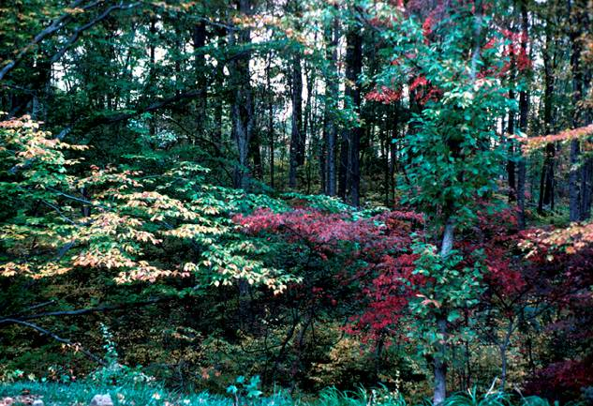
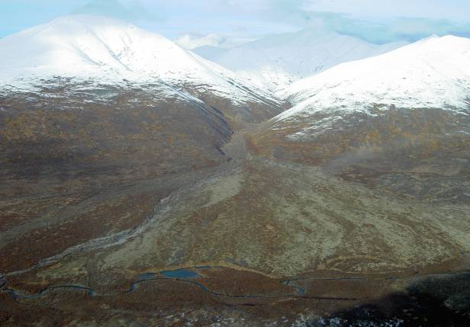
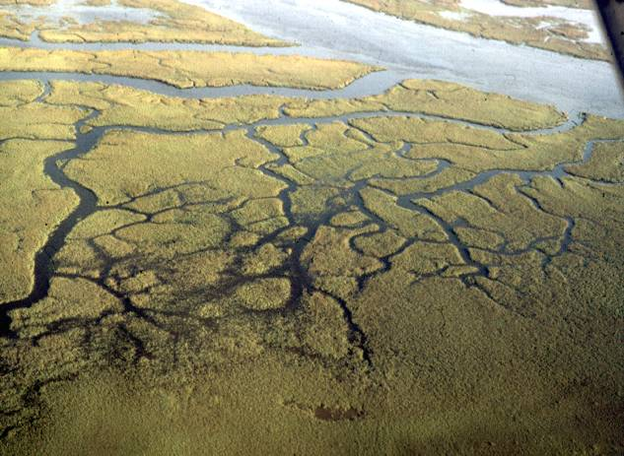
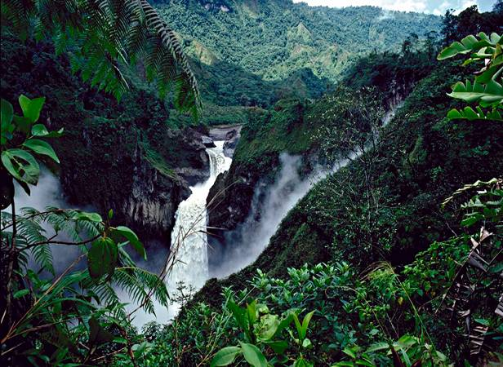
NATURESERVE ECOLOGY OVERVIEW
Natural Heritage Methodology Training
Pat Comer, Chief Terrestrial Ecologist

Slide 2
Ecology Overview
NatureServe Ecology Department
Coarse Filters & Fine Filters
NatureServe Ecology Methods
Where should we be in 5 years?

Slide 3
NatureServe Terrestrial Ecology Department
Pat Comer
Chief Terrestrial Ecologist
(Boulder, CO)
Don Faber-Langendoen
Senior Ecologist
(NY PT)
Marion Reid
Western Senior Regional Ecologist/
NPS Western Coordinator
(Boulder, CO)
Gwen Kittel
Regional Vegetation Ecologist
(CO)
Keith Schulz
Regional Vegetation Ecologist
(CO)
Kristin Snow
Assistant Ecologist/
Ecology Data Manager
(MN)
Shannon Menard
Midwest Senior Regional Ecologist/
Ecology Operations Manager
(Minneapolis, MN)
Jim Drake
Regional Vegetation Ecologist
(MN)
Carmen Josse
Senior Ecologist
Latin America and Caribbean
(Arlington, VA)
Lesley Sneddon
Eastern Senior Regional Ecologist
(Boston, MA)
Judy Teague
Regional Vegetation Ecologist/
NPS Eastern Coordinator
(NC)
Ery Largay
Regional Vegetation Ecologist
(MA)
Moy Burns
Administrative Assistant
(MA)
Milo Pyne
Southern Senior Regional Ecologist
(Durham, NC)
Carl Nordman
Regional Ecologist/Botanist
(NC)
Lindsey Smart
Regional Vegetation Ecologist
(NC)
Regan Smyth
Regional Vegetation Ecologist
(NC)
Mary Russo
Ecology Data Manager
(NC)
Laura Mason
Administrative Assistant
(NC)
Mark Hall Regional Vegetation Ecologist (CO)
Erin Lunsford Jones Regional Vegetation Ecologist (NC)
Sue Gawler
Regional Vegetation Ecologist
(ME)
Notes:
Our current org chart

Slide 4
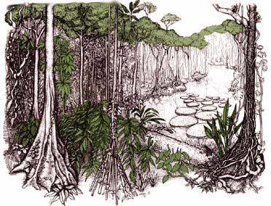

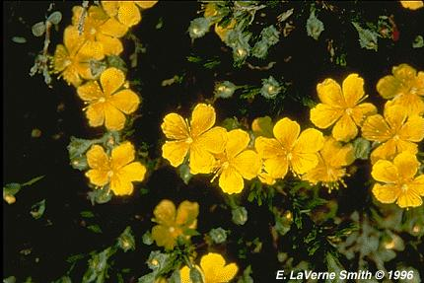
Approaches to Biodiversity Conservation
Species Diversity “hotspots”
“Vertebrate Gap Analysis”
“Umbrella Species”
“Landscape Representation”
How do we effectively represent biodiversity in resource management and conservation?
Notes:
Underlying our work is the effective representation of biodiversity for conservation

Slide 5
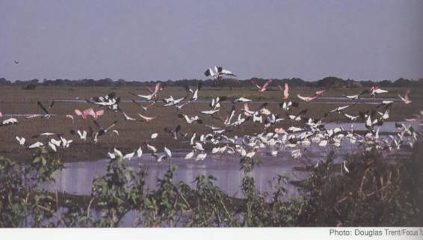
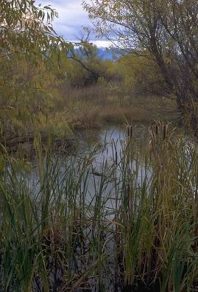
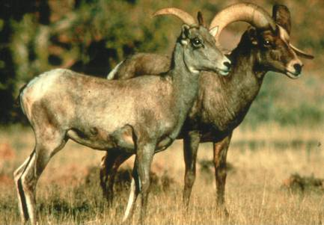
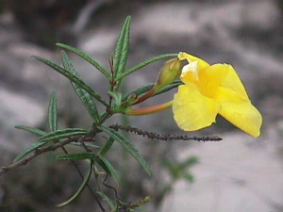
Coarse Filter/Fine Filter Approach
Ecological Systems
  recurring groups of communities
  natural landscape patterns and processes at scales useful for management and monitoring
Focal Communities
  unique environments
  rare plant communities
  rare aquatic habitats
  vulnerable species aggregations, migratory stopover points, etc.
Focal Species/Subspecies
  imperiled, declining, endemic, vulnerable, “umbrella”
Notes:
Elements of concern are hierarchical in nature and are grouped into species, communities, and ecological systems categories.
This encompasses what is commonly called the “coarse-filter/fine-filter approach.” Using this approach, spearheaded by The Nature Conservancy and NatureServe back in the 1970s, all characteristic ecological systems, then a subset of rare and vulnerable communities and species are used to represent the environmental variation and ecological processes that support all biological diversity.
The “coarse-filter” is provided by representing characteristic ecological system types (e.g. different forest, shrubland, grassland, wetland, and riverine systems). The “fine-filter” encompasses rare communities and species at risk that require special consideration to ensure that the ecological processes supporting them are considered in planning.
Our focus is on standard ecological classification and its application to conservation.

Slide 6
NatureServe Methodology
What is it?
Where is it?
What are status and trends of each (element) type?
What is the quality/condition of each occurrence?
(ecological classification)
(element mapping/occurrence)
(G/N/S Status Ranks)
(ecological integrity)
Notes:
Our core methodology. By answering these questions, we can move on to many conservation applications…

Slide 7
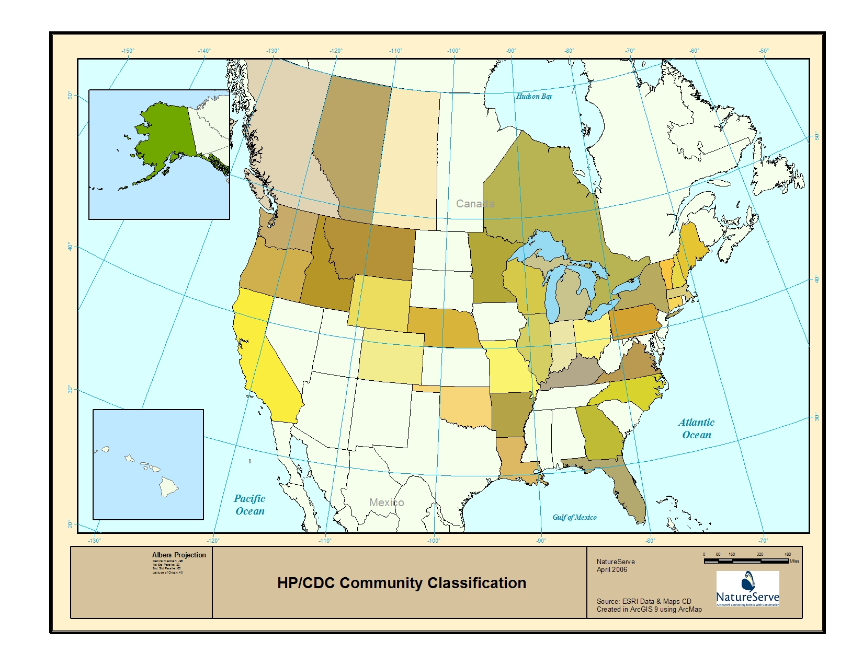
NHP/CDC Community Classifications
Notes:
Member programs maintaining local classification

Slide 8
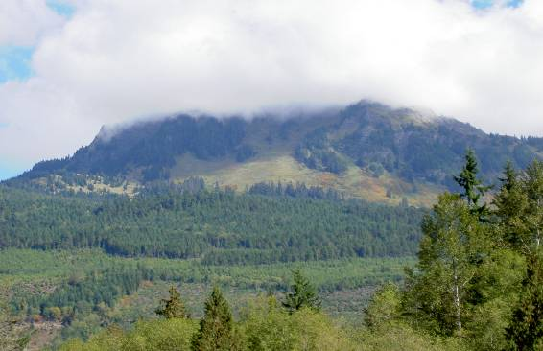
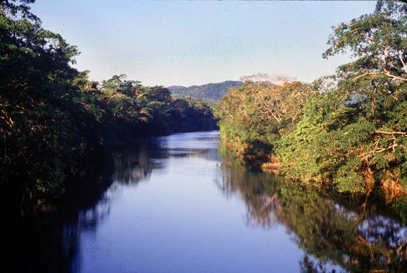
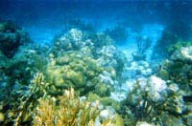
Internationally Standardized Ecological Classifications
Terrestrial
  Uplands
  Wetlands
  Subterranean
Aquatic
  Freshwater
    Riverine
    Lacustrine
  Marine
    Estuarine
    Nearshore
    Deep Ocean
Notes:
Our focus has mostly been in terrestrial environments.
In recent years TNC and selected member programs have advanced freshwater classification.
Just in th epast few years, we have begun to work in coastal marine ecological classification.

Slide 9
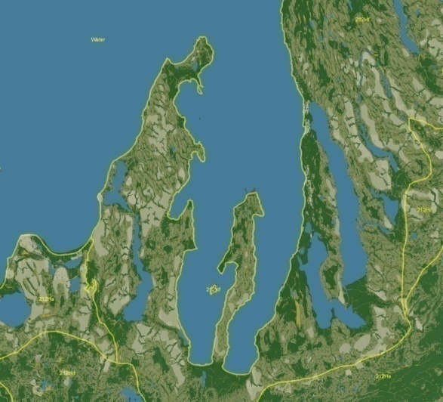
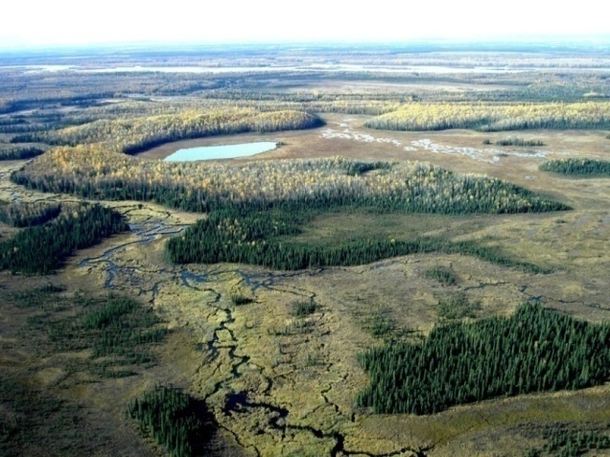
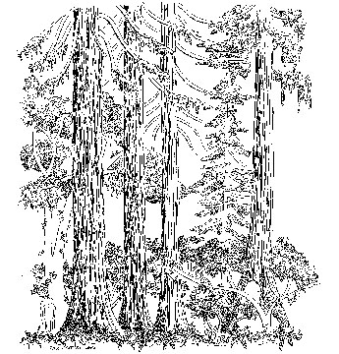
Terrestrial Ecological Classification
Multi-factor Classification
Biogeography and Bioclimate
Local Environment
Ecological Dynamics
Landscape Juxtaposition
Vegetation Structure, Composition, and Abundance
Land Classification
Bioclimate
Local Environment
Ecological Dynamics
Landscape Juxtaposition
Vegetation Classification
Biogeography
Vegetation Structure, Composition, and Abundance
Notes:
A second approach to ecological classification emphasized not only vegetation, but also incorporates other environmental factors to consistently describe each unit.
The NatureServe Terrestrial Ecological System units are driven by floristics at relatively local scales, but also integrate other biophysical factors into the definition of each type. This approach supports a variety of additional applications beyond existing vegetation classification. Among those, consistent development of map units down in the 1-5 hectare minimum map-unit range.

Slide 10
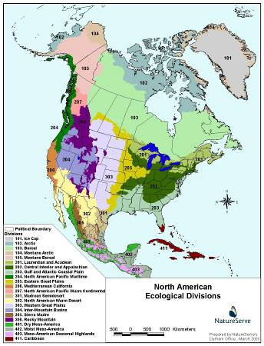
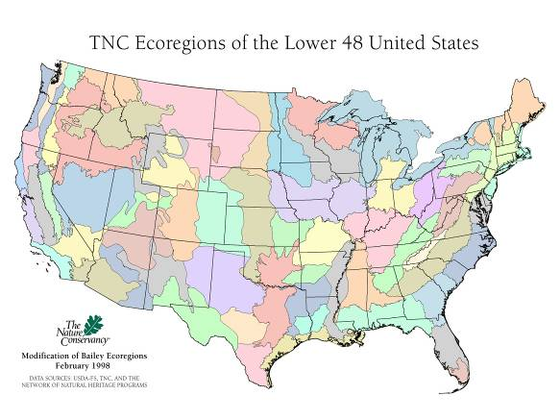
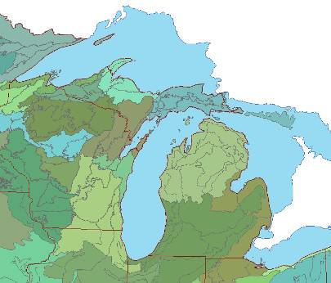
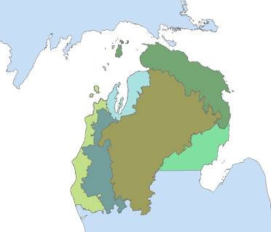
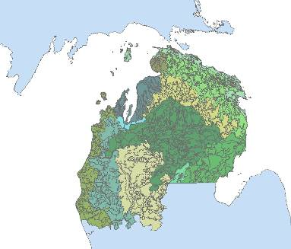

Terrestrial Landscape (spatial) Hierarchy
Subcontinental
Regional Landscape
Local Landscape
Domain Scale
Division Scale
ECOMAP Province and Section
Ecological Land Type
Notes:
Mapped Classification
Emphasize abiotic attributes (climate, landform, soil, hydrology, etc.)
Commonly applied to describe site productivity for forestry and range management
Applications to predictive range mapping and ecological restoration

Slide 11
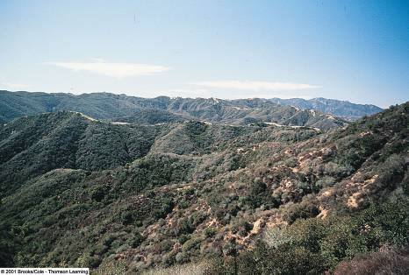
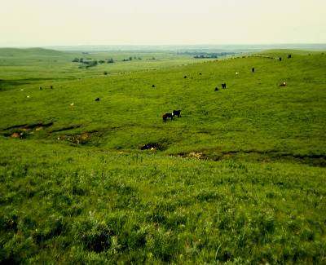
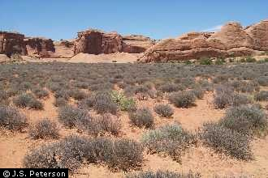
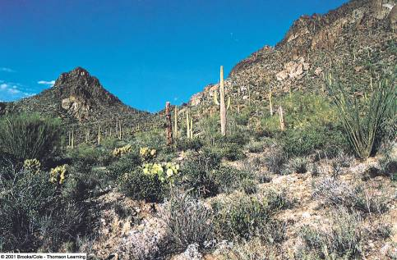
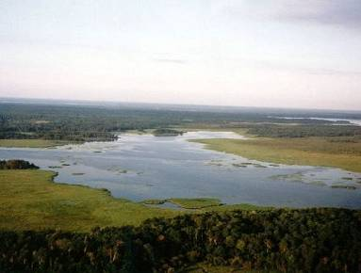
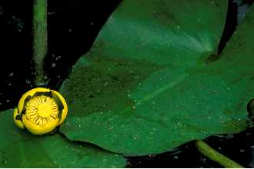
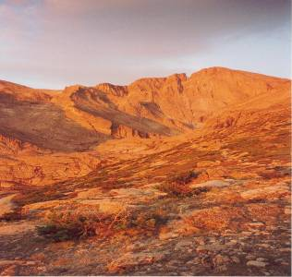
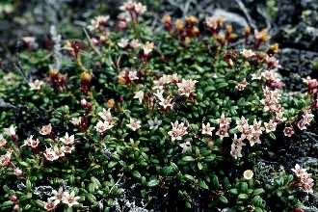
Forest & Woodland (Mesomorphic) Shrubland & Grassland
Semi-Desert Vegetation (Xeromorphic Vegetation)
Aquatic Vegetation
(Hydromorphic Vegetation)
Nonvascular Vegetation (Lithomorphic Vegetation)
Loiseleuria procumbens
Polar and High Mountain Vegetation (Cryomorphic Vegetation)
CULTURAL VEGETATION

Slide 12
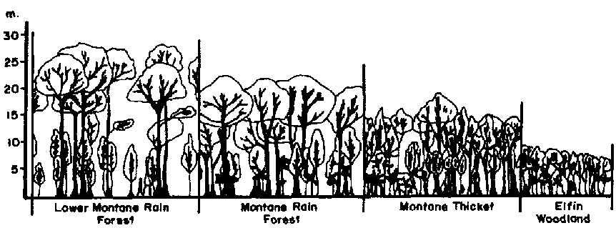
FGDC 2008 US-NVC Hierarchy
Multi-scaled Vegetation Taxonomy
Vegetated
Natural/Semi-natural
Upper Levels (physiognomic)
Class e.g., Forest and Woodland
Subclass e.g., Temperate Forest and Woodland
Formation e.g., Temperate Evergreen Broadleaf and Conifer Forest
Mid Levels (mixed)
Division Eastern North America Deciduous Broadleaf & Conifer Forest and Woodland
Macrogroup Atlantic and Gulf Coastal Plain Hardwood & Pine
Group Dry Longleaf Pine Woodland Group
Lower Levels (floristic)
Alliance Pinus palustris / Quercus spp. Woodland Alliance
Association Pinus palustris - Pinus taeda / Quercus geminata - Quercus hemisphaerica - Osmanthus americanus var. americanus / Assn
Notes:
This is the revised form of the US-NVC hierarchy
It addresses many of the problems of the 1997 hierarchy.

Slide 13
Terrestrial Landscape (spatial) Hierarchy
Vegetation (taxonomic) Hierarchy (2007)
Subcontinental Subcontinental Upper
Regional Landscape Mid
Local Landscape Lower
IVC Class
Domain Scale
IVC Subclass
Division Scale
IVC Formation
IVC Division
ECOMAP Province and Section
IVC Macrogroup
Ecological System
IVC Group
IVC Alliance
Ecological Land Type
IVC Association
Notes:
Though in the end, we are still coping with very complex interactions of classification concept and the spatial expression of ecological units on the ground.
This was the reality we were dealing with when we developed terrestrial ecological systems concepts. They take aspects of both spatially nested hierachies and taxonomic hierarchies to define pracical units for mapping and conservation.

Slide 14
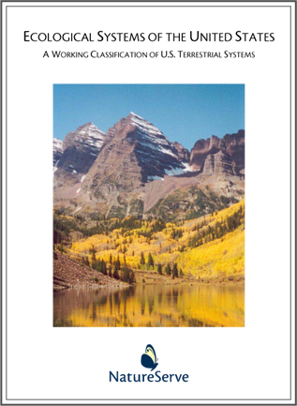

Terrestrial Ecological System
Group of IVC communities that tend to co-occur within landscapes with similar ecological processes, substrates, and/or environmental gradients.
Multi-factor Classification
Biogeography and Bioclimate
Local Environment
Ecological Dynamics
Landscape Juxtaposition
Vegetation Structure, Composition, and Abundance
Notes:
Ecological Systems are driven by floristics at relatively local scales, but may expand beyond alliances by relaxing physiognomic criteria. This supports consistent development of map units down in the 1-5 hectare mmu range.

Slide 15

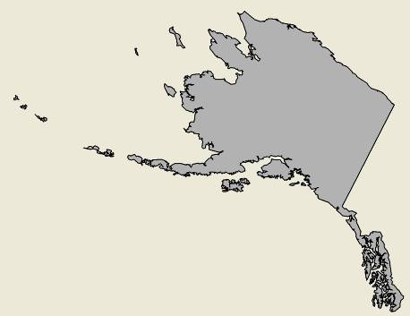
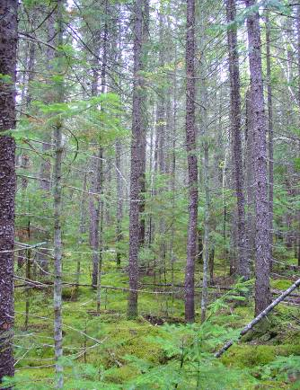
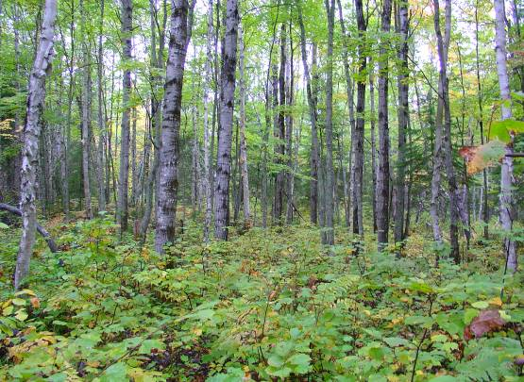
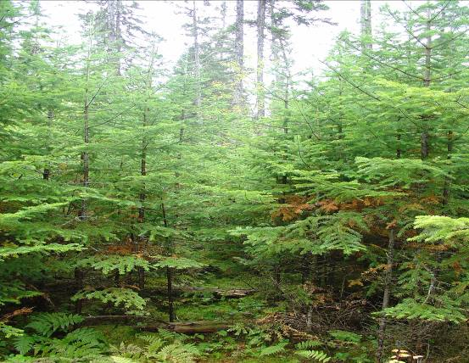
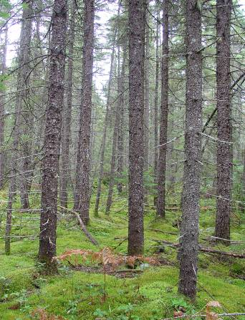
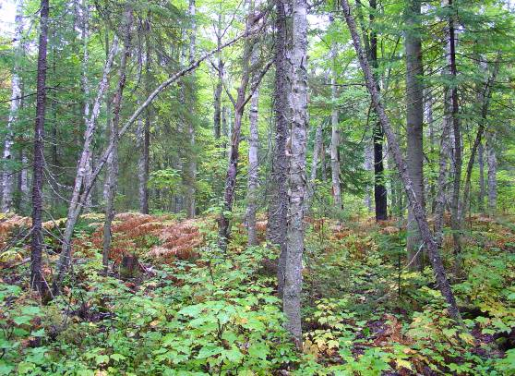
State and Transition Model
Ecological System and component
Vegetative States
Class B
(Mid Closed)
Class C (Mid Open)
Class A (herb/shrub/treed)
Class D (Late Open)
Succession
Disturbance
Class E
(Late Closed)
Notes:
Graphic representation of a VDDT model – quantitative state and transition model – NE Lowland Spruce-Fir Forest
Grey arrows represent successional pathways.
Red arrows represent disturbance transitions.

Slide 16
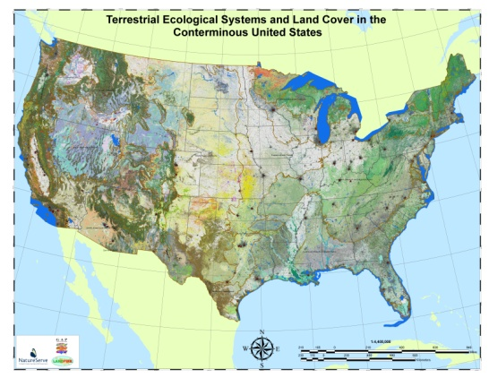
Numbers of Classification Units
IVC Formations(20 types)
IVC Macrogroups (~150 in U.S. and Canada)
Terrestrial Ecological System (~1000 in North America)
Notes:
Levels of map classes for mapping

Slide 17
NatureServe Methodology
What is it?
Where is it?
What are status and trends of each (element) type?
What is the quality/condition of each occurrence?
(ecological classification)
(element mapping/occurrence)
Notes:
Our core methodology. By answering these questions, we can move on to many conservation applications…

Slide 18
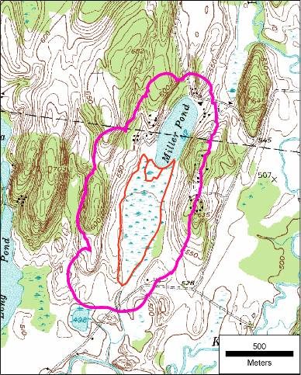
Occurrence Specifications
Barrier
5
0.3 km
10
2
10
0.5 km
2
10
separation distance (500m) for other natural land cover; 0.3 km for cultural vegetation;
…and then there are distinct barriers
Notes:
EOSPECS determines a separation distance (1 km natural, 0.5 km cultural veg.), a minimum polygon size (2 ha), and an aggregate polygon size (25 ha). Stepping-stones present an issue, where it meets the minimum polygon size. But a barrier is introduced forcing all combinations to fall below the 25 ha aggregate; so we have NO EOs (all are observations).
Under existing criteria we would have 3 10 ha EOs.
Most of our effort in the past has focused on applying these criteria in the field.

Slide 19
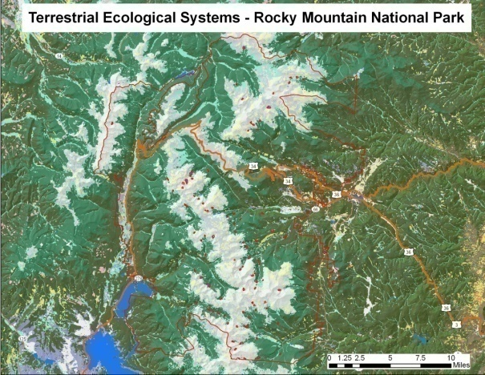
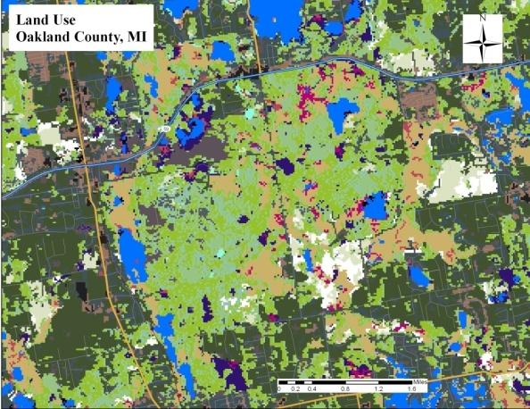
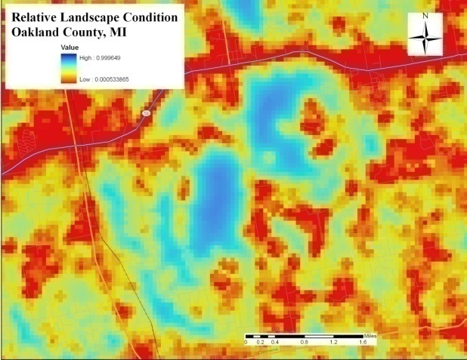
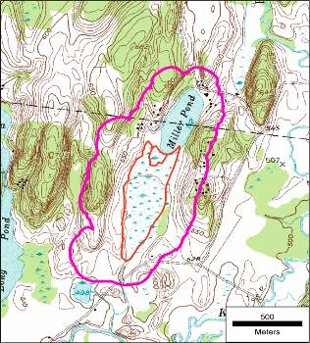
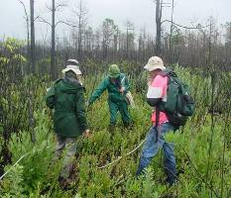
What is it?
Where is it?
Taxonomy & Classification
Maps and Surfaces
Occurrences through Field Inventory
Field Observations
Notes:
So our core methodology has been expanding over time. Because field samples – community observations are gathered first for classification development; they also get used a georeferenced locations to support map development. So these two componants, field observations and maps are becoming fundamental aspects of our work.

Slide 20
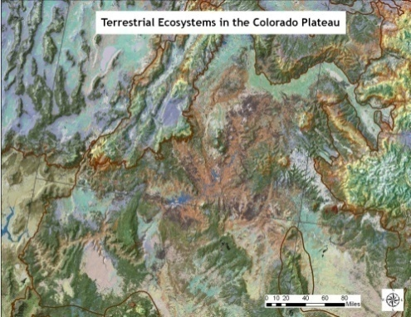
Modern Mapping Methods
Observations (point/poly)
Imagery: Landsat 7 ETM (1999-2002) for spring, summer & fall
NDVI, SAVI, Brightness,Greeness, Wetness, Landsat 7 Bands
DEM: Elevation, Aspect, Slope, Landform
Vector: Geology, Soils
Meteorological: DAYMET
Bioclimate
Image Indices
Landform
Lithology
Output translates
to map product
Notes:
Just to get techy for a moment, modern remote sensing is all about modeling; models that combine information from multiple mapped layers using statistical analysis to identify recurrent pattern.
Field samples form the foundation of these mapping techniques.

Slide 21
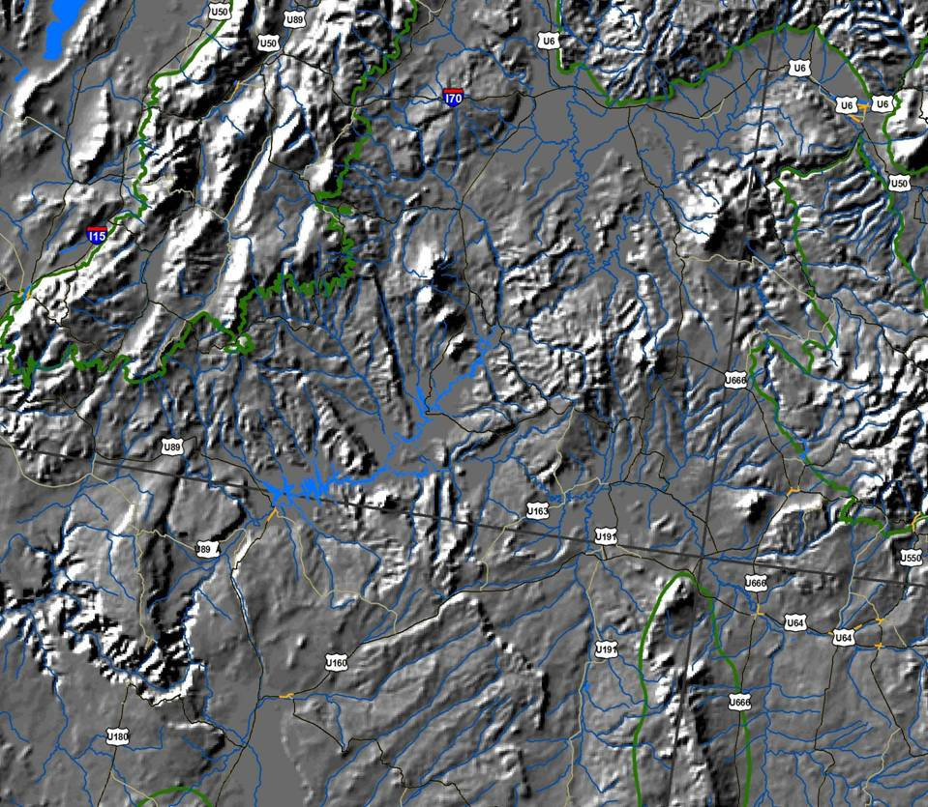
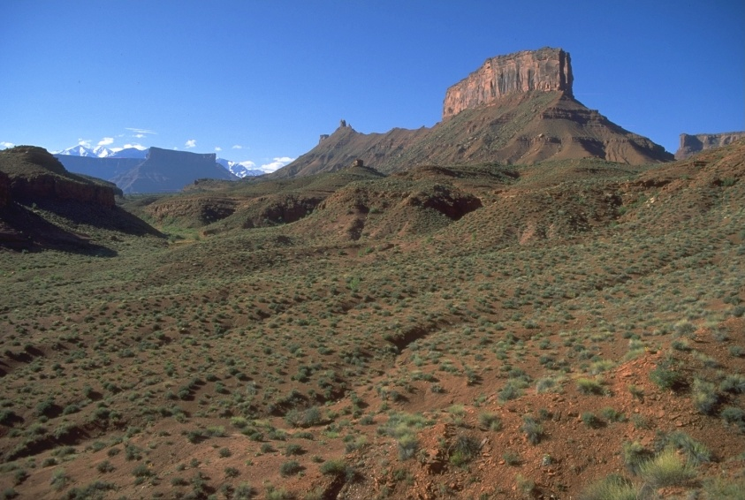
Sample Data
Colorado Plateau Blackbrush-Morman Tea Shrubland (ecological system)

Slide 22
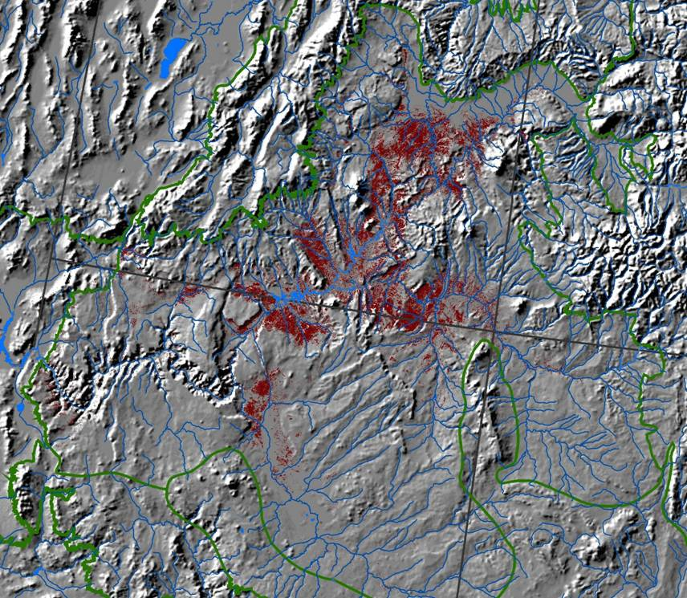
Mapped Distribution
Colorado Plateau Blackbrush-Morman Tea Shrubland (ecological system)

Slide 23
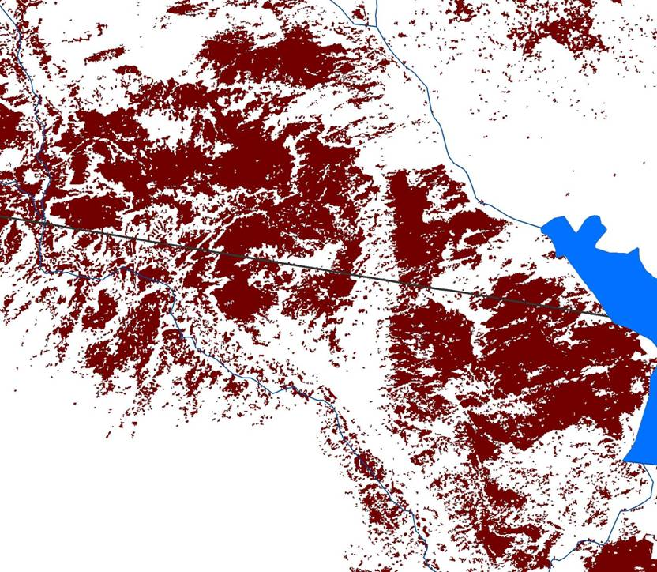
Inputs for Inventory and Occurrence Delineation
Field sample
Colorado Plateau Blackbrush-Morman Tea Shrubland (ecological system)
Notes:
One might use TM-derived data, subsequent GIS processing, then perhaps aerial photos and/or additional field visits, to establish EO boundaries.

Slide 24


U.S. Federal Agency Partners
►Existing vegetation composition and structure
►Vertebrate Distributions
►Land Stewardship
►Existing vegetation composition and structure
Biophysical Setting for each type
►Fire effects models
►Fire behavior fuel models and canopy fuel characteristics
►Simulated historical fire regimes
►Fire regime condition class
NOTE: The foundation of the U.S. map is ~500,000 samples; and our network has a crucial role to play in building/ maintaining these data.
Notes:
Our work in standardized ecological classification has lead us into major partnerships with U.S. federal agencies, centered in the DOI and USDA.
USGS GAP has, for over a decade aimed to map existing vegetation to provide one ‘coarse filter’ for gap analysis of wildlife habitat
DOI/USDA LANDFIRE is producing digital and spatial data describing existing vegetation composition and structure; fire effects models; fire behavior fuel models and canopy fuel characteristics; simulated historical fire regimes; and fire regime condition class.
NatureSeve ecologists have facilitated engagement of the entire network within the US to contribute to these major national investments.

Slide 25



Glacier National Park

Slide 26
Internationally Standardized Ecological Classifications
Terrestrial
  Uplands
  Wetlands
  Subterranean
Aquatic
  Freshwater
    Riverine
    Lacustrine
  Marine
    Estuarine
    Nearshore
    Deep Ocean
Notes:
Our focus has mostly been in terrestrial environments.
In recent years TNC and selected member programs have advanced freshwater classification.
Just in th epast few years, we have begun to work in coastal marine ecological classification.

Slide 27
high elevation
acidic sloping
1-2 order stream
high elevation
calcareous sloping
1-2 order stream
high elevation
calcareous flat
1-2 order stream
Calcareous bedrock
Intermittent Stream
mid elevation
acidic flat
1-2 order stream
mid elevation
calcareous flat
1-2 order stream
3-5 order
confined channel
stream
Acidic Bedrock
3-5 order meandering
stream on till
Wetland
very low elevation
calcareous flat
1-2 order stream on till
6+ River
(monotropic)

Slide 28
Internationally Standardized Ecological Classifications
Terrestrial
  Uplands
  Wetlands
  Subterranean
Aquatic
  Freshwater
    Riverine
    Lacustrine
  Marine
    Estuarine
    Nearshore
    Deep Ocean
Notes:
Our focus has mostly been in terrestrial environments.
In recent years TNC and selected member programs have advanced freshwater classification.
Just in th epast few years, we have begun to work in coastal marine ecological classification.

Slide 29
Coastal Marine Ecological Classification Standard
Hierarchy
Example
Level 1 Regime
Estuarine
Level 2 Formation
Lagoon
Level 3 Zone
Bottom
Level 4 Macrohabitat
Vegetated Softbottom
Level 5 Habitat
Seagrass Bed
Level 6 Biotope
Sand ripples-Thalassia

Slide 30



Florida Bay Bottom Types
CMECS Level 4 Macrohabitat
(adapted from Prager and Halley 1997)

Slide 31
Core NatureServe Methodology
What is it?
Where is it?
What are status and trends of each (element) type?
What is the quality/condition of each occurrence?
(ecological classification)
(element mapping/ occurrence)
(G/N/S Status ranks)

Slide 32






NatureServe
Factors and Categories of Conservation Status
Number of Occurrences/Area
Number of Occurrences/Area
w/Good Quality
Range Extent
Area of Occupancy
Long-term Trend
Short-term Trend
Threats (Severity, Scope, and Immediacy)
Apply to portion of range; e.g., N = Nation S=Subnation
N/S1 Critically Imperiled
N/S2 Imperiled
N/S3 Vulnerable
N/S4 Apparently Secure
N/S5 Demonstrably Secure
G1 Critically Imperiled
G2 Imperiled
G3 Vulnerable
G4 Apparently Secure
G5 Demonstrably Secure
Notes:
NatureServe has done rule based assessments for both species and ecological ‘elements’ of biodiversity to arrive at a ‘conservation status’ rank; with criteria applicable not only to global perspectives, but also for any subset of the range.

Slide 33


Long-Term Trend in Extent
Unaltered Extent Estimate
Current Extent Estimate
Notes:
Estimating long-term trend is exceedingly difficult. Fortunately, recently developed data on terrestrial ecological systems is providing useful input to approximate extent for each type we might have today if substantial land conversion had not taken place.
In addition to current extent, the inter-agency LANDFIRE effort also developed models of ‘biophysical settings’ for each of over 500 ecological system types – a model of predicted distribution of each type given assumptions about natural disturbance regimes.
We can also approximate historic extent by type by segmenting the nation into ecoregional landscapes and estimating proportional contribution of natural types to the total area of lands that have been converted.
So we are now well-postioned to apply Granks to ecological systems and many vegetation types.

Slide 34

Gauging Ecological Integrity
Provide an estimate of current ecological integrity
Help prioritize occurrences/sites for conservation attention
Highlight indicators to be used in management and monitoring
Provides basis for describing relative compatibilities between land uses/management practices with ecological requirements
Notes:
Our most information-intensive work relates to gauging ecological integrity.
This is clearly where we meet the limits of our knowledge, but where we can develop this information, it has the greatest payoff in terms of guiding resource management and conservation on the ground.

Slide 35
Organizing Factors that Affect Integrity
Condition – assessment of reproduction/ health, maturity, composition and structure, ecological processes, abiotic physical/chemical processes, etc.
+ Landscape Context - assessment of spatial patterns of occurrence (fragmentation / connectivity) and supporting landscape
+ Size - quantitative measure of patch size, area of occupancy, abundance, density, etc.
Estimated Integrity
Notes:
12

Slide 36
Integrated Tasks Across Scales for Ecological Assessments
 |  | Assessment / EIA | Applications
Level 1 – | Remote Sensing | Landscape around patches On-site indicators visible remotely | Level 1 EO Rank Support Status and Trends Implementation monitoring
Level 2 - | Rapid Field Observation | Relatively simple field indicators (stressor / condition metrics) | Level 2 EO Rank Conservation planning Integrated scorecard Restoration, mitigation, and management monitoring
Level 3 - | Intensive sampling | Detailed quantitative field indicators. Calibrated indicators (e.g., indices of biotic or ecological integrity, FQA). | Level 3 EO Rank Reference Sites for specific indicators
Integration
Notes:
We also don’t typically have the ability to do rigorous measurement of all indicators all of the time.
So, our framework is designed to organize indicators in 3 levels, along a gradient of investment needed for their measurement.

Slide 37
Where should we be in 5 years?
Implementation of revised international vegetation classification in US and Canada
Terrestrial Ecological Systems map(s) for the United States, Canada, and Latin America
Complete Status Ranking of terrestrial systems across the Americas
Complete initial Ecological Integrity Criteria for terrestrial ecological systems

Slide 38






