Slide 1
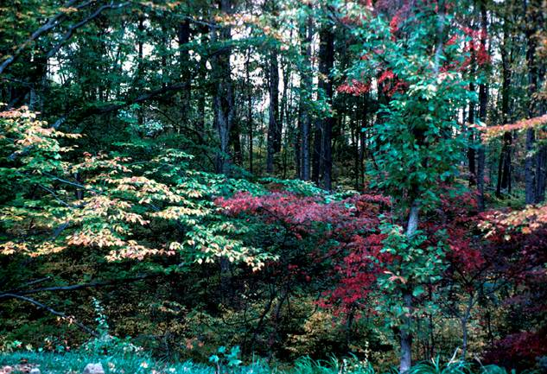
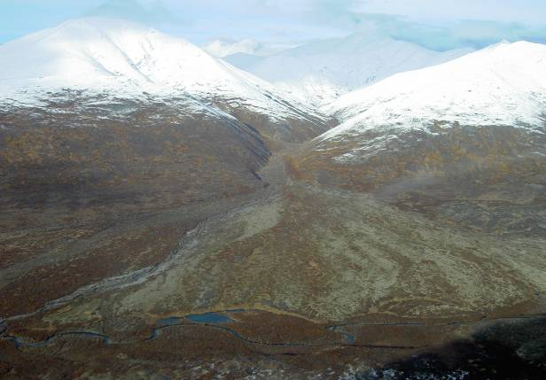

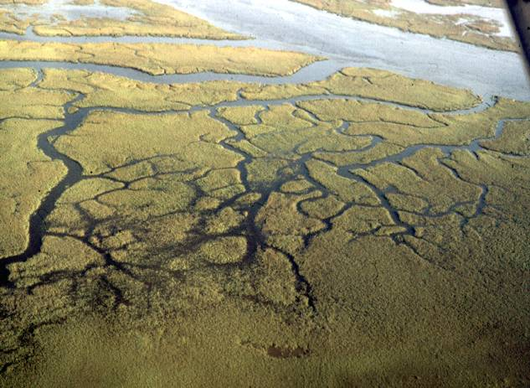
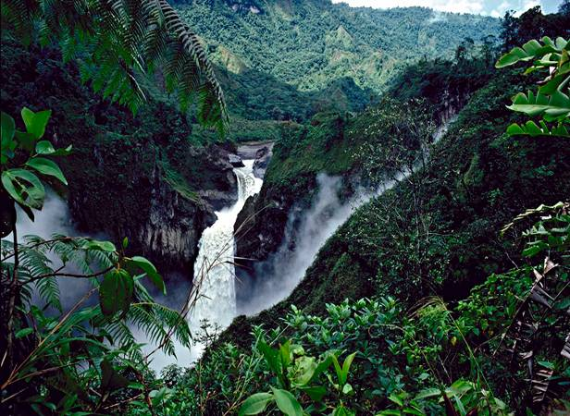

NATURESERVE ECOLOGY OVERVIEW
Natural Heritage Methodology Training
13 April 2015
Pat Comer, Chief Ecologist
Notes:
Pat Comer directs the Ecology Department of NatureServe’s Science Division. He completed undergraduate and graduate work in Forest & Landscape Ecology at the University of Michigan, Ann Arbor. In 1991, after spending two years in Costa Rica working in agroforestry, Pat began in our network as a field and research ecologist with the Michigan Natural Features Inventory. In 1998, he relocated to Boulder, Colorado and served as Senior Regional Ecologist for The Nature Conservancy. There he developed methods for ecoregion-scale conservation assessment and planning and worked on projects extending across western North America and Latin America. Pat joined NatureServe in 2002 and was appointed Chief Ecologist in 2003. Today, he continues his work with his staff and member program ecologists to advance methods for ecosystem assessment, planning, management, and monitoring.

Slide 2
Ecology Overview
NatureServe Ecology Department
Coarse Filters & Fine Filters
Ecology Methods
Where should we be in 5 years?

Slide 3
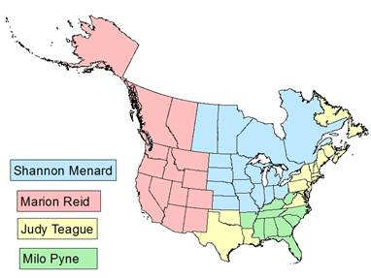
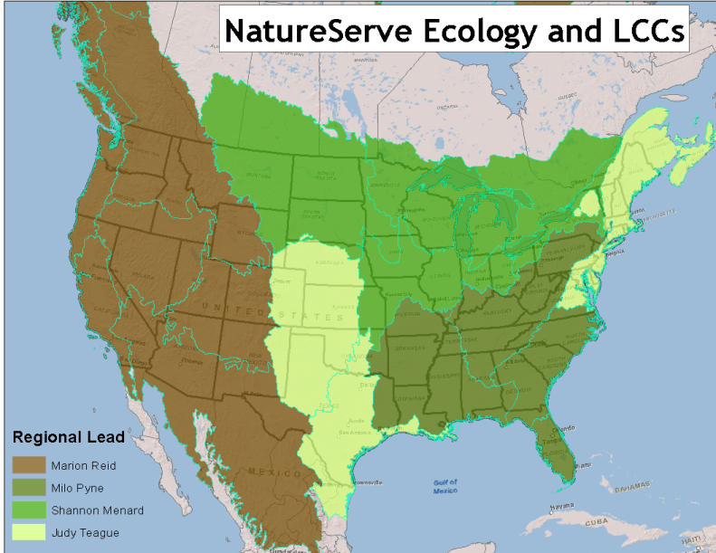
NatureServe Ecology Department
Pat Comer
Chief Ecologist
Don Faber-Langendoen Senior Research Ecologist (USA-Canada)
Carmen Josse
Senior Research Ecologist (Latin America)
Lesley Sneddon
National Ecologist (USA)
Marion Reid Senior Western Ecologist
Gwen Kittel W. Riparian Ecologist
Shannon Menard Senior Midwestern Ecologist
Rickie White SE Ecologist
Judy Teague Senior Eastern & S-Central Ecologist
Keith Schulz Western Ecologist
Jim Drake Midwest Ecologist
Carl Nordman SE Ecologist
Ery Largay NE Ecologist
Erin L. Jones MidAtlantic Ecologist
Regan Smyth Landscape Ecologist
Milo Pyne Senior Southeast Ecologist
Notes:
Our current org chart

Slide 4
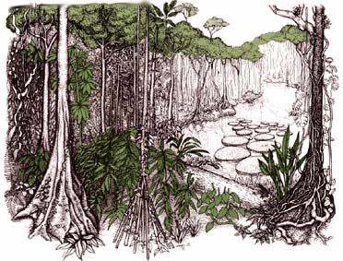

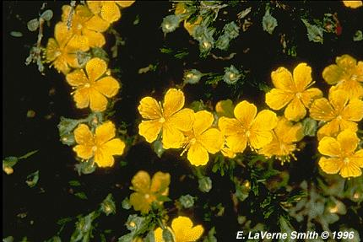
Approaches to Biodiversity Conservation
Species Diversity “hotspots”
“Vertebrate Gap Analysis”
“Umbrella Species”
“Enduring Features”
How do we effectively represent biodiversity in resource management and conservation?
Notes:
Underlying our work is the effective representation of biodiversity for conservation

Slide 5
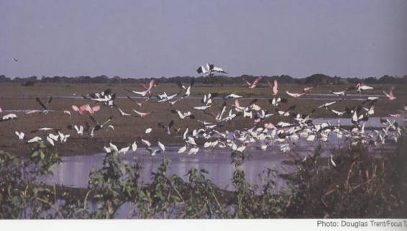
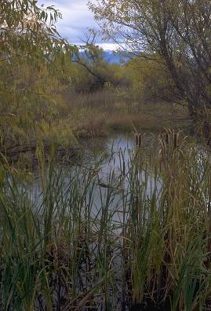
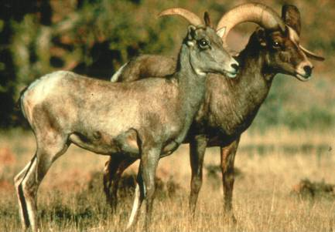
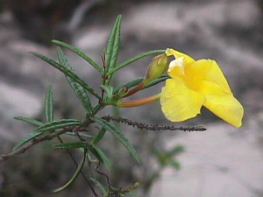
Coarse Filter/Fine Filter Approach
Ecological Systems
  natural landscape patterns and processes at scales useful for management and monitoring
Focal Communities
  unique environments
  rare plant communities
  rare aquatic habitats
  vulnerable species aggregations, migratory stopover points, etc.
Focal Species/Subspecies
  imperiled, declining, endemic, vulnerable, “umbrella”
Notes:
Elements of concern are hierarchical in nature and are grouped into species, communities, and ecological systems categories.
This encompasses what is commonly called the “coarse-filter/fine-filter approach.” Using this approach, spearheaded by The Nature Conservancy and NatureServe back in the 1970s, all characteristic ecological systems, then a subset of rare and vulnerable communities and species are used to represent the environmental variation and ecological processes that support all biological diversity.
The “coarse-filter” is provided by representing characteristic ecological system types (e.g. different forest, shrubland, grassland, wetland, and riverine systems). The “fine-filter” encompasses rare communities and species at risk that require special consideration to ensure that the ecological processes supporting them are considered in planning.
Our focus is on standard ecological classification and its application to conservation.

Slide 6
NatureServe Methodology
What is it?
Where is it?
How is it doing?
How is it changing?
(ecological classification)
(element mapping/occurrence)
(ecological integrity)
(At-risk status)
(Monitoring extent & condition)
(CC Vulnerability and Adaptation)
Notes:
Our core methodology. By answering these questions, we can move on to many conservation applications…

Slide 7
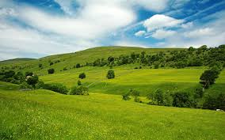
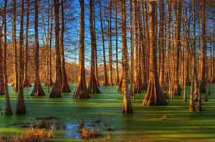
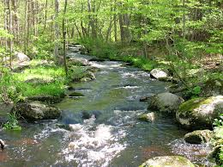
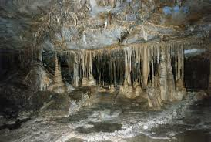

Ecosystem Classifications
Terrestrial
  Uplands
  Wetlands
  Subterranean
Aquatic
  Continental
    Riverine
    Lacustrine
    Subterranean
  Marine
    Estuarine
    Nearshore
    Deep Ocean
Notes:
Pat – We are discussing terrestrial classification – to be clear, we include uplands and wetlands under “terrestrial” concepts. “Wetlands” commonly defined as including rooted vascular vegetation.

Slide 8
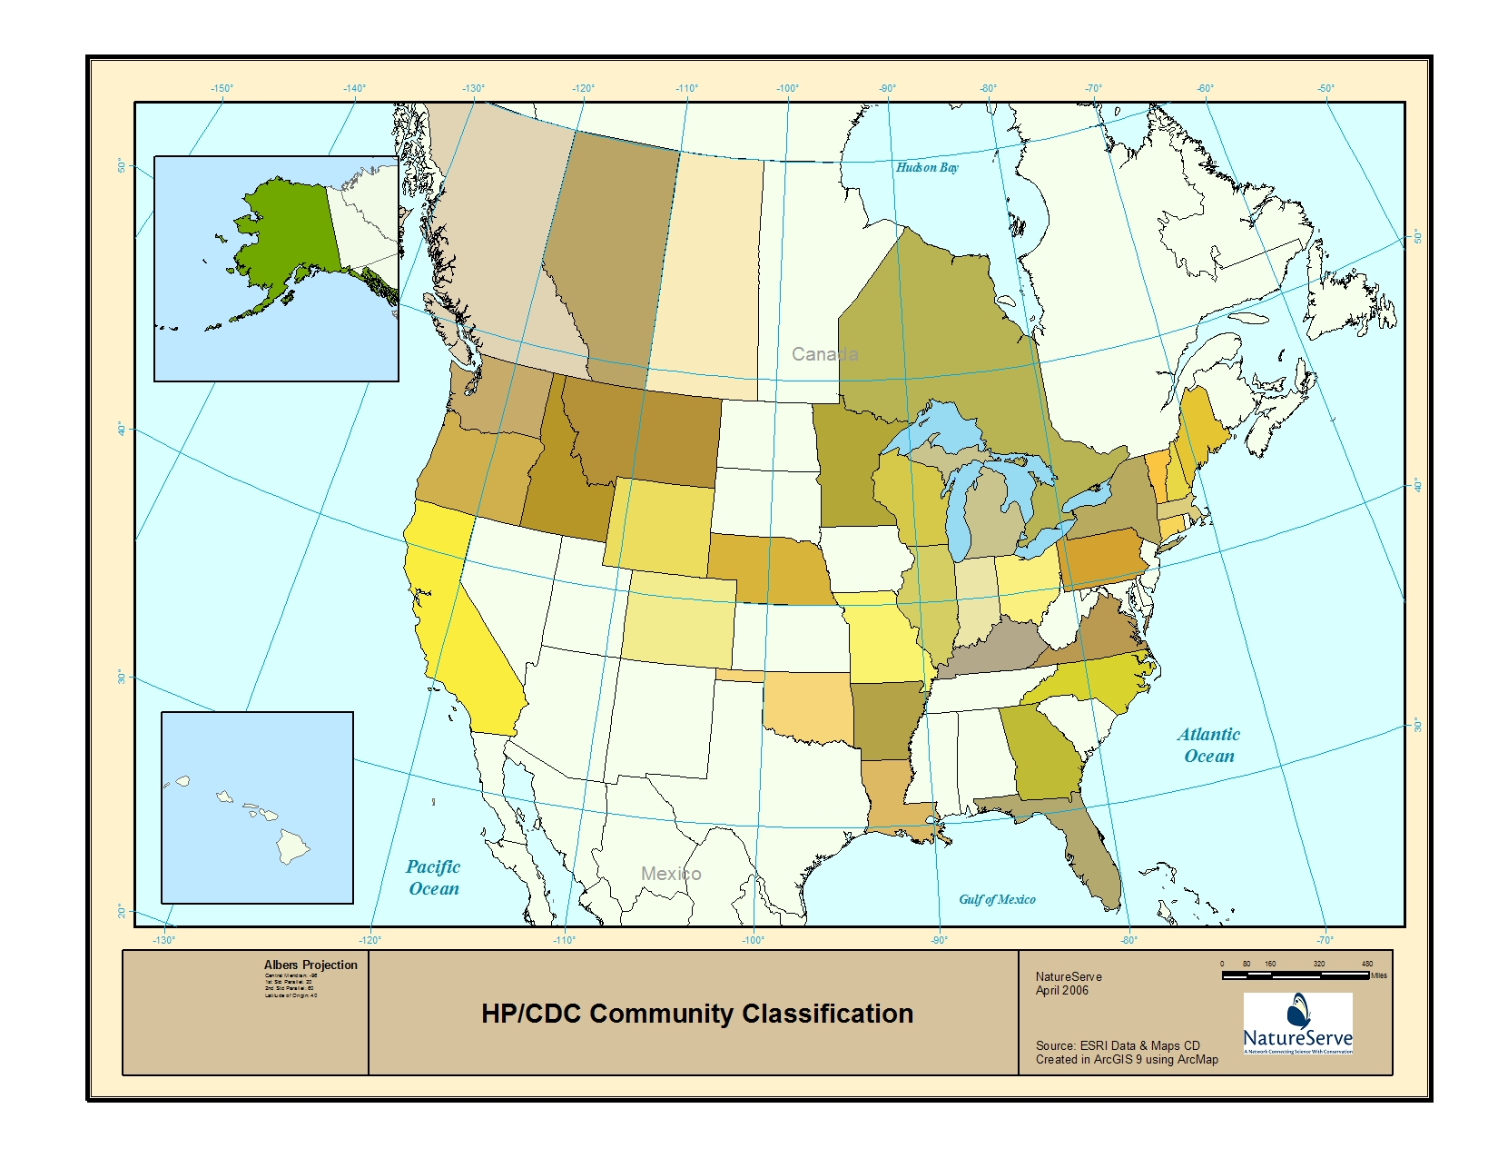
NHP/CDC Community Classifications
Notes:
Member programs maintaining local classification

Slide 9
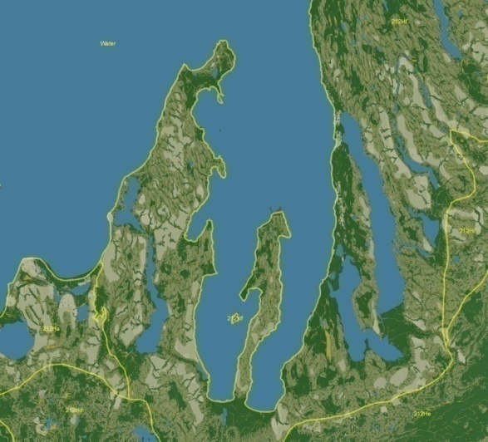
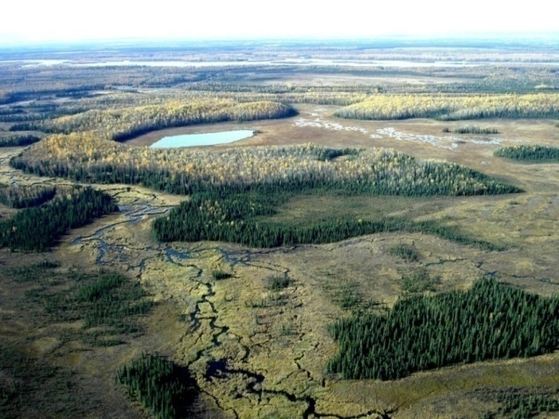
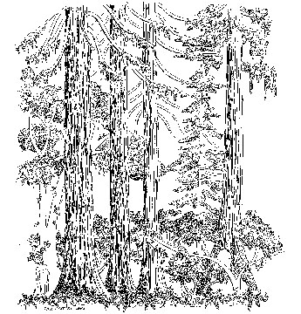
Classification Approaches
Multi-factor
Biogeography and Bioclimate
Vegetation Structure, Composition, and Abundance
Local Environment
Ecological Dynamics
Landscape Pattern
Land-based
Bioclimate/Ecoregions
Local Environment
Ecological Dynamics
Landscape Pattern
Vegetation-based
Plant geography
Phytosociology
Vegetation Structure, Composition
Notes:
Pat –common approaches in terrestrial ecological classification, depending on purpose and need…and history…

Slide 10
Classification Approaches
Multi-factor
NatureServe Ecol. Systems
EcoVeg
EUNIS habitats
IUCN habitats
Numerous local classifications
Land-based
Ecoregions, Life Zones
Global Ecological Land Units (Sayre et al. 2014)
Land Capability Classifications (FAO, USA, Canada, Germany)
Vegetation-based
UNESCO 1973 (physiognomy)
Braun-Blanquet
Euroveg
phytosoc. classifications from Canada, Chile, etc.
Notes:
Pat – various manifestations of various approaches

Slide 11
Relationship to Other Approaches
Terrestrial
  Uplands
  Wetlands
  Subterranean
Aquatic
  Continental
    Riverine
    Lacustrine
    Subterranean
  Marine
    Estuarine
    Nearshore
    Deep Ocean
Classification emphasizing:
plant assemblages
vs.
animal
assemblages
Ecoveg encompasses all areas with >1% cover of nonvascular and vascular rooted, emergent, submergant, and floating aquatic vegetation.
Notes:
Pat - Terrestrial vs. aquatic and subterranean classification approaches:
In common – use of geophysical setting and processes
Distinct – terrestrial measurement of biotic component through plants vs. animals in aquatic and subterranean ecosystems.
Ecoveg encompasses all areas with >1% cover of nonvascular and vascular rooted, emergent, submergent, and floating aquatic vegetation.

Slide 12
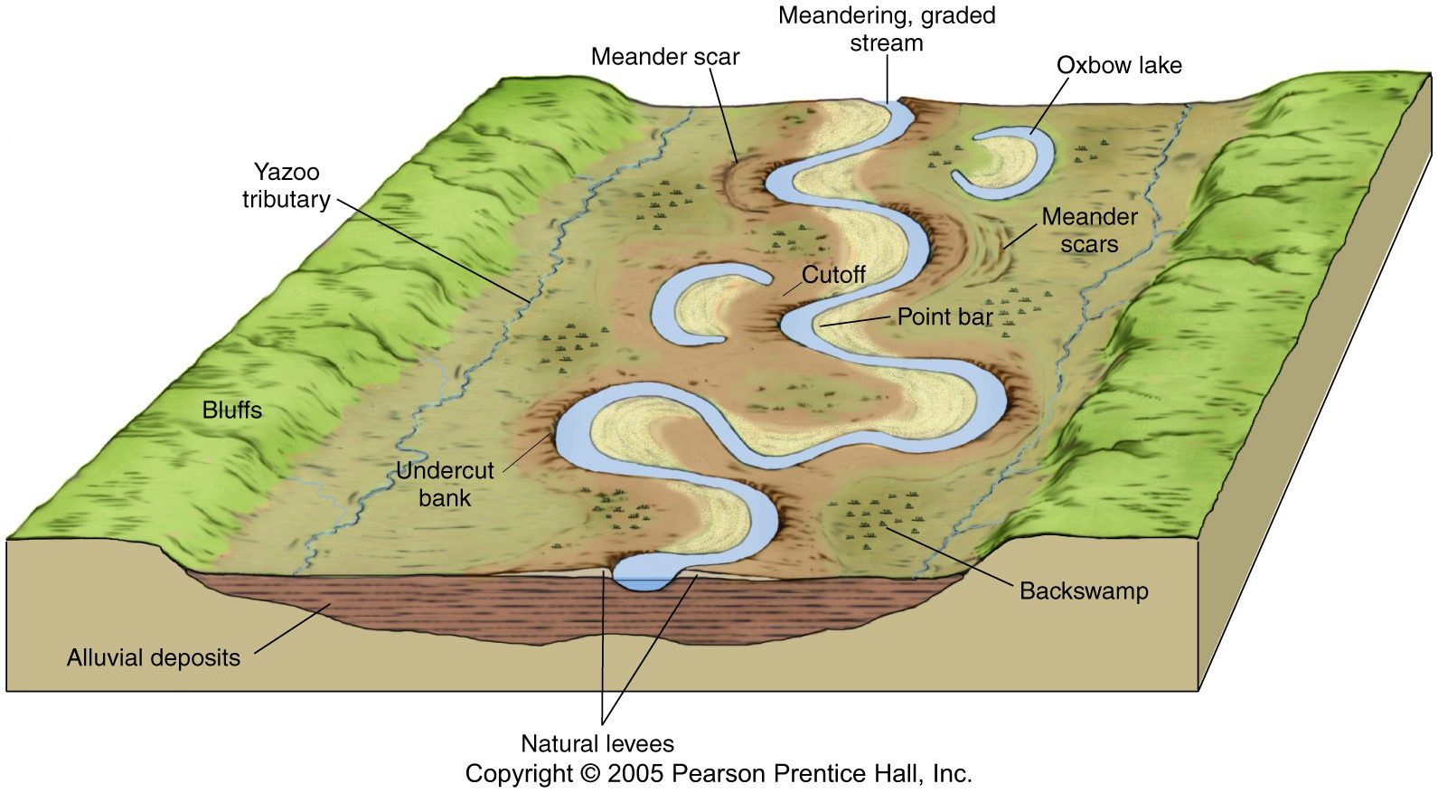
high elevation
acidic sloping
1-2 order stream
high elevation
calcareous sloping
1-2 order stream
high elevation
calcareous flat
1-2 order stream
Calcareous bedrock
Intermittent Stream
mid elevation
acidic flat
1-2 order stream
mid elevation
calcareous flat
1-2 order stream
3-5 order
confined channel
stream
Acidic Bedrock
3-5 order meandering
stream on till
Wetland
very low elevation
calcareous flat
1-2 order stream on till
6+ River
(monotropic)
Notes:
Pat

Slide 13
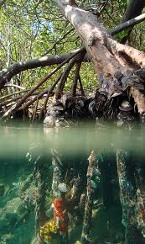
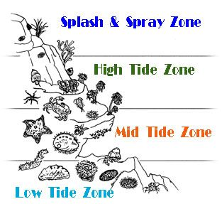
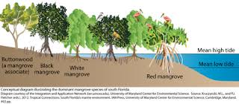
Coastal Transition
Terrestrial - Marine
Notes:
Pat

Slide 14
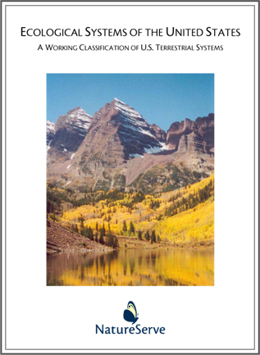

Terrestrial Ecological System
Group of IVC communities that tend to co-occur within landscapes with similar ecological processes, substrates, and/or environmental gradients.
Multi-factor Classification
Biogeography and Bioclimate
Local Environment
Ecological Dynamics
Landscape Juxtaposition
Vegetation Structure, Composition, and Abundance
Notes:
Ecological Systems are driven by floristics at relatively local scales, but may expand beyond alliances by relaxing physiognomic criteria. This supports consistent development of map units down in the 1-5 hectare mmu range.

Slide 15
From “Natural” to “Cultural”
Growth forms and floristic characteristics reflect ecological and biogeographic variables
Natural Vegetation
Vegetation with no apparent recent historical natural analogs…often composed of invasive species that have expanded with human influence
Ruderal Vegetation
Distinctive structure and composition that is determined by the response to human intervention
Cultural Vegetation
Notes:
Don

Slide 16
EcoVeg Hierarchy:
Summary of Criteria
Hierarchy Levels | Criteria
Upper
Level 1 – Formation Class | General growth form response to climate & substrate
Level 2 – Formation Subclass | Vegetation structural response to global mega- or macroclimate (latitude and continental drivers)
Level 3 - Formation | Vegetation structural response to global macroclimate and topo-edaphic factors (elevation, seasonality, hydrologic conditions)
Mid
Level 4 – Division | Subcontinental species assemblage (broad set of diagnostic species, continental difference in mesoclimate, substrate, hydrology)
Level 5 – Macrogroup | Multiple sets of diagnostic species (intermediate sets of diagnostic species , many >25% constancy; subcontinental difference in mesoclimate, substrate, hydrology, disturbance regime)
Level 6 – Group | Narrow set of diagnostic species (moderately high constancy among diagnostics, regional difference in mesoclimate, substrate, hydrology mesoclimate, substrate, hydrology, disturbance regime)
Lower
Level 7 – Alliance | Diagnostic species esp. in upper canopy (high constancy among diagnostics, subregional climate, substrates, hydrology, disturbance regime)
Level 8 – Association | Local species assemblage, microclimate, substrate
Notes:
Don

Slide 17
EcoVeg Hierarchy:
Classification Resolution and Strength (sensu Hermoso et al. 2013)
Hierarchy Levels | Example
Upper
Level 1 – Formation Class | Shrubland & Grassland
Level 2 – Formation Subclass | Temperate & Boreal Shrubland & Grassland
Level 3 - Formation | Temperate Grassland & Shrubland
Mid
Level 4 – Division | Great Plains Grassland & Shrubland
Level 5 – Macrogroup | Great Plains Tallgrass Prairie
Level 6 – Group | Central Great Plains Tallgrass Prairie
Lower
Level 7 – Alliance | Big Bluestem – Indian grass Mesic Prairie
Level 8 – Association | Big Bluestem – Indian grass / Gayfeather Prairie
Increasing resolution & strength
Notes:
Don

Slide 18
Numbers of Classification Units
(North and South America)
IVC Formations (41 [natural] types)
IVC Macrogroups (~500 [natural] types)
Terrestrial Ecological System (~1,600 types)
Notes:
Levels of map classes for mapping

Slide 19
NatureServe Methodology
What is it?
Where is it?
How is it doing?
How is it changing?
(ecological classification)
(element mapping/occurrence)
(ecological integrity)
(At-risk status)
(Monitoring extent & condition)
(CC Vulnerability and Adaptation)
Notes:
Our core methodology. By answering these questions, we can move on to many conservation applications…

Slide 20
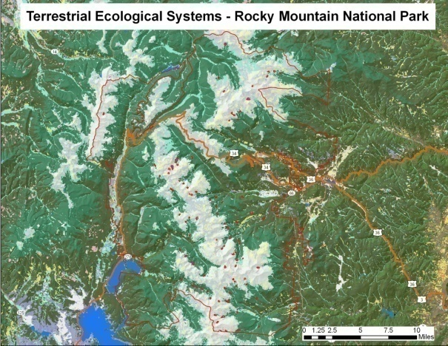
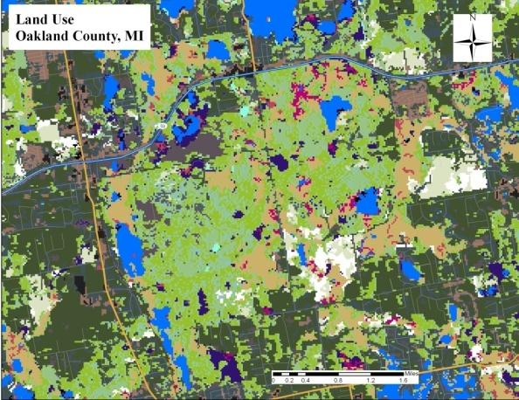
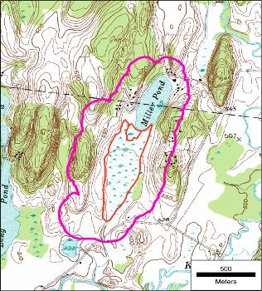
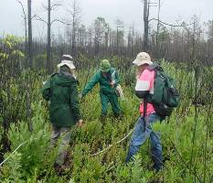
What is it?
Where is it?
Taxonomy & Classification
Maps and Surfaces
Occurrences through Field Inventory
Field Observations
Notes:
So our core methodology has been expanding over time. Because field samples – community observations are gathered first for classification development; they also get used a georeferenced locations to support map development. So these two componants, field observations and maps are becoming fundamental aspects of our work.

Slide 21
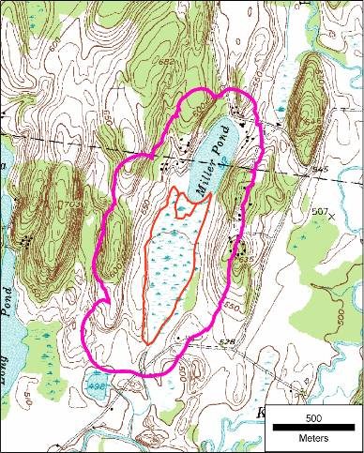
Occurrence Specifications
Barrier
5
0.3 km
10
2
10
0.5 km
2
10
separation distance (500m) for other natural land cover; 0.3 km for cultural vegetation;
…and then there are distinct barriers
Notes:
EOSPECS determines a separation distance (1 km natural, 0.5 km cultural veg.), a minimum polygon size (2 ha), and an aggregate polygon size (25 ha). Stepping-stones present an issue, where it meets the minimum polygon size. But a barrier is introduced forcing all combinations to fall below the 25 ha aggregate; so we have NO EOs (all are observations).
Under existing criteria we would have 3 10 ha EOs.
Most of our effort in the past has focused on applying these criteria in the field.

Slide 22
Inductive Modeling
Observations (point/poly)
Imagery: LANDSAT ETM for spring, summer & fall
NDVI, SAVI, Brightness, Greenness, Wetness, etc.
DEM: Elevation, Aspect, Slope, Landform
Vector: Geologic extremes, Soil texture, drainage, pH
Meteorological: bioclimate types, interpolated climate variables
Bioclimate
Image Indices
Landform
Lithology
Output translates
to map product

Slide 23


U.S. Federal Agency Partners
►Existing vegetation composition and structure
►Vertebrate Distributions
►Land Stewardship
►Existing vegetation composition and structure
Biophysical Setting for each type
►Fire effects models
►Fire behavior fuel models and canopy fuel characteristics
►Simulated historical fire regimes
►Fire regime condition class
NOTE: The foundation of the U.S. map is ~500,000 samples; and our network has a crucial role to play in building/ maintaining these data.
Notes:
Our work in standardized ecological classification has lead us into major partnerships with U.S. federal agencies, centered in the DOI and USDA.
USGS GAP has, for over a decade aimed to map existing vegetation to provide one ‘coarse filter’ for gap analysis of wildlife habitat
DOI/USDA LANDFIRE is producing digital and spatial data describing existing vegetation composition and structure; fire effects models; fire behavior fuel models and canopy fuel characteristics; simulated historical fire regimes; and fire regime condition class.
NatureSeve ecologists have facilitated engagement of the entire network within the US to contribute to these major national investments.

Slide 24
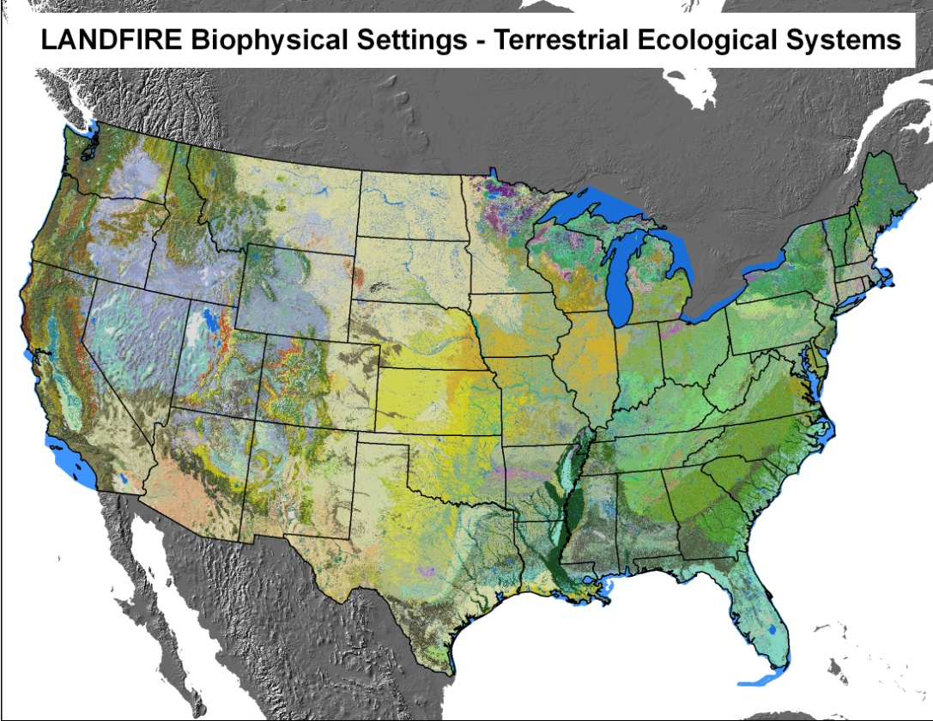
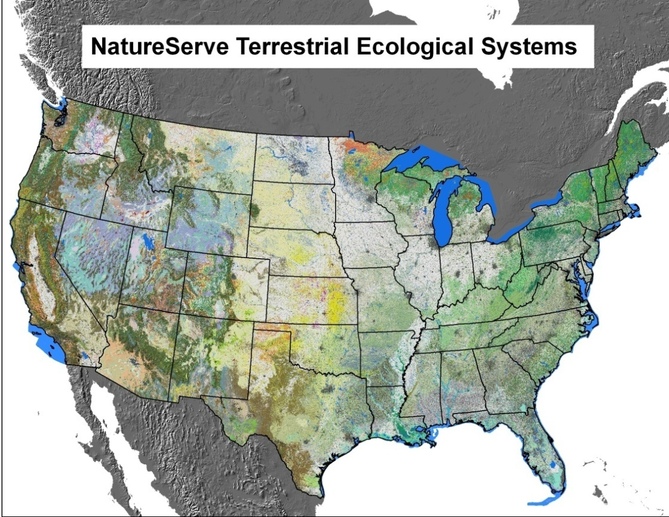
USA National Mapping
Unaltered Extent Estimate
Current Extent Estimate
Notes:
Estimating long-term trend is exceedingly difficult. Fortunately, recently developed data on terrestrial ecological systems is providing useful input to approximate extent for each type we might have today if substantial land conversion had not taken place.
In addition to current extent, the inter-agency LANDFIRE effort also developed models of ‘biophysical settings’ for each of over 500 ecological system types – a model of predicted distribution of each type given assumptions about natural disturbance regimes.
We can also approximate historic extent by type by segmenting the nation into ecoregional landscapes and estimating proportional contribution of natural types to the total area of lands that have been converted.
So we are now well-postioned to apply Granks to ecological systems and many vegetation types.

Slide 25
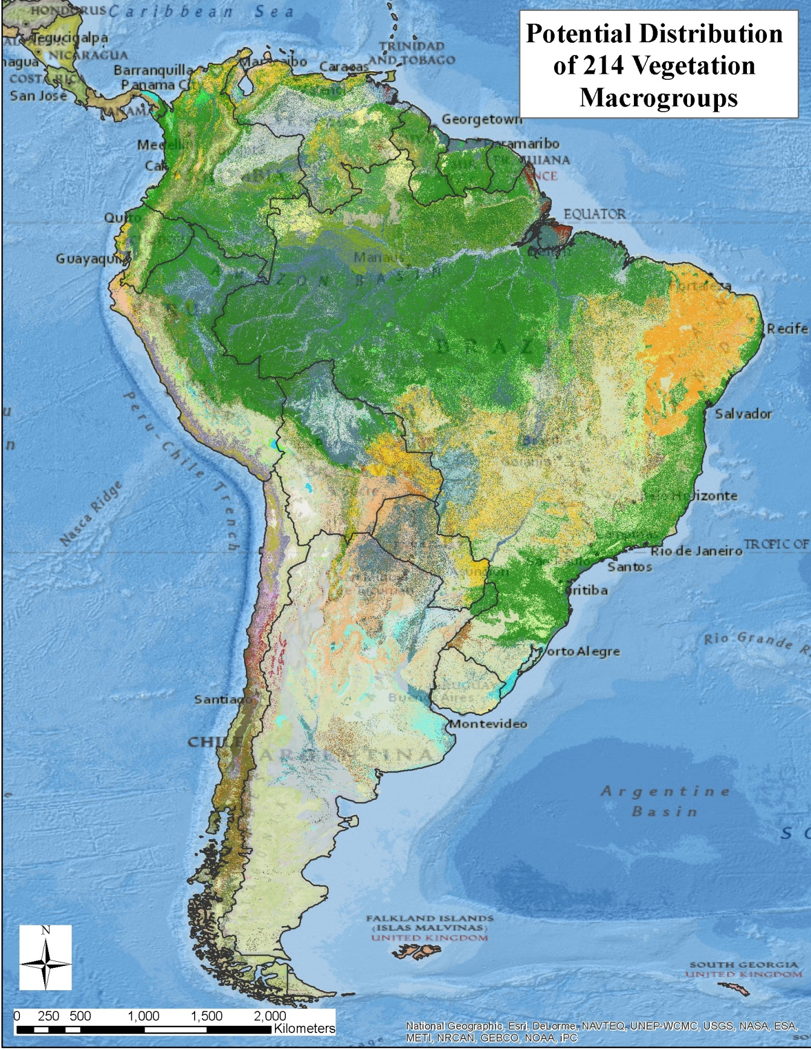
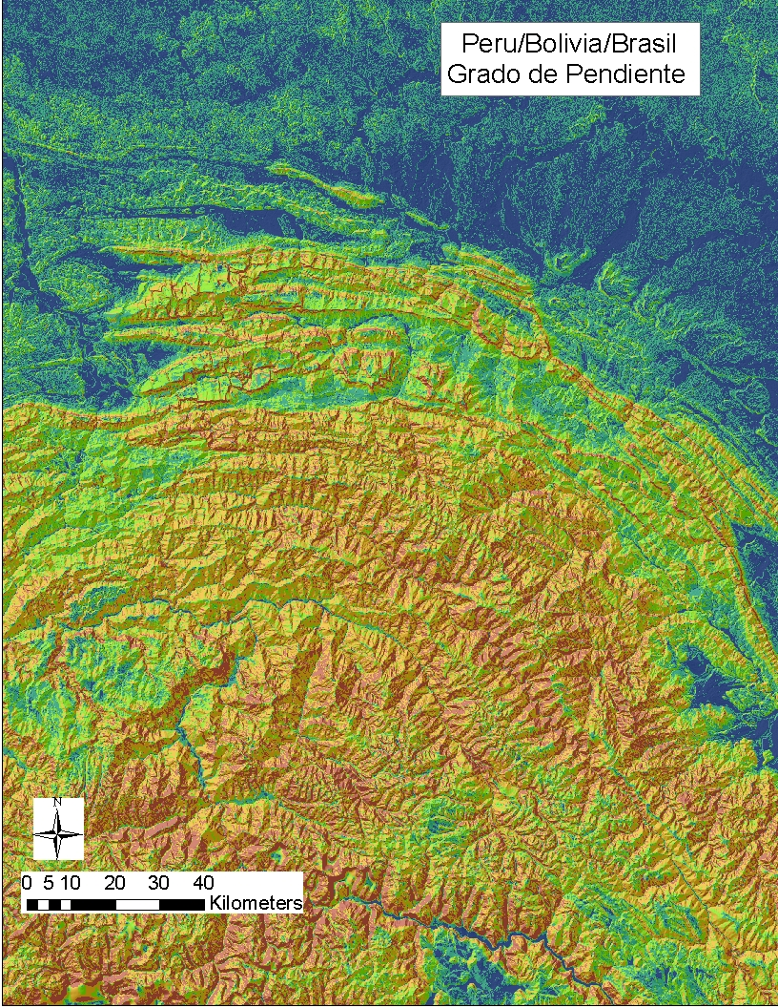
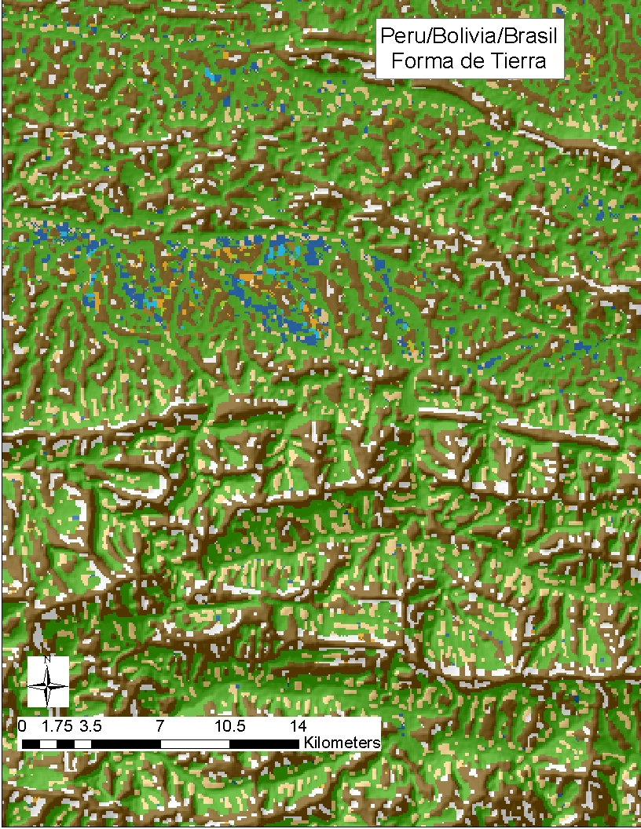
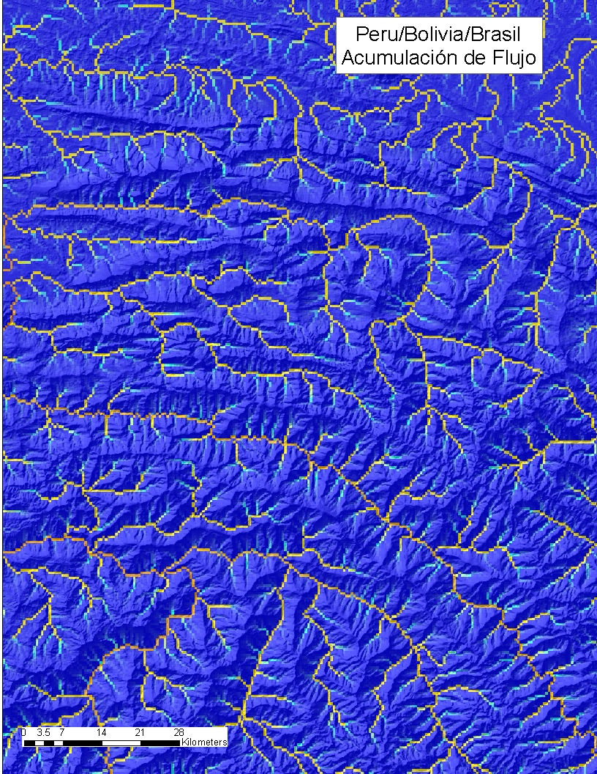
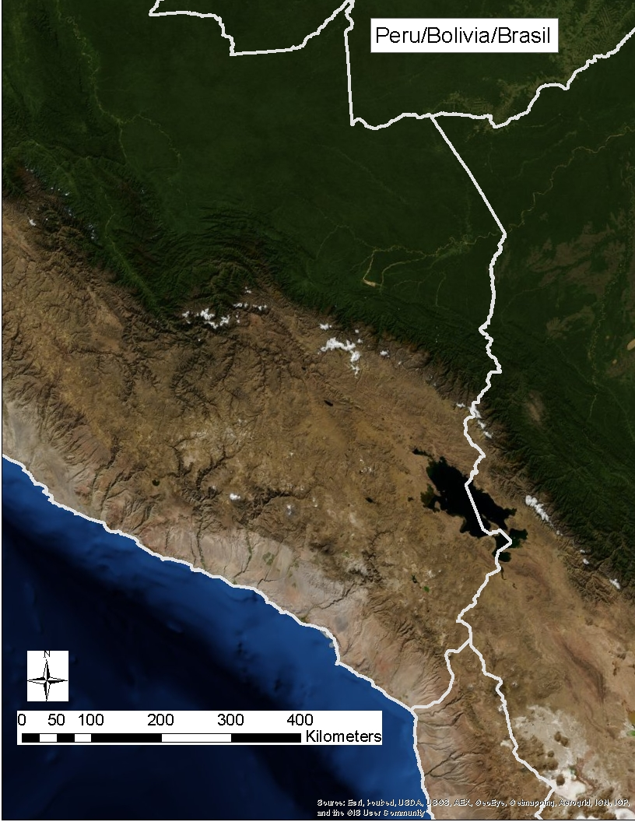
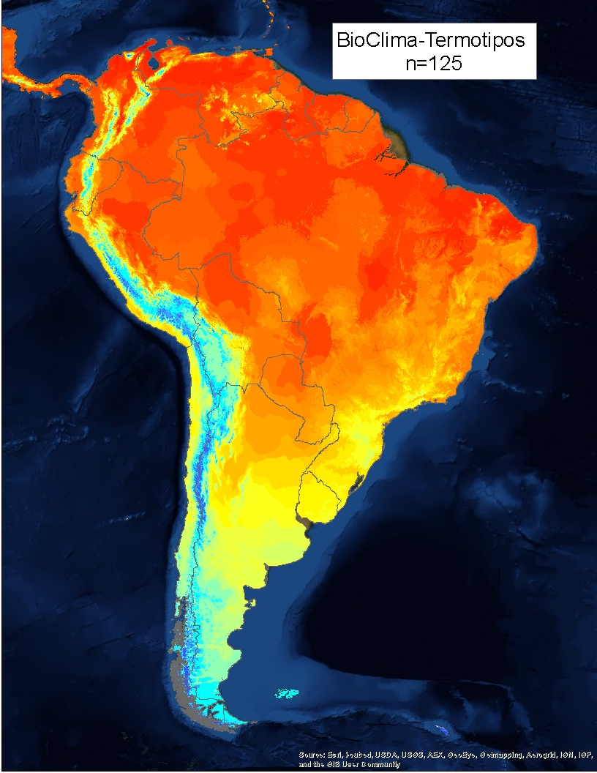
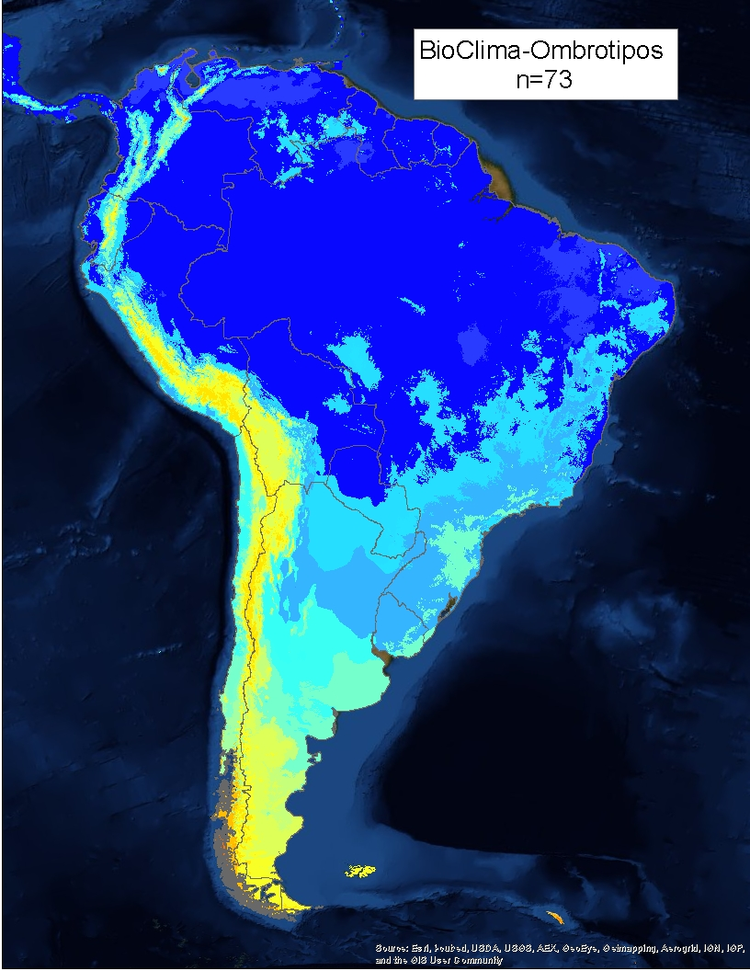
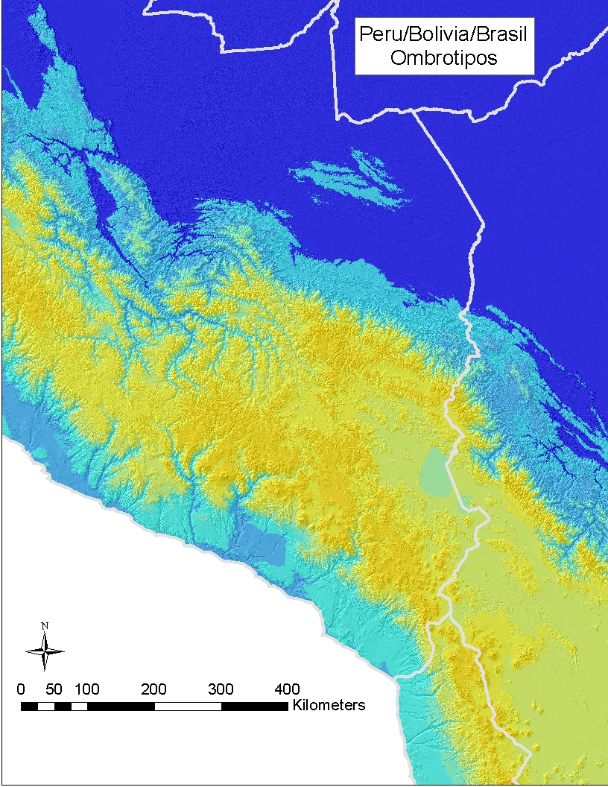
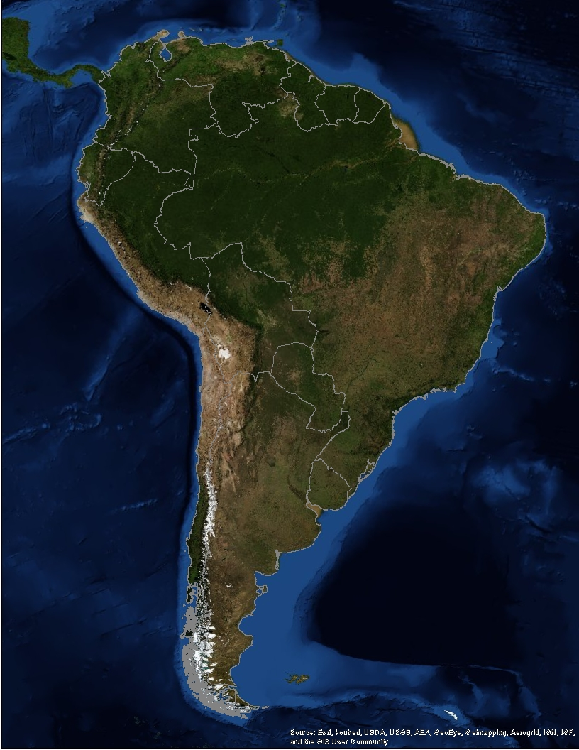
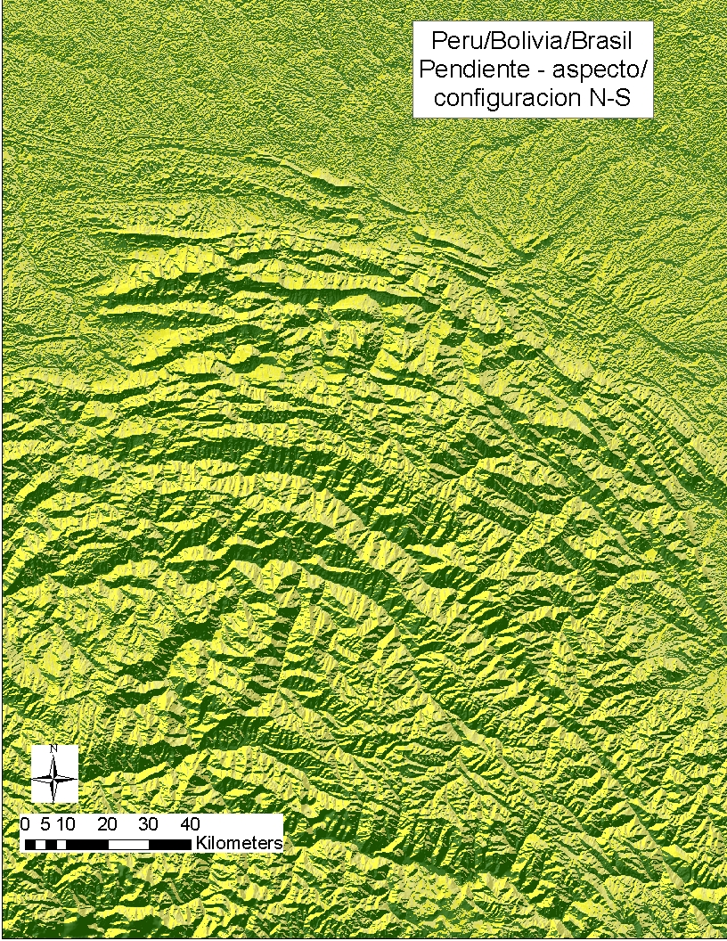
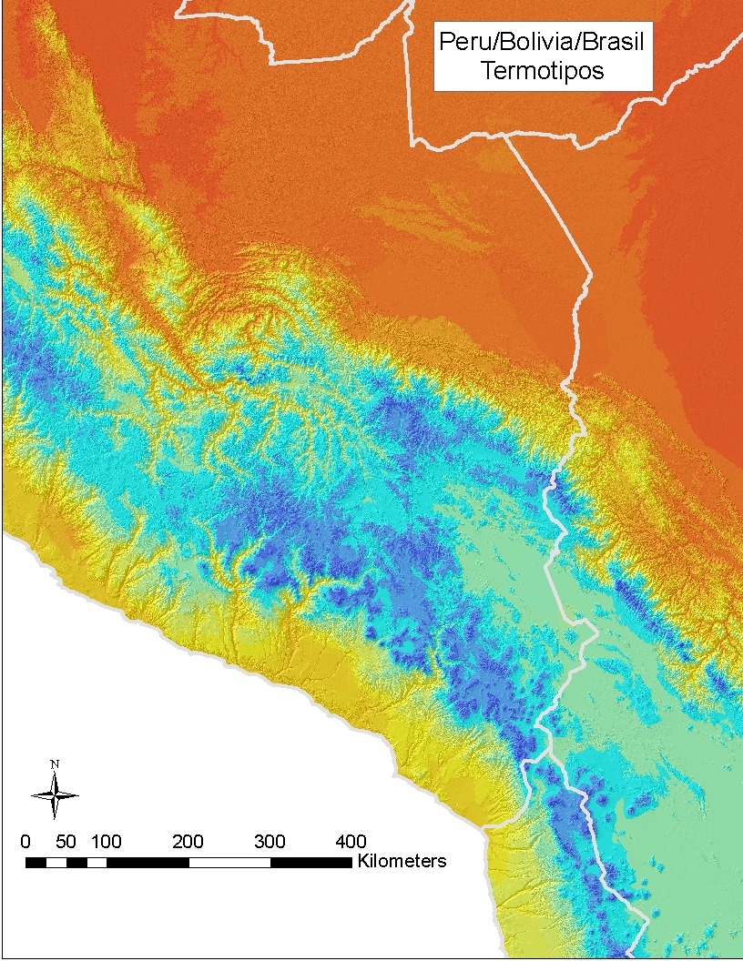
Notes:
Pat

Slide 26
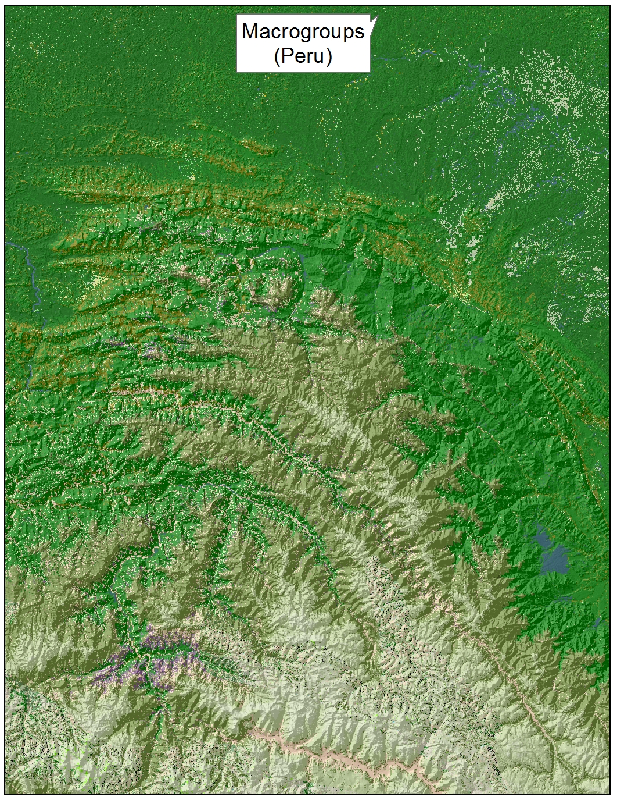
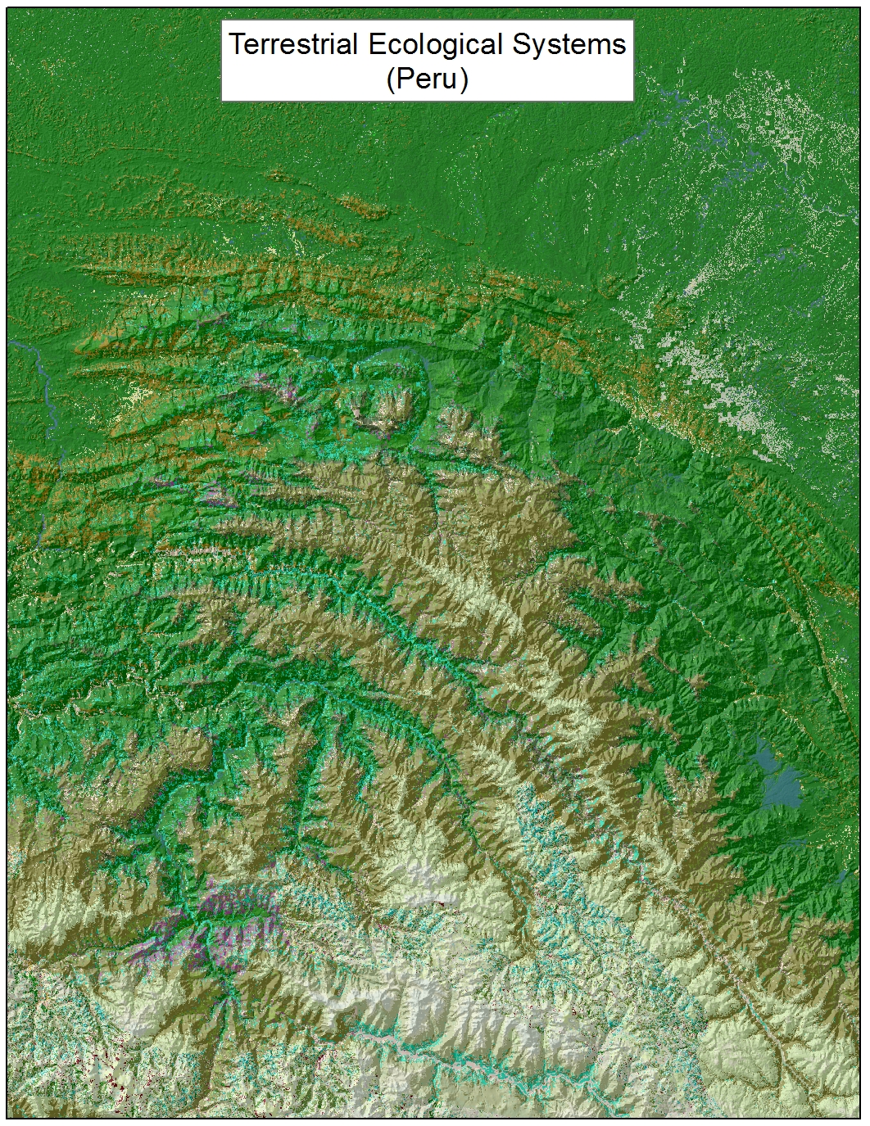
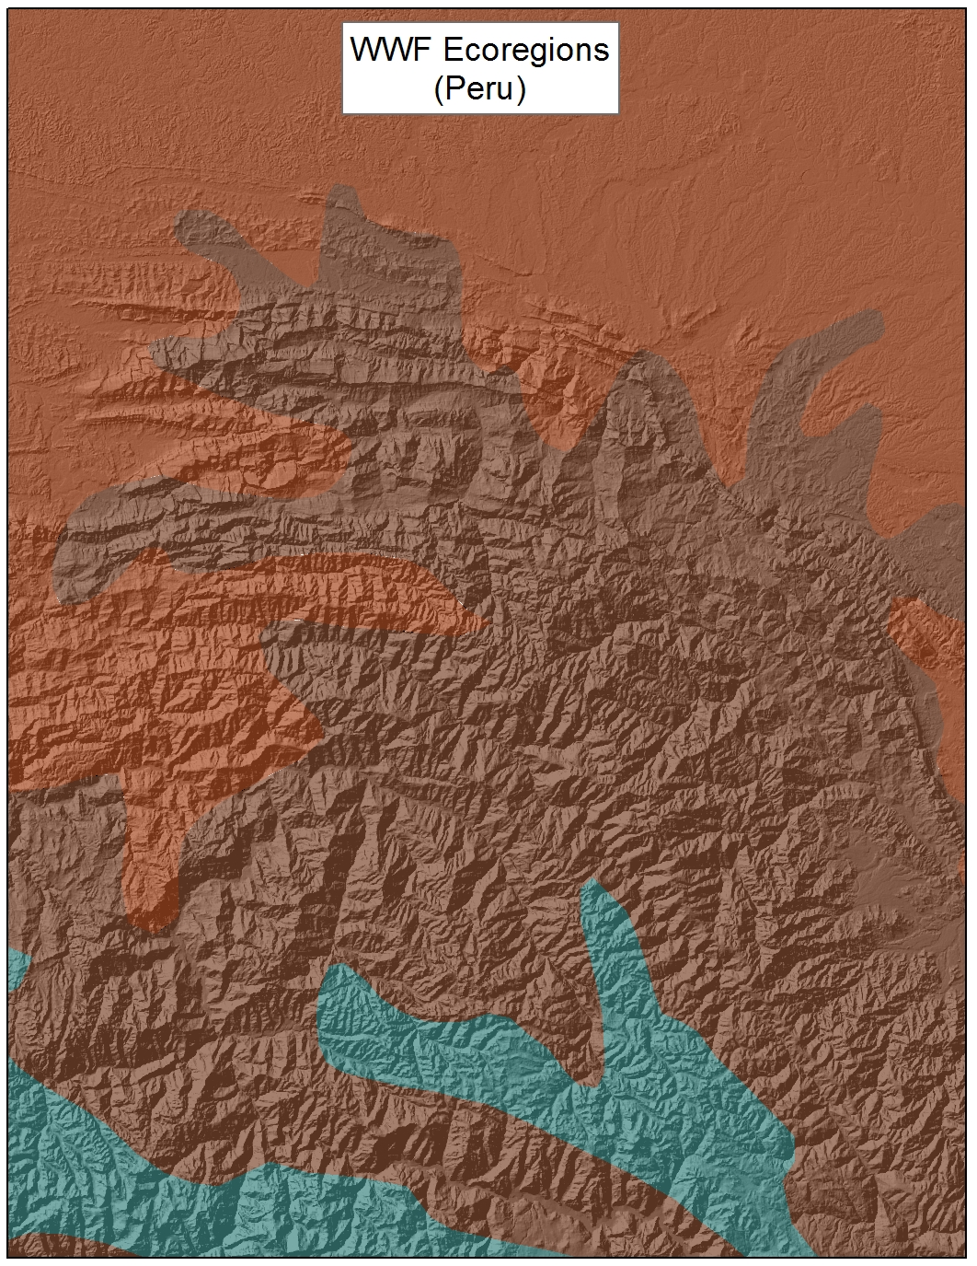
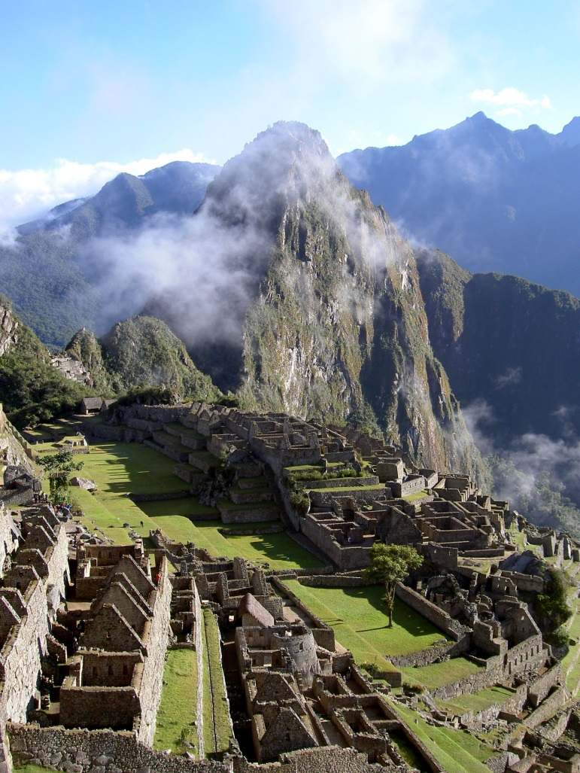
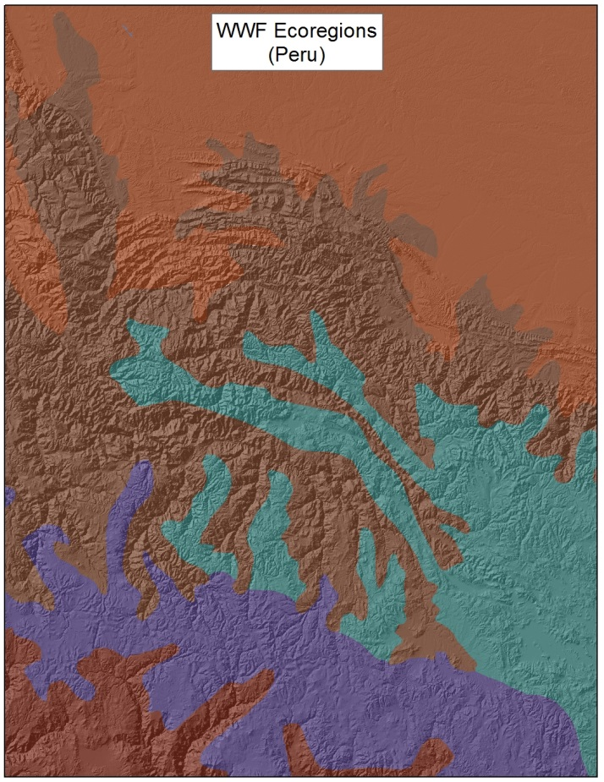
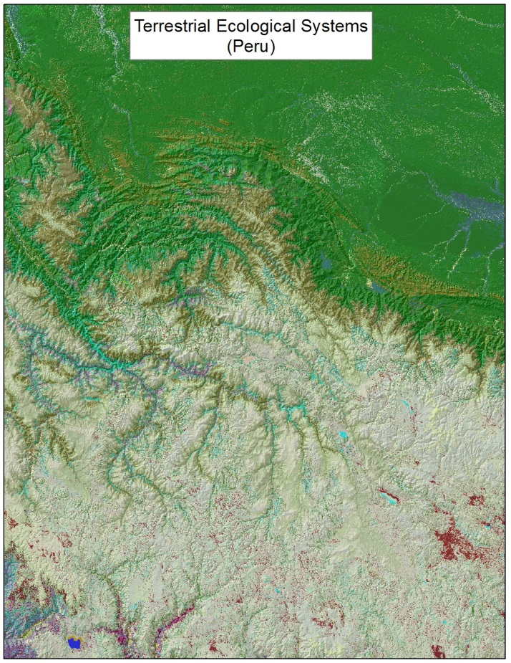
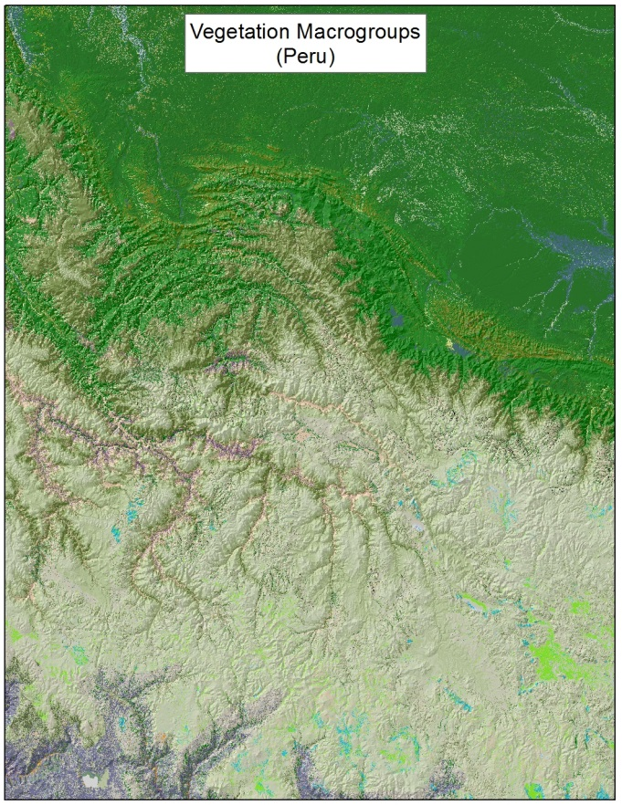

Slide 27



Internationally Standardized Ecological Classifications
Terrestrial
  Uplands
  Wetlands
  Subterranean
Aquatic
  Freshwater
    Riverine
    Lacustrine
  Marine
    Estuarine
    Nearshore
    Deep Ocean
Notes:
Our focus has mostly been in terrestrial environments.
In recent years TNC and selected member programs have advanced freshwater classification.
Just in th epast few years, we have begun to work in coastal marine ecological classification.

Slide 28
high elevation
acidic sloping
1-2 order stream
high elevation
calcareous sloping
1-2 order stream
high elevation
calcareous flat
1-2 order stream
Calcareous bedrock
Intermittent Stream
mid elevation
acidic flat
1-2 order stream
mid elevation
calcareous flat
1-2 order stream
3-5 order
confined channel
stream
Acidic Bedrock
3-5 order meandering
stream on till
Wetland
very low elevation
calcareous flat
1-2 order stream on till
6+ River
(monotropic)

Slide 29
NatureServe Methodology
What is it?
Where is it?
How is it doing?
How is it changing?
(ecological classification)
(element mapping/occurrence)
(ecological integrity)
(At-risk status)
(Monitoring extent & condition)
(CC Vulnerability and Adaptation)
Notes:
Our core methodology. By answering these questions, we can move on to many conservation applications…

Slide 30

Gauging Ecological Integrity
Provide an estimate of current ecological integrity
Help prioritize occurrences/sites for conservation attention
Highlight indicators to be used in management and monitoring
Provides basis for describing relative compatibilities between land uses/management practices with ecological requirements
Notes:
Our most information-intensive work relates to gauging ecological integrity.
This is clearly where we meet the limits of our knowledge, but where we can develop this information, it has the greatest payoff in terms of guiding resource management and conservation on the ground.

Slide 31
Ecological Integrity Assessment (EIA)
EO Rank | Rating Category | Key Ecological Attribute | Indicator
A,B,C,D | Condition | Stand Development / Maturity | e.g. Woody Vegetative Cover
…or an index score of 0.0 – 1.0 |  | Biotic Composition | e.g. Invasive Grasses
...or “Good” “Moderate Concern” “Significant Concern” |  | Ecological Processes | e.g. Herbivory/ Utilization
 |  | Abiotic Physical/Chemical Attributes and variability | e.g. Nutrient input
 | Size | Area supporting patch dynamics | e.g. Minimum dynamic area
 | Landscape Context | Landscape Structure | e.g. Mosaic Structure
 |  | Landscape Dynamics | e.g. Disturbance size and return interval
Notes:
Bob/Pat: NatureServe methodology has long applied to characterizing the relative quality/condition of a given location or mapped ‘occurrence’ of a community type or species location. This area has been in a process of advancement for NatureServe Ecology, mainly because we can go deeper with valuable information on the ground, applicable to many aspects of ecological conservation, restoration, management, and mitigation.
Our basic framework includes
1) identifying a minimum set of key ecological attributes that drive the function of the given focal resource.
2) We then clarify indicators we would use to measure the status of each unit.
3) we then need rules to ‘roll up’ scores from measuring each indicator, first to provide composite scores for each rank factor, and if needed, to create a composite rating for each occurrence (very good = A good = B fair = C poor = D).

Slide 32
Measurement and Level of Effort
 |  | Assessment / EIA | Applications
Level 1 – | Remote Sensing | Landscape around patches On-site indicators visible remotely | Support Status and Trends Regional conservation planning
Level 2 - | Rapid Field Observation | Relatively simple field indicators (stressor / condition metrics) | Site conservation planning Restoration, mitigation, and management monitoring
Level 3 - | Intensive sampling | Detailed quantitative field indicators. Calibrated indicators (e.g., indices of biotic or ecological integrity, FQA). | Reference Sites for specific indicators
Notes:
We also don’t typically have the ability to do rigorous measurement of all indicators all of the time.
So, our framework is designed to organize indicators in 3 levels, along a gradient of investment needed for their measurement.

Slide 33


Theme | Impact Score | Relative Stress | Decay Score | Impact Decays to Zero
Transportation
Dirt roads, 4-wheel drive | 0.7 | Low | 0.5 | 200m
Local, neighborhood and connecting roads | 0.5 | Medium | 0.5 | 200m
Secondary and connecting roads | 0.2 | High | 0.2 | 500m
Primary Highways with limited access | 0.05 | Very High | 0.1 | 1000m
Primary Highways without limited access | 0.05 | Very High | 0.05 | 2000m
Urban and Industrial Development
Low Density Development | 0.6 | Medium | 0.5 | 200m
Medium Density Development | 0.5 | Medium | 0.5 | 200m
Powerline/Transmission Line | 0.5 | Medium | 0.9 | 100m
Oil/gas wells | 0.5 | Medium | 0.2 | 500m
Mines | 0.5 | Medium | 0.2 | 500m
High Density Development | 0.05 | Very High | 0.05 | 2,000m
Managed and Modified Land Cover
Ruderal Forest & Upland | 0.9 | Very Low | 1 | 0
Native Veg. with introduced Species | 0.9 | Very Low | 1 | 0
Recently Logged | 0.9 | Very Low | 0.5 | 200m
Managed Tree Plantations | 0.8 | Low | 0.5 | 200m
Introduced Tree & Shrub | 0.5 | Medium | 0.5 | 200m
Introduced Upland grass & forb | 0.5 | Medium | 0.5 | 200m
Introduced Wetland | 0.3 | High | 0.8 | 125m
Cultivated Agriculture | 0.3 | High | 0.5 | 200m
Modeling Current Landscape Condition
Notes:
Pat: brief explanation of the landscape condition model; a 90m pixel surface that integrates assumptions of relative impact and distance decay from common landscape stressors.
Our approach is to use expert knowledge to parameterize the model, then use field observation for model validation/calibration.

Slide 34
“medium”
“excellent”
¨poor”
“good”
p = 0.026
r² = 0.438
Field Measurement
Example of data from 250 reference wetlands sites in the Midwest USA assessed for ecological integrity
Notes:
Pat

Slide 35






NatureServe
Factors and Categories of Conservation Status
Number of Occurrences/Area
Number of Occurrences/Area
w/Good Quality
Range Extent
Area of Occupancy
Long-term Trend
Short-term Trend
Threats (Severity, Scope, and Immediacy)
Apply to portion of range; e.g., N = Nation S=Subnation
N/S1 Critically Imperiled
N/S2 Imperiled
N/S3 Vulnerable
N/S4 Apparently Secure
N/S5 Demonstrably Secure
G1 Critically Imperiled
G2 Imperiled
G3 Vulnerable
G4 Apparently Secure
G5 Demonstrably Secure
Notes:
NatureServe has done rule based assessments for both species and ecological ‘elements’ of biodiversity to arrive at a ‘conservation status’ rank; with criteria applicable not only to global perspectives, but also for any subset of the range.

Slide 36


Long-Term Trend in Extent
Unaltered Extent Estimate
Current Extent Estimate
Notes:
Estimating long-term trend is exceedingly difficult. Fortunately, recently developed data on terrestrial ecological systems is providing useful input to approximate extent for each type we might have today if substantial land conversion had not taken place.
In addition to current extent, the inter-agency LANDFIRE effort also developed models of ‘biophysical settings’ for each of over 500 ecological system types – a model of predicted distribution of each type given assumptions about natural disturbance regimes.
We can also approximate historic extent by type by segmenting the nation into ecoregional landscapes and estimating proportional contribution of natural types to the total area of lands that have been converted.
So we are now well-postioned to apply Granks to ecological systems and many vegetation types.

Slide 37

Results summarized to 1 mile² hexagon
Not including types primarily distributed in CA and TX
Critically Imperiled
Imperiled
Western Governors Association Crucial Habitats Initiative
74 terrestrial ecological systems assessed

Slide 38


Keith, D.A., J.P. Rodríguez, K. M. Rodríguez-Clark, K. Aapala, A.Alonso, M.Asmussen, S. Bachman, A., Bassett, E.G. Barrow, J.S. Benson, M.J. Bishop, R. Bonifacio, T.M. Brooks, M.A. Burgman, P.J. Comer, F., Comín, F. Essl, D. Faber-Langendoen, P.G. Fairweather, R. Holdaway, M. Jennings, R. T. Kingsford, R.E. Lester, R. Mac Nally, M.A. McCarthy, J. Moat, E. Nicholson, M.A. Oliveira-Miranda, P. Pisanu, B. Poulin, U. Riecken, M.D. Spalding, S. Zambrano-Martínez.
2013.
Scientific Foundations for an IUCN Red List of Ecosystems. PLoS ONE. Vol. 8 Issue 5
CE = Critically Endangered
E = Endangered
VU = Vulnerable
NT = Near Threatened
LC = Least Concern

Slide 39


Slide 40


45%
45%
27%
23%
If FRCC2 = Moderate Departure = >50% severity,
then:
Criteria C3: 68% of extent
has >50% severity
= Vulnerable

Slide 41

Western Great Plains Foothill and Piedmont Grassland
Criterion | Score | Criterion | Rank Calculator Score
A1 - extent past 50 years | DD | Short-term Trend | unknown
A2- extent next 50 years | NE
A3 - extent past 250 years (-57%) | VU | Long-term Trend | -0.22
B1 – EOO (210,000 km²) | LC | Range Extent (210,000 km²) | 4.71
B2 – AOO (410 hexes @100 km²) |  | Area of Occupancy (4,900 km²) | 4.81
B3 - very few locations | LC | Number of EOs | unknown
C1 – Enviro Degrad - past 50 years | DD
C2 – Enviro Degrad - next 50 years | NE | Overall Threat (Scope/Severity) (High) | 1.83
C3 – Enviro Degrad - past 250 years | VU | % Area in Good Integrity (16%) | 3.30
D1 – Biol Disrupt - past 50 years | VU
D2 – Biol Disrupt - next 50 years | NE
D3 – Biol Disrupt - past 250 years | DD
 |  | Environmental Specificity | NA
 |  | Intrinsic Vulnerability | NA
Overall Score | VU |  | G3
CR= Critically Endangered, EN = Endangered, VU = Vulnerable, LC = Least Concern,
DD = Data Deficient, NE = Not Evaluated
Notes:
C3 68% of extent has >50% severity = VU
Use Environmental Specificity only if # EOs or AOO is unknown or null
Use Intrinsic Vulnerability only if Overall threat is unknown or null

Slide 42
Habitat CC Vulnerability Assessment

Slide 43


Climate Envelope Shift
12% overlap between 2010 & 2060

Slide 44



Linking Vulnerability Assessment to Adaptation Strategy
Select conservation feature
and
Define management goal
Monitor and evaluate action plan efficacy
Build conceptual model
}
Vulnerability
Assessment
Assess
climate change impacts
Identify future climate scenarios
Implement
action plan
Revisit feature / goal?
}
Identify intervention points
and management actions
{
Adaptation
Strategy
Evaluate actions
Develop action plan
Cross et al. 2012
Notes:
44

Slide 45

What is it?
Where is it? How’s it doing? How’s it changing?
Taxonomy & Classification & Conceptual modeling
Maps and Surfaces
Occurrences through Field Inventory
Field Observations
Notes:
So our core methodology has been expanding over time. Because field samples – community observations are gathered first for classification development; they also get used a georeferenced locations to support map development. So these two componants, field observations and maps have become a fundamental aspect of our work.

Slide 46
Where should we be in 5 years?
Peer-reviewed implementation for terrestrial (and freshwater) classifications in the Americas
Updated terrestrial ecological systems and IVC map(s) for the United States, new maps for Canada, and Latin America
Complete initial EIA, reference locations, and HCCVI for terrestrial & freshwater ecological systems
IUCN Red Listing and Status Ranking of terrestrial/fw ecosystems of the Americas

Slide 47

Questions?
Patrick Comer, Chief Ecologist
Pat_comer@natureserve.org
Boulder CO
Ph: 703-797-4802
Photo by Jared Hobbs

