Slide 1
Facilitating data collection & review
Updates to the Observation survey and new developments!
Whitney Weber
www.NatureServe.org
May 5, 2021

Slide 2
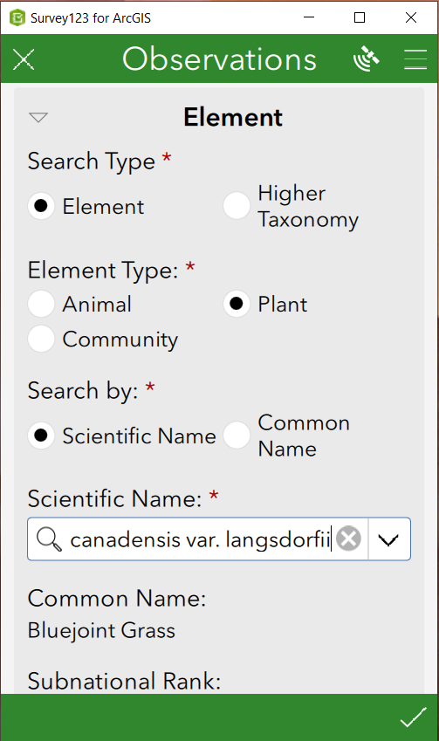
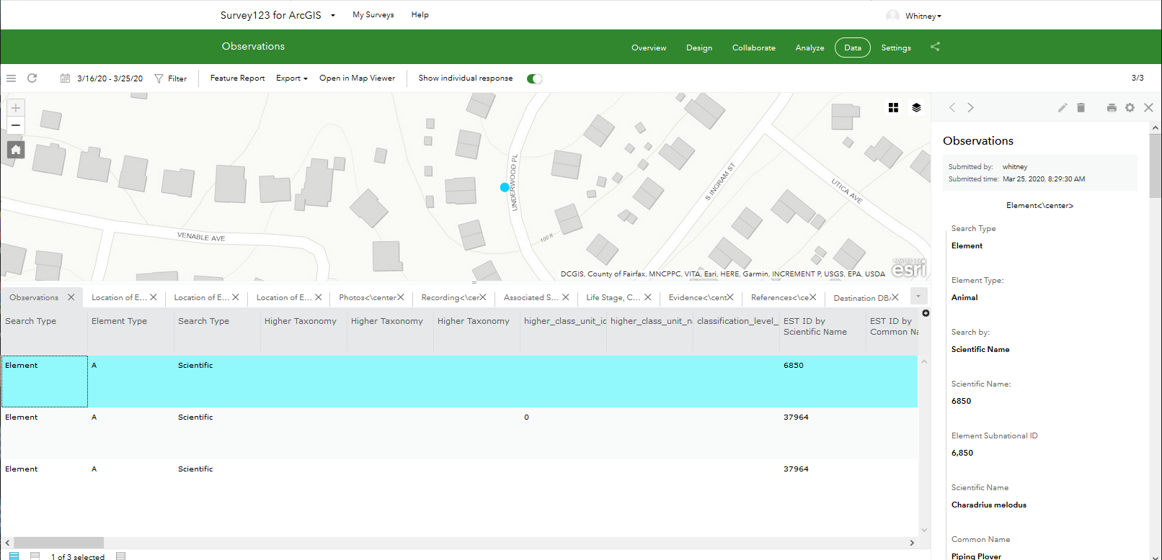
What is the Observations survey?
Field tool for collecting observation data which:
Leverages existing software (Survey123, Dashboard ) and capabilities
Utilizes data model of the Biodiversity Observation Data Standard
Logic-driven
Populated with elements from Biotics
Customizable
Available for use on Smartphones, tablets, laptops
Generates live data, available for use in web maps, dashboards,...
Survey123
Utilizes
Biodiversity
Observation
Data
Standard
Feature Layer
in ArcGIS

Slide 3
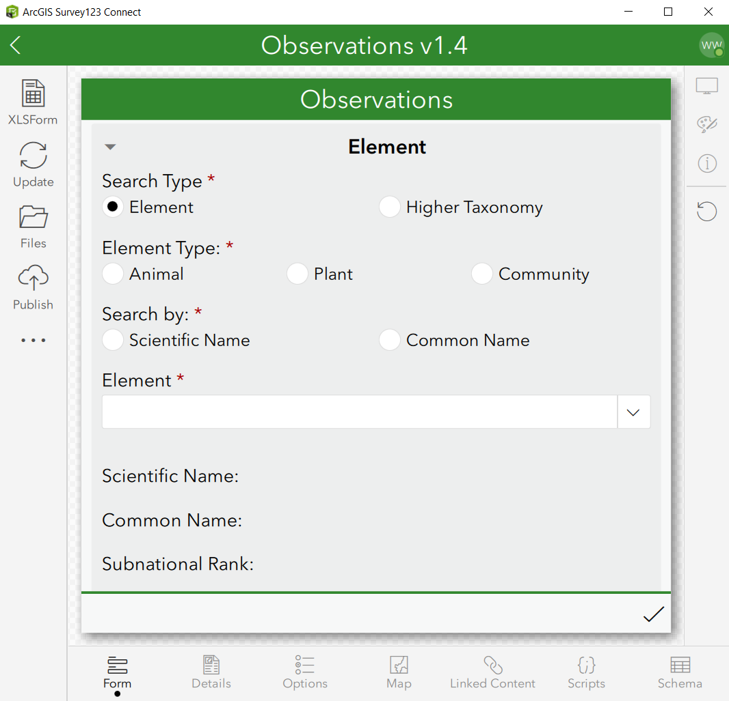
Why use the Observations survey?
Pre-built survey; requires little effort to publish and begin using
Uses a standardized data model (Biodiversity Observation Data Standard) while allowing for customization
In conjunction with Observations toolboxes, facilitates creation of EOs in Biotics
Minimizes data backlog
Produces real-time data available for use in web maps, dashboard, story maps…

Slide 4
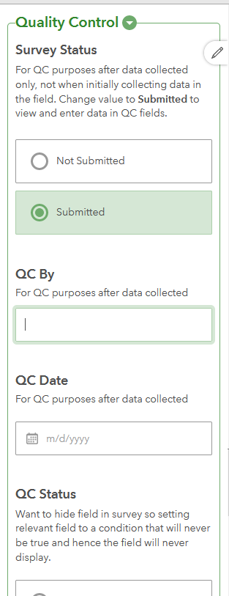
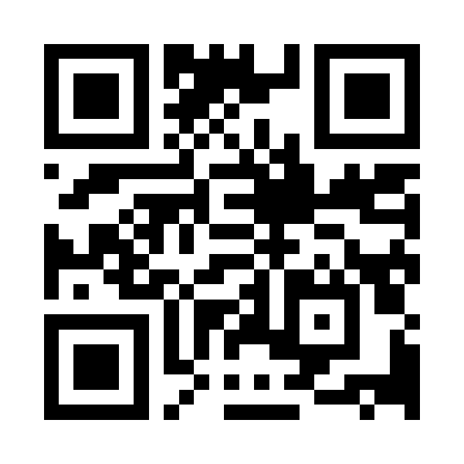
NEW in Observation Survey v1.4
Updated to Survey123 v 3.12.232
Updated for use in web form as well as app
Increased performance and ease of updating data lists
Option to sketch or use vertex draw methods for lines and polygons
Multiline functionality for photos rather than a repeat section
Detected & Dataset fields added to reflect Biotics
QC fields added for use with Dashboard
Test out the Observations survey

Slide 5
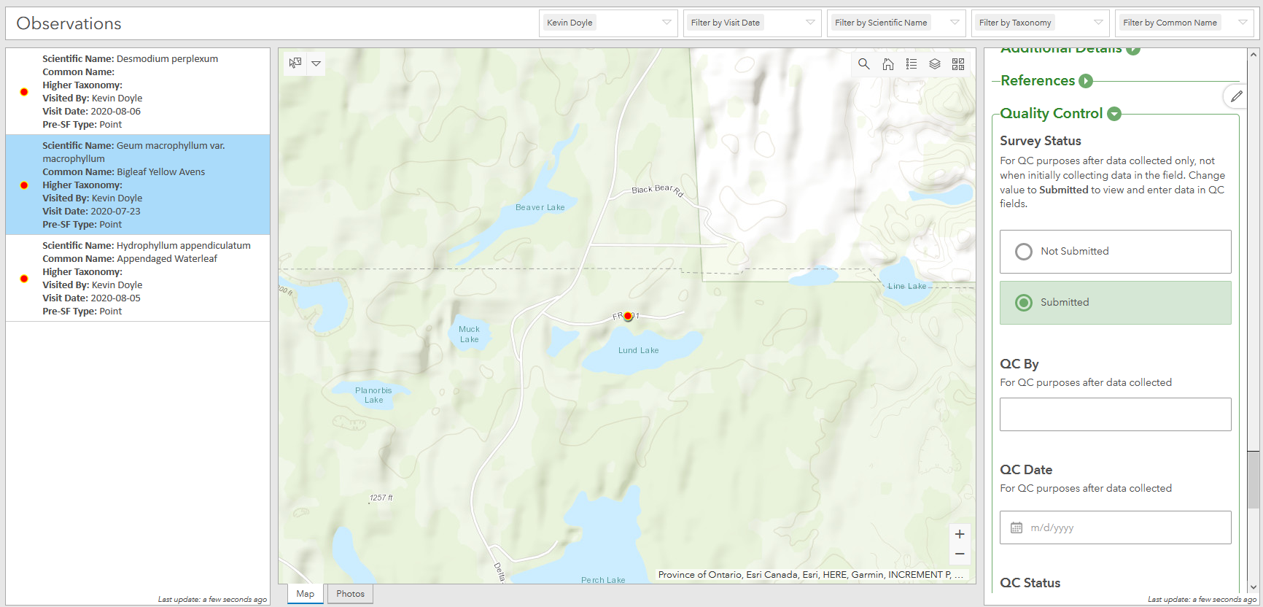
Dashboard of Survey Results
Leverages existing Esri software
Enables edits/updates to survey answers
Facilitates data review/qc
User-friendly for non-GIS users

Slide 6
Create EOs from data collected via Observations survey: Observation Toolboxes
Applies standard methodology
Assigns Observations to new or existing EOs according to separation distance
Limits Observations to Tracked species (Y, P, W)
Defaults to Suitable Habitat while allowing customization of separation distance
Populates BulkCreate.gdb template for import into Biotics 5; possible given use of standard data model
Does not alter original data but adds to it
ArcGIS
Online
Local Observation
Geodatabase
Observations
assigned to EOs
Bulk Create
Template
Observation BLP
toolbox
(ArcGIS)
Observations
toolbox
(ArcGIS)
Bulk Create
tool (Biotics)

Slide 7
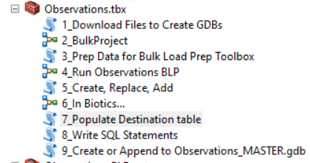
NEW in Observations Toolbox
Identify and generate SQL statements to add Visit record to an existing SF rather than create a new SF
Identify and populate Bulk Replace geodatabase with data which should replace an existing SF (spatial feature and/or tabular data) rather than create a new one
Populate destination table in Observations.gdb with SF/EO IDs & status (Included, Replaced, Modified)
Append new observations to MASTER Observations.gdb

Slide 8
NEW in Observations Toolbox
Auto-generate SQL statements to populate following fields (until BX-4414 implemented)
SOURCE_FEATURES, where SOURCE_FEATURE_ID IS NOT NULL:
Data Sensitive, Data Sensitive Category, Data Sensitive Reasons
VISIT, where SOURCE_FEATURE_ID IS NOT NULL:
Detected
VISIT, where SOURCE_FEATURE_ID IS NOT NULL and ADD_VISIT is not NULL:
Visit Date, Visit Note, Visited By
EO, where EO_ID IS NOT NULL AND UPDATE_EO IS NOT NULL:
Data Sensitive, Data Sensitive Category, Data Sensitive Reasons, Condition of EO, Confidence Extent
EO_REFERENCE, where EO_ID IS NOT NULL AND UPDATE_EO IS NOT NULL:
Reference, Primary Reference, according to EO_REF_PRIM data

Slide 9
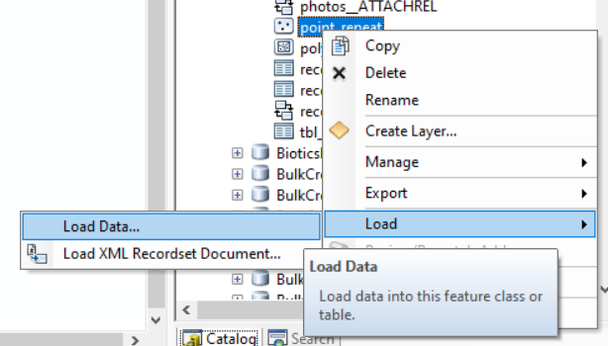
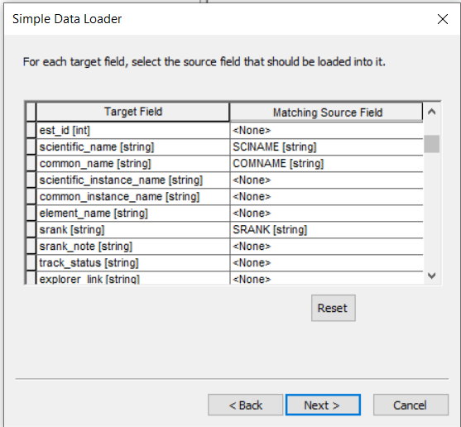
Create EOs from Observations: other Sources via Simple Data Loader
External Data Sources
Esri tool
Facilitates crosswalk from one data model to another
Instructions found in this help topic
Enables aggregation of data from multiple sources into a single geodatabase
Leverage Simple Data Loader (ArcGIS), Observation BLP toolbox (ArcGIS) & Bulk Create (Biotics)
Establish taxonomy & filter to meet quality standards
Aggregate via Simple Data Loader
(Esri)
Observation BLP
toolbox
(ArcMap)
Bulk Create
tool (Biotics)
Bulk Create
Template
Observations
assigned to EOs

Slide 10
What’s Next?
Thursday, May 13 from 2 – 3:30 Eastern:
Customizing, Creating & Publishing the Observations Survey
Whitney Weber, NatureServe
Future webinars to be scheduled:
Creating the Observations Dashboard
Using Simple Data Loader to bulk Create EOs from an external data source
Bi-monthly Data Managers Conference Call

Slide 11
Resources
Observations survey in Survey123 - from creating survey to Bulk Create
Bulk Load Prep Toolbox
Collect Data via Survey123
Test out the Observations survey
Additional information regarding the Biodiversity Observation Data Standard

Slide 12
Questions, Comments, Discussion

